Slide 1
Ministry of Investment,
Industry and Trade of the Republic of Uzbekistan
Privatization of Privatization of Tashkent Children’s Dental Polyclinic No. 1
Project overview
Business model:
Full ownership transfer via public auction. The polyclinic operates on 0.5 ha, providing specialized dental care for children.
Project scope
Privatization of 100% shares of Children’s Dental Polyclinic №1, a state-owned healthcare facility under the Ministry of Health
Investment terms:
Investor will acquire 100% ownership via public auction.
Timeline
2025
2026
Transfer of ownership to the investor
Public auction announcement and bidding process
Financing (estimated value)
$1-3 million (subject to auction results)
Location
Yakkasaroy district, Tashkent city
Advantages and Potential
Stable demand for healthcare services in the capital.
Potential for modernization with advanced dental technologies.
Strategic location in a densely populated area.

Slide 2
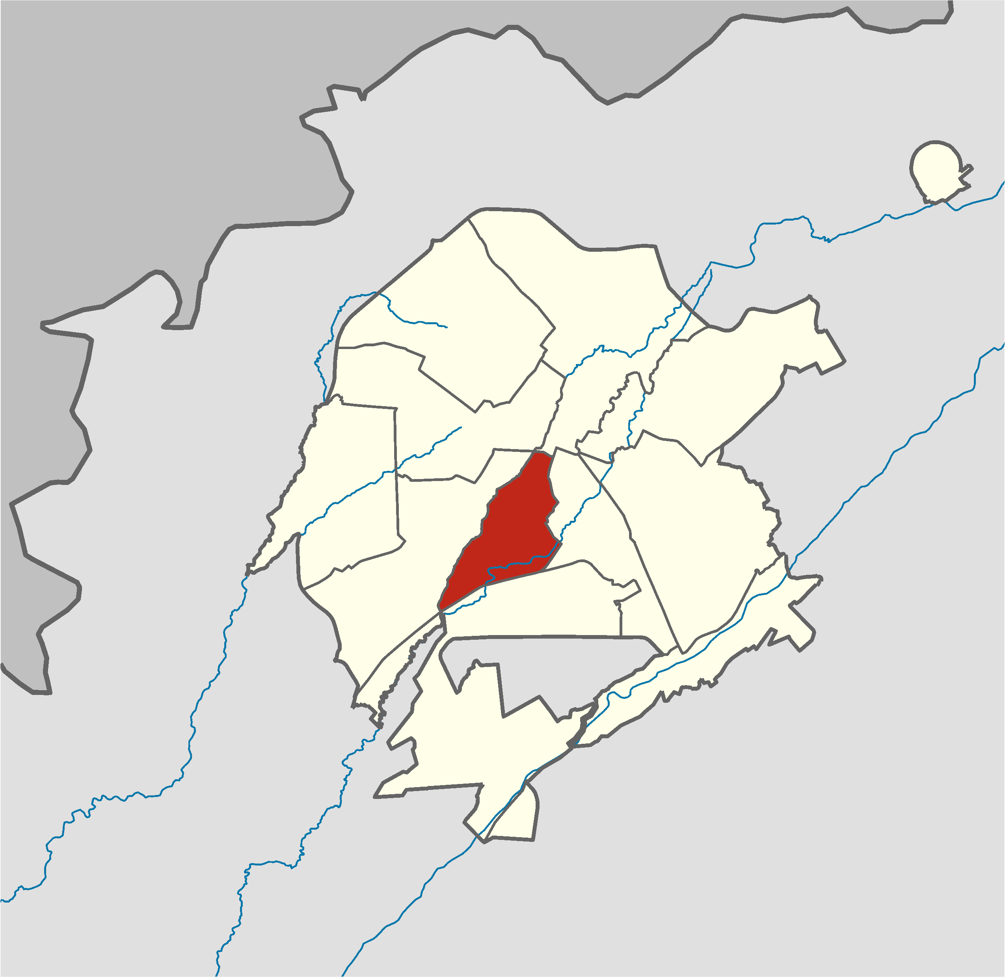
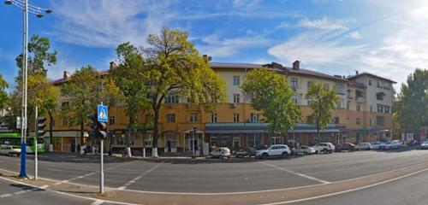
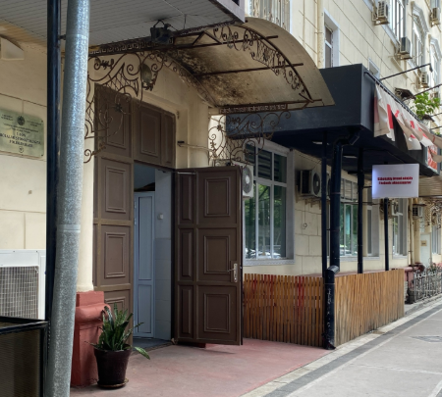
Ministry of Investment,
Industry and Trade of the Republic of Uzbekistan
We invite to invest in Privatization of Tashkent Children’s Dental Polyclinic No. 1
Project overview
Location
Tashkent city
Population | 3,0 million
Tashkent region
Area | 435 km²
Child Population (0–17 years) | 30%
Tashkent city
Competitive landscape
High demand for pediatric dental services in Tashkent.
The project will address 10% of city’s pediatric dental care demand by 2027.
NPV
$0.3 million
IRR
12%
PI
1.03
PP
6.5 years

