Slide 1

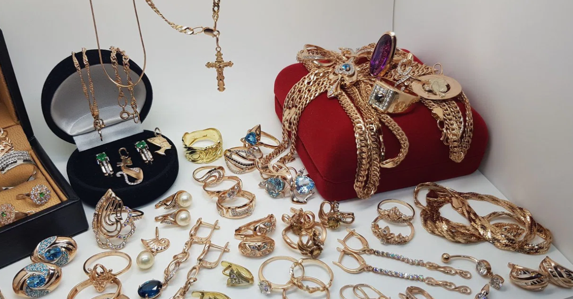





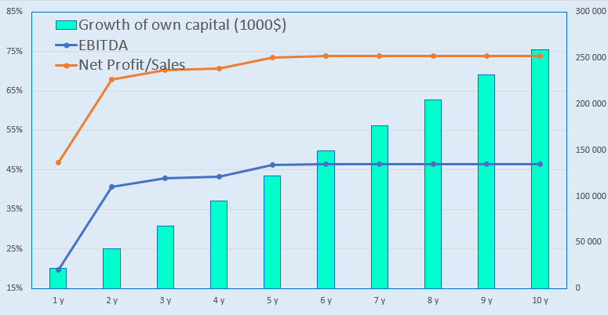
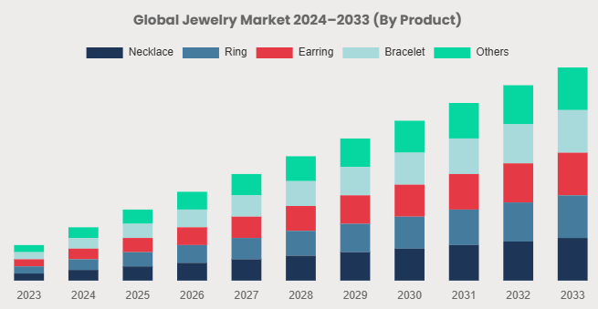



Jewelry manufacturing
Industry
Jewelry industry
Project cost
Investment plan
Total investment is 4.6 million US dollars,
of which :
Total cost $4,6 million
Project goal
The project plans to expand the chain of jewelry stores and increase exports. Production volume is 2,500 tons per year. We invite foreign and local investors to implement the startup project.
Buildings and structures
10,1%
$0,46 million
Contribution of the initiator - 78,2 % ($3,6 mln.)
Loans - 0% ($ 0 mln.)
Direct investment - 21,8% ($0,98 mln.)
Equipment
21,3%
$0,97 million
Other
0,4%
$0,1 million
Working capital
68,1%
$3,1 million
The final cost and financing structure of the project will be determined after negotiations with investors.
Project products
The project includes the production of gold chains, bracelets, rings, and earrings in sets.
Investment indicators:
Profitability:
Why is it worth investing in jewelry?
NPV, US$ mln. – 174,6
IRR, % – 166,1%
EBITDA, % – 46%
DPP, years - 1,7
Inflation protection — Gold retains its value for centuries and often appreciates during periods of high inflation. When national currencies depreciate, gold acts as a safe haven.
Low dependence on other assets — The price of gold doesn't always depend on the stock market or economic cycles. During crises, when stocks and bonds fall, gold often rises.
Benefits
Exemption from property tax and land tax on real estate and land plots used in the production process for business entities producing jewelry and being members of the “Uzbekzargarsanoat” Association
Refineries are granted the right, without additional permits, to sell precious metals to jewelry manufacturers in acceptable forms and quantities, as well as to produce and sell souvenir coins made from precious metals.
Project initiator
«ALEXANDRA GOLD» LLC
Khorezm region, Khiva city
MFY Yangi Turmush, Karimova Street, 6.
Phone number: +998 (90) 737 52 52
Email address: temursobirov@mail.ru
Location
Khorezm region
Market
According to Fortune Business Insights, the market size in 2024 was $232.94 billion. The market is projected to grow from $242.79 billion in 2025 to $343.9 billion by 2032, growing at a CAGR of 5.1%.
Khorezm region
Square | 16 800 km²
Population | 4,0 million
Required area
~ 8000 sq.m.
6%

Slide 2
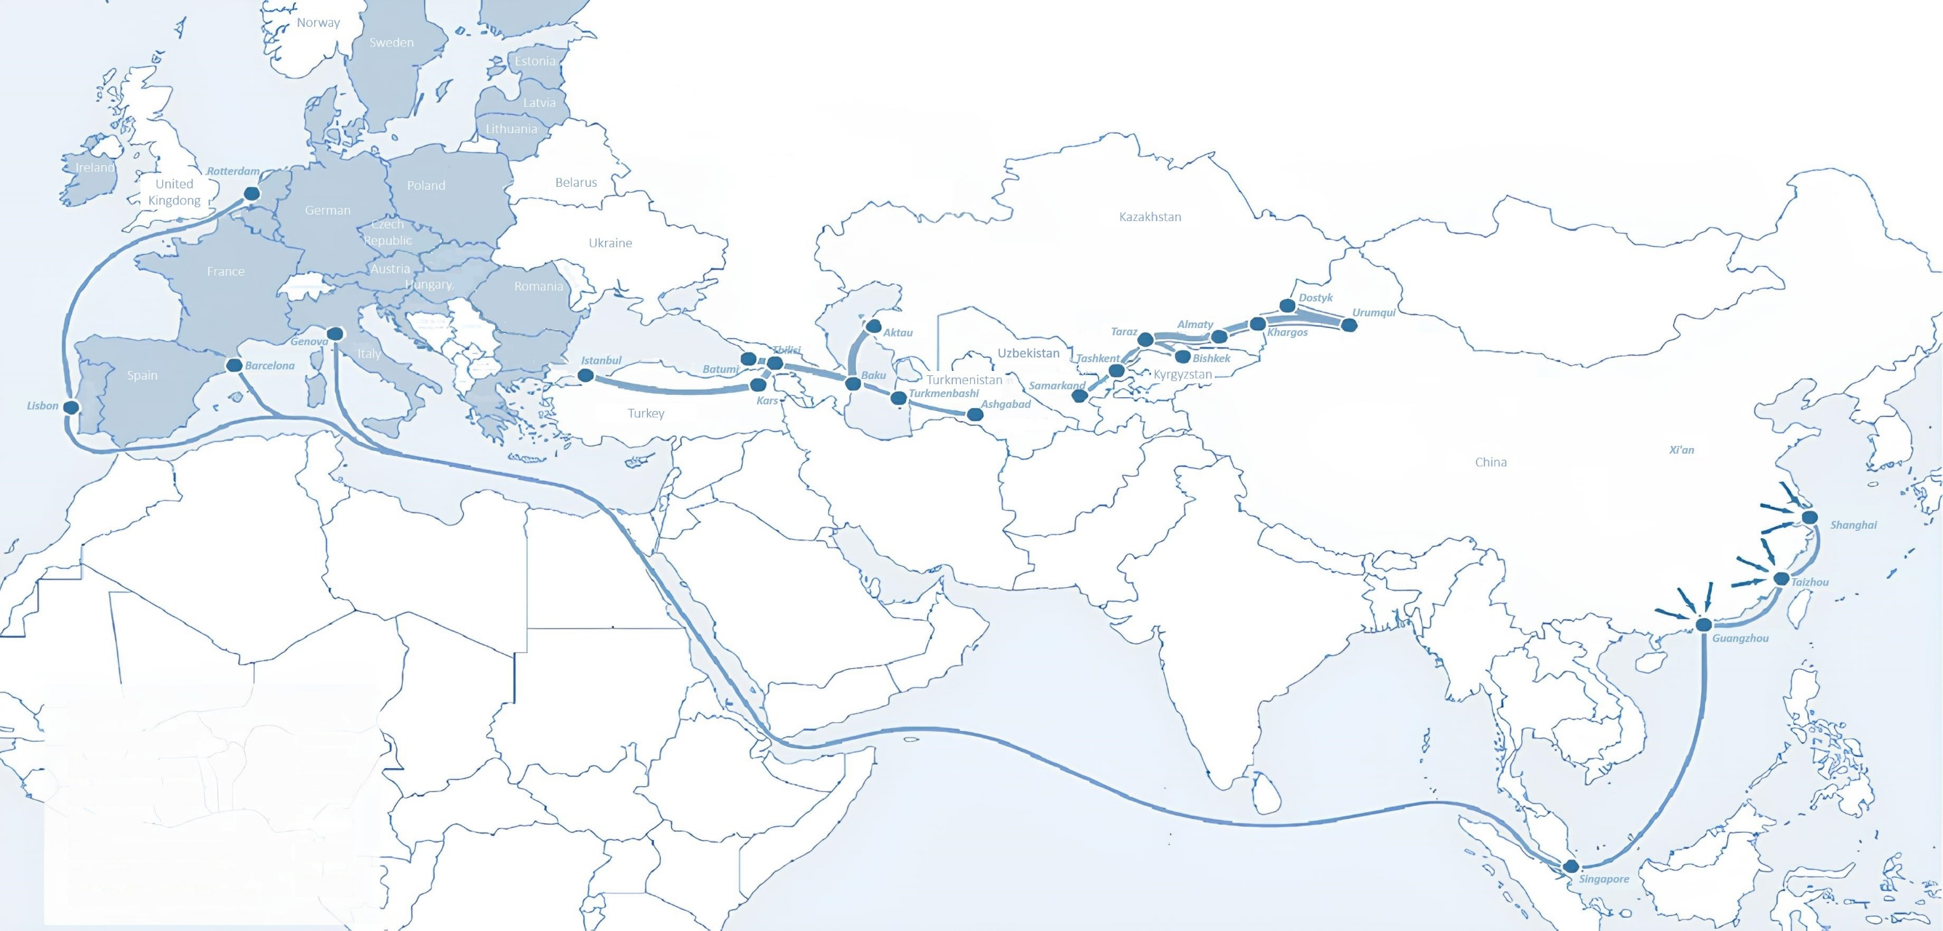
International logistics transport corridors
Tallin
Sankt-Peterburg
Riga
Latvia
Moscow
Klaipeda
Hamburg
Minsk
Berlin
Brest
Povorina
Essen
Lviv
Kyiv
Paris
Chop
Volgograd
Kandiagash
Aktogay
Astraxan
Beyney
Saksaulskaya
Ulan-Bator
Osh
Bayangal-Mangal
Mersin
Malatya
Saraxa
Mazar-i-Sharif
Kashgar
Xirat
Afghanistan
Peshavar
Iran
Pakistan
Bandar-e-Abbas
Chakhbahar
Karachi

Slide 3
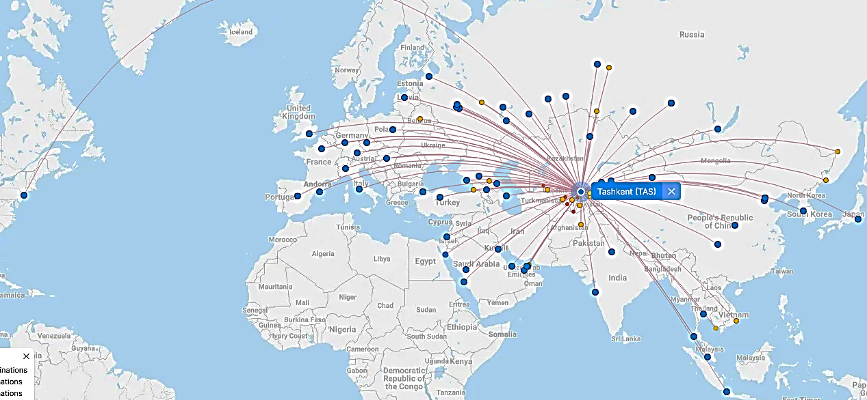
Flights from Tashkent and other airports in Uzbekistan
New York
Visa-free travel for tourists from 90 countries
59 different airlines operate at Uzbekistan Airport.
There are 11 airports across the country, the main of which are Tashkent, Samarkand and Bukhara.

