Slide 1

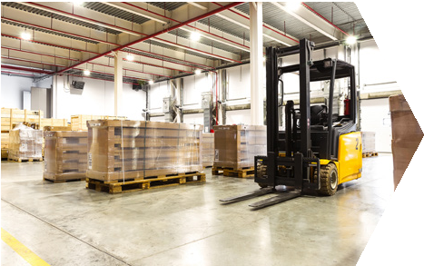




Ministry of Investment,
industry and trade
of the Republic of Uzbekistan
Agrologistics complex establishment project
Project overview
Business model:
The network of cold-storage warehouse logistics hubs in 10 ha land
Project scope
Construction of agrologistics complex in Samarkand region
Financing
35 mln USD
1. Warehouse operation process
Timeline
2025
2026
Construction of the 2nd stage
2027
Full coordinated launch of project
Development of the warehouse chain design, construction of warehouses, equipment procurement
Receiving
Storage
Picking
Packaging
Shipping
2. Warehouse description
3. Warehouse layout
Services
Storage Handling
Storage
Picking
Clients
Food manufacturers Wholesalers
Food exporters
Buffer space
Packaging
Load area
Office
Upload area
Office
Products
Fresh and processed food products (including canned)

Slide 2

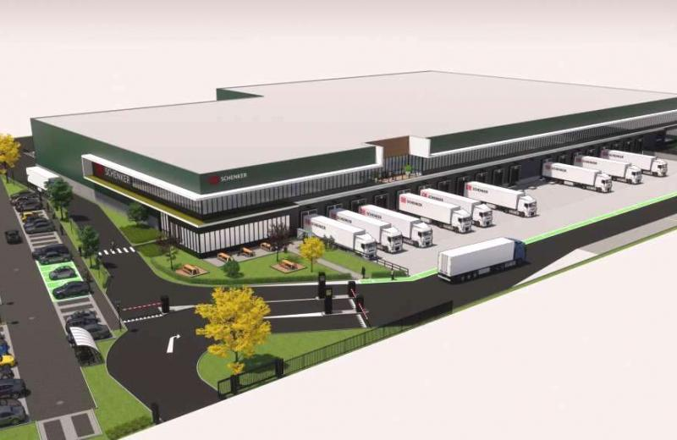

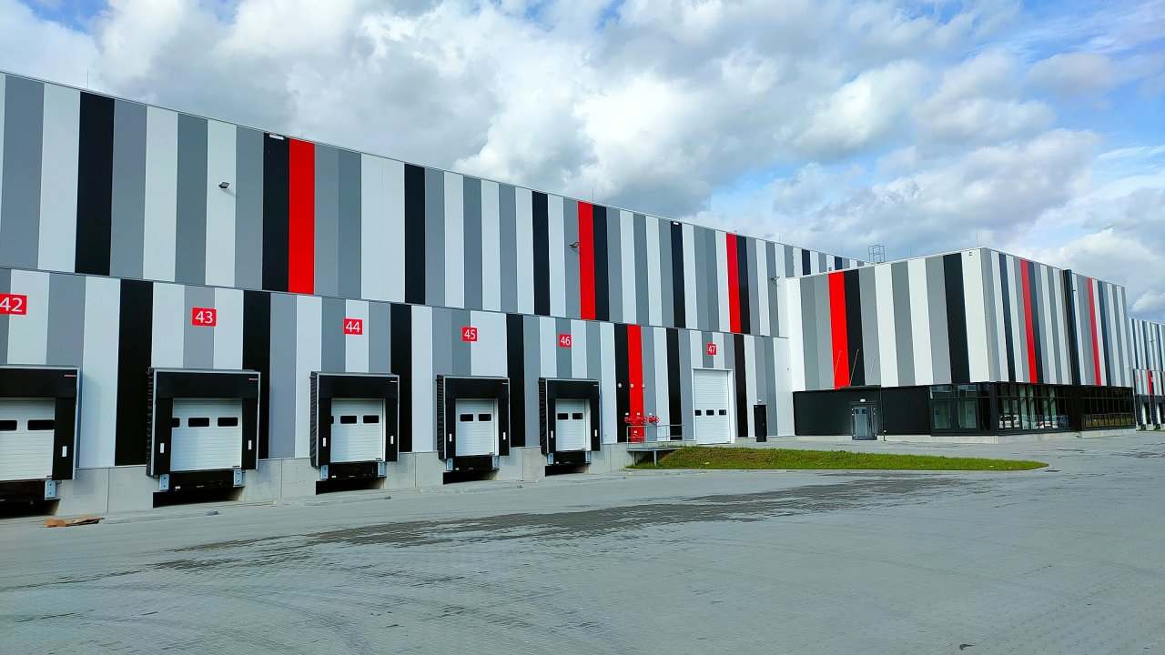


Ministry of Investment,
industry and trade
of the Republic of Uzbekistan
We invite to invest in logistics and storage industry in Uzbekistan
Competition: Uzbekistan offers highly competitive structure of operating costs for logistics and carrying shipments internationally
Project overview
Trade agreements
Location
Samarkand Region
CIS Free Trade Agreement creates more integrated and open market with CIS countries.
GSP+ agreement allows to export to EU at reduced or zero tariff for
6 200 products.
Samarkand region
Size | 16 400 km²
Population | 3,7 million
Logistics hubs can benefit from:
  There is an additional demand for storing 2.5 million tons of products
  Availability of skilled labor
  Opportunity to fill an empty niche in CA market
  Growing demographical rates in Central Asia
  Hubs are located on “E-40” highway (fastest connection transit from China to Europe)
Competitive landscape
Proposed project
Currently there are capacity of storing 600 thsd tons in private warehouses of Uzbekistan
1 544
140
9%
805
52%
Launching a network of 4 hubs
(with capacity of 100 thsd tons each) will help capture 9-10% market
share in 2027
599
39%
2017
Estimated growth
2027

Slide 3

On the strategic international logistics corridor
Ministry of Investment,
industry and trade
of the Republic of Uzbekistan
Tallin
Sankt-Peterburg
Riga
Latvia
Moscow
Klaipeda
Hamburg
Minsk
Berlin
Brest
Povorina
Essen
Lviv
Kyiv
Paris
Chop
Volgograd
Kandiagash
Aktogay
Astraxan
Beyney
Saksaulskaya
Ulan-Bator
Osh
Bayangal-Mangal
Mersin
Malatya
Saraxa
Mazar-i-Sharif
Kashgar
Xirat
Afghanistan
Peshavar
Iran
Pakistan
Bandar-e-Abbas
Chakhbahar
Karachi

Slide 4

Excellent air connectivity from Tashkent and other Uzbek airports
Ministry of Investment,
industry and trade
of the Republic of Uzbekistan
New York
A visa-free policy for tourists from
90 countries
Diverse range of 59 carriers in Uzbekistan’s airport
11 airports across the Country, the main airports are Tashkent, Samarkand and Bukhara

