Slide 1
Ministry of Investment,
Industry and Trade of the Republic of Uzbekistan
Production of infant food products
Project overview
Business model: Factory with capacity of 30 thsd tons of fruit purees and porridge
Project scope
Construction of factory for production of infant food (fruit purees and porridge)
Financing
50 mln USD
Production process for infant food
Incentives
Selection of raw materials, washing and cleaning
Heat treatment, grinding, pasteurization
Adding ingredients, packaging
Quality control and storage
Infrastructure development at state cost* (project cost exceeding 15 mln USD)
Across the Republic, 27 FEZs offer tax breaks on land, property, water and CIT.
(CIT - applied for investments over 3 mln USD)
Project description
Exemption from taxes
3 years if investment is between 0,3 – 3 mln USD
5 years if investment is between 3 – 5 mln USD
7 years if investment is between 5 – 10 mln USD
10 years if investment is over 10 mln USD
Domestic market
Existing 5 neighbor markets
Russia, Europe, Middle East markets
4 production lines
Capability to produce various infant food products
~200 employees
Production and trade volume of infant food (2024), mln USD
Production
Export
Import
Consumption
Consumption (CA)
Infrastructure
Gas 12 cent/m³
Electricity 7 cent/kWh
Water 20 cent/m³
1,0
2,0
6,6
7,6
600

Slide 2
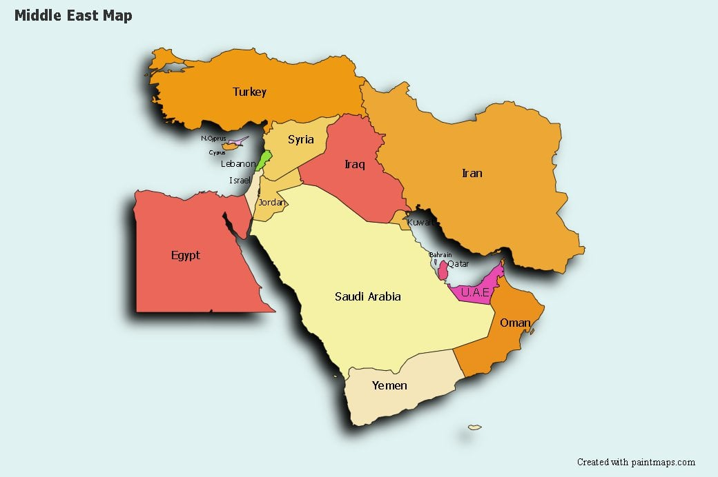
Ministry of Investment,
Industry and Trade of the Republic of Uzbekistan
We invite to invest in infant food manufacturing in Uzbekistan
Project overview
Trade agreements
Competition: Uzbekistan offers highly competitive structure of operating costs for manufacturing of finished goods internationally
GSP+ agreement allows to export to EU at reduced or zero tariff for 6 200 products.
CIS Free Trade Agreement creates more integrated and open market with CIS countries.
Volume of import of infant food in different regions
RUSSIA
2 bln USD
EUROPE
20 bln USD
MIDDLE EAST
6 bln USD
Location
Tashkent region
Tashkent region
Size | 15 250 km²
Population | 3 million
Availability of labor in food industry
Faculties of colleges: 10
Faculties of higher education: 24
Number of graduates: 4 332
Local food producers can benefit from:
Growing demand and limited offer in domestic and international market
Access to cheap agricultural products
- Building on existing infrastructure and distribution networks
Infrastructure development at state cost*
Incentives: Free Economic Zones offer tax breaks

Slide 3
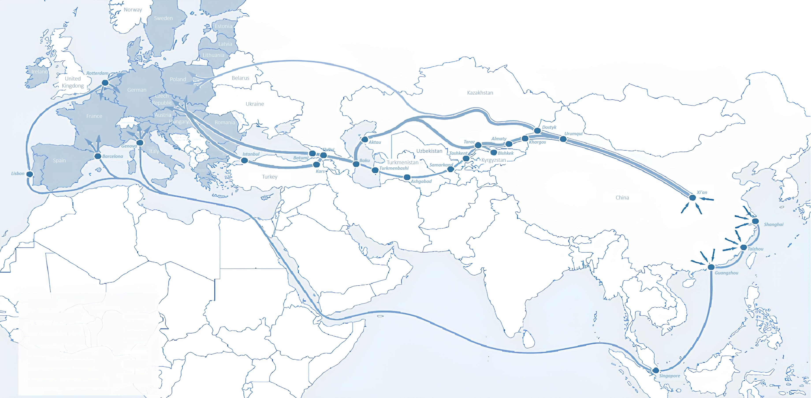
On the strategic international logistics corridor
Ministry of Investment,
Industry and Trade of the Republic of Uzbekistan
Minsk
Moscow
Minsk
Ural
Mashhad
Mazar-i-Sharif
Aksu
Torbat-e Heydariyeh
Afghanistan
Iran
Direction
Duration
Cost
Bandar-e-Abbas
Bandar-e-Jask
Karachi
UZB-RUS-EU
14 days
4 500 USD
CN-KGZ-UZB
20-45 days
5 300 USD
UZB-CN-Mid.East*
1 day
800 USD/ton
UZB-KAZ-RUS-GE-TR
15-18 days
3 500 USD
UZB-KAZ-RUS-KOR
30 days
4 500 USD
* - by plane

Slide 4
Excellent air connectivity from Tashkent and other Uzbek airports
Ministry of Investment,
Industry and Trade of the Republic of Uzbekistan
A visa-free policy for tourists from 90 countries
Diverse range of 59 carriers in Uzbekistan’s airport
11 airports across the Country, the main airports are Tashkent, Samarkand and Bukhara
https://www.flightconnections.com/flights-from-tashkent-tas

