Slide 1

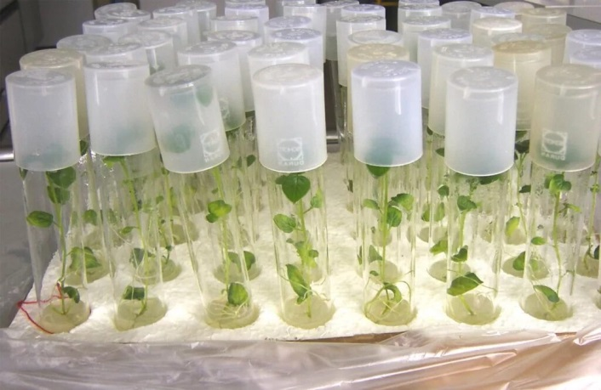






Cultivation of tree and shrub seedlings using modern
“in vitro” technologies.
Industry
Project indicators
Agriculture
Project goal
Project cost:
Investment requirements
$ 2,0 mln.
$ 2,0 mln.
Growing healthy, high-quality and virus-free seedlings of trees and shrubs based on modern in-vitro technologies, with their subsequent sale in the market of the Khorazm region and throughout the territory of Uzbekistan
Power:
Local market– 80%
Export– 20%
50 thousand units(Seedlings of fruit trees and shrubs)
Advantages of the project
Payback period:
4 years
~80 employees
High reproduction rate — the ability to obtain thousands of plants from one initial sample. This is important for rare, highly valuable or difficult to reproduce species, when it is necessary to urgently restore the population after disasters or diseases.
Genetic homogeneity – in vitro seedlings are genetically identical copies of the mother plant, which ensures a high degree of uniformity in yield and growth rate.
Process
Selection of explant and maintenance in a special environment
Formation of new shoots on the seedling
Adaptation of seedlings
Planting seedlings in the ground
Market
In 2025, the market size is estimated to be US$32.11 billion.
The market is projected to reach around US$68.57 billion by 2034, growing at a CAGR of 8.80% from 2025 to 2034.
Project initiators
Ministry of Ecology, Environmental Protection and Climate Change of the Republic of Uzbekistan
Location
Khorazm region
Benefits and targeted project support
Subsidies are provided in the amount of 50 percent of the costs of purchasing seedlings planted along the edges of fields using the in-vitro method, but not more than 25 thousand soums for each rootstock of a fruit seedling.
Loans for water supply are allocated by crediting the borrowers' bank cards with a portion of no more than 50 percent of the costs of installing pumps and pipes for a period of 12 months, including a grace period of up to 6 months, at a rate higher than the Central Bank's base rate.
Allocation of 50 billion soums for the purchase of drying shops and cold storage facilities for a period of 84 months, including a grace period of up to 36 months, at a rate of 14 percent per annum.
Territorial Department of Ecology for Khorazm region
Urgench, Al-khorazmi 29.
info@xorazm.uz
http://gov.uz/eco
Khorazm region
Size | 6050 km²
Population | ~2,05 million

Slide 2


International logistics transport corridors
Tallin
Sankt-Peterburg
Riga
Latvia
Moscow
Klaipeda
Hamburg
Minsk
Berlin
Brest
Povorina
Essen
Lviv
Kyiv
Paris
Chop
Volgograd
Kandiagash
Aktogay
Astraxan
Beyney
Saksaulskaya
Ulan-Bator
Osh
Bayangal-Mangal
Mersin
Malatya
Saraxa
Mazar-i-Sharif
Kashgar
Xirat
Afghanistan
Peshavar
Iran
Pakistan
Bandar-e-Abbas
Chakhbahar
Karachi

Slide 3

Air connections from Tashkent and other airports of Uzbekistan
New York
A visa-free policy for tourists from
90 countries
Diverse range of 59 carriers in Uzbekistan’s airport
11 airports across the Country, the main airports are Tashkent, Samarkand and Bukhara

