Slide 1

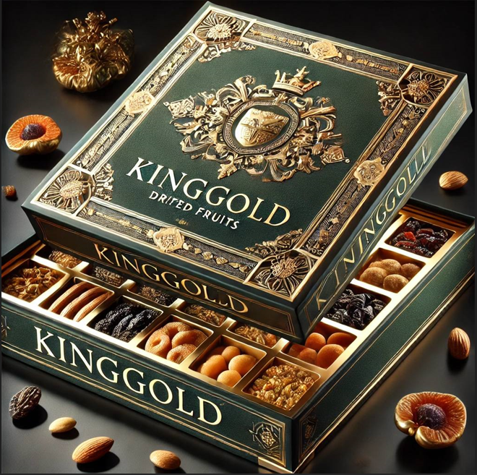
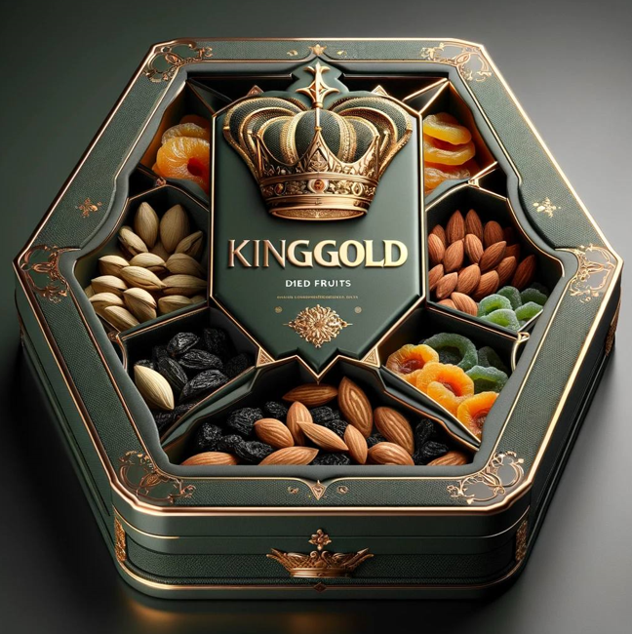

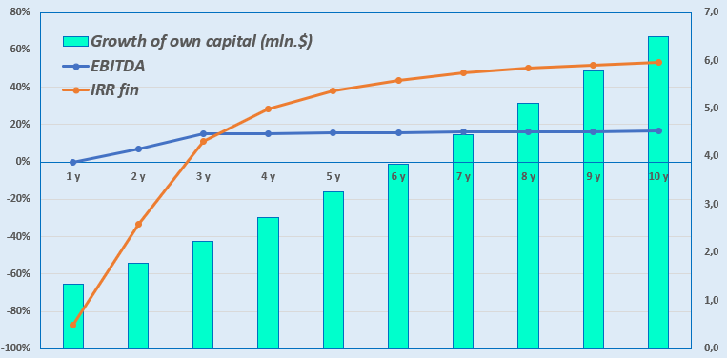
Production of Dried Fruits in Premium Packaging
Sector:
Agro-industrial complex and food industry
Project Cost:
Total cost – US$ 1,23 mln.
Investment Proposal:
Investment amount — US$ 1.23 million, including:
Project Objective:
Production and export of dried fruits and vegetables in premium packaging in accordance with the standards of Organic, Global G.A.P., and Halal.
Foreign and local investors are invited to participate in the project.
Buildings and facilities
55,9%
$0,67 mln.
Initiator's contribution - 25,0% ($0,31 mln.)
Credit - 0 % ($0 mln.)
Direct investments - 75,0% ($0,92 mln).
Equipment
12,2%
$0,23 mln.
Installation
5,8%
$0,27 mln.
Final project cost and financing structure will be defined after negotiations with investors..
Other
1,2%
$0,06 mln.
Market
The global market for organic food and beverages is projected to reach USD 1.58 trillion by 2037, growing at an average annual rate of 14.1%.
North America is expected to dominate in revenue (49.8%) due to increasing public awareness and demand for organic products.
Investments in this direction are on the rise. The U.S. invested over USD 30 million in 2025, including funds from the American Rescue Plan, to support local organic production.
Goal — to create new jobs and income sources for farmers and producers.
Profitability Chart:
Financial Indicators:
NPV, US$ mln. – 2,7
IRR, % – 29,2%
EBITDA, % – 16,0%
PI – 3,24
DPP, год - 4,2
Why Invest in Organic Farming?
Growing demand for organic products. Consumers are interested in foods grown without synthetic fertilizers and pesticides.
Development of the domestic consumer market — increased consumption of organic products, growing public awareness.
Expansion into export markets — access to new promising markets such as the U.S., EU, China, Asia, and the Middle East.
Initiator
LLC «KINGGOLD»
Location
Namangan Region
Established in February 2025 to implement a project for the production of dried fruits in premium packaging.
Authorized capital — 100 million UZS.
Founders: local entrepreneurs – Trububaev S. – 100%
Addreses: Namangan Region, Chortoq District, Soz-Soyka MFY, Yangi Zamon St., No. 20.
Incentives
Until January 1, 2028: 0% income and social tax on production and packaging of dried fruits.
From April 1, 2027: 0% VAT on wholesale sales of dried fruits and vegetables, including dried ones.
In 2025–2026: The state will subsidize 25% of the sorting and packaging costs of fruit and vegetable products for cooperatives.
Namangan Region
Area | 7 440 km²
Population | 3,1 mln.
Required land area ~ 2,0 ha
6%

Slide 2

International Transport and Logistics Corridors
Tallin
Sankt-Peterburg
Riga
Latvia
Moscow
Klaipeda
Hamburg
Minsk
Berlin
Brest
Povorina
Essen
Lviv
Kyiv
Paris
Chop
Volgograd
Kandiagash
Aktogay
Astraxan
Beyney
Saksaulskaya
Ulan-Bator
Osh
Bayangal-Mangal
Mersin
Malatya
Saraxa
Mazar-i-Sharif
Kashgar
Xirat
Afghanistan
Peshavar
Iran
Pakistan
Bandar-e-Abbas
Chakhbahar
Karachi

Slide 3

Air Connectivity from Tashkent and Other Airports of Uzbekistan
New York
Visa-free regime for tourists from 90 countries.
59 different airlines operate in Uzbekistan’s airports.
There are 11 airports across the country, with the main ones located in Tashkent, Samarkand, and Bukhara.

