Slide 1

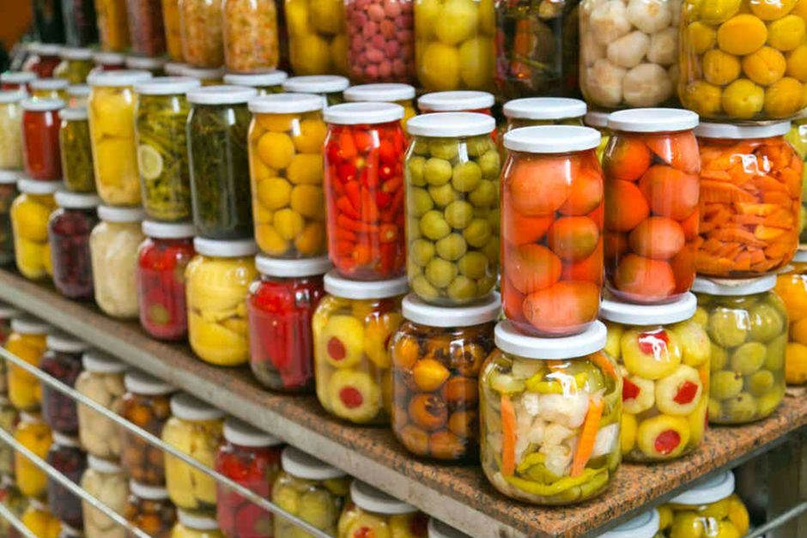

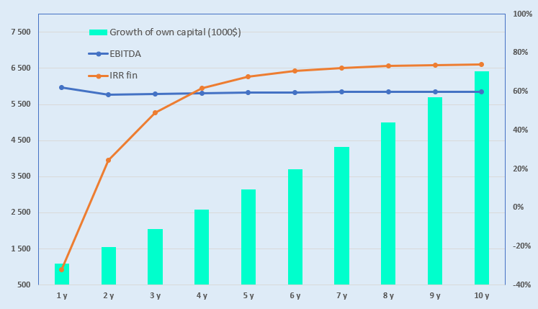
Cluster for the Production of Fruit and Vegetable Canned Products
Industry
Agro-Industrial Complex and Food Industry
Project cost:
Total cost US$ 0,88 million
Investment plan
Total investment USD 0.88 million, of which:
Project Objective
Production and export of canned fruit and vegetable products in accordance with the requirements of Organik, Global G.A.P, and Halal standards.We invite both foreign and local investors to participate in project implementation.
Buildings and structures
24,2%
$0,21 million
Contribution of the initiator 11,1 % ($0,68 million)
Loans 0% ($ 0 million)
Direct investments 22,8% ($0,2 million)
Equipment
48,8%
$0,43 million
Other
3,4%
$0,03 million
The final cost and financing structure of the project will be determined following negotiations with investors.
Working capital
23,5%
$0,21 million
Project Products
The project produces approximately 2 million conventional cans of canned fruit and vegetable products.
Profitability:
Investment indicators :
Why Invest in the Organic Farming Sector?
Growing demand for organic products – consumers are increasingly interested in produce grown without the use of synthetic fertilizers, pesticides, or other additives.
Development of the domestic consumer market – rising consumption of organic products, along with increased public awareness and trust in organic goods.
Expansion of export destinations – access to new and promising markets, such as the USA, EU, China, as well as countries in Asia and the Middle East.
NPV, US$ million – 4,3
IRR, % – 65,2%
EBITDA, % – 60%
DPP, years - 1,7
Market
The market volume for organic food and beverages is projected to reach USD 1.58 trillion by 2037, reflecting an average annual growth rate of approximately 14.1%. North America is expected to dominate revenue generation, accounting for around 49.8%, driven by increasing public awareness and strong demand for organic products.
Investments in this sector:In 2025, the United States invested over USD 300 million—including funds from the American Rescue Plan—into a new initiative aimed at transitioning to organic production. The objective is to create new markets and income streams for farmers and producers.
Initiator
«BEST-GARDEN TOMORQA XIZMATI» LLC
Created - 2019
Authorized capital – 7.0 billion UZS
Founders:
F. Mamatov – 12,9 %
М. Mamatov – 12,9 %
B. Mamatov – 74,2 %
The enterprise is located at the address Surkhandarya region, Bandikhansky district, MFY Bektepa
Location
Surkhandarya region
Incentives
Until January 1, 2028, a reduced profit tax and social tax rate of 1% is applied to the sale of fruit and vegetable products in modern packaging.
Until April 1, 2027, a 1% customs duty rate is applied to the import of equipment for processing, packaging, and sorting fruits and vegetables, including dried fruits.
In 2025–2026, agricultural cooperatives engaged in fruit and vegetable production will receive 25% reimbursement from the state for expenses related to sorting and packaging.
Surkhandarya region
Area | 20 800 km²
Population | 2,9 million
Required area
~ 1,5 thousand hа
6%

Slide 2

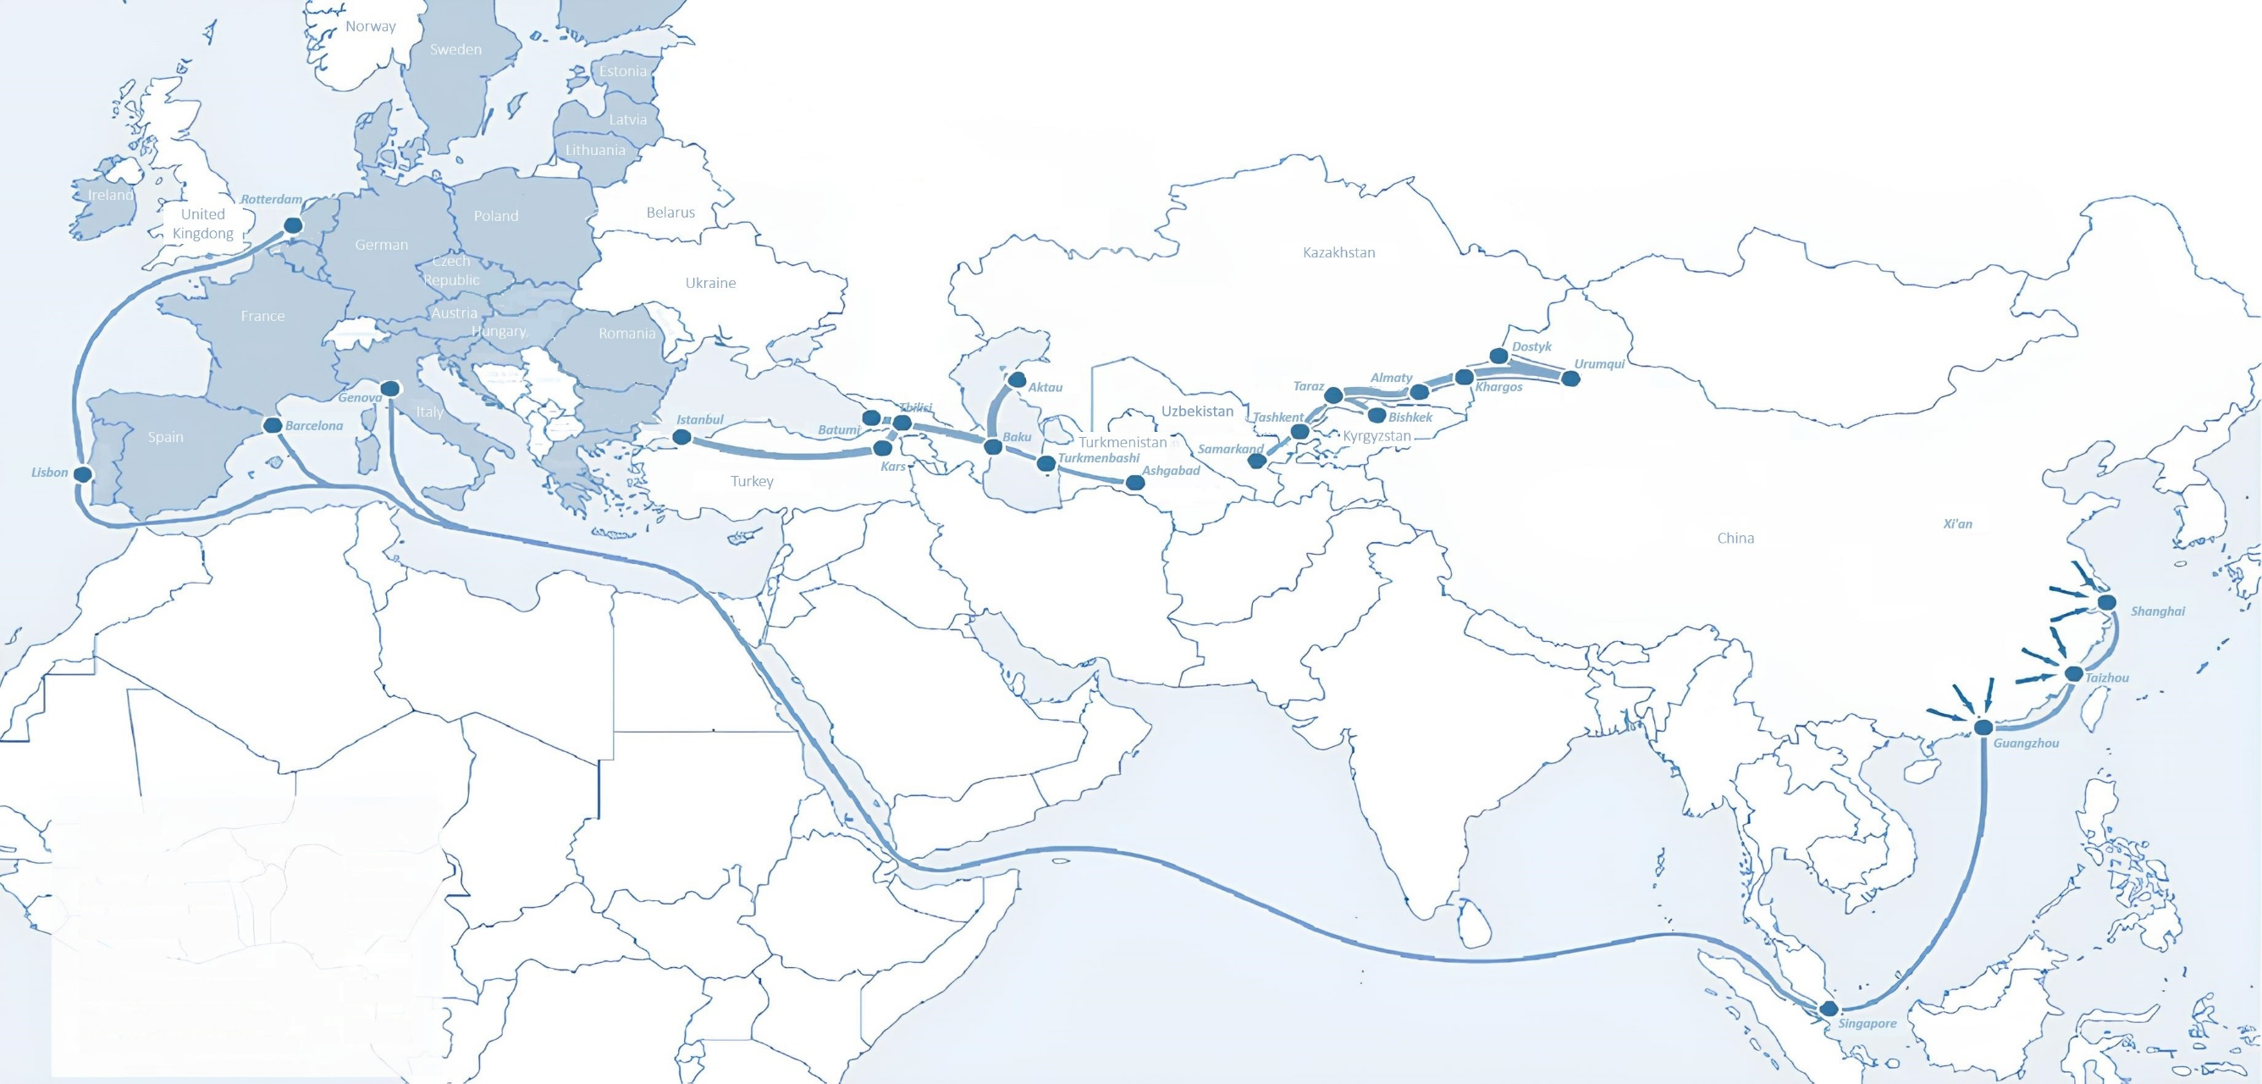
International logistics transport corridors
Tallin
Sankt-Peterburg
Riga
Latvia
Moscow
Klaipeda
Hamburg
Minsk
Berlin
Brest
Povorina
Essen
Lviv
Kyiv
Paris
Chop
Volgograd
Kandiagash
Aktogay
Astraxan
Beyney
Saksaulskaya
Ulan-Bator
Osh
Bayangal-Mangal
Mersin
Malatya
Saraxa
Mazar-i-Sharif
Kashgar
Xirat
Afghanistan
Peshavar
Iran
Pakistan
Bandar-e-Abbas
Chakhbahar
Karachi

Slide 3
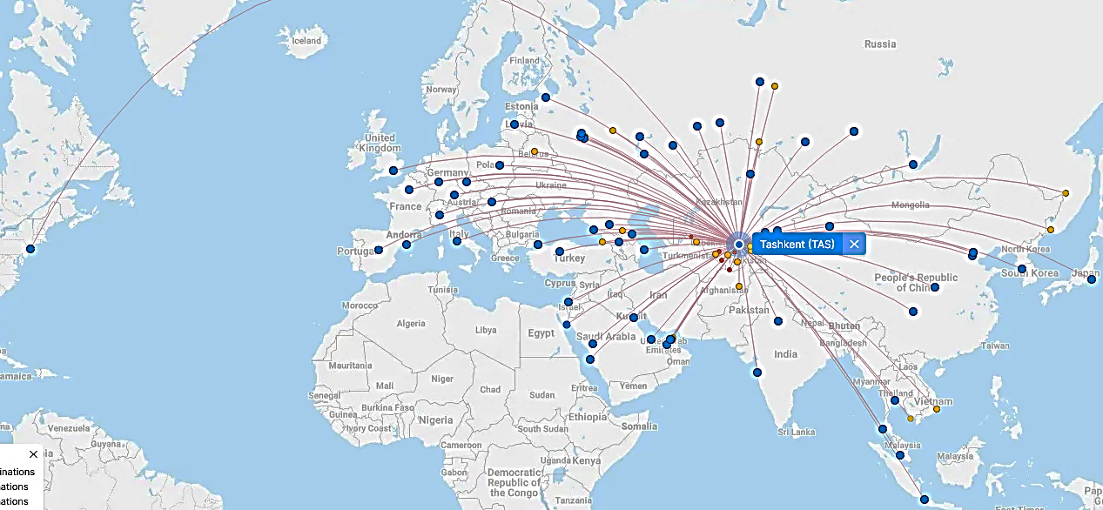
Air connections from Tashkent and other airports of Uzbekistan
New York
A visa-free policy for tourists from
90 countries
Diverse range of 59 carriers in Uzbekistan’s airport
11 airports across the Country, the main airports are Tashkent, Samarkand and Bukhara

