Slide 1

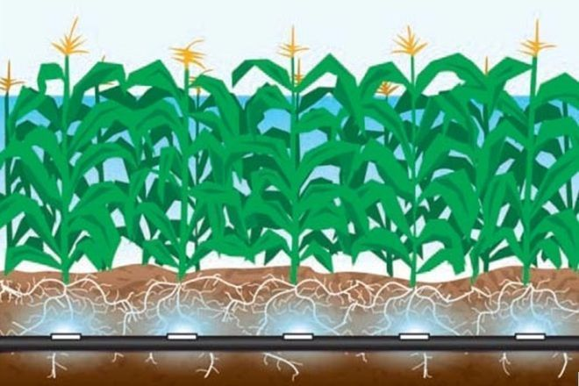

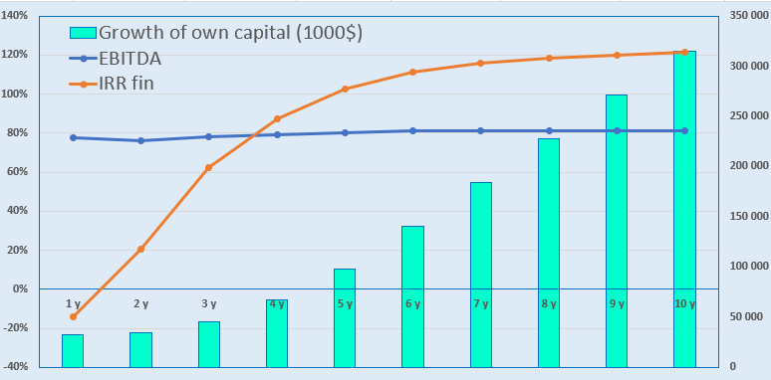
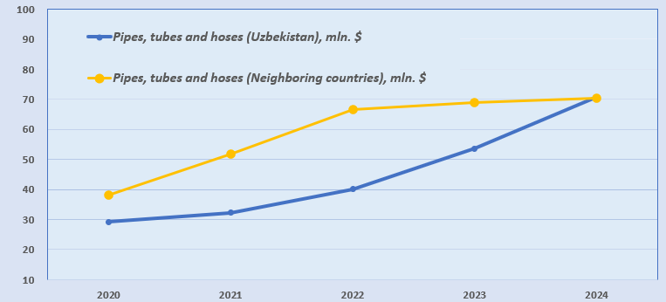
Subsurface Drip Irrigation System
Activity
Agriculture and recycling of used car tires
Project Cost Breakdown:
Total – US$ 70 million
Investment Plan
Total investment: $70 million USD:
Project Goal
To cultivate cotton on 5,000 hectares per year using in-house produced SDI (Subsurface Drip Irrigation) systems.
The SDI systems are manufactured from recycled car tires, totaling more than 10,000 tons annually.
Buildings and Structures
11,5%
$8.1 million
Promoter’s Contribution - 14,0 % ($9,8 million)
Loans and government funds - 36,0% ($25,2 million)
Direct Investments - 50,0% ($35 million)
Equipment
71,3%
$49.9 million
Land Treatment Machinery
10,0%
$7 million
Final cost and financing structure will be determined after negotiations with investors.
Working Capital
7,2%
$5 million
Project Products
Cotton raw material: 25,000–125,000 tons ($15.6–78.1 million USD)
Subsurface drip irrigation hoses: ~70 million meters annually
Investment
Indicators:
Profitability:
System Advantages
No water evaporation
Up to 80% water savings compared to traditional irrigation
Up to 30% savings compared to surface drip irrigation
Maintains soil structure, reduces compaction from machinery
Ensures healthy root development and nutrient delivery
Up to 60% fertilizer savings due to direct delivery through irrigation hoses
Up to 70% reduction in manual labor due to centralized water supply
Cotton yield reaches an average of 5 tons/ha — 2.5 times higher than traditional irrigation.
NPV, US$ million – 191,0
IRR, % – 40,0%
EBITDA, % – 81%
DPP, years - 4,02
Market
By 2031, the organic cotton market is expected to reach $17.14 billion USD with a CAGR of 3%.
The demand for premium cotton is driven by shifting consumer preferences and the rising popularity of cotton blends in the fashion industry.
Initiator
«ECOSUV» MChJ
Founded: 2019
Charter Capital: 8.2 million UZS
Patent: Subsurface Drip Irrigation System (Patent No. FAP 02189)
Implementation of these systems on sandy and semi-sandy soils gradually frees up cotton fields for cultivating other crops.
Implemented location
Republic of Karakalpakstan
Demand
In 2024, Uzbekistan and neighboring countries imported tubes, pipes, and hoses from vulcanized rubber worth over $140 million USD.
Average annual growth in demand is 15% compared to previous years.
Republic of Karakalpakstan and Fergana Valley (Yazyovan)
Square | 166 300 km²
 | 410 km²
Population | 2,05 million
 | 119 000
Yazyovan
Required Area
~ 336,000 hectars
6%

Slide 2

International logistics transport corridors
Tallin
Sankt-Peterburg
Riga
Latvia
Moscow
Klaipeda
Hamburg
Minsk
Berlin
Brest
Povorina
Essen
Lviv
Kyiv
Paris
Chop
Volgograd
Kandiagash
Aktogay
Astraxan
Beyney
Saksaulskaya
Ulan-Bator
Osh
Bayangal-Mangal
Mersin
Malatya
Saraxa
Mazar-i-Sharif
Kashgar
Xirat
Afghanistan
Peshavar
Iran
Pakistan
Bandar-e-Abbas
Chakhbahar
Karachi

Slide 3

Flights from Tashkent and other airports in Uzbekistan
New York
• Visa-free regime for tourists from 90 countries
• 59 airlines operate in Uzbekistan
• 11 airports, with Tashkent, Samarkand, and Bukhara being major hubs

