Slide 1

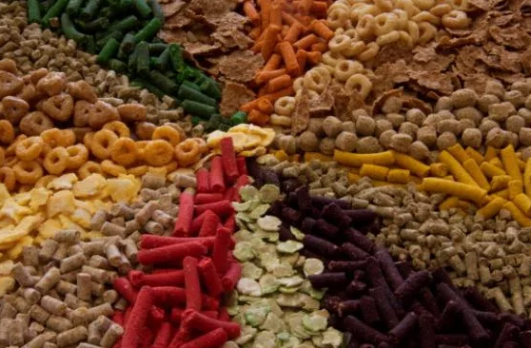

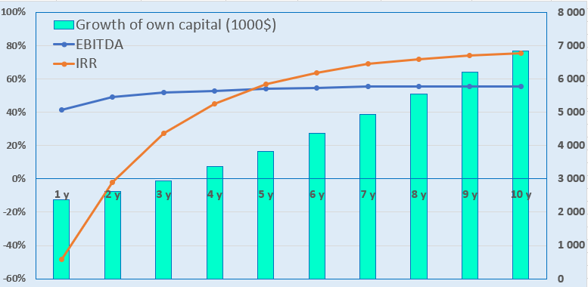
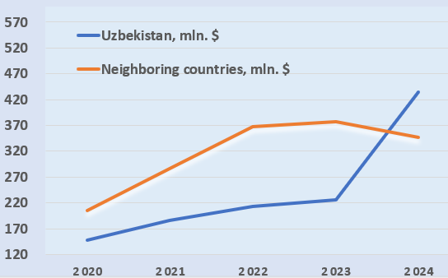
Production of animal feed and fertilizers based on food waste processing
Branch
Fisheries and agriculture
Project cost:
Total cost $ 2,22 mln.
Investment plan
Total investment - 2.22 million US dollars, including:
Project objective
Organization of the production of mixed feed for feeding fish, poultry, and other domestic animals by organizing a food waste collection network in the region. The project is aimed at increasing the provision of farms with mixed feed, as well as obtaining environmentally friendly fertilizer - humus. When the project is fully operational, it will be possible to produce 4 thousand units of mixed feed and fertilizers.
Buildings and structures
64,7%
$1,44 mln.
26,5%
Initiator contribution 78,5 % ($ 1,75 million)
Direct investments 21,5% ($ 0,48 million)
Equipment
$0,59 mln.
Others
2,9%
$0,07 mln.
The final cost and financing structure of the project will be determined based on the results of negotiations with investors.
Working capital
5,9%
$0,013 mln.
Why invest in food waste disposal?
Rentability:
Investment indicators:
Increasing ecological feed - food production waste - is a valuable raw material for the production of feed for livestock, poultry, and fish, and this is especially relevant for the meat, fish, dairy, and grain industries.
Reducing the consumption of natural resources - waste processing allows for the recovery and reuse of materials, which decreases the need for new raw materials.
Reduction of greenhouse gas emissions - organic waste, when improperly disposed of, decomposes and releases methane, which contributes to climate change. Waste processing (composting, anaerobic digestion for biogas production) reduces emissions.
Stimulating innovation - new technologies, methods, and materials are developed and applied in the waste processing process, creating new business opportunities.
Government support. Financing research and infrastructure, providing tax incentives and subsidies, and implementing regulations that encourage the processing of food waste.
NPV, US$ million – 2,5
IRR, % – 15,8%
EBITDA, % –55,0 %
Payback period (DPP), year — 5,2
Tashkent region
Market
The volume of the global market for fish feed in 2024 amounted to 3.12 billion US dollars, and the average annual growth rate is about 5.1 percent.
By 2033, this figure will reach 5.45 billion US dollars, and from 2026 to 2033, the market will develop at an average annual growth rate of 7.4 percent.
Import dynamics
Project initiator
Placement
Ministry of Ecology, Environmental Protection and Climate Change.
"ALFA GARANT" LLC (Bekabad city)
"FIN EXPERT PRO" LLC (Nukus city)
The implementation of projects is provided for by Resolution No. 589 of the Cabinet of Ministers of the Republic of Uzbekistan dated September 16, 2025.
Placement of projects in the Tashkent region and the Republic of Karakalpakstan.
Tashkent region
Area | 15300 sq.km
Population | 2,65 million
6%

Slide 2


International logistics transport networks
Tallin
Sankt-Peterburg
Riga
Latvia
Moscow
Klaipeda
Hamburg
Minsk
Berlin
Brest
Povorina
Essen
Lviv
Kyiv
Paris
Chop
Volgograd
Kandiagash
Aktogay
Astraxan
Beyney
Saksaulskaya
Ulan-Bator
Osh
Bayangal-Mangal
Mersin
Malatya
Saraxa
Mazar-i-Sharif
Kashgar
Xirat
Afghanistan
Peshavar
Iran
Pakistan
Bandar-e-Abbas
Chakhbahar
Karachi

Slide 3

High-quality flights from Tashkent and other airports of Uzbekistan.
New York
Visa-free regime for tourists from 90 countries.
A wide network of 59 airlines operating in the airports of Uzbekistan.
There are 11 airports throughout the country, the most important of which are in Tashkent, Samarkand, and Bukhara.

