Slide 1

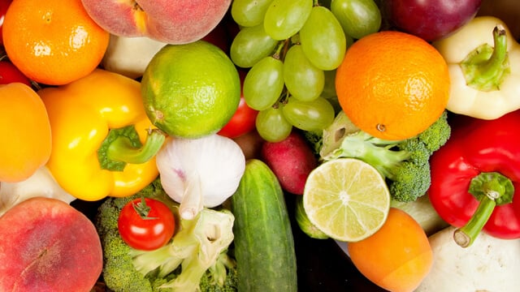

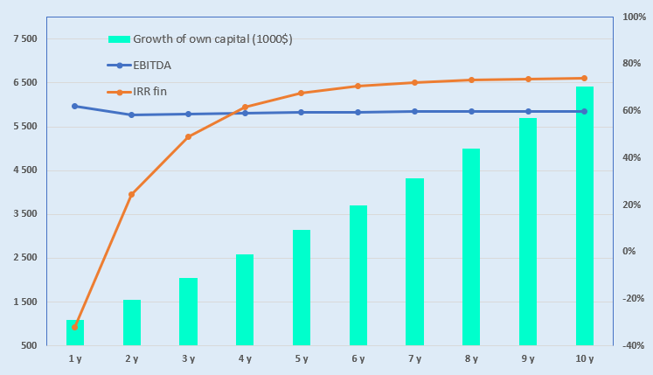
Cluster for the fruit and vegetable processing project
Industry
Agro-Industrial Complex and Food Industry
Project cost:
Total cost US$ 27,0 million
Investment plan
Total investment USD 27,0 million, of which:
Project Objective
To establish a modern facility for the processing and drying of fruit and vegetable products, aimed at producing high-quality goods that meet international standards such as Organic, Global G.A.P., and Halal. The project seeks to boost export potential and attract both local and foreign investment for long-term growth.
.
Buildings and structures
24,8%
$6,7 million
Contribution of the initiator 7,4 % ($2,0 million)
Direct investments 92,6% ($25,0 million)
Equipment
48,2%
$13,0 million
Other
3,4%
$0,92 million
The final cost and financing structure of the project will be determined following negotiations with investors.
Working capital
23,5%
$6,35 million
Project Products
The project processes approximately 26,000 tons of fruit and vegetable products annually.
Profitability:
Investment indicators :
Why Invest in the Organic Farming Sector?
Growing demand for organic products – consumers are increasingly interested in produce grown without the use of synthetic fertilizers, pesticides, or other additives.
Development of the domestic consumer market – rising consumption of organic products, along with increased public awareness and trust in organic goods.
Expansion of export destinations – access to new and promising markets, such as the USA, EU, China, as well as countries in Asia and the Middle East.
NPV, US$ million – 9,5
IRR, % – 30,1%
EBITDA, % –55,6 %
DPP, years - 3
Market
The market volume for organic food is projected to reach USD 587 billion by 2033, reflecting an average annual growth rate of approximately 11%. North America is expected to dominate revenue generation, accounting for around 49.8%, driven by increasing public awareness and strong demand for organic products.
Investments in this sector: In 2025, the United States invested over USD 300 million—including funds from the American Rescue Plan—into a new initiative aimed at transitioning to organic production. The objective is to create new markets and income streams for farmers and producers.
Initiator
“MILMAXTRADE” LLC
Created - 2020
Authorized capital – 2.72 billion UZS
Founder:
Sh. Khusenov – 100%
The enterprise is located at the address 5A, Piridastgir Street, Bukhara City, Bukhara Region
Location
Bukhara region
Incentives
Fruit and vegetable products sold in modern packaging are subject to a 1% profit and social tax rate reduction until January 1, 2028 .
Fruit and vegetable processing, packing, and sorting equipment, including dried fruit, is subject to a 1% customs duty rate until April 1, 2026.
In 2025–2026, agricultural cooperatives engaged in fruit and vegetable production will receive 25% reimbursement from the state for expenses related to sorting and packaging.
Bukhara region
Area | 40200 km²
Population | 2,1 million
Required area
~ 2 thousand hа
6%

Slide 2


International logistics transport corridors
Tallin
Sankt-Peterburg
Riga
Latvia
Moscow
Klaipeda
Hamburg
Minsk
Berlin
Brest
Povorina
Essen
Lviv
Kyiv
Paris
Chop
Volgograd
Kandiagash
Aktogay
Astraxan
Beyney
Saksaulskaya
Ulan-Bator
Osh
Bayangal-Mangal
Mersin
Malatya
Saraxa
Mazar-i-Sharif
Kashgar
Xirat
Afghanistan
Peshavar
Iran
Pakistan
Bandar-e-Abbas
Chakhbahar
Karachi

Slide 3

Air connections from Tashkent and other airports of Uzbekistan
New York
A visa-free policy for tourists from
90 countries
Diverse range of 59 carriers in Uzbekistan’s airport
11 airports across the Country, the main airports are Tashkent, Samarkand and Bukhara

