Slide 1

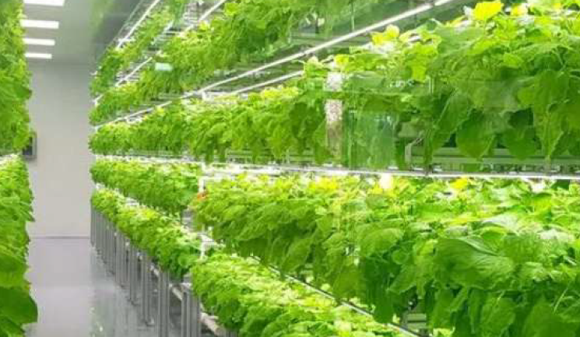

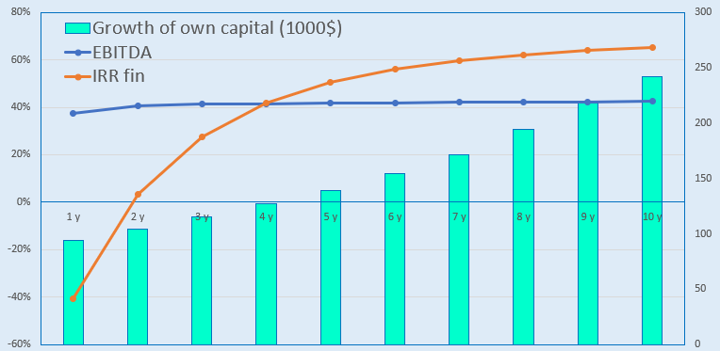
Cultivation of Fruits and Vegetables Using the Aeroponics Method (Startup Project)
Industry
Agro-industrial Complex and Food Industry
Project cost:
Total cost – USD 85.1 thousand
Investment plan
Total investment – USD 85.1 thousand, of which:
Buildings and structures
30,6%
$26,0 thousand
Initiator’s contribution – 17.7% (USD 15.1 thousand)
Loans – 0% (USD 0 thousand)
Direct investments – 82.3% (USD 70.0 thousand)
Project goal
Cultivation of fruits, vegetables, and greens in accordance with the requirements of Organik, Global G.A.P, and Halal standards.
We invite foreign and local investors to participate in the implementation of the startup project.
Equipment
48,2%
$41,0 thousand
Other
15,3%
$13,05 thousand
.
The final cost and financing structure of the project will be determined after negotiations with investors.
Working capital
5,9%
$5,05 thousand
Project products
The project will cultivate strawberries, tomatoes, cucumbers, and greens, producing approximately 15–18 tons per year..
Investment indicators:
Прибыльность:
Why is it worth investing in the organic farming sector?
NPV, US$ (thousand) – 102,1
IRR, % – 22,8%
EBITDA, % – 42%
DPP, years - 4,4
Growing demand for organic products – Consumers are increasingly interested in produce grown without the use of synthetic fertilizers, pesticides, or other additives.
Development of the domestic consumer market – Expanding the consumption of organic products, increasing public awareness, and building trust in organic goods.
Expansion of export destinations – Entering new promising markets, such as the USA, EU, China, Asian countries, and the Middle East.
Market
According to marketresearchfuture.com, in 2024 the global fresh strawberry market was valued at USD 15.68 billion. It is expected to grow to USD 21.43 billion by 2034. The forecasted market growth rate for the period from 2025 to 2034 is around 3.2% per year.
According to gminsights.com, in 2024 the global fresh vegetables market was valued at USD 949.8 billion. It is expected to reach USD 1.6 trillion by 2034, with a projected annual growth rate of 4.7% between 2025 and 2034.
Initiator
Private entrepreneur
Shokirov Sultonbek
Education – Higher education
Project location
Andijan Region, Andijan District
Urukzor-2, Sayfiobod street
Location
Andijan Region
Benefits
Until January 1, 2028, when selling fruit and vegetable products in modern packaging, the corporate income tax and social tax rates are set at 1%.
Until April 1, 2027, when importing equipment for processing, packaging, and sorting fruits and vegetables (including dried fruits), a customs duty rate of 1% applies.
In 2025–2026, cooperatives operating in the agricultural sector, particularly those engaged in fruit and vegetable production, will receive state compensation of 25% of the costs for sorting and packaging their products.
Andijan Region
Area | 42 68 km²
Population | 3,4 million
Required area
~ 400 kv.m.
6%

Slide 2

International transport and logistics corridors
Tallin
Sankt-Peterburg
Riga
Latvia
Moscow
Klaipeda
Hamburg
Minsk
Berlin
Brest
Povorina
Essen
Lviv
Kyiv
Paris
Chop
Volgograd
Kandiagash
Aktogay
Astraxan
Beyney
Saksaulskaya
Ulan-Bator
Osh
Bayangal-Mangal
Mersin
Malatya
Saraxa
Mazar-i-Sharif
Kashgar
Xirat
Afghanistan
Peshavar
Iran
Pakistan
Bandar-e-Abbas
Chakhbahar
Karachi

Slide 3

Air connections from Tashkent and other airports of Uzbekistan
New York
Visa-free regime for tourists from 90 countries of the world
59 different airlines operate in Uzbekistan’s airports
There are 11 airports across the country, the main ones being Tashkent, Samarkand, and Bukhara.

