Slide 1





Ministry of Investment,
Industry and Trade
of the Republic of Uzbekistan
Production of acetic acid
Project overview
Business model: manufacturing facility with production 36 thsd tons of acetic acid per year
Project scope
Construction of acetic acid manufacturing plant
Financing
120 USD mln
Production process for acetic acid
Incentives
Infrastructure development at state cost*
(project cost exceeding 15 mln USD)
Across the Republic, 27 FEZs offer tax breaks on land, property, water and CIT.
(CIT - applied for investments over 3 mln USD)
Methanol Preparation
Carbonylation Reaction
Purification and Separation
Final Product Refining
Project description
Domestic market
Existing 5 neighbor markets
Russia, Europe, Middle East markets
Capacity ~36 thsd tons
per year
Exemption from taxes
3 years if investment
is between 0,3 – 3 mln USD
5 years if investment
is between 3 – 5 mln USD
7 years if investment
is between 5 – 10 mln USD
10 years if investment
is over 10 mln
USD
Eco-friendly production
~145 employees
Production and trade volume of acetic acid (2024)
Infrastructure
Gas 12 cent/m³
Electricity 7 cent/kWh
Water 6-61 cent/m³
Export
Import
Consumption CA
$26,3 mln
$4,6 mln
$12 billion

Slide 2
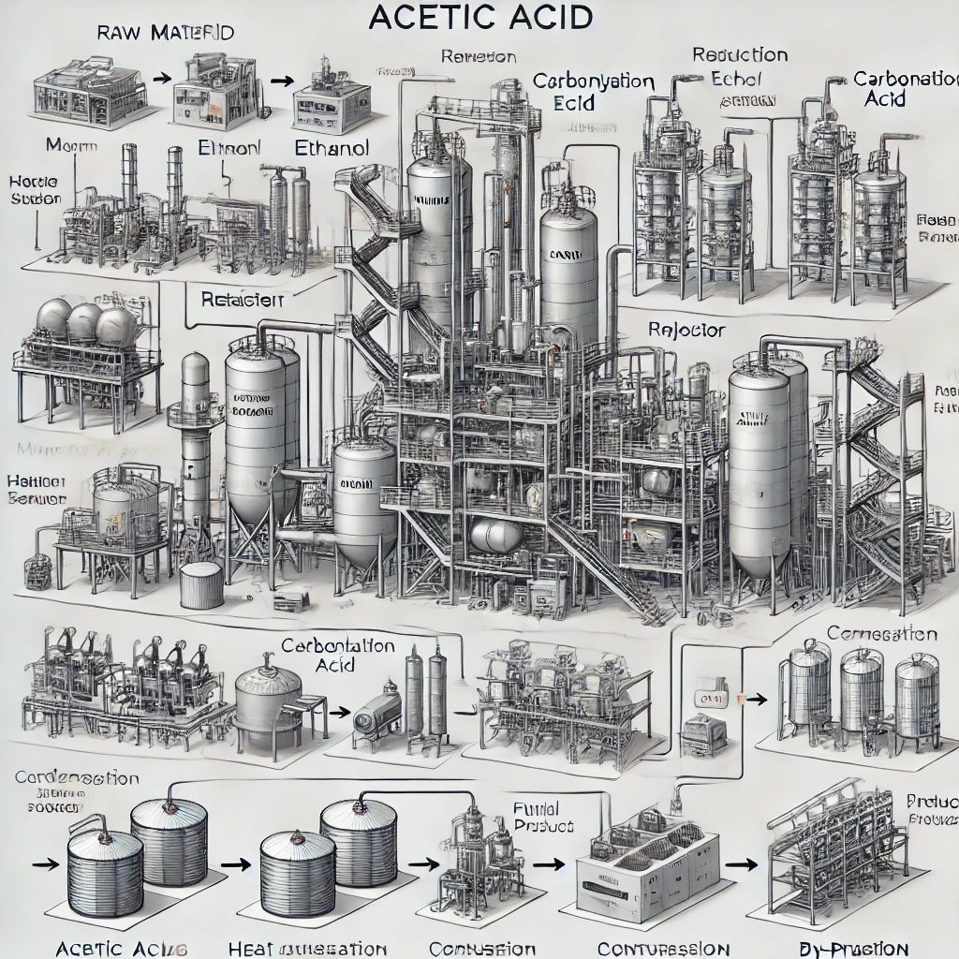




Ministry of Investment,
Industry and Trade
of the Republic of Uzbekistan
We invite to invest in production of acetic acid in Uzbekistan
Project overview
Trade agreements
Vinegar
GSP+ agreement allows to export to EU at reduced or zero tariff for
6 200 products.
CIS Free Trade Agreement creates more integrated and open market with CIS countries.
Pharmacy
Textile
Navoi region
Plastic production
Navoi region
Size | 110 990 km²
Population | 1,03 mln
Cleaning Products
Proximity to the abundant potash base
Availability of labor in chemical industry
Local acetic acid manufacturers can benefit from:
  - Growing chemical sector
  - Availability of skilled & unskilled labor
  Stable political and security environment
  Infrastructure development at state cost
  Incentives: Free economic zones offer tax breaks on land, CIT, water
Higher education institutions: 5
Faculties of higher education: 19
Number of graduates: 1 600
Competitive environment

Slide 3

On the strategic international logistics corridor
Ministry of Investment,
Industry and Trade
of the Republic of Uzbekistan
Tallin
Sankt-Peterburg
Riga
Latvia
Moscow
Klaipeda
Hamburg
Minsk
Berlin
Brest
Povorina
Essen
Lviv
Kyiv
Paris
Chop
Volgograd
Kandiagash
Aktogay
Astraxan
Beyney
Saksaulskaya
Ulan-Bator
Osh
Bayangal-Mangal
Mersin
Malatya
Saraxa
Mazar-i-Sharif
Kashgar
Xirat
Afghanistan
Peshavar
Iran
Pakistan
Bandar-e-Abbas
Chakhbahar
Karachi

Slide 4

Excellent air connectivity from Tashkent and other Uzbek airports
Ministry of Investment,
Industry and Trade
of the Republic of Uzbekistan
A visa-free policy for tourists from 90 countries
Diverse range of 59 carriers in Uzbekistan’s airport
11 airports across the Country, the main airports are Tashkent, Samarkand and Bukhara

