Slide 1



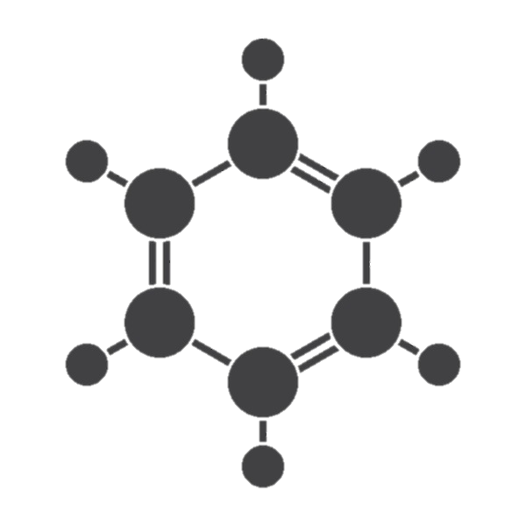

Production of liquid fertilizers
Ministry of Investment,
Industry and Trade
of the Republic of Uzbekistan
Project overview
Financing
50 mln USD
Business model: manufacturing facility with production capacity
200 thsd liters of liquid fertilizers per year
Project scope
Construction of alkyl benzol
Production process for liquid fertilizers
Incentives
Infrastructure development at state cost*
(project cost exceeding 15 mln USD)
Across the Republic, 27 FEZs offer tax breaks on land, property, water and CIT.
(CIT - applied for investments over 3 mln USD)
Grinding and raw
material preparation
Dissolution and mixing
Filtration and purification
Stabilization and Conditioning
Project description
Domestic market
Access to Central Asian markets.
International markets
Exemption from taxes
3 years if investment
is between 0,3 – 3 mln USD
5 years if investment
is between 3 – 5 mln USD
7 years if investment
is between 5 – 10 mln USD
10 years if investment
is over 10 mln
USD
2 production lines
Capability to produce various grades and compositions
~100 employees
Production and trade volume of potash products (2024)
Infrastructure
Gas 12 cents/m³
Electricity 7 cents/kWh
Water 20 cents/m³
Production
Export
Import
Consumption
204 thsd tons
3,8 thsd tons
42 thsd tons
238 thsd tons

Slide 2














Ministry of Investment,
Industry and Trade
of the Republic of Uzbekistan
We invite to invest in production of liquid fertilizers in Uzbekistan
Project overview
Trade agreements
Competition: Uzbekistan offers highly competitive structure of operating costs for manufacturing of finished goods internationally
GSP+ agreement allows to export to EU at reduced or zero tariff for
6 200 products.
CIS Free Trade Agreement creates more integrated and open market with CIS countries.
Top-7 potash fertilizers exporters, USD bln
Import of potash fertilizers
in Uzbekistan, USD mln
Average wage,
USD ths per month
Average gas cost,
US cents per m³
Сanada | 8000 |  | n 3,4 | 35
China | 5000 | 12 | 1,3 | 40
Belarus | 3000 |  | 0,7 | 72
Israel | 2000 |  | 4,1 | 33
Jordan | 1500 |  | 0,6 | 59
Germany | 200 | 0,006 | 3,5 | 40
Russia | 100 |  | 1,4 | 13
 | 0,1 |  | 0,4 | 12
Location
Republic of Karakalpakstan
Republic of Karakalpakstan
Size | 166 600 km²
Population | 2 million
Uzbekistan
Availability of labor in oil & gas industry
Local liquid fertilizers producers can benefit from:
- Growing agricultural sector
- Availability of skilled & unskilled labor
- Stable political and security environment
- Infrastructure development at state cost
- Incentives: Free economic zones offer tax breaks on land, CIT, water
Higher education institutions: 3
Faculties of higher education: 4
Number of graduates: 1 200

Slide 3

On the strategic international logistics corridor
Ministry of Investment,
Industry and Trade
of the Republic of Uzbekistan
Tallin
Sankt-Peterburg
Riga
Latvia
Moscow
Klaipeda
Hamburg
Minsk
Berlin
Brest
Povorina
Essen
Lviv
Kyiv
Paris
Chop
Volgograd
Kandiagash
Aktogay
Astraxan
Beyney
Saksaulskaya
Ulan-Bator
Osh
Bayangal-Mangal
Mersin
Malatya
Saraxa
Mazar-i-Sharif
Kashgar
Xirat
Afghanistan
Peshavar
Iran
Pakistan
Bandar-e-Abbas
Chakhbahar
Karachi

Slide 4

Excellent air connectivity from Tashkent and other Uzbek airports
Ministry of Investment,
Industry and Trade
of the Republic of Uzbekistan
New York
A visa-free policy for tourists from
90 countries
Diverse range of 59 carriers in Uzbekistan’s airport
11 airports across the Country, the main airports are Tashkent, Samarkand and Bukhara

