Slide 1

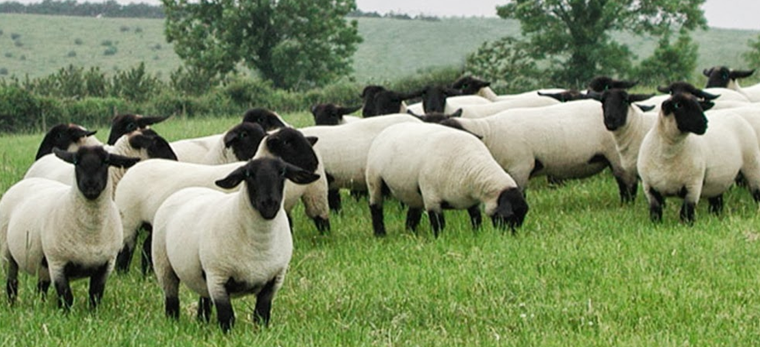

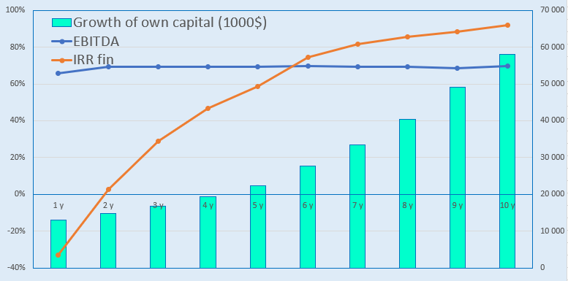
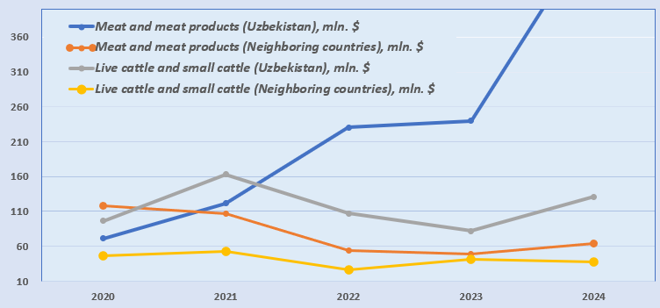
Creation of a sheep breeding complex
Industry
Animal husbandry and food industry
Project cost:
Total cost– US$ 35,6 million
Investment plan
Total investment is US$35.6 million, of which:
Project goal
Creation of a sheep breeding complex
(13 тыс. голов МРС породы Дорпер).
Для производства свежего мяса и мясо- молочной продукции проект будет оснащен современным оборудование фермы и переработки мяса МРС породы Дорпер.
Buildings and structures
32,0%
$11.3 million
Contribution of the initiator- 5,7 % ($2.1 million)
Credits - 66,4% ($23,6 million)
FDI- 27,8% ($9.9 million).
Equipment
23,0%
$8.3 million
others
36,0%
$12.8 million
The final cost and financing structure of the project will be determined after negotiations with investors..
Liquid capital
9,0%
$3.1 million
Project products
The project will annually produce about 600 tons of fresh meat and more than 15 thousand heads of breeding sheep. The Dorper sheep breed of meat direction is distinguished by good productivity, unpretentiousness in care, breeding features and health.
Инвестиционные показатели:
Profitability:
NPV, US$ million – 23,2
IRR, % – 21,9%
EBITDA, % – 70%
DPP, years - 6,2
Raw material supply
To support the project, a special government decision (PP-285 of 08/23/2023) on livestock farming was adopted, according to which 100-150 hectares of land will be allocated for livestock projects for fodder crops, at the expense of reducing the area under cotton and grain crops.
Market
Since December 2024, the meat market in physical terms has grown by 1.1%, while within the segments there were sharper fluctuations for canned meat - growth of 19.9%, for chilled semi-finished products - growth of 7.4%, for fresh beef - growth of 6%. Restrictions on the export of meat products by neighboring countries have led to an increase in the price of meat in Uzbekistan. According to forecasts, by 2032 the size of the cattle and beef market will reach 136.9 billion US dollars. From 2025 to 2032, the market will grow at a rate of 4%.
Initiator
“SOXIBKOR AGRO EKSPORT” LLC
Created in 2020.
Authorized capital – 200 million UZS
The farm is located on an area of 10 hectares in the Tashkent or Surkhandarya region, where land allocation of 100-150 hectares will also be provided to provide a fodder base and herd walking.
Location
Tashkent region
Demand
In January-April 2025, Uzbekistan imported meat products worth $197 million. This is 66% more than the same period last year ($118.5 million).
Tashkent region
Area | 15 300 km²
Population | 3,1 million
Required area ~ 252 ha
6%

Slide 2

International logistics transport corridors
Tallin
Sankt-Peterburg
Riga
Latvia
Moscow
Klaipeda
Hamburg
Minsk
Berlin
Brest
Povorina
Essen
Lviv
Kyiv
Paris
Chop
Volgograd
Kandiagash
Aktogay
Astraxan
Beyney
Saksaulskaya
Ulan-Bator
Osh
Bayangal-Mangal
Mersin
Malatya
Saraxa
Mazar-i-Sharif
Kashgar
Xirat
Afghanistan
Peshavar
Iran
Pakistan
Bandar-e-Abbas
Chakhbahar
Karachi

Slide 3

Flights from Tashkent and other airports in Uzbekistan
New York
Visa-free travel for tourists from 90 countries
There are 59 different airlines operating at the airport of Uzbekistan
There are 11 airports across the country, the main of which are Tashkent, Samarkand and Bukhara.

