Slide 1
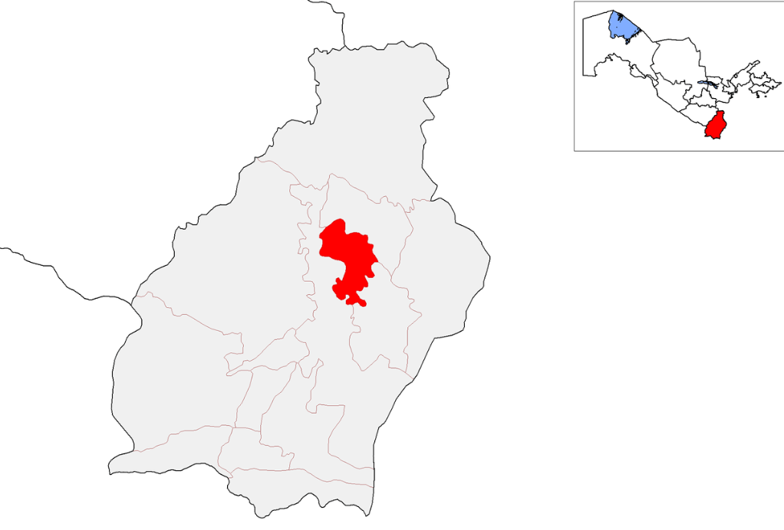
Prospective investment projects of Oltinsoy district of Surkhandarya region
Oltinsoy district
Indicators of proposed projects
A district in Surkhandarya region.
Founded in 1981.
Center - the village of Qarluk
Area - 570 sq. km.
Population - 116.9 thousand.
Climate - Subtropical, characterized by mild winters and hot summers.
Number of projects
10 projects
IRR average
42,7 %
Total cost
$ 69,4 mln.
New jobs
705
Oltinsoy district of Surkhandarya region
New projects
Food industry
Agriculture
Why invest in the region?
Geographical location. The region borders three countries, Tajikistan, Turkmenistan and Afghanistan, which opens up wide opportunities for the provision of logistics services.
Economic potential. The Oltinsoy district has reserves of decorative stone used in construction, as well as the ability to process 80 thousand tons of grapes and 13 thousand tons of grain per year.
Availability of minerals. Modern trade and service centers can be created on the Manguzar-Termez-Denov highway passing through the district.
Prospects in agriculture. There are untapped opportunities for cultivation in the region, for example, the creation of ferula, sheep and cattle breeding complexes, etc.
Tourism development. The rich ancient history of the region, the presence of architectural and historical monuments, architectural buildings, as well as the beautiful nature of the region provide excellent prospects for the development of tourism here.
2 projects
$ 33,5 mln.
2 projects
$ 13,7
mln.
Pharmaceuticals
Other industry
2 projects
$ 2,9 mln.
4 projects
$ 19,3
mln.
Proposals for placement of projects
Land, property, water tax benefits
Project examples
IT sector. In 2019, main and subscriber fiber optic communication cables based on GPON technology were laid in Altynsay district. It is planned to increase the bandwidth of the telecommunications network to the district center from 10 Gbit/s to 100 Gbit/s.
Logistics development. There are 237 km of main roads in the district, of which 25.8 km are in need of repair. In 2022, 25.4 km of internal roads were laid with asphalt and concrete, and 225 km with sand and gravel
"Small industrial zone" will be established on 3.0 hectares of land in the "Bo'ston" MFY area of ​​the district
An innovative products production park "Innovation Park" will be established in the district (4.4 hectares).
Exemption from taxes
3 years
(Investment
0.3 - 3 mln. USD)
5 years
(Investment
3-5 mln. USD)
7 years
(Investment
5-10 mln. USD)
10 years
(Investment
10 mln. USD)

Slide 2
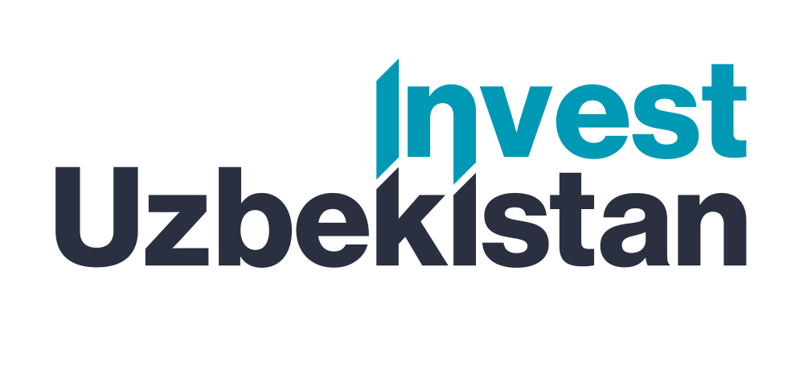
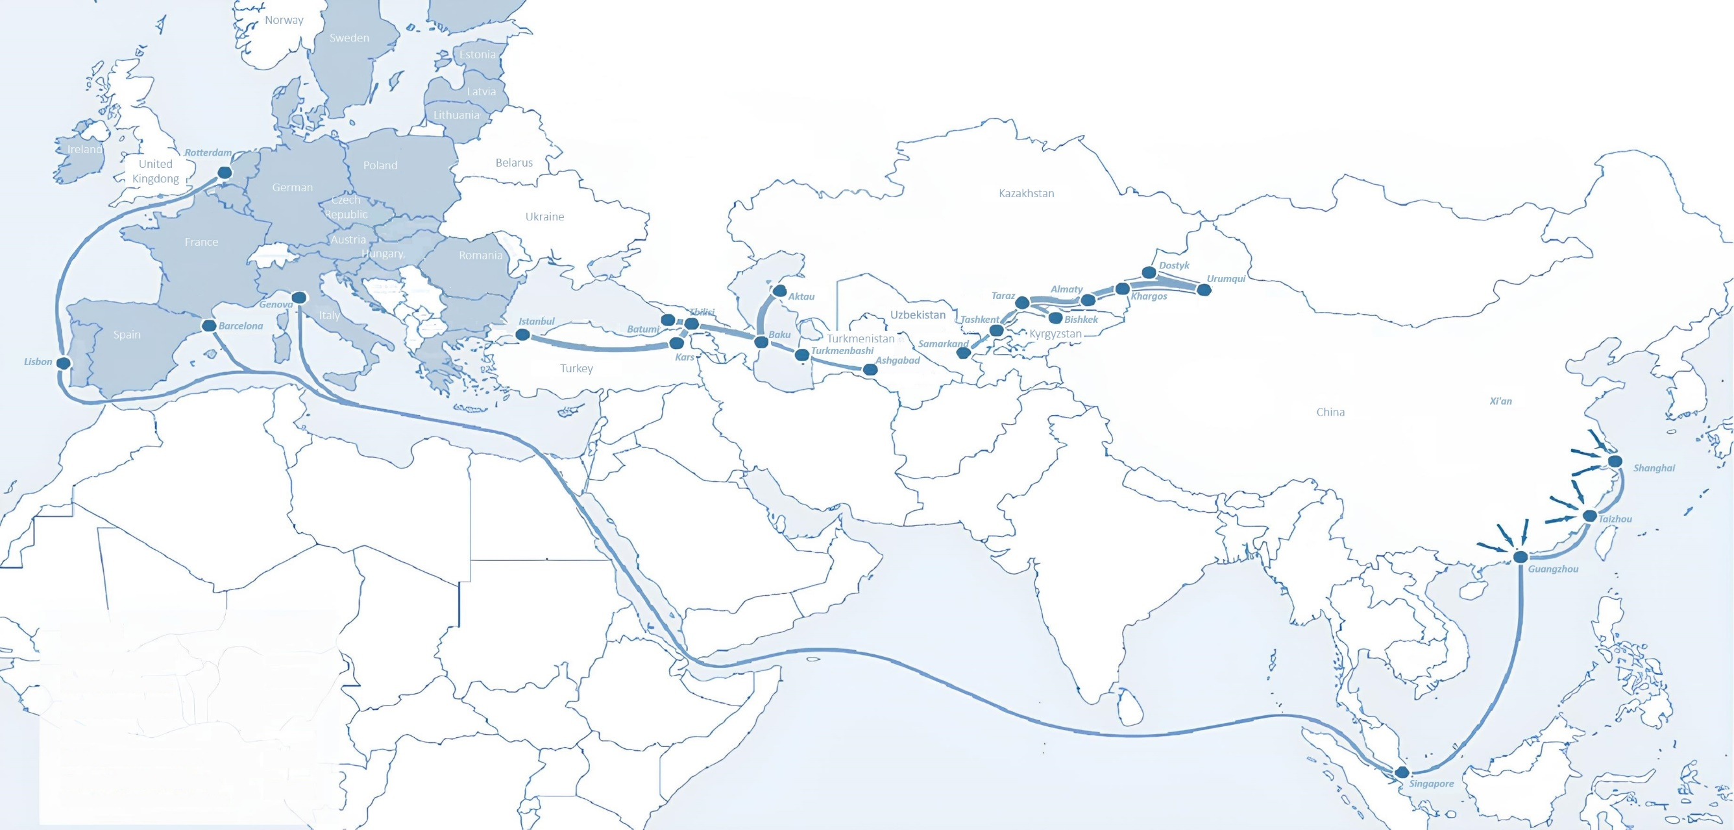
International logistics transport corridors
Tallin
Sankt-Peterburg
Riga
Latvia
Moscow
Klaipeda
Hamburg
Minsk
Berlin
Brest
Povorina
Essen
Lviv
Kyiv
Paris
Chop
Volgograd
Kandiagash
Aktogay
Astraxan
Beyney
Saksaulskaya
Ulan-Bator
Osh
Bayangal-Mangal
Mersin
Malatya
Saraxa
Mazar-i-Sharif
Kashgar
Xirat
Afghanistan
Peshavar
Iran
Pakistan
Bandar-e-Abbas
Chakhbahar
Karachi

Slide 3
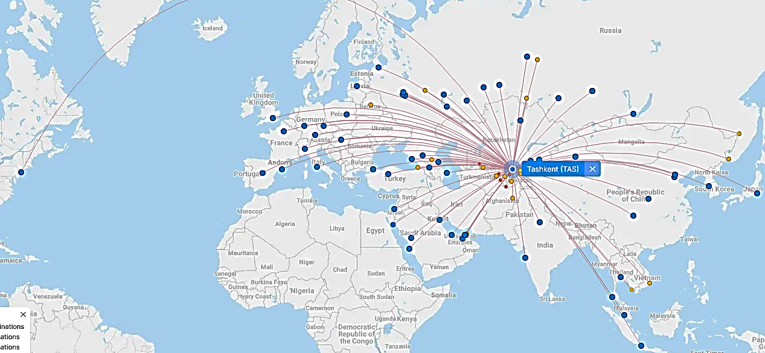
Air connections from Tashkent and other airports of Uzbekistan
New York
A visa-free policy for tourists from 90 countries
Diverse range of 59 carriers in Uzbekistan’s airport
11 airports across the Country, the main airports are Tashkent, Samarkand and Bukhara

Slide 4
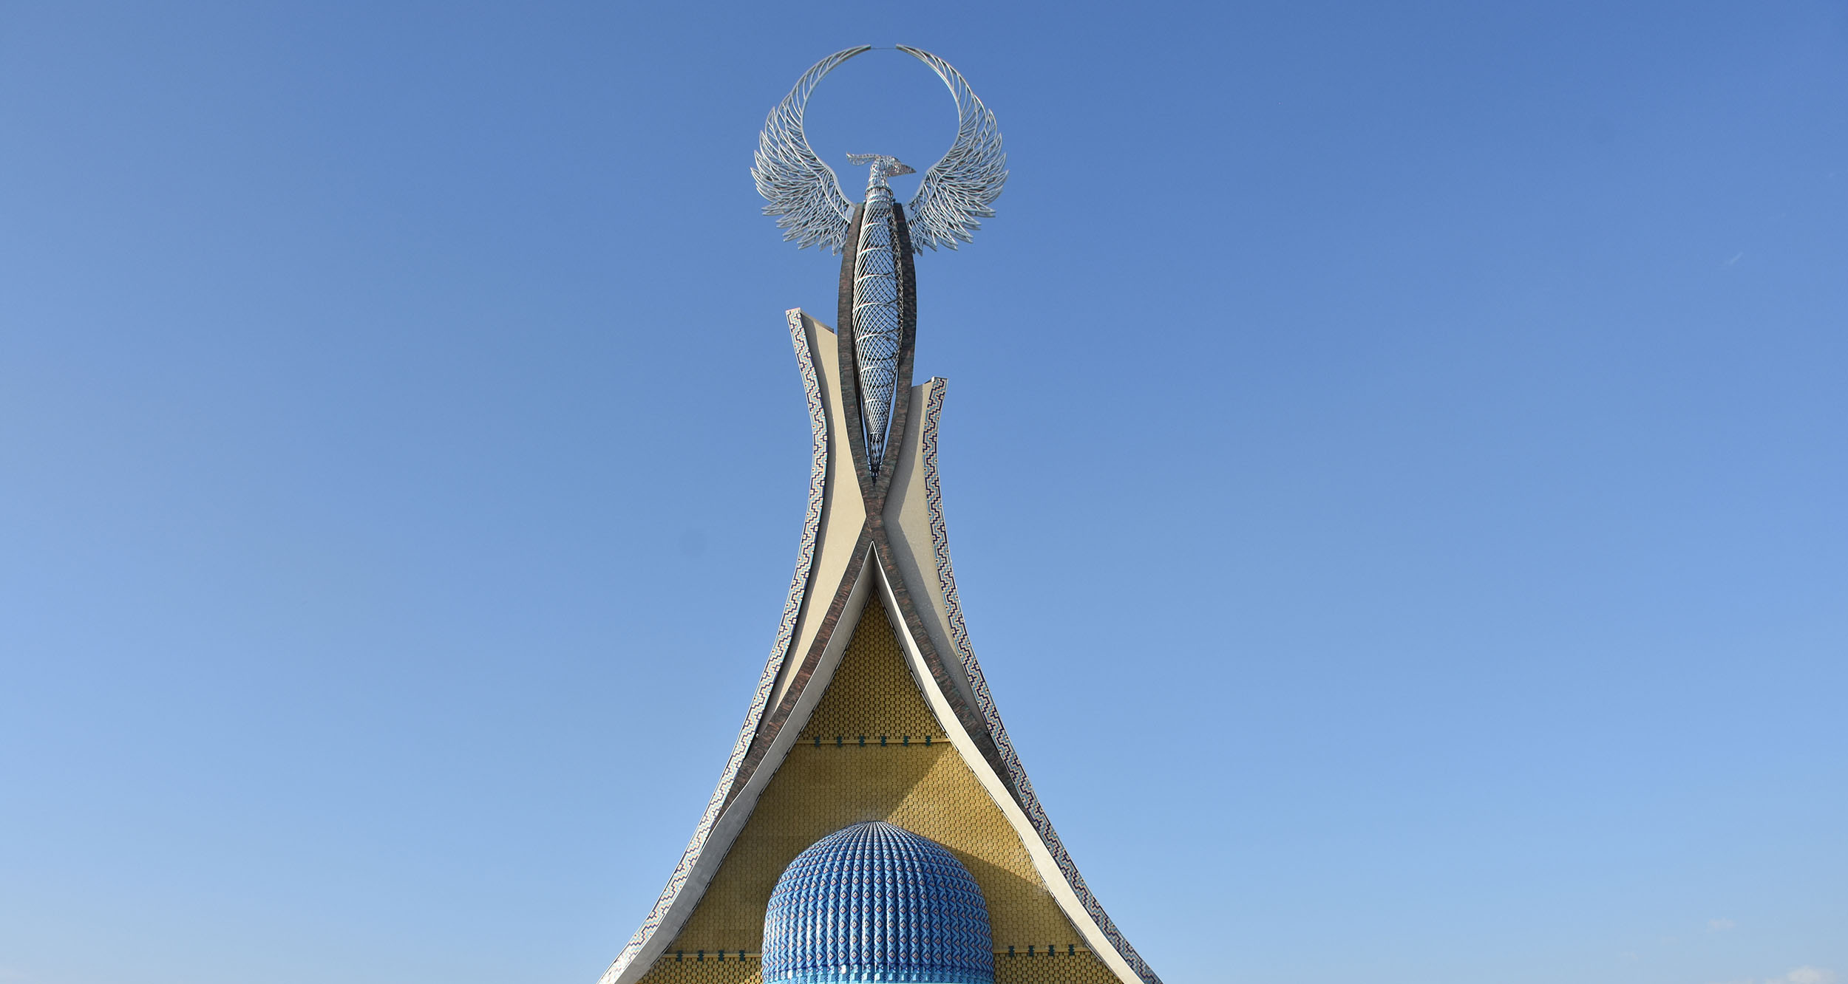
Project proposals

Slide 5
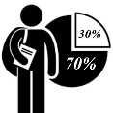
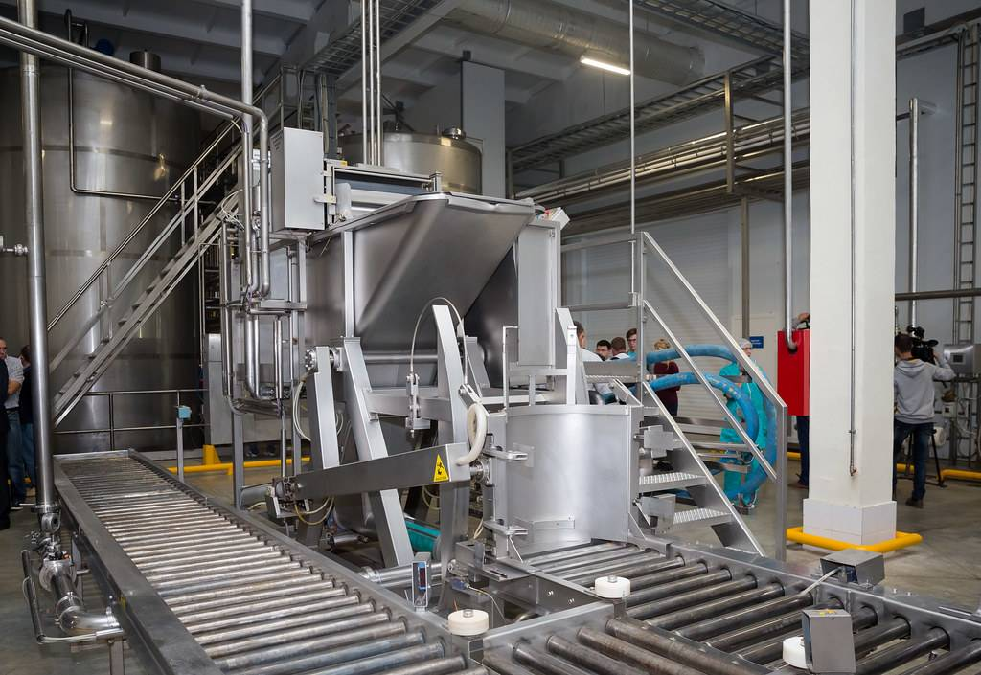
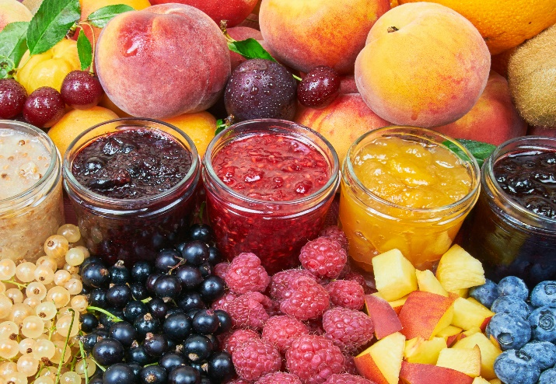
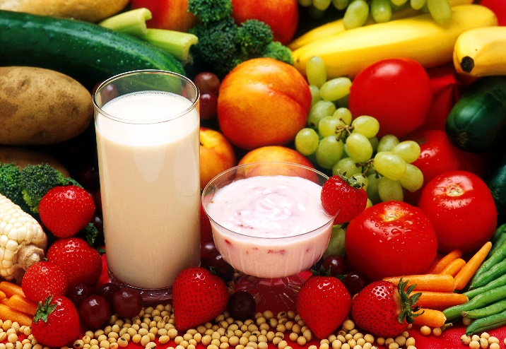
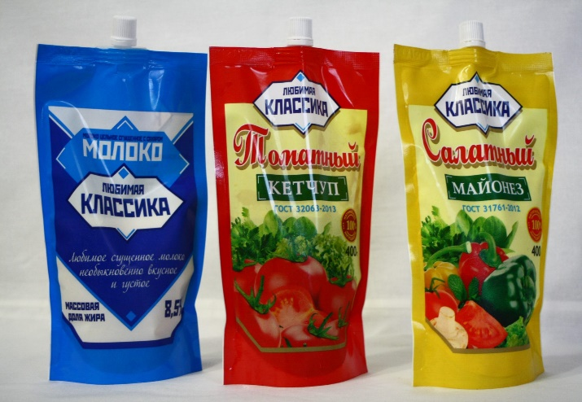
INVESTMENT OFFER
Growing fruits and vegetables in a cluster way, as well as processing fruits and vegetables, production of pectin, apple concentrate, baby food, ketchup and dairy products
Project cost:
$ 32,6 million ($13,1 million own resources,
$ 19,5 million bank loans)
Production capacity (per year):
1.Pectin and apple concentrate-2 625 tonn;
2. Baby food-19,9 million pieces
3. Ketchup- 21,6 million pieces
4. Dairy products-6,7 million pieces
IRR (fin):
45,3%
NPV (fin):
51,2 million dollar
Annual market need:
1.Pectin and apple concentrate-2 625 tonn;
2. Baby food-19,9 million pieces
3. Ketchup- 21,6 million pieces
4. Dairy products-6,7 million pieces
Project payback:
5 years
Jobs:
190 people
Project implementation period:
12 months
Surkhandarya region, Altynsoy district,
“Karsagan” MFY

Slide 6
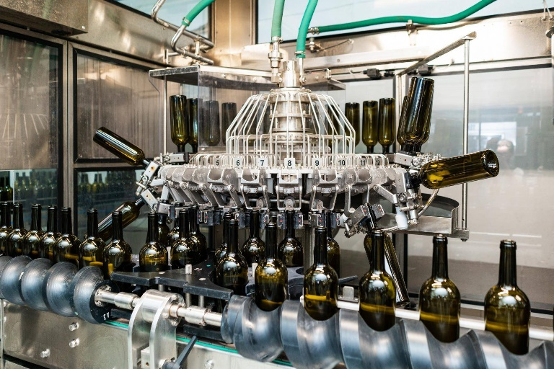
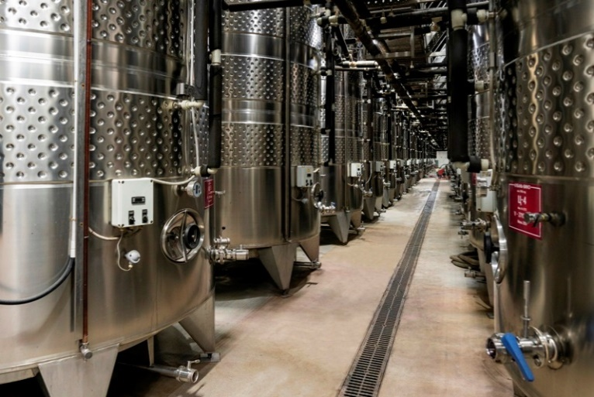
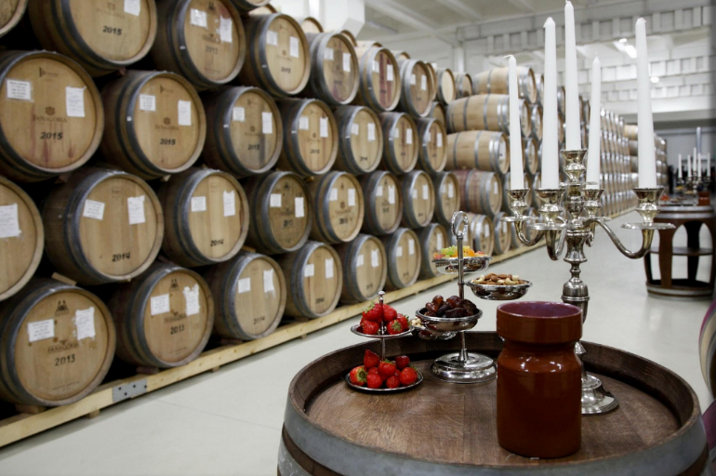
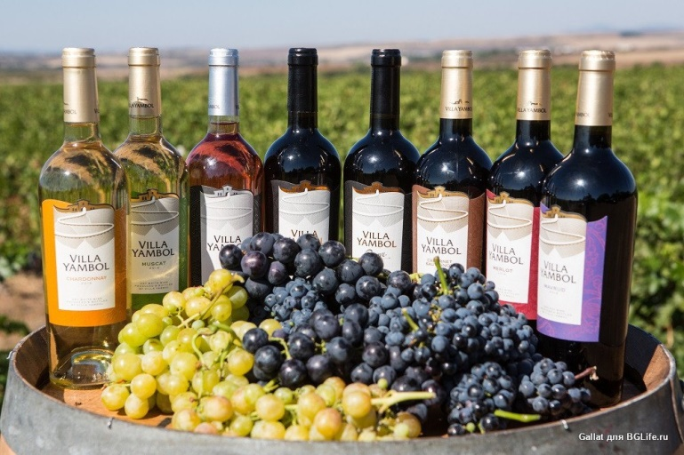
INVESTMENT OFFER
Organization of production wine
Project cost:
$ 0,9 million ($0,3 million own resources,
$ 0,6 million bank loans)
Production capacity (per year):
6,5 thousand tons
IRR (fin):
18,0%
NPV (fin):
0,15 million dollar
Annual market need:
65 thousand tons
Project payback:
5 years
Jobs:
50 people
Project implementation period:
12 months
Surkhandarya region, Altynsoy district,
“Shakarqamish” MFY

Slide 7
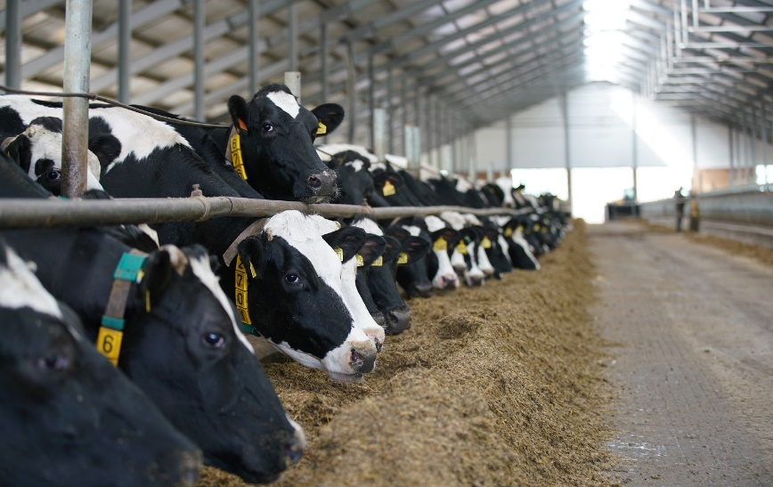
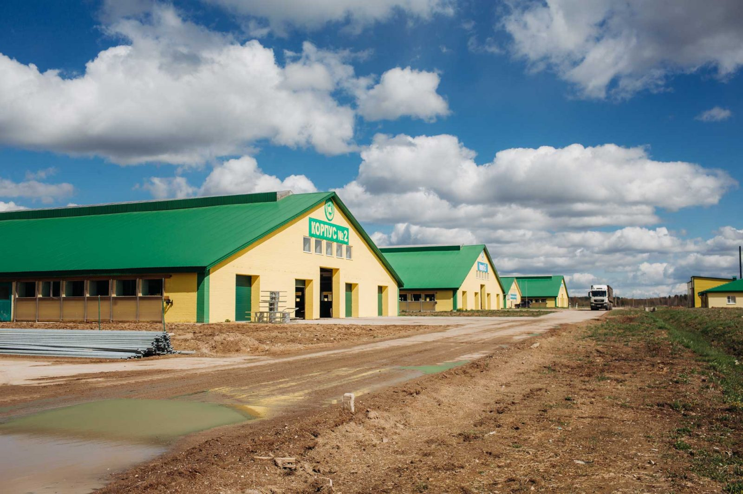
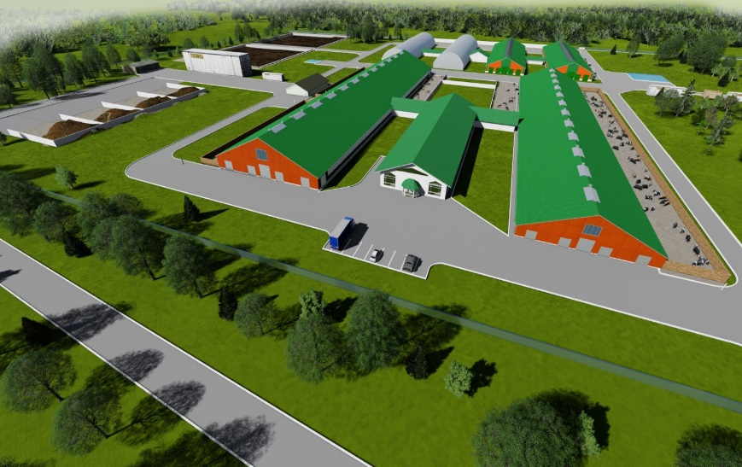
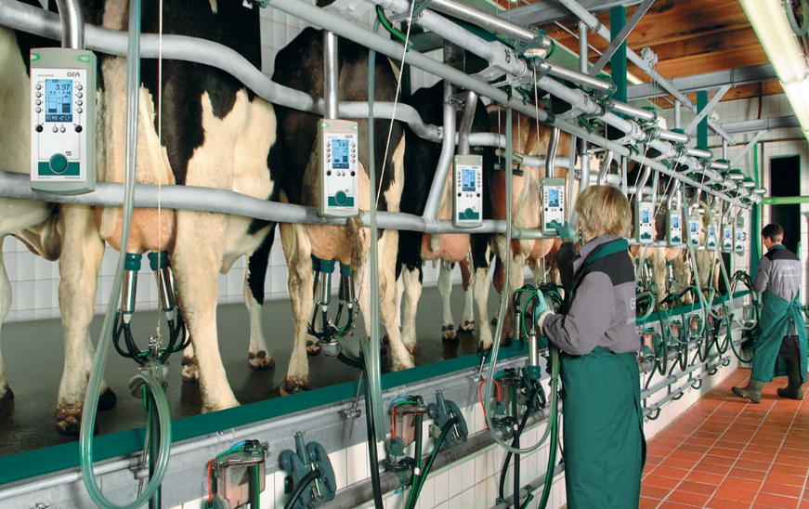
INVESTMENT OFFER
Organization of cattle collection
Project cost:
$ 4,7 million ($1,4 million own resources,
$ 3,3 million bank loans)
Production capacity (per year):
605 thousand tons
IRR (fin):
16,0%
NPV (fin):
1,7 million dollar
Annual market need:
7,0 million tonne
Project payback:
5 years
Jobs:
100 people
Project implementation period:
12 months
Surkhandarya region, Altynsoy district,
“Mingchinor” MFY

Slide 8
Investment project for the organization of a production line for processing, sorting and packaging of legumes and a production line for drying fruits and vegetables
INVESTMENT OFFER
Project cost:
$ 9,0 million ($2,7 million own resources,
$ 6,3 million bank loans)
Production capacity (per year):
9,2 thousand tons
IRR (fin):
46,0%
NPV (fin):
1,4 million dollar
Annual market need:
1 500 thousand tons
Project payback:
5 years
Jobs:
50 people
Project implementation period:
12 months
Surkhandarya region, Altynsoy district,
“Jobi” MFY

Slide 9
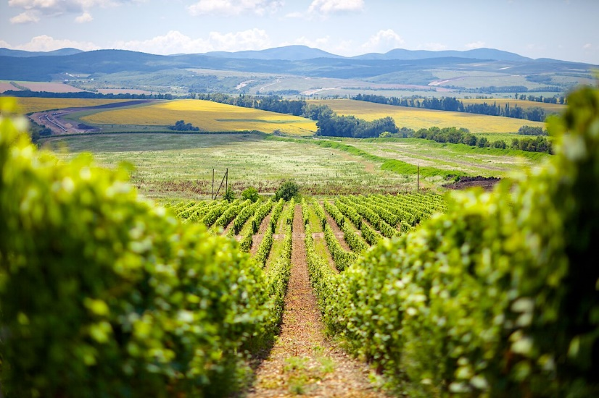
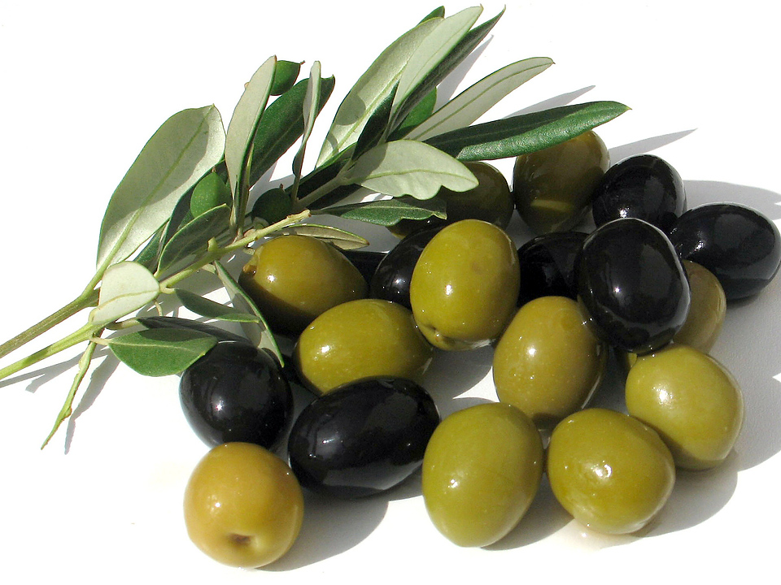
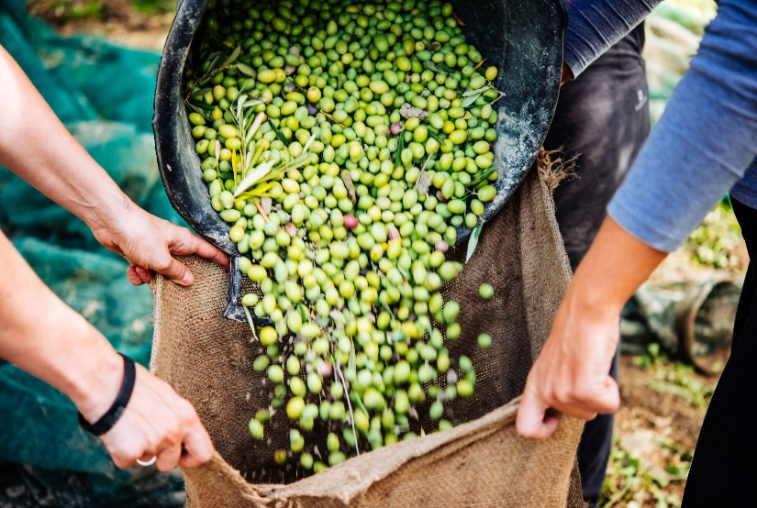
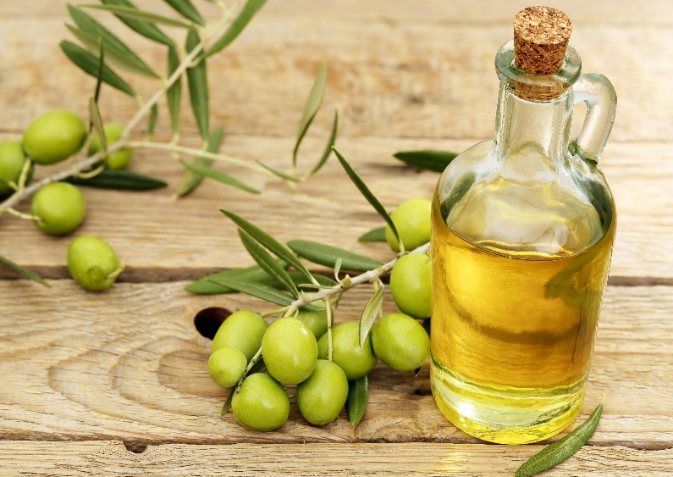
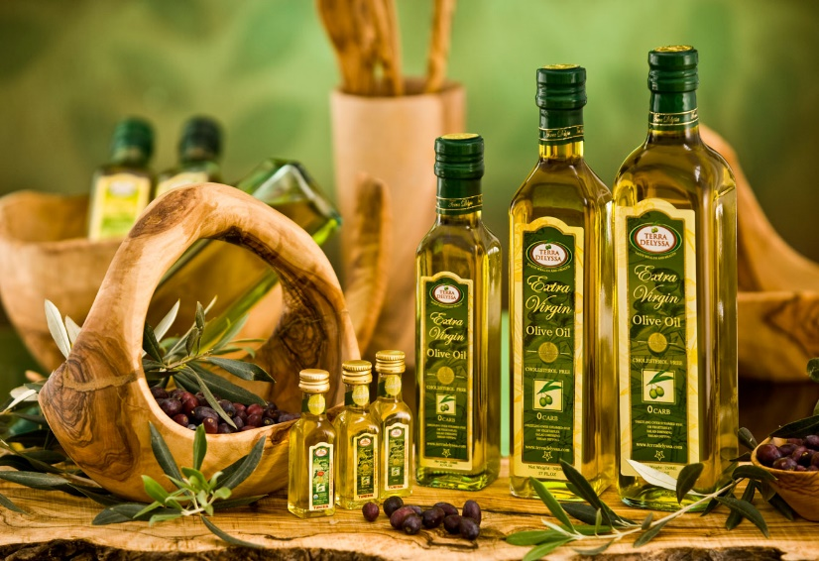
INVESTMENT OFFER
ORGANIZATION OF OLIVE PLANTATIONS AND OLIVE OIL PRODUCTION
Project cost:
$ 2,3 million ($0,7 million own resources,
$ 1,6 million bank loans)
Production capacity (per year):
3 million pieces
IRR (fin):
69,0%
NPV (fin):
1,2 million dollar
Annual market need:
25 million pieces
Project payback:
5 years
Jobs:
50 people
Project implementation period:
12 months
Surkhandarya region, Altynsoy district,
“Karsagan” MFY

Slide 10
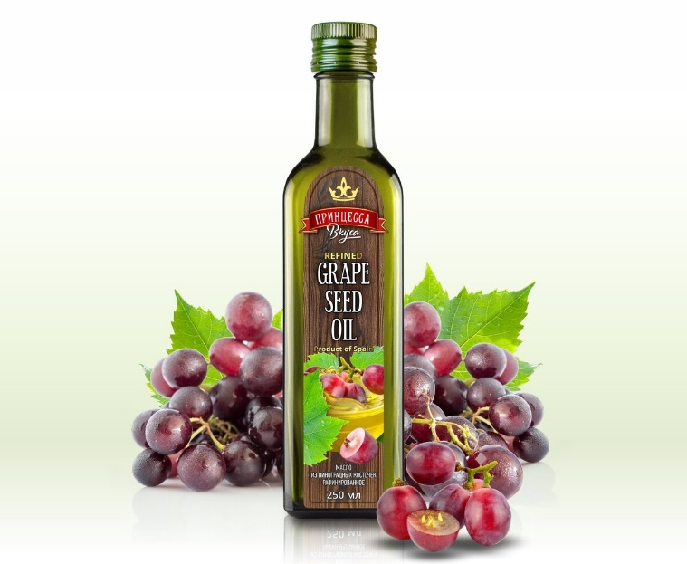
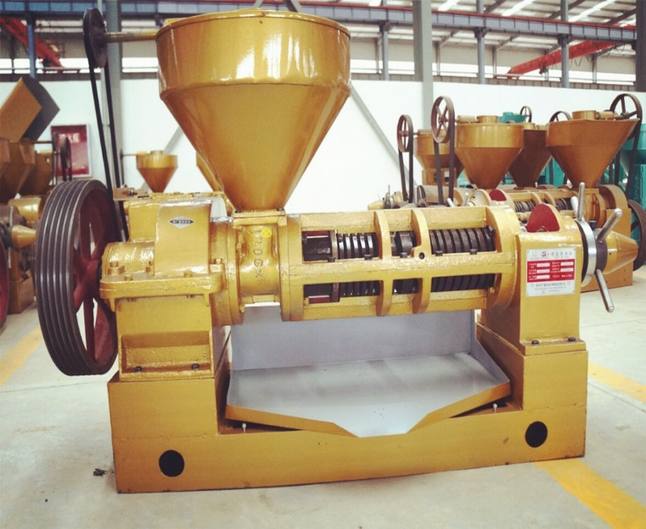
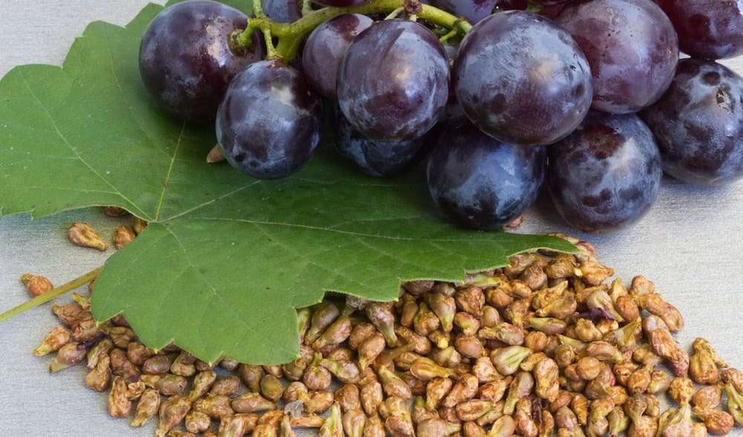
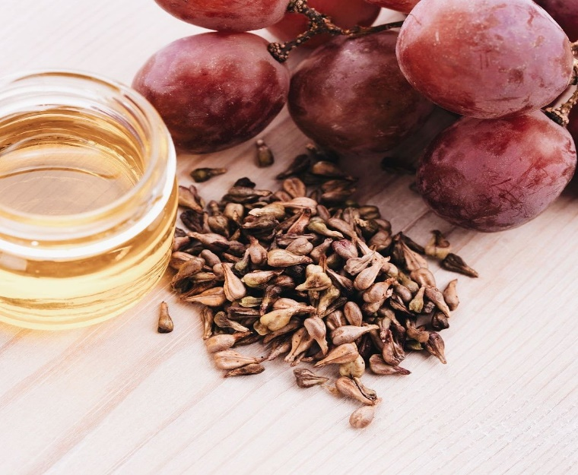
INVESTMENT OFFER
ORGANIZATION OF PRODUCTION OF GRAPE SEED OIL
Project cost:
$ 0,6 million ($0,2 million own resources,
$ 0,4 million bank loans)
Production capacity (per year):
11,8 thousand tons
IRR (fin):
69,0%
NPV (fin):
1,5 million dollar
Annual market need:
250 thousand tons
Project payback:
5 years
Jobs:
25 people
Project implementation period:
12 months
Surkhandarya region, Altynsoy district,
“Vaxshivor” MFY

Slide 11
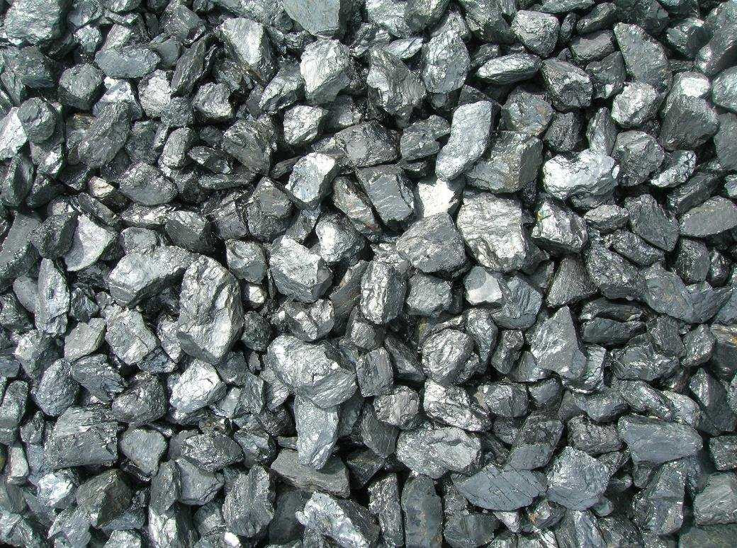
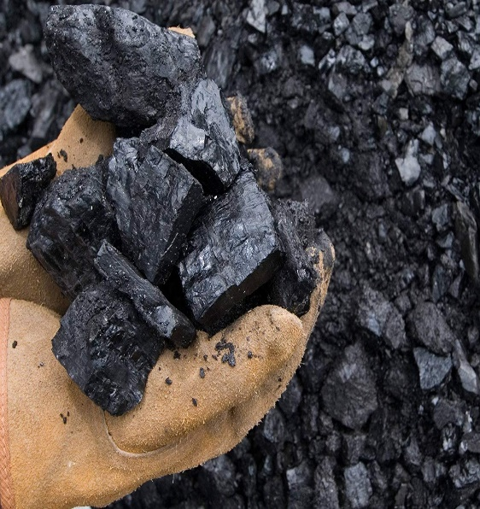
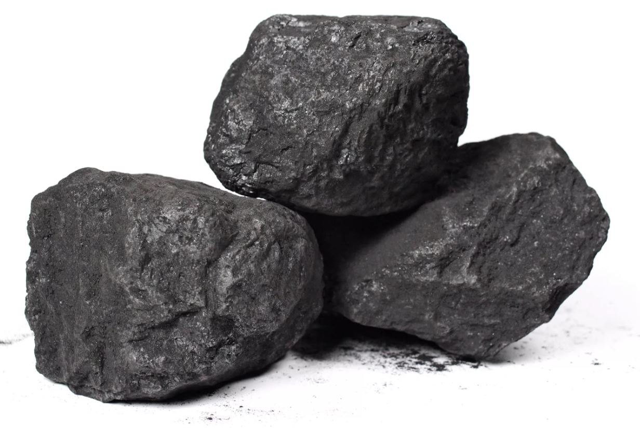
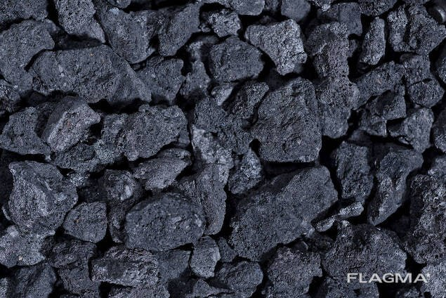
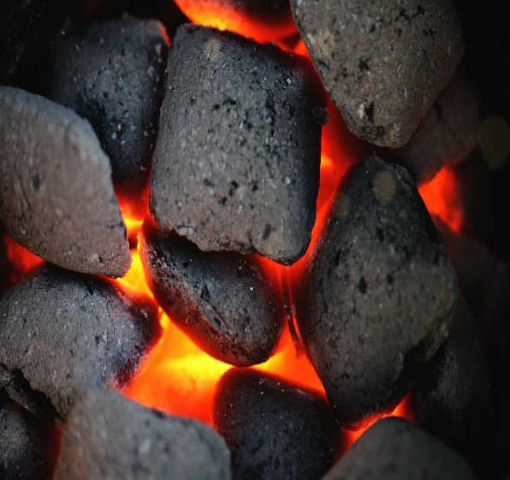
INVESTMENT OFFER
Production of coke from coal
Project cost:
$ 8,2 million ($2,4 million own resources,
$ 5,7 million bank loans)
Production capacity (per year):
10 thousand tons
IRR (fin):
48,0%
NPV (fin):
3,0 million dollar
Annual market need:
20 million tons
Project payback:
5 years
Jobs:
30 people
Project implementation period:
12 months
Surkhandarya region, Altynsoy district,
“Buston” small industrial area

Slide 12
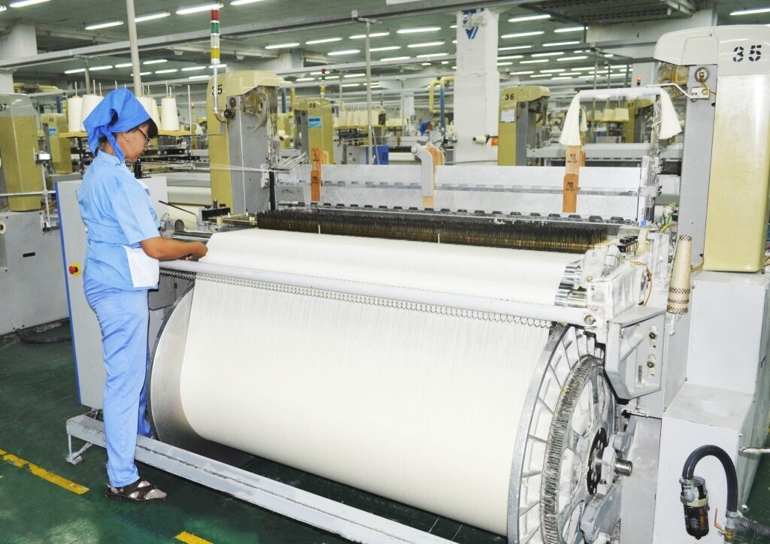
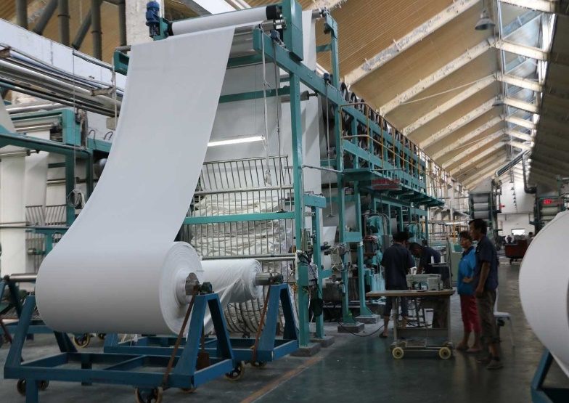
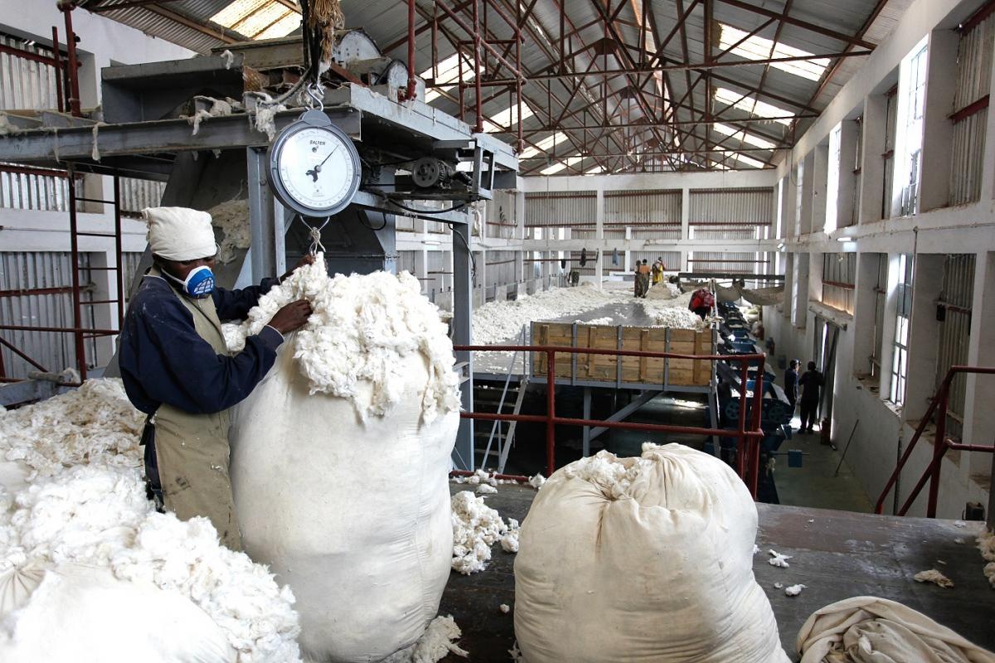
INVESTMENT OFFER
Organization of cotton processing and production of calico
Project cost:
$ 2,3 million ($0,7 million own resources,
$ 1,6 million bank loans)
Production capacity (per year):
70 thousand tonne
IRR (fin):
42,0%
NPV (fin):
2,1 million dollar
Annual market need:
500 thousand tonne
Project payback:
5 years
Jobs:
90 people
Project implementation period:
12 months
Surkhandarya region, Altynsoy district,
“Bibizaynab” community gathering

Slide 13
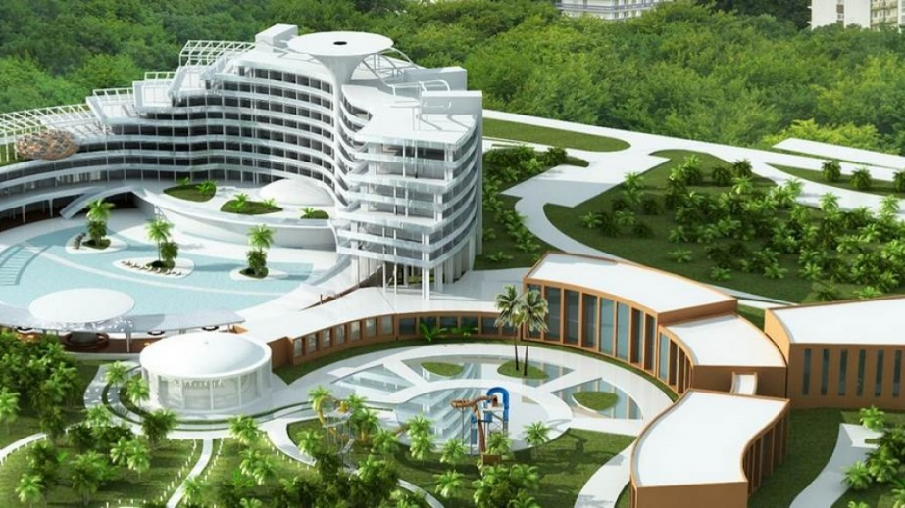
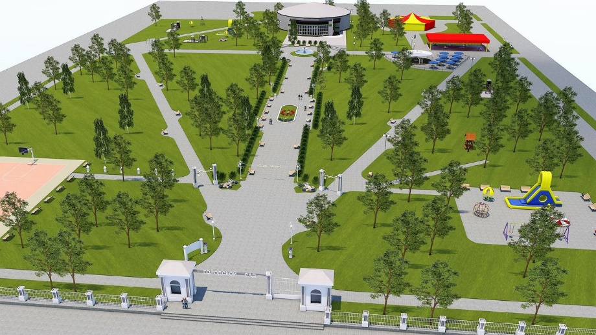
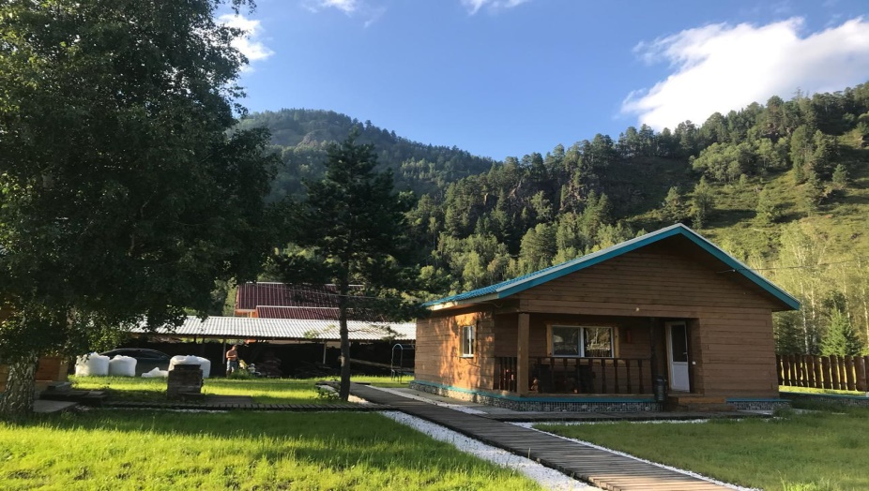
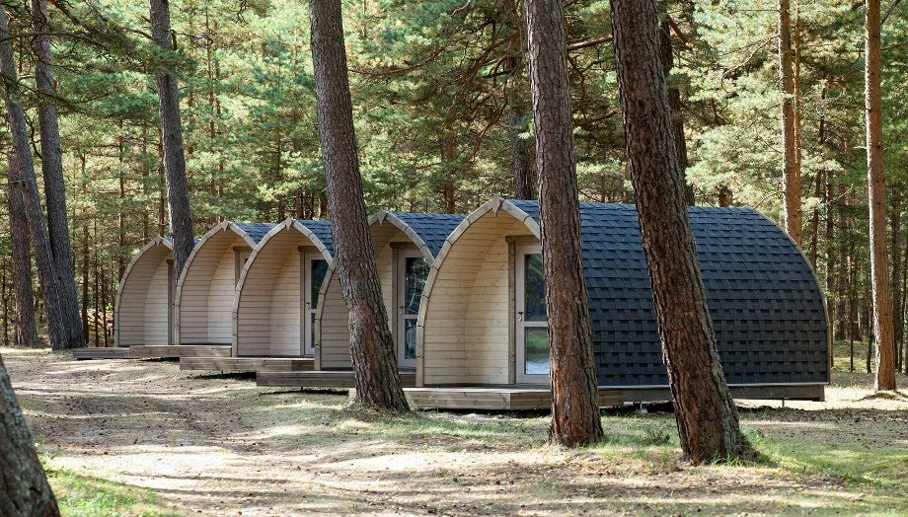
INVESTMENT OFFER
Organization of a wellness center
Project cost:
$ 7,0 million ($2,2 million own resources,
$ 4,8 million bank loans)
Production capacity (per year):
339 500 clients
IRR (fin):
39,0%
NPV (fin):
5,4 million dollar
Annual market need:
339 500 clients
Project payback:
5 years
Jobs:
60 people
Project implementation period:
12 months
Surkhandarya region, Altynsoy district,
“Xujaipok” MFY

Slide 14
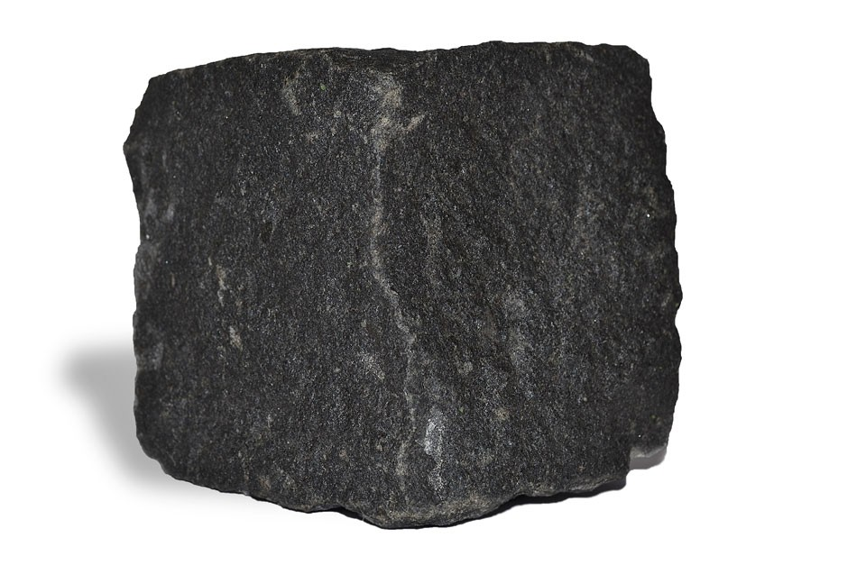
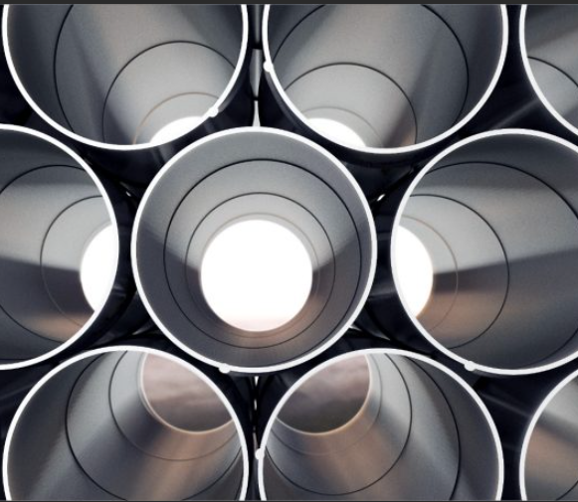
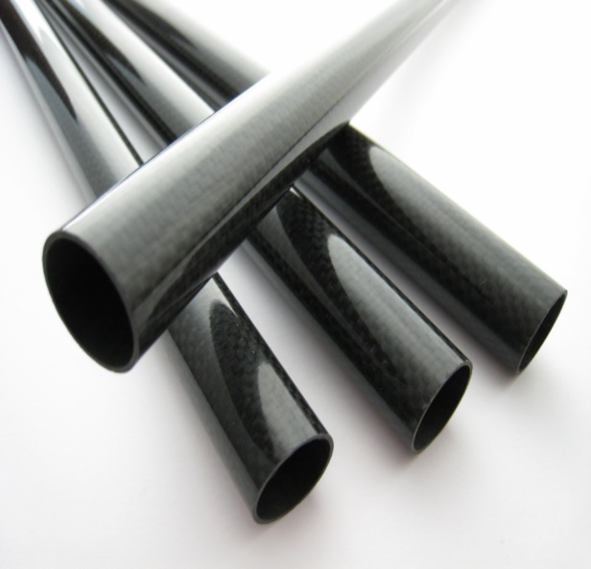
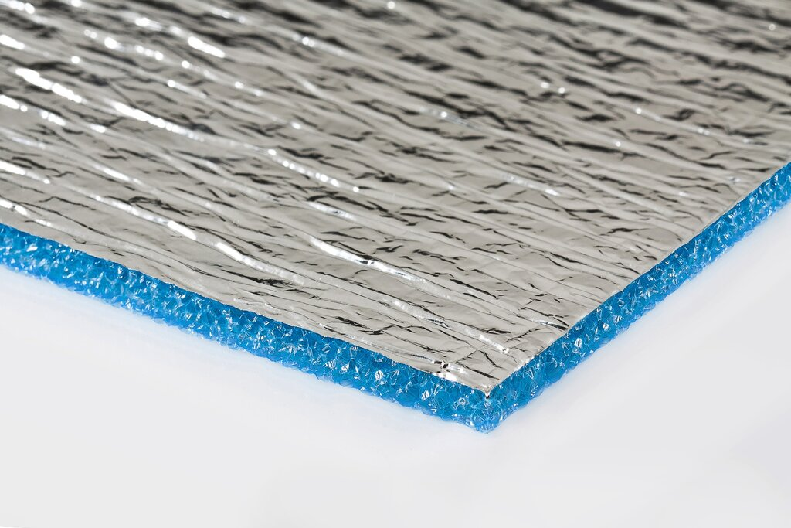
INVESTMENT OFFER
Organization of production of basalt fibers and pipes
Project cost:
$ 1,8 million ($0,5 million own resources,
$ 1,3 million bank loans)
Production capacity (per year):
11 thousand square meter
IRR (fin):
35,0%
NPV (fin):
0,9 million dollar
Annual market need:
800 thousand square meter
Project payback:
5 years
Jobs:
60 people
Project implementation period:
12 months
Surkhandarya region, Altynsoy district,
“Buston” small industrial area

