Slide 1

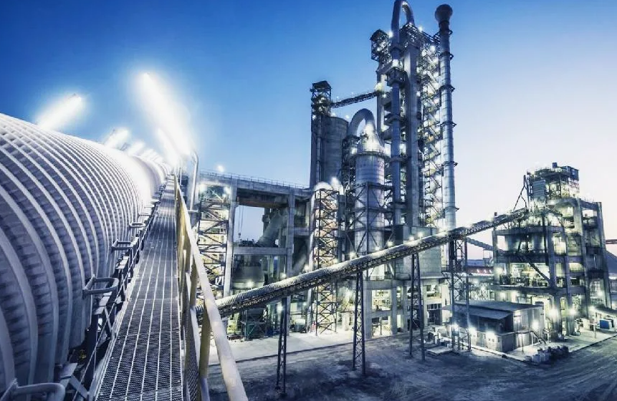

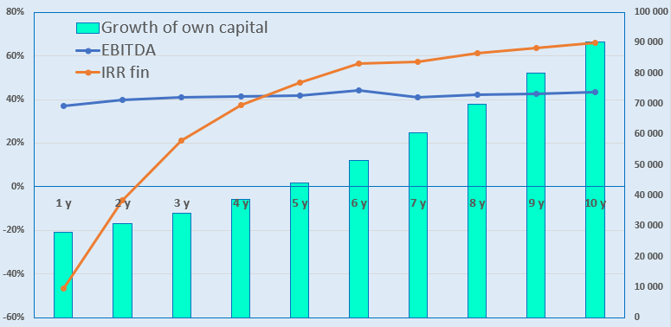
PRODUCTION OF HIGH-GRADE PORTLAND CEMENT
Industry
Construction materials industry
Project value:
Total value– US$ 33,3 million
Investment proposal
The project requires an investment of 33.3 million US dollars, of which:
Project goal
Portland cement production by "Jizzax zamin sement" company.
We invite companies as potential investors.
Buildings and structures
21,3%
$7,1 million
Initiator's contribution - 33,5% ($11,2 million)
Credit - 21,0% ($7,0 million)
Direct investments - 45,5% ($15,1 million).
Tools
60,1%
$20,0 million
Project products
Production of high-grade Portland cement in the amount of 600 thousand tons per year.
Circulating funds
13,9%
$4,6 million
The final cost and financing structure of the project will be determined after the feasibility study and based on the results of negotiations with investors..
And others
4,7%
$1,55 million
Raw material base
Kutermin mine. Located 40 km southeast of the city of Jizzakh.
"Balykli-Tau" mine. It is approximately 180 km from the project.
The reserves of limestone at the Kutarma and Balyklitau fields will last 150 years. The limestone of the Kutarma mine is unique in its composition and can be used to produce white cement.
Profit:
Investment indicators:
NPV, US$ million–36,4
IRR, % – 22,6%
EBITDA, % – 43,0%
PI – 2,4
DPP, year- 4,9
Market
By the end of 2025, the global construction market will grow from $16,152.39 billion in 2024 to $17,045.95 billion, with an average annual growth rate of 5.5%. In the coming years, the market is expected to grow even stronger: by 2029, its volume will reach $21,260.28 billion, with an average annual growth rate of 5.7%.
What is the attractiveness of industry projects?
Growth of the construction sector. In 2025, the demand for construction work will remain high due to state programs to modernize infrastructure, develop private and commercial construction, and increase investments in industrial facilities.
State support for the industry. The government can subsidize large projects, provide preferential loans, and tax breaks.
Investment diversification. Unlike unstable financial markets, real estate and construction remain stable sectors that provide profitability even during crisis periods.
Multiplicative effect. 1 dollar of investment in the construction industry gives an additional 5-7 dollars of investment in the economy as a whole. Improving the quality of construction materials production saves 125 US dollars in maintenance costs for buildings and structures.
Initiator
LLC "Jizzakh zamin cement".
Placement
Jizzakh region
Created on September 29, 2020.
Authorized fund - 100 million soums.
Founder - Sherkulov A.T.
Jizzakh region, Jizzakh city, Chemists quarter, Textile Workers street, 7a
Jizzakh region
Area | 15 300 km²
Population | 2,9 million
Required area ~ 15,0 ha
6%

Slide 2

International transport logistics corridors
Tallin
Sankt-Peterburg
Riga
Latvia
Moscow
Klaipeda
Hamburg
Minsk
Berlin
Brest
Povorina
Essen
Lviv
Kyiv
Paris
Chop
Volgograd
Kandiagash
Aktogay
Astraxan
Beyney
Saksaulskaya
Ulan-Bator
Osh
Bayangal-Mangal
Mersin
Malatya
Saraxa
Mazar-i-Sharif
Kashgar
Xirat
Afghanistan
Peshavar
Iran
Pakistan
Bandar-e-Abbas
Chakhbahar
Karachi

Slide 3

Flights from Tashkent and other airports of Uzbekistan
New York
Visa-free regime for tourists from 90 countries
59 different airlines operate at the Uzbekistan airport.
There are 11 airports across the country, the main ones being Tashkent, Samarkand, and Bukhara.

