Slide 1
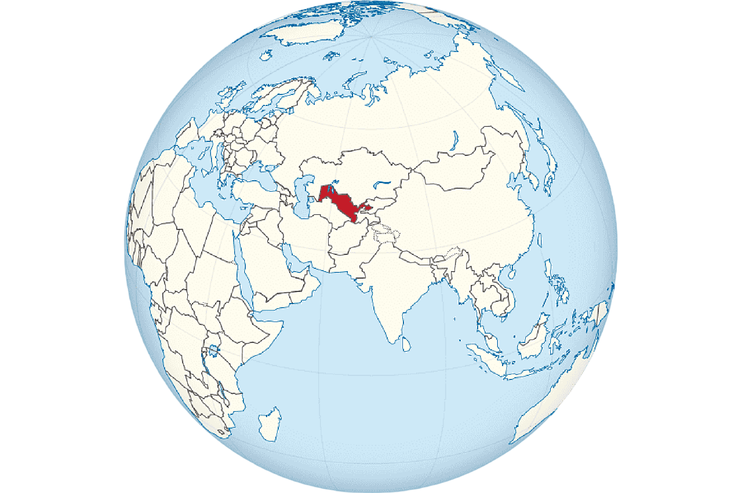
Promising Projects of the Investment Program of the Republic of Uzbekistan for 2025
Republic of Uzbekistan
Republic of Uzbekistan
Located in Central Asia.
Area – 448,924 sq. km.
Population – 38 million people.
GDP – $115 billion.
Capital – Tashkent city.
The climate is continental and arid, with hot summers and moderately cold winters.
The most promising projects are included in the country's Investment Program.
List of Project Proposals by Sector
Energy sector
Chemical Industry
30
Project
Cost $9,8 billion
7
Project
Cost $10,8 million
Geology and Mineral Resources
Transport Infrastructure
7
Project
Cost $1,5 billion
21
Project
Cost $3,7 billion
Why Invest in the Republic of Uzbekistan?
Rich natural resources. Uzbekistan holds leading global positions in the production of gold, uranium, copper, silver, lead, zinc, tungsten, rare metals, and other resources.
Favorable conditions and incentives for investors. To attract foreign capital, Uzbekistan offers tax and customs benefits, has established more than 20 free economic zones, and implements a public-private partnership program.
Strategic geographic location and developed logistics. Uzbekistan is situated at the crossroads of major transport corridors and serves as a bridge between Western and Eastern, Northern and Southern markets, making it an important logistics hub.
Qualified workforce. Over 60% of Uzbekistan’s population consists of young people under the age of 30 – they are well-educated, eager to learn, and fluent in foreign languages.
Stable economy and GDP growth. The country shows consistent growth of 5–7% per year.
Over the past seven years, Uzbekistan has attracted more than $78 billion in foreign direct investment, launched over 1,000 projects, and established production of 1,800 new product types.
Agriculture
Water Management
8
Project
Cost $0,7 billion
20
Project
Cost $2,3 billion
Education
Other
6
Project
Cost $0,71 billion
9
Project
Cost $0,85 billion
Project Location Proposals
More than 20 Free Economic Zones
Regional Targeted Industrial Zones
New Industrial Zones
Tax benefits on land, property, and water
Exemption from taxes
3 years
(Investment
0.3 - 3 mln. USD)
5 years
(Investment
3-5 mln. USD)
7 years
(Investment
5-10 mln. USD)
10 years
(Investment
10 mln. USD)
Key Indicators of Proposed Projects
Number of projects
108 project
Total cost
$ 30,4 billion
New Jobs
213 048
Investment Requirement
$ 25,9 billion

Slide 2
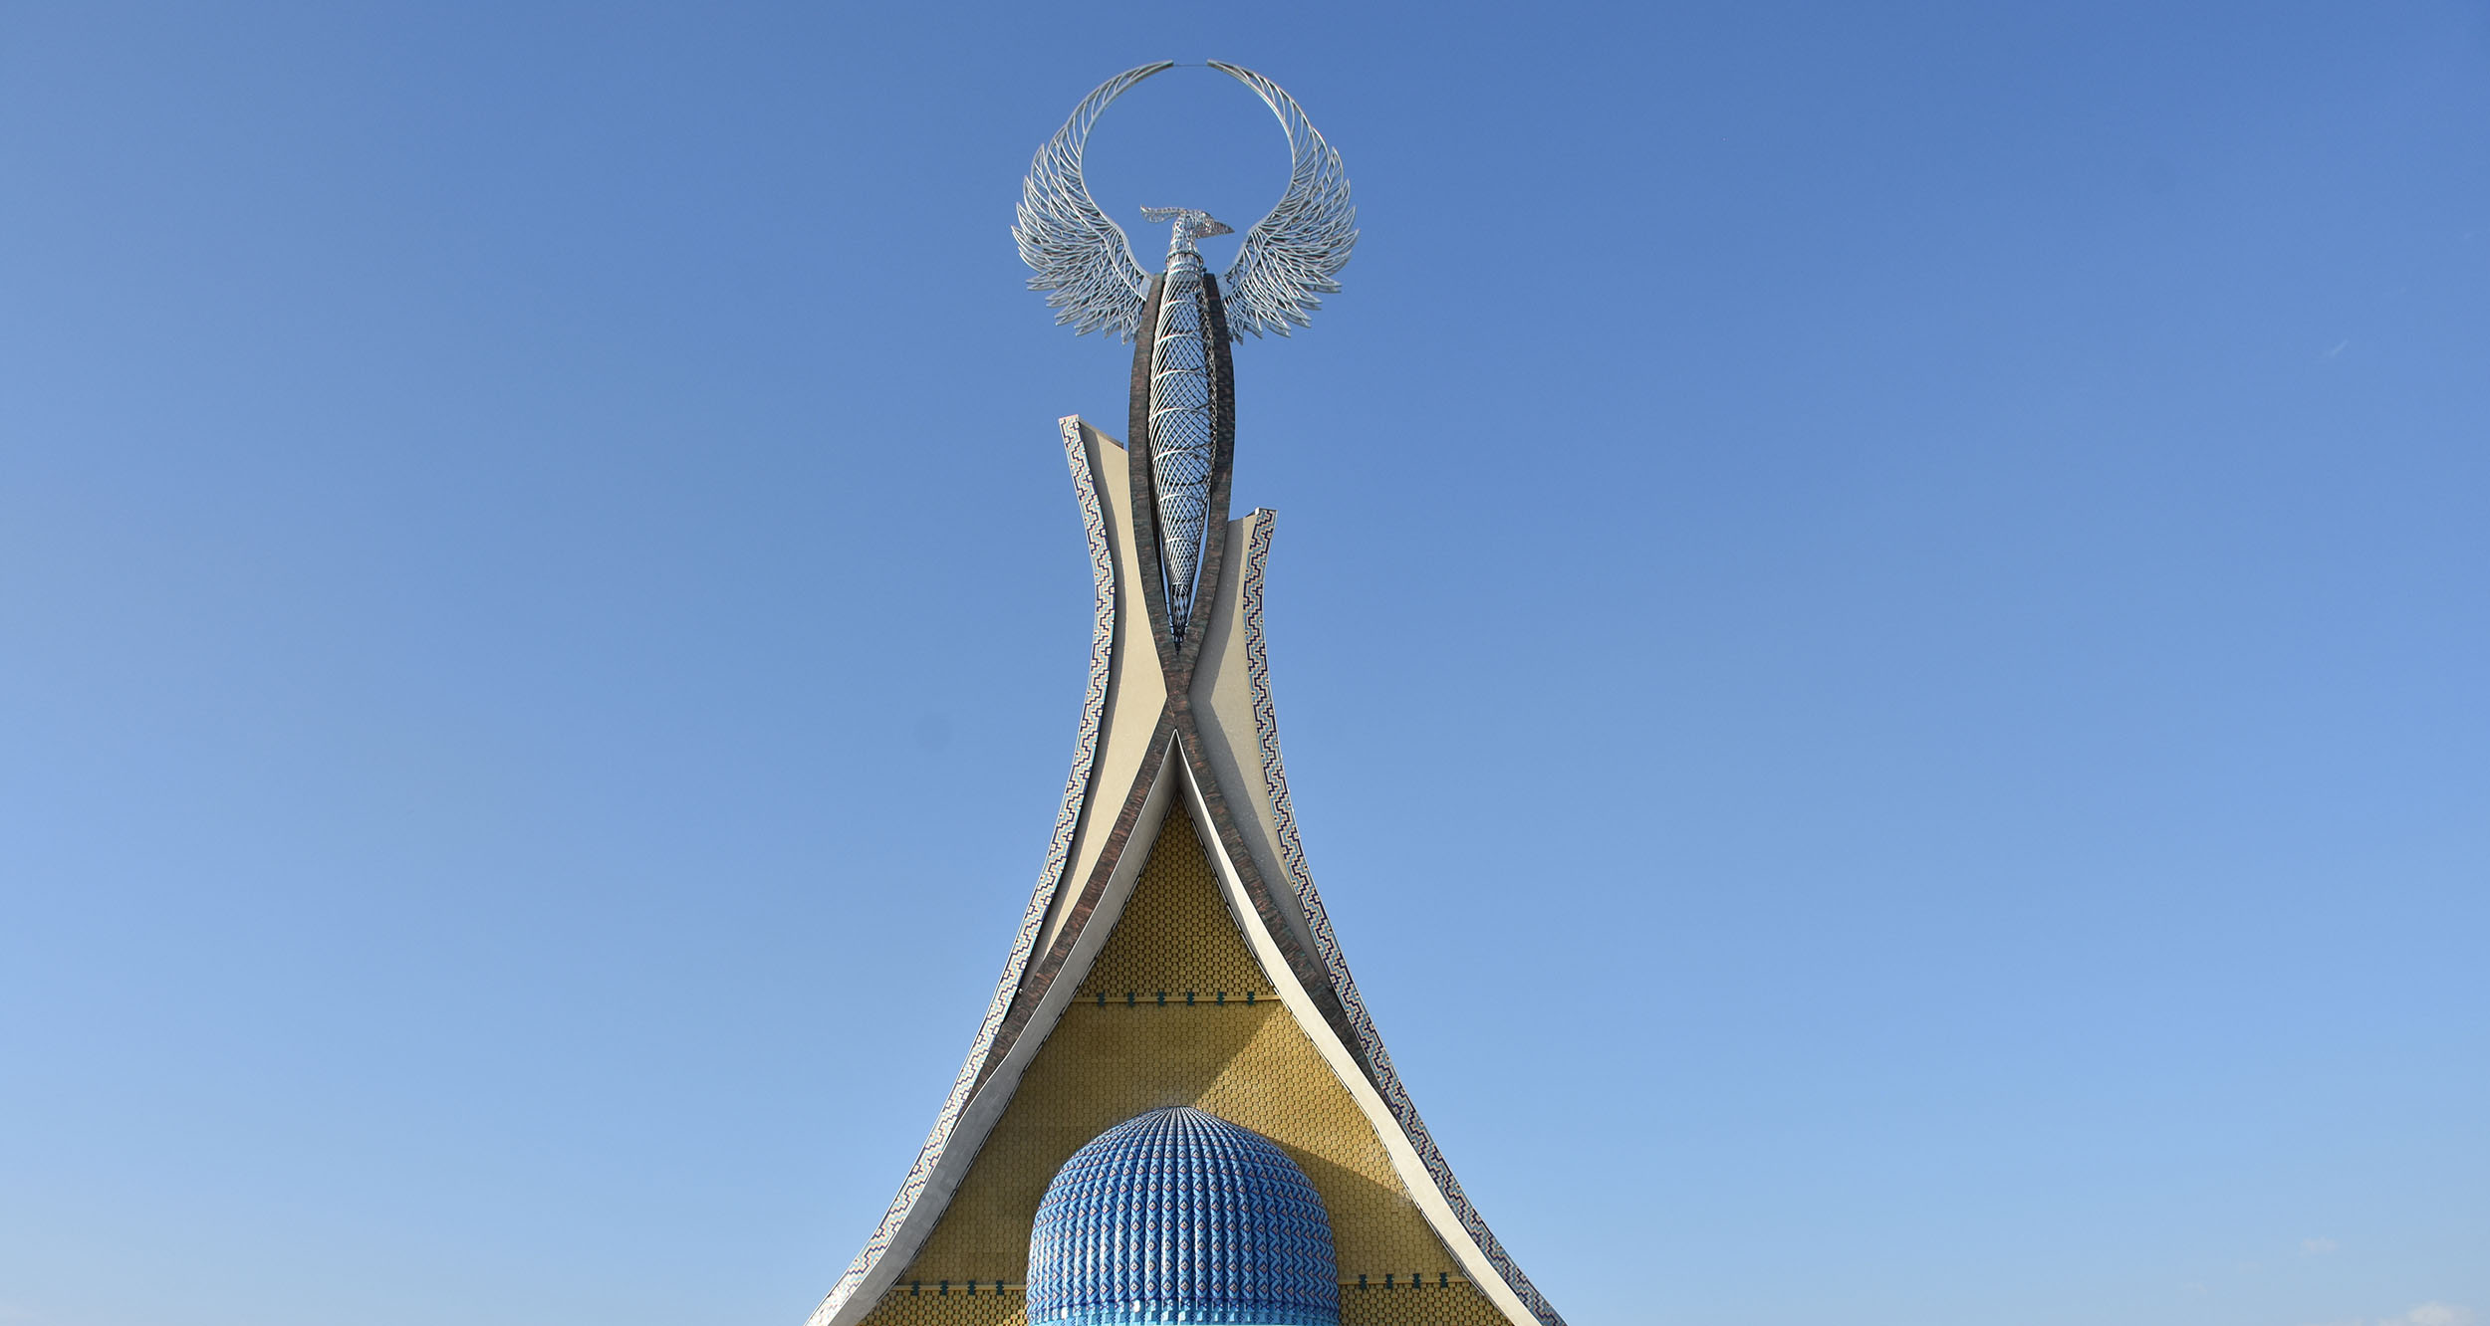
Project proposals

Slide 3
List of project proposals. Energy sector
№ | Project names | Project initiator | Location | Project cost, million $
1 | Modernization of gas supply systems in Samarkand and Bukhara cities | Ministry of Energy | Samarkand Region | 628,0
2 | Investment in 3 wind power plants (1.5 GW) in Karakalpakstan and a 1.0 GW solar power plant in Samarkand region (20–25% stake) | Ministry of Energy | Republic of Karakalpakstan | 800,0
3 | Construction of a hybrid wind and solar photovoltaic power plant in Bukhara region | Ministry of Energy | Bukhara Region | 500,0
4 | Construction of a 500 MW wind power plant and 100 MW energy storage systems in Kungrad district (“Kungrad 2” wind power plant) | Ministry of Energy | Republic of Karakalpakstan | 677,0
5 | Construction of a 300 MW wind power plant in Gijduvan district | Ministry of Energy | Bukhara Region | 403,0
6 | Construction of a 100 MW wind power plant | Ministry of Energy | Tashkent City | 100,0
7 | Installation of agrivoltaic solar panels with up to 100 MW capacity | Ministry of Energy | Across the Republic | 150,0
8 | Modernization of energy facilities, construction and digitalization of photovoltaic plants in cooperation with Siemens Energy | Ministry of Energy | Across the Republic | 1 000,0
9 | Construction of a thermal power plant under PPP on the basis of “Navoiazot” JSC | Ministry of Energy | Navoi Region | 1 200,0
10 | Installation of Siemens Energy gas turbines for cogeneration in Tashkent and across the country | Ministry of Energy | Namangan Region, Tashkent Region, Syrdarya Region | 72,0
Why should one invest in the energy sector?
1. Growing demand for energy. As the population and industrial development increase, energy consumption rises, creating higher demand for energy infrastructure.
2. Development of renewable energy sources. Solar, wind, hydro, and other forms of renewable energy offer sustainable and environmentally friendly opportunities.

Slide 4
List of project proposals. Energy sector
№ | Project names | Project initiator | Location | Project cost, million $
11 | Financing projects of foreign investors-projects for the construction and digitization of photovoltaic plants (Akva Pauer) | Ministry of Energy | Across the Republic | 500,0
12 | Construction and digitization of photovoltaic and wind stations (masdar, Akwa Pauer, etc. | Ministry of Energy | Across the Republic | 1 000,0
13 | Construction of energy storage systems with a capacity of 50 MW in the Khorezm region | Ministry of Energy | Khorezm Region | 35,0
14 | Organization of production of aclylbenzene for synthetic laundry detergent | JSC "Uztraneftgaz" | Kashkadarya Region | 230,0
15 | Modernization of Khojaabad compressor station | JSC "Uztransgaz" | Andijan Region | is being determined
16 | Modernization of the Mubarak compressor station | JSC "Uztransgaz" | Kashkadarya Region | is being determined
17 | Construction of high voltage power transmission networks and substations (EPS+F) | JSC "National Electric Grid of Uzbekistan" | Across the Republic | 100,0
18 | Development and digitalization expansion of trunk electricity networks to increase the level of decorbonization | JSC "National Electric Grid of Uzbekistan" | Across the Republic | 150,0
19 | Conversion of" Sarimoy " substation to 500 kV substation | JSC "National Electric Grid of Uzbekistan" | Khorezm Region | 13,5
20 | Construction of power transmission networks within the framework of the project for the development and integration of the energy market in Central Asia (Remit) | JSC "National Electric Grid of Uzbekistan" | Namangan, Fergana, and Andijan Regions | 40,2
Why should one invest in the energy sector?
3. Government support. Many governments recognize the importance of developing energy infrastructure and encourage investments in power plants.
4. Diversification of the investment portfolio. Investing in power plants allows for risk distribution across various assets. The energy sector is considered relatively stable and less susceptible to financial market volatility.

Slide 5
List of project proposals. Energy sector
№ | Project names | Project initiator | Location | Project cost, million $
21 | Construction of “Namangan” substation in Kosonsoy district, Namangan region | JSC "National Electric Grid of Uzbekistan" | Namangan Region | 66,0
22 | Construction of 500 kV transmission line connecting “Qorako‘l” and “Nurobod” substations | JSC "National Electric Grid of Uzbekistan" | Samarkand, Kashkadarya, and Bukhara Regions | 80,0
23 | Phase II – Digital transformation and improvement of distribution network reliability | JSC "Regional Electric Networks" | Across the Republic | 300,0
24 | Efficiency improvement of 0.4–10 kV distribution networks and transformation of “Regional Electric Networks” JSC | JSC "Regional Electric Networks" | Across the Republic | 300,0
25 | Construction of a 179 MW gas-piston power plant in Kashkadarya region | JSC "Thermal Power Plants" | Kashkadarya Region | 140,0
26 | Sale of the 900 MW combined-cycle plant and infrastructure of “Talimarjan Thermal Power Plant” JSC | JSC "Thermal Power Plants" | Kashkadarya Region | 160,0
27 | Construction of “Qorongitugay” HPP on the Pskem River, Bo‘stonliq district, Tashkent region | JSC "Uzbekhydroenergo" | Tashkent Region | 671,0
28 | Construction of the Kishtut HPP cascade (Kishtut-1, Kishtut-2, Mizot – 70 MW) on the Topalang River, Surkhandarya region | JSC "Uzbekhydroenergo" | Surkhandarya Region | 185,0
29 | Construction of Khodjakent Combined Cycle Power Plant (CCPP) | JSC "Uzbekhydroenergo" | Tashkent Region | 320,0
30 | Construction of “Sokh” HPP in Sokh district, Fergana region (15 MW) | JSC "Uzbekhydroenergo" | Fergana Region | 33,0
Why should one invest in the energy sector?
5. International cooperation. Investments in power plants can become part of international cooperation and partnerships with other countries.
6. Over the past five years, foreign investments in the republic’s energy sector have exceeded $25 billion. Installed capacity has increased by 50% and reached 25 gigawatts.

Slide 6
List of Project Proposals. Chemical Industry
№ | Project names | Project initiator | Location | Project cost, million $
1 | Modernization and expansion of existing ammonia production facilities at" Navoiyazot " JSC | JSC "Uzkimyosanoat" | Navoi Region | 40,0
2 | Expansion of the production of urea at" Navoiyazot " JSC | JSC "Uzkimyosanoat" | Navoi Region | 110,0
3 | Organization of production of Butandiol 1,4 | JSC "Uzkimyosanoat" | Navoi Region | 350,0
4 | Modernization of existing ammonia and urea production capacities of JSC" Maxam-Chirchik" | JSC "Uzkimyosanoat" | Tashkent Region | 50,0
5 | Construction of a gas-chemical complex by Uz olefins industry LLC (MTO-2 ) | JSC "Uzkimyosanoat" | Republic of Karakalpakstan | 10 000,0
6 | Modernization of Solid Waste Management in the Fergana Valley | Ministry of Ecology, Environmental Protection and Climate Change | Fergana Valley | 243,0
7 | Modernization of Solid Waste Management in the Khorezm region | Ministry of Ecology, Environmental Protection and Climate Change | Khorezm Region Administration | 6,8
Why Invest in the Chemical Industry?
1. Constant Demand. Chemical industry products are used in various areas of life, from household goods to industrial production.
2. Availability of Raw Materials. The country has reserves of raw materials for the production of mineral fertilizers, natural gas for energy, and crude oil for a wide range of petrochemical products.
3. Export Potential. Uzbekistan’s chemical sector is focused on exporting to neighboring Central Asian countries.
4. Importance for Other Industries. Many economic sectors such as pharmaceuticals, construction, agriculture, and energy depend on the chemical industry for the supply of raw materials and inputs.

Slide 7
List of Project Proposals. Geology and Mineral Resources
№ | Project names | Project initiator | Location | Project cost, million $
1 | Implementation of Geology and exploration in Uzbekistan on promising areas for precious and rare metals (promising yacht mining area for tungsten and gold in Samarkand region; promising Northern Nurota mining area for precious metals in Samarkand and Navoi regions (Karakuduk, Statehouse, holiday plots) | Ministry of Mining and Geology | All regions of the Republic | 20,0
2 | Production of lists for the automotive industry and household appliances by Gallaaral steel manufacturing LLC | Ministry of Mining and Geology | Municipality of Jizzakh Region | 187,0
3 | Construction of a complex for mining and processing silver-containing mines from the "Nukrakon" and "Cosmonachi" mines | JSC "Navoi Mining and Metallurgical Combine" | Navoi Region | 275,0
4 | Establishing the production of copper cable on the basis of" Dit OKMK " QK | JSC "Almalyk Mining and Metallurgical Combine" | Tashkent Region | 10,0
5 | Youth-development of mine I and central repair of OKMK-Organization of production and repair of mining machines and equipment on the basis of a mechanical plant (mechanical engineering plant) | JSC "Almalyk Mining and Metallurgical Combine" | Tashkent Region | 865,0
6 | Joint development of the" south-I "and" South-II "plots of the" Kauldi " mine | JSC "Almalyk Mining and Metallurgical Combine" | Tashkent Region | 65,0
7 | Development of the" Quyikenjasoy " gold mine | JSC "Almalyk Mining and Metallurgical Combine" | Tashkent Region | 70,0
Why Invest in the Mining and Geological Sector?
1. Constant Demand for Natural Resources. They form the foundation of all production and are essential for building global infrastructure and maintaining existing systems.
2. Availability of Strategically Important Mineral Resources. The country has decided to focus on the extraction of high-revenue mineral resources (such as gold, silver, copper, uranium, hydrocarbons, and zinc), minerals with high added value (like copper, iron, lead, and other technological metals), and metals essential for the transition to green energy (including lithium, copper, tungsten, molybdenum, niobium, magnesium, tantalum, and graphite).
3. Stimulating the Growth of Related Sectors. The mining and metallurgical industry supplies raw materials for electrical engineering, construction materials production, the chemical industry, and jewelry manufacturing.

Slide 8
List of Project Proposals. Transport Infrastructure
№ | Project names | Project initiator | Location | Project cost, million $
1 | Modernization of the Tashkent Metro infrastructure, including upgrading existing metro lines and gradually supplying equipment and spare parts | Ministry of Transport | Tashkent City | 60,0
2 | Procurement of Electric Buses for the City of Samarkand (Stage 2) | Ministry of Transport | Samarkand Region | 162,0
3 | Electric Buses for the City of Namangan | Ministry of Transport | Namangan Region | 67,5
4 | Construction of a new bypass road in Chirchik (connecting highways 4Р5 and 4K755A) with asphalt concrete pavement (based on PPP) | Uzavtoyul | Tashkent Region | 60,0
5 | Reconstruction of 765–806 km section of A380 "Guzar–Bukhara–Nukus–Beyneu" road (construction with concrete pavement) | Uzavtoyul | Republic of Karakalpakstan | 255,0
6 | Reconstruction of 224–302 km section of A376 "Kokand–Jizzakh" road (with cement concrete pavement) | Uzavtoyul | Syrdarya Region | 200,0
7 | Reconstruction of 1095–1120 km section of M39 "Almaty–Bishkek–Tashkent–Termez" road (with concrete pavement) | Uzavtoyul | Samarkand Region | 100,0
8 | Repair of local public roads in the Republic of Karakalpakstan and Khorezm Region | Uzavtoyul | Republic of Karakalpakstan | 200,0
9 | Reconstruction of 0–37 km section of A373 "Gulistan–Buka–Angren–Kokand–Andijan" road | Uzavtoyul | Syrdarya Region | 138,8
10 | Construction and reconstruction of bridges, overpasses, and artificial structures across the Republic | Uzavtoyul | All regions of the Republic | 200,0
Why Invest in Transport Infrastructure?
1. Development of Transport Logistics. This helps enhance the competitiveness of national producers in both domestic and international markets.
2. Improving Regional Accessibility. Investments in transport help reduce isolation, promote regional development, anchor production locally, and create new jobs.

Slide 9
List of Project Proposals. Transport Infrastructure
№ | Project names | Project initiator | Location | Project cost, million $
11 | Reconstruction of 24–182 km section of 4R40 "Dashtobod–Zomin–Bakhmal–Gallaorol" road (with concrete pavement) | Uzavtoyul (UzAutoRoad) | Jizzakh Region | 246,6
12 | 4R160 "Urgench–Gurlan–Mangit–Turkmenistan Border": Reconstruction of 5–75 km section (with concrete pavement) | Uzavtoyul (UzAutoRoad) | Khorezm Region | 220,0
13 | Reconstruction of 207–365 km section of M37 "Samarkand–Bukhara–Turkmenbashi" road (with concrete pavement) | Uzavtoyul (UzAutoRoad) | Bukhara Region | 488,0
14 | Reconstruction of 5–43 km and 68–130 km sections of A380 "Guzar–Bukhara–Nukus–Beyneu" road | Uzavtoyul (UzAutoRoad) | Kashkadarya Region | 600,0
15 | M39 "Almaty–Bishkek–Tashkent–Termez": Reconstruction of 1037–1081 km 4-lane road section (with reinforced concrete pavement) | Uzavtoyul (UzAutoRoad) | Samarkand Region | 130,0
16 | New 4R60 route: "Uchkuduk–Nabitotchka–Akbaytal–Kukayaz–Kazakhstan Border", total length 0–198 km. Road construction underway with concrete pavement. | Uzavtoyul (UzAutoRoad) | Navoi Region | 257,4
17 | Construction of new 8 km section of Bukhara Ring Road connecting 228 km of A380 with 276 km of M37 highway | Uzavtoyul (UzAutoRoad) | Bukhara Region | 30,0
18 | Modernization and management of Andijan International Airport (under PPP) | JSC "Uzbekistan Airports" | Andijan Region | 136,0
19 | Modernization of wastewater treatment facilities in Namangan (under PPP) | Ministry of Construction and Housing and Utilities | Namangan Region | 96,0
20 | Modernization of the Navoi–Uchkuduk railway line | JSC "Uzbekistan Railways" | Navoi District | 41,0
21 | Modernization of the Tashkent–Angren railway section | JSC "Uzbekistan Railways" | Tashkent City | 32,0
Why Invest in Transport Infrastructure?
3. Improving the Environmental Situation. The improvement of transport infrastructure affects the level of environmental pollution and climate change. The introduction of new technologies and materials helps reduce emissions into the atmosphere and liquid environments.
4. . Enhancing the safety of transport operations and improving working conditions for drivers and carriers.

Slide 10
List of Project Proposals. Agriculture
№ | Project names | Project initiator | Location | Project cost, million $
1 | Construction of modern greenhouses on 180 hectares in the Republic of Karakalpakstan, 250 hectares in Khorezm region, and in other regions of the republic | Ministry of Agriculture | Republic of Karakalpakstan and Khorezm region | 139,0
2 | Production and localization of local products under the Canadian sausage brand | Ministry of Agriculture | All regions of the Republic | 5,0
3 | Modernization of the milk processing plant by JV LLC “Lactalis Central Asia” | Ministry of Agriculture | Namangan Regional Administration | 10,0
4 | Organization of wheat processing and gluten production by “Biologic” company | Ministry of Agriculture | Fergana Regional Administration | 200,0
5 | Establishment of an agrologistics center by “Vkus Agro” company | Ministry of Agriculture | Fergana Regional Administration | 50,0
6 | Creation of a cooperation and digital system in agriculture by “TMC Global” company | Ministry of Agriculture | Fergana Regional Administration | 100,0
7 | Production of components for water-saving technologies based on Chinese technology in Tashkent region | Ministry of Agriculture | Tashkent Regional Administration | 125,0
8 | Establishment of poultry farming complexes | "Poultry Industry" Association | Being determined / Under consideration | 40,0
Why invest in agriculture?
1. Export potential. Agricultural products have strong export potential, and investors can benefit from the growing demand in global markets. As the world population increases, the demand for food also rises, requiring the agricultural sector to continuously increase production.
2. Favorable natural conditions. Uzbekistan offers diverse climatic conditions, fertile lands, and clean water resources, creating ideal conditions for organic farming.
3. Education and scientific research. Uzbekistan is actively developing scientific research and education in the field of agricultural sciences, which contributes to the implementation of new technologies and methods in agriculture.

Slide 11
List of Project Proposals. Water Management
№ | Project names | Project initiator | Location | Project cost, million $
1 | Reconstruction of the "Suyenli" canal system in the Republic of Karakalpakstan | Ministry of Water Resources | Republic of Karakalpakstan | 118,0
2 | Restoration of main irrigation canals in the Tashsoka system of Khorezm region (Phase 2) | Ministry of Water Resources | Khorezm region | 130,0
3 | Reconstruction of irrigation infrastructure in Tashkent region | Ministry of Water Resources | Tashkent region | 220,0
4 | Modernization of 204 pumping stations (Phase 2) | Ministry of Water Resources | Nationwide | 400,0
5 | Construction of the “Ayokchisoy” and “Obizarang” mudflow reservoirs | Ministry of Water Resources | Kitab district of Kashkadarya region, Sariosiyo district of Surkhandarya region | 60,0
6 | Modernization of 110 pumping stations | Ministry of Water Resources | Nationwide | 150,0
7 | Reconstruction of the irrigation system in the Zarafshan basin | Ministry of Water Resources | Syrdarya and Jizzakh regions | 100,0
8 | Construction of the "Yakkabog-Karshi" main water pipeline and reconstruction of existing water distribution facilities in Kashkadarya region | JSC "Uzsuvta'minot" | Kashkadarya region | 198,0
9 | Development of climate-resilient water supply systems (Reconstruction of Tuyamuyun water intake in Nukus, Republic of Karakalpakstan; construction of a wastewater treatment plant in Gallaaral district, Jizzakh region; and improvement of drinking and wastewater systems in Fergana and Andijan regions) | JSC "Uzsuvta'minot" | Republic of Karakalpakstan, Jizzakh, Andijan, and Fergana regions | 270,0
Why should one invest in water management?
1. Ensuring food security. Irrigation systems make it possible to increase the volume and improve the quality of agricultural production, which is crucial in the context of population growth and climate change.
2. Minimizing the negative effects of irrigation. Improper water use can lead to soil salinization, erosion of the fertile layer, and pollution of water bodies. Investment in water management helps prevent these problems.

Slide 12
List of Project Proposals. Water Management
№ | Project names | Project initiator | Location | Project cost, million $
10 | Construction and reconstruction of water supply and sewerage systems in Kokand and Margilan cities, Fergana region | JSC "Uzsuvta'minot" | Fergana region | 110,0
11 | Construction and reconstruction of sewerage systems in the centers of Muzrabad, Altinsay, Angor, Qiziriq, and Boysun districts, Surkhandarya region | JSC "Uzsuvta'minot" | Surkhandarya region | 66,0
12 | Construction of a sewage treatment plant and sewerage network in the center of Shahrihon district | JSC "Uzsuvta'minot" | Andijan region | 28,5
13 | Construction and reconstruction of sewerage networks in the center of Asaka district | JSC "Uzsuvta'minot" | Andijan region | 32,0
14 | Construction of drinking and sewerage water systems and a sewage treatment facility in Khojaobod district | JSC "Uzsuvta'minot" | Andijan region | 18,0
15 | Improvement of drinking water supply for the population of Zarafshan city and Uchkuduk district, Navoi region | JSC "Uzsuvta'minot" | Navoi region | 100,0
16 | Modernization and reconstruction of the drinking water system in Angren city | JSC "Uzsuvta'minot" | Tashkent region | 100,0
17 | Improvement of drinking water supply in Sherobod district | JSC "Uzsuvta'minot" | Surkhandarya region | 30,0
18 | Development of sewerage systems in Beruniy and Buston cities, Republic of Karakalpakstan | JSC "Uzsuvta'minot" | Republic of Karakalpakstan | 26,4
19 | Construction and reconstruction of drinking and sewerage water systems in Piskent district, Tashkent region | JSC "Uzsuvta'minot" | Tashkent region | 35,2
20 | Construction of “Talimarjan-Muborak” water treatment facility | JSC "Uzsuvta'minot" | Kashkadarya region | 150,0
Why should one invest in water management?
3. Optimization of water resource use. Modern technologies, such as drip irrigation, reduce water losses caused by evaporation and inefficient distribution.
4. Preservation of ecosystems. Water used for irrigation can alter the hydrological regime of rivers and lakes, affecting both animal and plant life.

Slide 13
List of Project Proposals. Education
№ | Project names | Project initiator | Location | Project cost, million $
1 | Transformation of school education for economic growth objectives | Ministry of Preschool and School Education | All regions of the Republic | 50,0
2 | Improvement and implementation (Phase 2) of early childhood development | Ministry of Preschool and School Education | All regions of the Republic | 70,0
3 | Investment in school education under the “STEM” framework | Ministry of Preschool and School Education | All regions of the Republic | 100,0
4 | Construction and equipping of new buildings in general education schools across the regions of Uzbekistan | Ministry of Preschool and School Education | All regions of the Republic | 400,0
5 | Construction and equipping of new buildings in general education schools across the regions of Uzbekistan | Ministry of Preschool and School Education | All regions of the Republic | 42,8
6 | Construction of modern new general education schools in Samarkand region | Ministry of Preschool and School Education | Samarkand Region | 48,3
Почему стоит инвестировать в образование?
1. Long-term benefits. Education is an investment in the future, and the more people receive quality education, the stronger the economy and society
2. Quick return on investment. Unlike traditional ones, new educational projects move rapidly from the product development stage to initial sales.
3. Personalized learning technologies. Educational technology projects integrated with artificial intelligence, which enable individualized learning for each student, will become increasingly valuable

Slide 14
List of Project Proposals. Other Areas
№ | Project names | Project initiator | Location | Project cost, million $
1 | Development of telecommunication infrastructure of “Uzbektelecom” JSC (next phase) | Ministry of Digital Technologies | All regions of the Republic | 369,0
2 | Development of the postal communication network | Ministry of Digital Technologies | All regions of the Republic | 20,0
3 | Construction and equipment of the Republican Specialized Neurology and Stroke Scientific-Practical Medical Center and its regional branches | Ministry of Health | Tashkent City | 151,0
4 | Construction and equipment of hospitals in Beshkent and Karshi cities | Ministry of Health | Kashkadarya Region | 112,0
5 | Establishment of production of psychotropic and other types of medicines | Agency for the Development of the Pharmaceutical Network | All regions of the Republic | 50,0
6 | Improvement of the external labor migration system and its material-technical base | Ministry of Poverty Reduction and Employment | To be determined | 100,0
7 | Production of electrical energy equipment | "UzElTechSanoat" Association | All regions of the Republic | 10,5
8 | Organization of the production of high-voltage dry-type cast-resin insulated transformers at “Chirchiq Transformer Plant” JSC | "UzElTechSanoat" Association | Tashkent Region | 5,0
9 | Production of home textile products (Phase 1) | "UzTextileIndustry" Association | All regions of the Republic | 30,0
Why should one invest in other industries?
1.Stable long-term growth. The telecommunications sector overall shows stable long-term growth, as telecommunications are becoming increasingly important and resilient to economic cycles.
2. Long-term demand. Demographic changes, such as population growth and aging, are leading to an increased need for medical services and pharmaceuticals.
3. Innovation. The pharmaceutical industry is constantly evolving, with companies regularly developing new drugs, gene therapies, and diagnostic tools.

Slide 15
International logistics transport corridors
Tallin
Sankt-Peterburg
Riga
Latvia
Moscow
Klaipeda
Hamburg
Minsk
Berlin
Brest
Povorina
Essen
Lviv
Kyiv
Paris
Chop
Volgograd
Kandiagash
Aktogay
Astraxan
Beyney
Saksaulskaya
Ulan-Bator
Osh
Bayangal-Mangal
Mersin
Malatya
Saraxa
Mazar-i-Sharif
Kashgar
Xirat
Afghanistan
Peshavar
Iran
Pakistan
Bandar-e-Abbas
Chakhbahar
Karachi

Slide 16
Air connections from Tashkent and other airports of Uzbekistan
New York
A visa-free policy for tourists from 90 countries
Diverse range of 59 carriers in Uzbekistan’s airport
11 airports across the Country, the main airports are Tashkent, Samarkand and Bukhara

Slide 17
Developed infrastructure and natural resources
Competitive cost of doing business
Indicator
Cost
13,7 thousand km
184 thousand km
Electricity, $ per 1 kW*h
0.07
Total length of the gas pipeline
Total length of roads
Drinking water, $ per m³
0.06-0.61
4,7 thousand km
270 thousand km
Sewerage, $ per m³
0.03-0.57
Total length of the railway system
Total length of power transmission lines
Natural gas,
$ per m³
0.12
Salary, $
387.8
Natural resources
Resources | Ranking | Proven reserves
Gold | 10 | 184 mln uns
Natural gas | 19 | 1,87 trillion m
Honey | 10 | 44,7 mln tn
Uranium | 16 | 139,2 thousand tn
Tax
Proportion
3
PIT
12% (flat)
3
CIT
15%
VAT
12%

