Slide 1
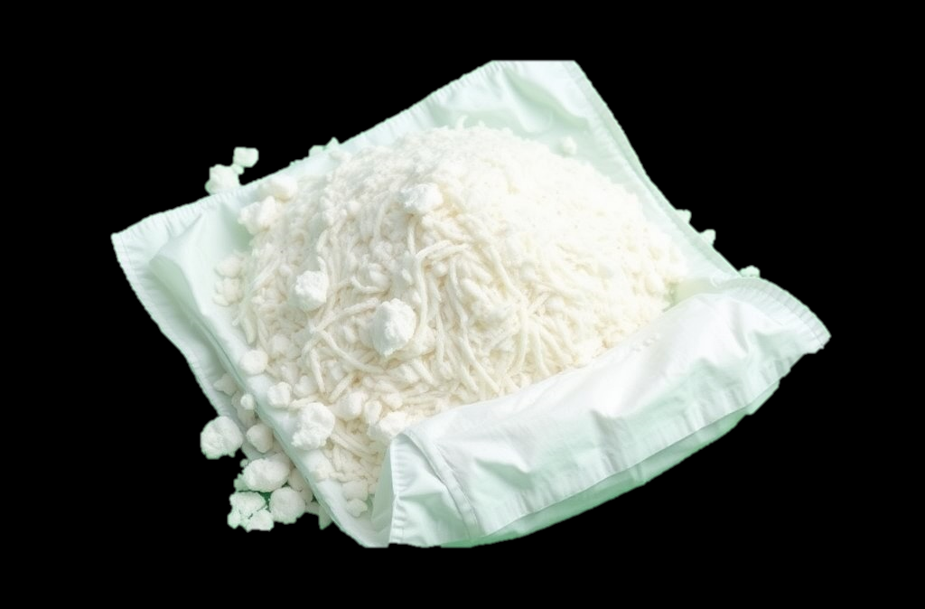
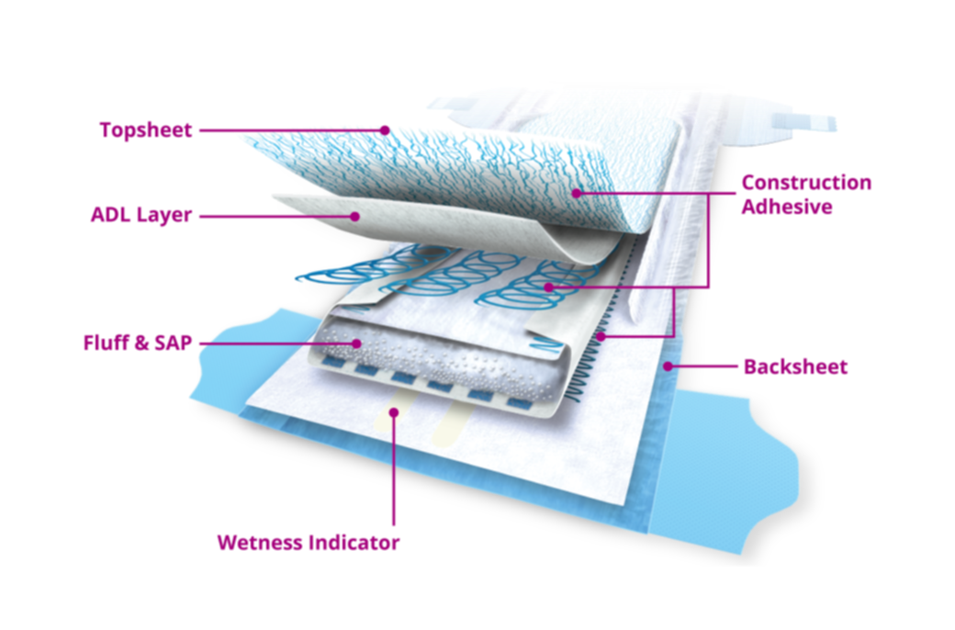
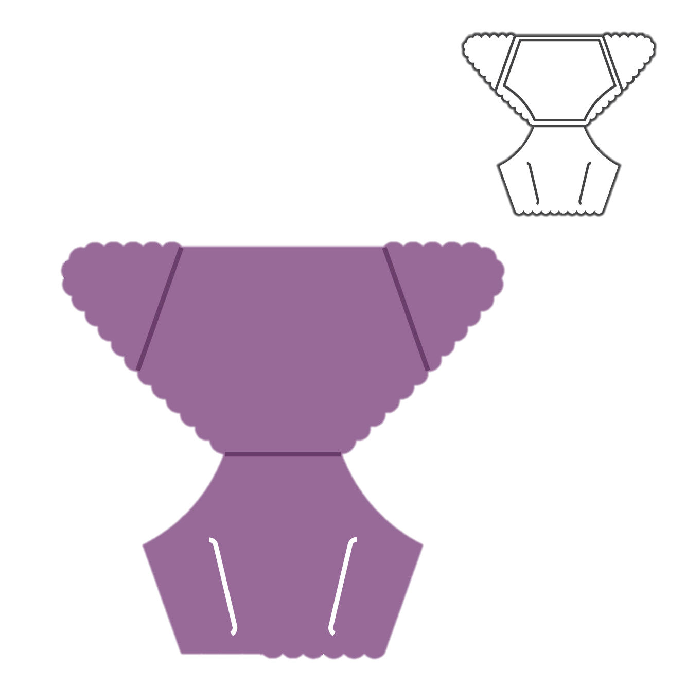
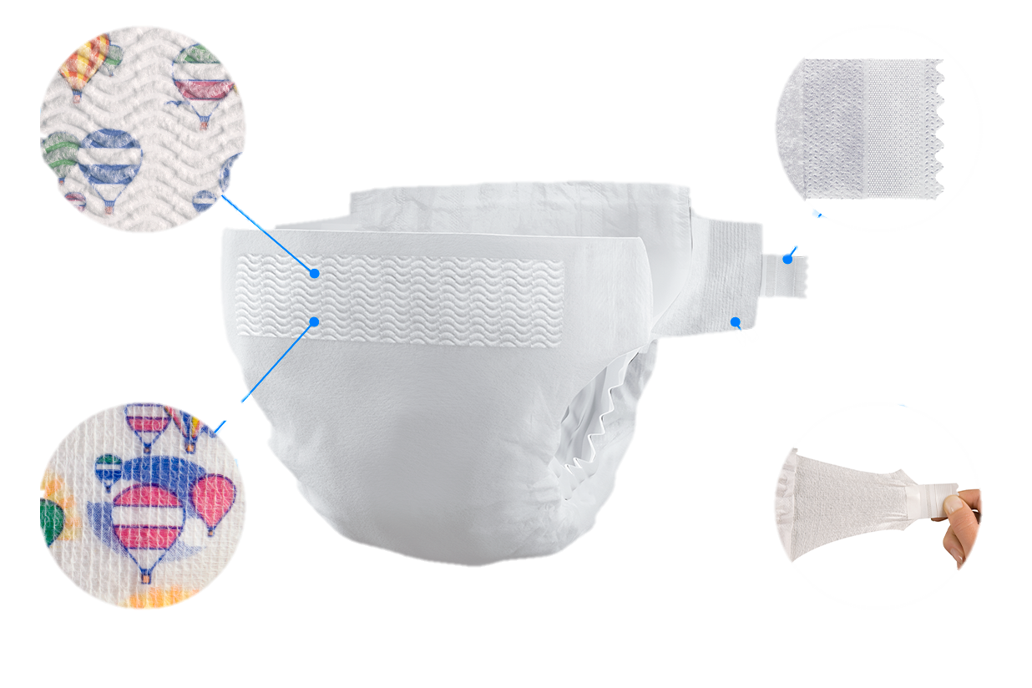
Ministry of Investment,
Industry and Trade of the Republic of Uzbekistan
Production of baby diapers and personal hygiene products
Project overview
Business model: Plant with production capacity of 60 mln packs of baby diapers and 70 mln packs of wet towels (baby wipes) per year
Project scope
Construction of baby diaper pants and personal hygiene products plant
Financing
30 mln USD
Process of producing diapers
Project description
Incentives
Infrastructure development at state cost* (project cost exceeding 15 mln USD)
By placing enterprises in the FEZ, investor receives tax breaks on land, property, water, CIT.
(CIT - applied for investments over 3 mln USD)
Domestic market
Russia, Europe, Middle East
Existing 5 neighbor markets
Material preparation
Mixing and forming absorbent core
~150 employees
Exemption from taxes
3 years if investment is between 0,3 – 3 mln USD
5 years if investment is between 3 – 5 mln USD
7 years if investment is between 5 – 10 mln USD
10 years if investment is over 10 mln USD
Layer assembly
2 packing lines
Cutting and shaping
5 production lines
Infrastructure
Gas 12 cents/m³
Electricity 7 cents/kWh
Water 20 cents/m³
Capability of production various types of hygiene products
Fastener application

Slide 2
We invite to invest in production of baby hygiene products
Ministry of Investment,
Industry and Trade of the Republic of Uzbekistan
Main indicators of baby hygiene products sector
Trade agreements
Number of babies (under 4 years old)
4,37 mln
GSP+ agreement allows to export to EU at reduced or zero tariff for 6 200 products.
CIS Free Trade Agreement creates more integrated and open market with CIS countries.
Location
Products imported in 2024
26,4 thsd tons (92,7 mln USD)
Tashkent region
Tashkent region
Size | 15 300 km²
Population | 4,5 million
Demand for diapers in Uzbekistan in 2023
575 mln packs
Availability of labor in technical industry
Higher education institutions: 5
Faculties of higher education: 14
Number of graduates: 3 000
Local baby products producers can benefit from:
Constant demand for diapers and hygiene products
High level of birth rate
Availability of skilled & unskilled labor
Infrastructure development at state cost*

Slide 3
On the strategic international logistics corridor
Ministry of Investment,
Industry and Trade of the Republic of Uzbekistan
Tallin
Sankt-Peterburg
Riga
Latvia
Moscow
Klaipeda
Hamburg
Minsk
Berlin
Brest
Povorina
Essen
Lviv
Kyiv
Paris
Chop
Volgograd
Kandiagash
Aktogay
Astraxan
Beyney
Saksaulskaya
Ulan-Bator
Osh
Bayangal-Mangal
Mersin
Malatya
Saraxa
Mazar-i-Sharif
Kashgar
Xirat
Afghanistan
Peshavar
Iran
Pakistan
Bandar-e-Abbas
Chakhbahar
Karachi

Slide 4
Excellent air connectivity from Tashkent and other Uzbek airports
Ministry of Investment,
Industry and Trade of the Republic of Uzbekistan
New York
A visa-free policy for tourists from 90 countries
Diverse range of 59 carriers in Uzbekistan’s airport
11 airports across the Country, the main airports are Tashkent, Samarkand and Bukhara

