Slide 1



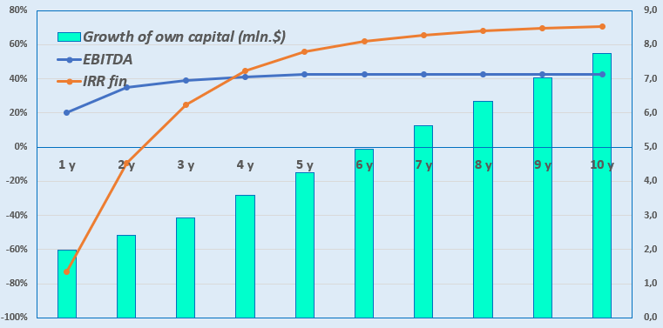
Establishment of a preschool and school educational institution
Industry
Public education
Project cost:
Total cost– 1,73 mln. dollars
Offer to the investor
The volume of investments in the amount of 1.73 million US dollars, of which:
Project goal
The project provides for the creation of preschool (240 places) and school (792 places) a private educational institution that provides education according to international standards with the participation of specialists from Canada.
We invite companies as potential investors.
Buildings and structures
86,5%
$1,5 mln.
Equipment
7,5%
$0,13 mln.
Contribution of the initiator- 29,0% ($0,5 mln.)
Investments and loans- 71,0% ($1,23 mln.).
Working capital
56,8%
$0,07 mln.
The project financing structure will be determined after negotiations with the investor..
Other
3,7%
$0,03 mln.
Project services
School and preschool education. The school educates children from three to nineteen years old and provides certificates and diplomas of secondary education that meet international standards.
Profitability:
Investment indicators:
NPV, US$ mln – 3,5
IRR, % – 28,2%
EBITDA, % – 43,0%
PI – 3,01
DPP, year - 4,0
Why it's worth investing in Education?
Long-term benefits. Education is an investment in the future, and the more people receive high—quality knowledge, the stronger the economy and society.
Fast payback. New educational projects, unlike traditional ones, quickly move from the product creation stage to the first sales.
Personalized learning technologies. Technological educational projects integrated with artificial intelligence will become more and more valuable, making it possible to make learning individual for each student.
Government support for the industry. In the next 3-4 years, Uzbekistan plans to increase pre-school education coverage to at least 80% of children. To do this, they are going to create kindergartens for 240,000 places with the involvement of the private sector. It is also planned to create 112,000 new student places in 58 modern schools in the regions at the expense of budgetary funds, attracting funds from the IFI.
Initiator
“Canada intrenational school in Samarkand” LLC
Placement
Samarkand city
Demand
There is a shortage of 1.2 million student places in schools in Uzbekistan, which is considered the highest among Central Asian countries.
In 2025, they plan to build 162 preschool educational institutions, open 100 private kindergartens and a thousand family kindergartens, but in this case, the coverage of children with preschool education will be up to 78%.
The strengths of the Canadian education system include program diversity, high teaching standards, and flexible learning formats. These strengths are found across preschool, secondary, and tertiary education.
Created on March 15, 2024
The authorized capital is 10.0 million soums
Founder Bahodirov Zarif – 100%
Contact phone number.: +998 91 313 33 99
E-mail: zarifbahodirov3@gmail.com
adress: Samarkand city, MFY Uzbekistan, 114 Uzbekistan Street.
Samarkand city
Area | 123 km²
Population | 573,2 thousand
Required area ~ 1,6 ha
6%

Slide 2

International logistics transport corridors
Tallin
Sankt-Peterburg
Riga
Latvia
Moscow
Klaipeda
Hamburg
Minsk
Berlin
Brest
Povorina
Essen
Lviv
Kyiv
Paris
Chop
Volgograd
Kandiagash
Aktogay
Astraxan
Beyney
Saksaulskaya
Ulan-Bator
Osh
Bayangal-Mangal
Mersin
Malatya
Saraxa
Mazar-i-Sharif
Kashgar
Xirat
Afghanistan
Peshavar
Iran
Pakistan
Bandar-e-Abbas
Chakhbahar
Karachi

Slide 3

Flights from Tashkent and other airports in Uzbekistan
New York
Visa-free travel for tourists from 90 countries
There are 59 different airlines operating at the airport of Uzbekistan
11 airports across the country, the main of which are Tashkent, Samarkand and Bukhara

