Slide 1
Ministry of Investment,
Industry and Trade of the Republic of Uzbekistan
Metal processing and production of metal-based sheets
Project overview
Financing
Up to 215 USD mln
Business model: manufacturing facility with production capacity of 50 thsd tons of metal-based sheets per year
Project scope
Metal processing and production of metal-based sheets
Production process for metal-based sheets
Incentives
Infrastructure development at state cost* (project cost exceeding 15 mln USD)
Across the Republic, 27 FEZs offer tax breaks on land, property, water and CIT.
(CIT - applied for investments over 3 mln USD)
Mining and processing of ore (preparation of raw materials)
Thermal and surface treatment
Hot and cold rolling
Slicing and packing
Project description
Domestic market
Existing neighbor markets
International markets
Exemption from taxes
3 years if investment is between 0,3 – 3 mln USD
5 years if investment is between 3 – 5 mln USD
7 years if investment is between 5 – 10 mln USD
10 years if investment is over 10 mln USD
7 production lines
Capability to produce various sizes and design
~280 employees
Production and trade volume of metal-based sheets (2023)
Infrastructure
Gas 12 cents/m³
Electricity 7 cents/kWh
Water 20 cents/m³
Production
Export
Import
Consumption
Consumption (CA)
350 thsd tons
100 USD mln
400 USD mln
550 USD mln
1,5 USD bln

Slide 2
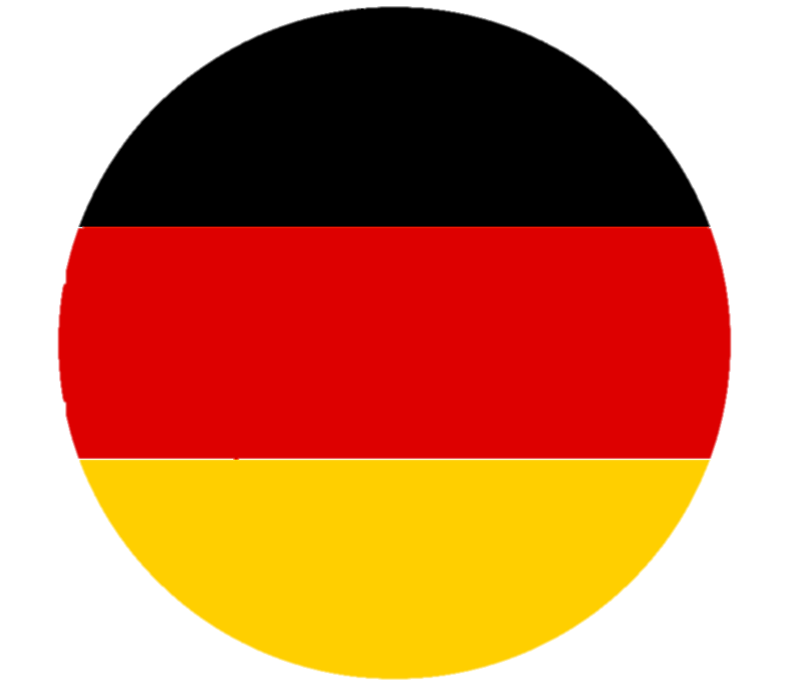
We invite to invest in manufacturing of metal processing and production of metal-based sheets in Uzbekistan
Ministry of Investment,
Industry and Trade of the Republic of Uzbekistan
Project overview
Trade agreements
Competition: Uzbekistan offers highly competitive structure of operating costs for manufacturing of finished goods internationally
GSP+ agreement allows to export to EU at reduced or zero tariff for 6 200 products.
CIS Free Trade Agreement creates more integrated and open market with CIS countries.
Top-7 steel exporters, mln tons
Steel import Uzbekistan, mln tons
Average wage, USD thsd per month
Average gas cost,
US cents per m³
China | 70 | 1,39 | 1,3 | 40
Japan | 40 |  | 3 | 55
Korea | 30 | 0,02 | 2,5 | 50
Russia | 25 | 0,74 | 0,8 | 15
India | 15 |  | 0,4 | 30
Germany | 15 |  | 3,5 | 40
Kazakhstan | 6 | 0,20 | 0,7 | 20
Uzbekistan |  |  | 0,4 | 12
Location
Syrdarya region
Syrdarya region
Size | 7 900 km²
Population | 900 thsd
Availability of labor in metallurgical industry
Local metal processing and production of metal-based sheets manufacturers can benefit from:
- Availability of skilled & unskilled labor
- Proximity to large markets i.e China and Russia
- Stable political and security environment
- Incentives: Free economic zones offer tax breaks on land, CIT, water.
- Free Trade Agreements: CIS Free Trade Agreement, GSP+
Higher education institutions: 4
Faculties of higher education: 8
Number of graduates: 1 300

Slide 3
On the strategic international logistics corridor
Ministry of Investment,
Industry and Trade of the Republic of Uzbekistan
Tallin
Sankt-Peterburg
Riga
Latvia
Moscow
Klaipeda
Hamburg
Minsk
Berlin
Brest
Povorina
Essen
Lviv
Kyiv
Paris
Chop
Volgograd
Kandiagash
Aktogay
Astraxan
Beyney
Saksaulskaya
Ulan-Bator
Osh
Bayangal-Mangal
Mersin
Malatya
Saraxa
Mazar-i-Sharif
Kashgar
Xirat
Afghanistan
Peshavar
Iran
Pakistan
Bandar-e-Abbas
Chakhbahar
Karachi
* - by plane

Slide 4
Excellent air connectivity from Tashkent and other Uzbek airports
Ministry of Investment,
Industry and Trade of the Republic of Uzbekistan
New York
A visa-free policy for tourists from 90 countries
Diverse range of 59 carriers in Uzbekistan’s airport
11 airports across the Country, the main airports are Tashkent, Samarkand and Bukhara
https://www.flightconnections.com/flights-from-tashkent-tas

