Slide 1
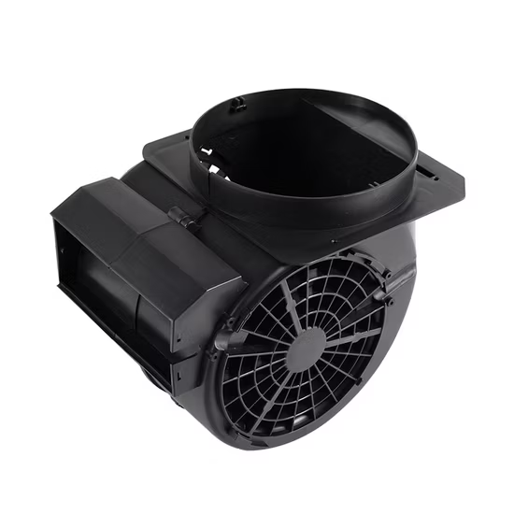
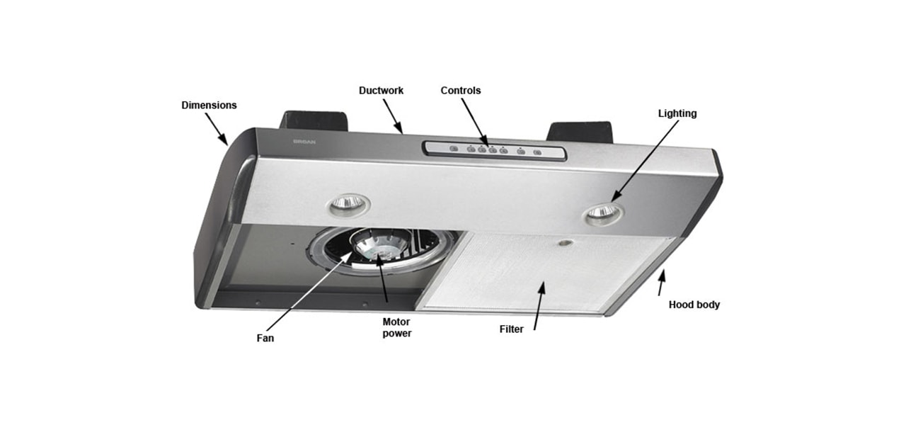
Production of range hood components
Ministry of Investment,
Industry and Trade of the Republic of Uzbekistan
Project overview
Business model: production of 18 million units of range hood components per year
Project scope
Production of plastic parts, chip, filter and etc.
Financing
25 mln USD
Production process for range hood components
Incentives
Infrastructure development at state cost* (project cost exceeding 15 mln USD)
Across the Republic, 27 FEZs offer tax breaks on land, property, water and CIT.
(CIT - applied for investments over 3 mln USD)
Design and development
Production of
parts and filters
Assembling the connecting parts
Quality control, packaging and logistics
Exemption from taxes
3 years if investment is between 0,3 – 3 mln USD
5 years if investment is between 3 – 5 mln USD
7 years if investment is between 5 – 10 mln USD
10 years if investment is over 10 mln USD
Project description
Domestic market
Existing 5 neighbor markets
Russia, Europe, Middle East markets
4 production lines
Capability to produce various sizes and powers
~150 employees
Production and trade volume of range hood (2024)
Infrastructure
Gas 12 cents/m³
Electricity 7 cents/kWh
Water 20 cents/m³
Production
Export
Import
Consumption (including CA region)
10 USD mln
1 USD mln
4 USD mln
70 USD mln

Slide 2
We invite to invest in production of range hood components in Uzbekistan
Ministry of Investment,
Industry and Trade of the Republic of Uzbekistan
Project overview
Trade agreements
Competition: Uzbekistan offers highly competitive structure of operating costs for manufacturing of finished goods internationally
GSP+ agreement allows to export to EU at reduced or zero tariff for 6 200 products.
CIS Free Trade Agreement creates more integrated and open market with CIS countries.
Top-7 range hood exporters, USD bln
Uzbekistan range
hood import, USD mln
Average wage, USD ths per month
Average electricity cost US cents kw/h
China | 2,8 | 1 | 1,5 | 12
Germany | 0,9 | 1 | 4,2 | 15
Turkey | 0,4 |  | 3,0 | 10
Poland | 0,4 | 0,5 | 3,5 | 11
USA | 0,3 |  | 6,4 | 10
Italy | 0,6 |  | 3,0 | 12
South Korea | 0,2 |  | 2,5 | 14
Uzbekistan | 0,001 |  | 0,4 | 12
Location
Jizzakh region
Size | 20 500 km²
Population | 1,5 million
Jizzakh region
Availability of labor in electrical industry
Higher education institutions: 24
Faculties of higher education: 32
Number of graduates: 4 000
Range hood manufacturers can benefit from:
- Rapidly growing population and purchasing power of the population
- Availability of skilled & unskilled labor
Building on existing infrastructure and distribution networks
Incentives: Free economic zones offer tax breaks on land, CIT, water.

Slide 3
On the strategic international logistics corridor
Ministry of Investment,
Industry and Trade of the Republic of Uzbekistan
Tallin
Sankt-Peterburg
Riga
Latvia
Moscow
Klaipeda
Hamburg
Minsk
Berlin
Brest
Povorina
Essen
Lviv
Kyiv
Paris
Chop
Volgograd
Kandiagash
Aktogay
Astraxan
Beyney
Saksaulskaya
Ulan-Bator
Osh
Bayangal-Mangal
Mersin
Malatya
Saraxa
Mazar-i-Sharif
Kashgar
Xirat
Afghanistan
Peshavar
Iran
Pakistan
Bandar-e-Abbas
Chakhbahar
Karachi

Slide 4
Excellent air connectivity from Tashkent and other Uzbek airports
Ministry of Investment,
Industry and Trade of the Republic of Uzbekistan
New York
A visa-free policy for tourists from 90 countries
Diverse range of 59 carriers in Uzbekistan’s airport
11 airports across the Country, the main airports are Tashkent, Samarkand and Bukhara

