Slide 1
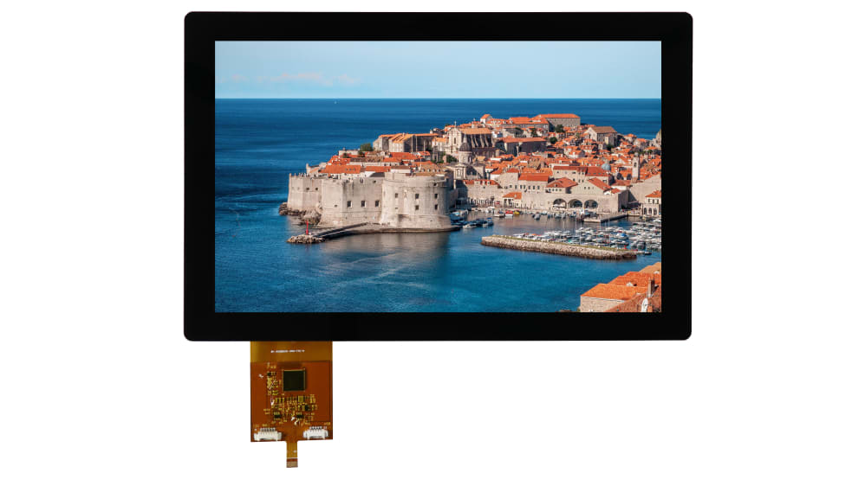
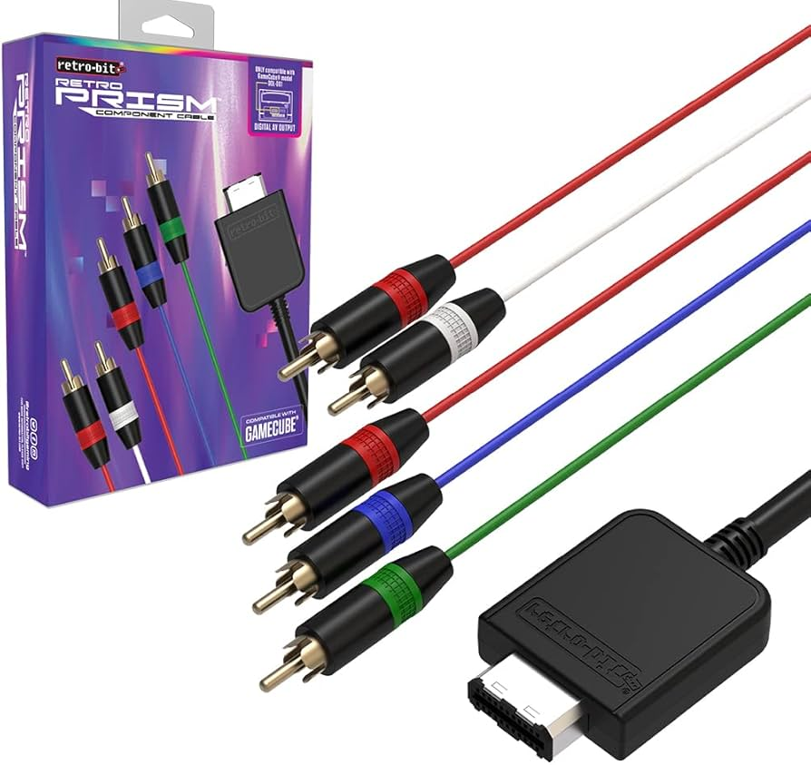
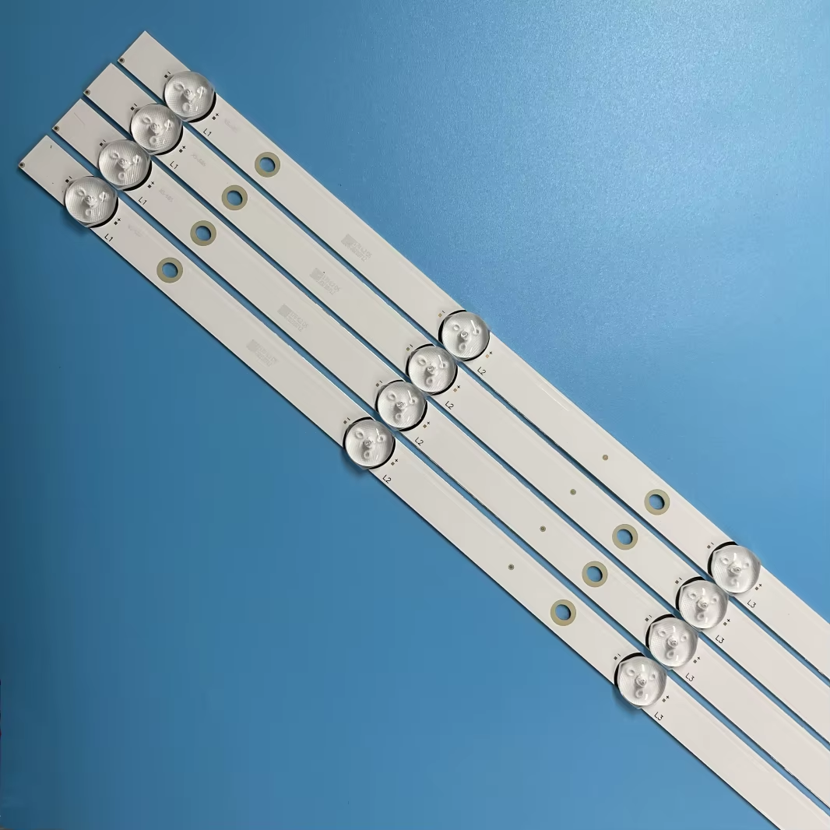
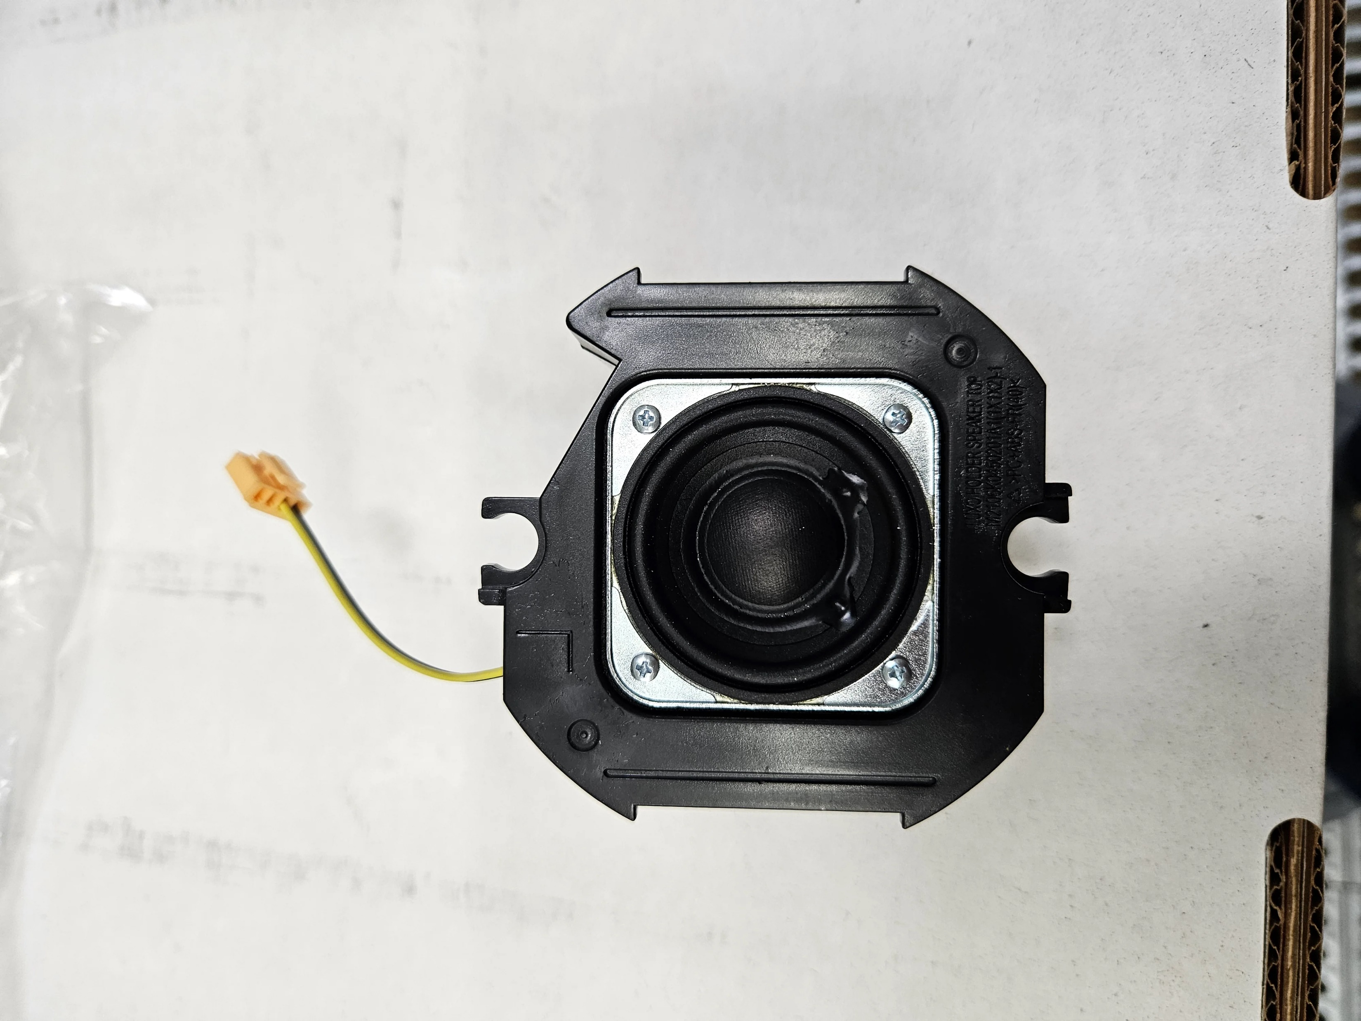
Localization of television product components
Ministry of Investment,
Industry and Trade of the Republic of Uzbekistan
Project overview
Financing
20 mln USD
Business model: production of 15 types of television product components
Project scope
Localization of television product components
Television product components:
Incentives
Infrastructure development at state cost* (project cost exceeding 15 mln USD)
Across the Republic, 27 FEZs offer tax breaks on land, property, water and CIT.
(CIT - applied for investments over 3 mln USD)
LCD screen
Prism
LED lamps
Reflector
TV lens holder
Project description
Domestic market
Existing 5 neighbor markets
Russia, Europe, Middle East markets
Exemption from taxes
3 years if investment is between 0,3 – 3 mln USD
5 years if investment is between 3 – 5 mln USD
7 years if investment is between 5 – 10 mln USD
10 years if investment is over 10 mln USD
5 production lines
Capability to produce various sizes
~400 employees
Production and trade volume of TVs and monitors (2024)
Infrastructure
Gas 12 cents/m³
Electricity 7 cents/kWh
Water 20 cents/m³
Production
Export
Import
Consumption (including CA region)
110 USD mln
52 USD mln
40 USD mln
650 USD mln

Slide 2
Ministry of Investment,
Industry and Trade of the Republic of Uzbekistan
We invite to invest in television product components in Uzbekistan
Project overview
Trade agreements
GSP+ agreement allows to export to EU at reduced or zero tariff for 6 200 products.
CIS Free Trade Agreement creates more integrated and open market with CIS countries.
Components of television producing:
13 localized:
Front lamp
Internal frame
Rear panel
Main PCB
Plastic TV button housing
TV lens holder
Rear cover
Metal foot mount
Left plastic support foot
Right plastic support foot
Operating instructions
Foam plastic
Packing carton
15 imported parts:
LCD screen
Prism
Diffuser
Reflector
LED lamps
Decorative attachment for inputs on the main PCB
Decorative attachment for outputs on the main PCB
4 types of Wire
Speaker
TV button
Metal Vesa mount
Screws
etc.
Location
27 components
Samarkand region
Size | 16 800km²
Population | 4,1 million
Samarkand region
Availability of labor in electrical industry
Higher education institutions: 24
Faculties of higher education: 32
Number of graduates: 4 000
Television components manufacturers can benefit from:
- Rapidly growing population and purchasing power of the population
- Availability of skilled & unskilled labor
Building on existing infrastructure and distribution networks
Incentives: Free economic zones offer tax breaks on land, CIT, water.

Slide 3
On the strategic international logistics corridor
Ministry of Investment,
Industry and Trade of the Republic of Uzbekistan
Tallin
Sankt-Peterburg
Riga
Latvia
Moscow
Klaipeda
Hamburg
Minsk
Berlin
Brest
Povorina
Essen
Lviv
Kyiv
Paris
Chop
Volgograd
Kandiagash
Aktogay
Astraxan
Beyney
Saksaulskaya
Ulan-Bator
Osh
Bayangal-Mangal
Mersin
Malatya
Saraxa
Mazar-i-Sharif
Kashgar
Xirat
Afghanistan
Peshavar
Iran
Pakistan
Bandar-e-Abbas
Chakhbahar
Karachi

Slide 4
Excellent air connectivity from Tashkent and other Uzbek airports
Ministry of Investment,
Industry and Trade of the Republic of Uzbekistan
New York
A visa-free policy for tourists from 90 countries
Diverse range of 59 carriers in Uzbekistan’s airport
11 airports across the Country, the main airports are Tashkent, Samarkand and Bukhara

