Slide 1
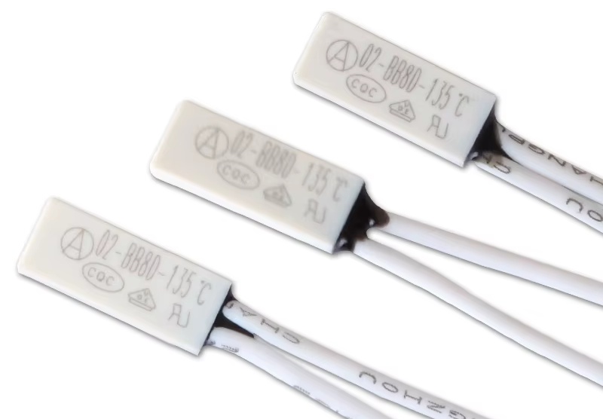
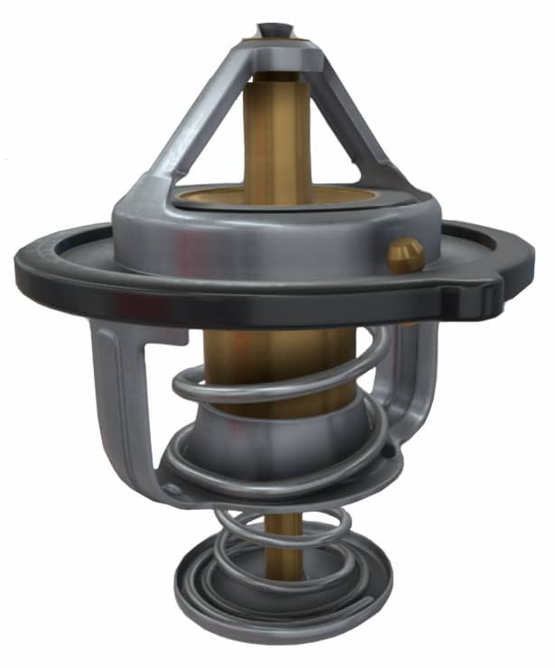
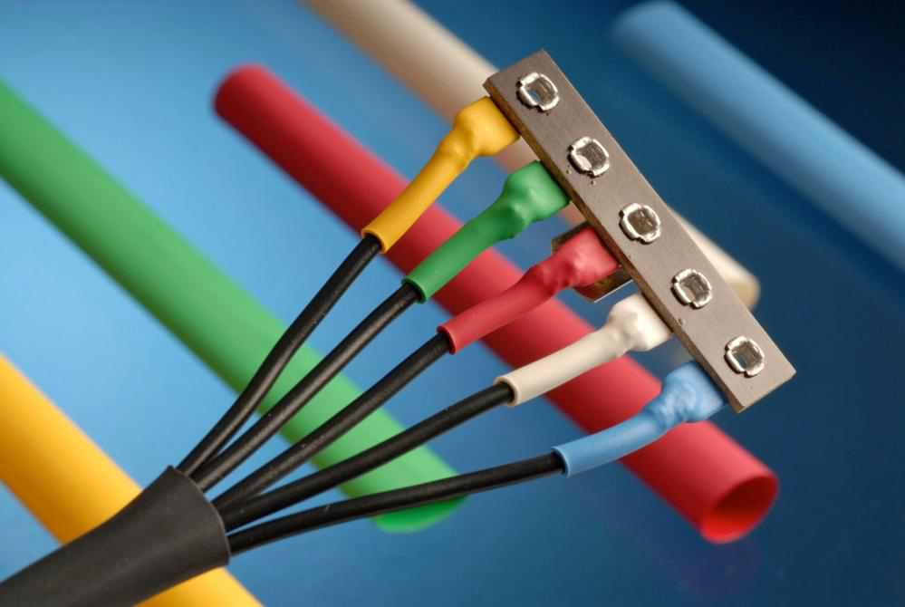
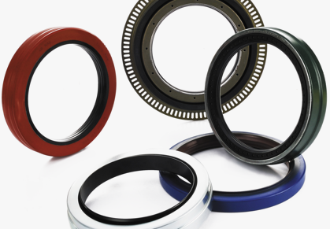
Ministry of Investment,
Industry and Trade of the Republic of Uzbekistan
Localization of Electric water heater product components
Project overview
Project scope
Localization of producing electric water heater components
Financing
15 mln USD
Business model: production of 18 types of electric water heater product components
electric water heater product components:
Incentives
Infrastructure development at state cost* (project cost exceeding 15 mln USD)
Across the Republic, 27 FEZs offer tax breaks on land, property, water and CIT.
(CIT - applied for investments over 3 mln USD)
Protective thermostat
Thermostat
Heat-shrink tubing
Spreader seal
Thermometer
Project description
Domestic market
Existing 5 neighbor markets
Russia, Europe, Middle East markets
Exemption from taxes
3 years if investment is between 0,3 – 3 mln USD
5 years if investment is between 3 – 5 mln USD
7 years if investment is between 5 – 10 mln USD
10 years if investment is over 10 mln USD
7 production lines
Capability to produce various sizes
~350 employees
Production and trade volume of electric water heater (2024)
Infrastructure
Gas 12 cents/m³
Electricity 7 cents/kWh
Water 20 cents/m³
Production
Export
Import
Consumption (including CA region)
80 USD mln
45 USD mln
35 USD mln
210 USD mln

Slide 2
Ministry of Investment,
Industry and Trade of the Republic of Uzbekistan
We invite to invest in Electric water heater product components in Uzbekistan
Project overview
Trade agreements
GSP+ agreement allows to export to EU at reduced or zero tariff for 6 200 products.
CIS Free Trade Agreement creates more integrated and open market with CIS countries.
Components of electric water heater producing:
28 localized:
Outer shell
Scotch tape
PET packing tape
Box Control knob
LED board
Connecting wires
Arc diffuser
Circle diffuser
Control panel
Water inlet and outlet tubes
Flange of inner tank
Power cord
Bracket
Thermal insulation (FPU)
Packing foam
18 imported parts:
Self-tapping screw and bolt
Protective thermostat
Thermostat
Switch
Plug
Heat-shrink tubing
Sealer
Water intake tube sealer
Spreader seal
Spreader
Water intake tube
Magnesium anode
Thermometer.
Location
Andijan Region
15 details
46 component
Andijan region
Size | 4200 km²
Population | 2,9 million
Availability of labor in electrical industry
Higher education institutions: 24
Faculties of higher education: 32
Number of graduates: 4 000
Electric water heater components manufacturers can benefit from:
- Rapidly growing population and purchasing power of the population
- Availability of skilled & unskilled labor
Building on existing infrastructure and distribution networks
Incentives: Free economic zones offer tax breaks on land, CIT, water.

Slide 3
On the strategic international logistics corridor
Ministry of Investment,
Industry and Trade of the Republic of Uzbekistan
Tallin
Sankt-Peterburg
Riga
Latvia
Moscow
Klaipeda
Hamburg
Minsk
Berlin
Brest
Povorina
Essen
Lviv
Kyiv
Paris
Chop
Volgograd
Kandiagash
Aktogay
Astraxan
Beyney
Saksaulskaya
Ulan-Bator
Osh
Bayangal-Mangal
Mersin
Malatya
Saraxa
Mazar-i-Sharif
Kashgar
Xirat
Afghanistan
Peshavar
Iran
Pakistan
Bandar-e-Abbas
Chakhbahar
Karachi

Slide 4
Excellent air connectivity from Tashkent and other Uzbek airports
Ministry of Investment,
Industry and Trade of the Republic of Uzbekistan
New York
A visa-free policy for tourists from 90 countries
Diverse range of 59 carriers in Uzbekistan’s airport
11 airports across the Country, the main airports are Tashkent, Samarkand and Bukhara

