Slide 1

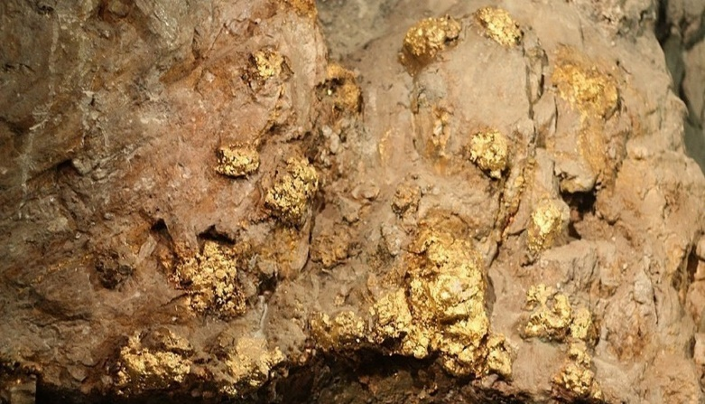

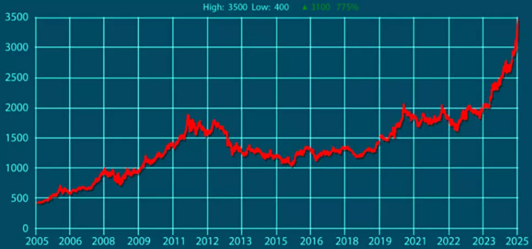
Geological exploration and development of deposits in the Navoi region (Balakarak, Yambyskak and Hayrak sites) for the extraction of gold and other metals
Industry
Geology and non-ferrous metallurgy
Project cost
The average cost of exploration expenses for gold reserves is $75 per ounce. The average capital expenditures for these projects will amount to approximately $200 per ounce.
The purpose of the project
The development of the industry is stimulated by the expansion of the search for new raw materials within the known ore regions and new promising areas of Mesocainozoic deposits.
The project provides for the exploration of new deposits in the Navoi region and the production of gold and other precious metals.
Financing plan:
Project
cost
100%
$11.48 million
Local contribution– 15% ($1.72 million)
Attracted loans – 42,5% ($4,9 million)
Direct investments – 42,5% ($4.9 million).
Machinery equipment
61%
$6.9 million
Construction
12%
$1.4 million
The final cost and financing structure of the project will be determined based on the results of negotiations with the investor.
Working capital
27%
$3.1 million
Deposits and forecast reserves
Proven gold reserves in Uzbekistan amount to 6.4 thousand tons. The country also has large deposits of silver — 24.6 thousand tons, copper — 21.3 million tons. Large reserves of non-ferrous metals create an opportunity for investments in mining and processing.
In Navoi region, the initiator of the project proposes three deposits (Balakarak, Yambysak and Airak sites) for research. On the manifestations of Yambyskak and other fragments confined to the intersection points of individual seams of the Yambyskak structure, gold is accompanied by increased silver contents of 1-10 g/t, less often 10-50 g/t, in one sample of 894 g/t.
Silver mineralization is spatially, possibly genetically, linked to gold ore (Stockwork, Yambyskak manifestations) and polymetallic (Airak and Akkazat) mineralization. In the first case, the intensity of silver ore mineralization reaches 0-50 g/t (in one sample 894 g/t), in the second it does not exceed 26 g/t, which increases the value of the identified ore occurrences.
Investment attractiveness of the project:
NPV, US$ million – 50,6
IRR, % – 43,6%
PI – 5,29
DPP, years - 3,39
The financial results will be clarified after the final feasibility study.
The Initiator
The Ministry of Mining and Geology of the Republic of Uzbekistan implements a unified policy for the study, use, and protection of mineral resources, as well as ensuring the increase of mineral reserves and the reproduction of the mineral raw material base and industrial capacities on-site.
The interested investors will be provided with the available technical documentation for review after signing the NDA agreement.
Project placement
Navoiy Region
Market
Gold futures reached $3,500, and the spot price also briefly exceeded this level during intraday trading. This marks a staggering 775% increase in just 20 years.
What is the appeal of the project?
All signs point to gold being in the midst of a historical rise, with gold prices regularly reaching historic highs. Here are some forecasts supporting gold's upward momentum and strong macroeconomic foundation: Goldman Sachs: $4,500 by 2025; J.P. Morgan: $4,000 by the second quarter of 2026; R. Kiyosaki: $5,000 in 2025.
Navoi Region
Size | 110,8 km²
Population | 1,1 million
Required area
~ 2,0 ha

Slide 2

On the strategic international logistics corridor
Tallin
Sankt-Peterburg
Riga
Latvia
Moscow
Klaipeda
Hamburg
Minsk
Berlin
Brest
Povorina
Essen
Lviv
Kyiv
Paris
Chop
Volgograd
Kandiagash
Aktogay
Astraxan
Beyney
Saksaulskaya
Ulan-Bator
Osh
Bayangal-Mangal
Mersin
Malatya
Saraxa
Mazar-i-Sharif
Kashgar
Xirat
Afghanistan
Peshavar
Iran
Pakistan
Bandar-e-Abbas
Chakhbahar
Karachi

Slide 3

Excellent air connectivity from Tashkent and other Uzbek airports
New York
A visa-free policy for tourists from
90 countries
Diverse range of 59 carriers in Uzbekistan’s airport
11 airports across the Country, the main airports are Tashkent, Samarkand and Bukhara

