Slide 1



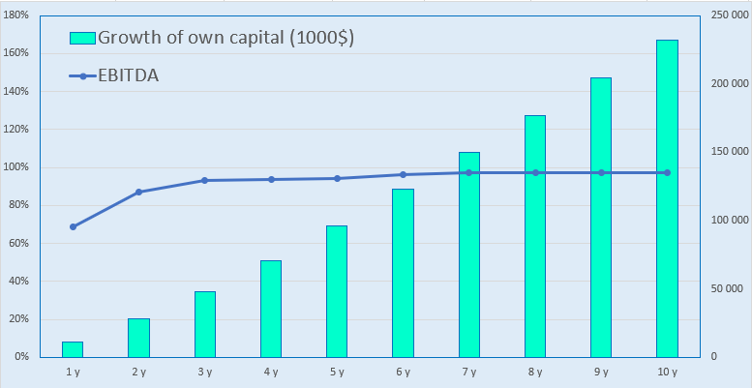
Breeding of Rhopalurus junceus and obtaining venom (Startup)
Branch
Pharmaceutical industry
Project cost:
Total cost – US$ 255,6 thousand
Investment plan
The total investment is 255.6 thousand US dollars, of which:
The purpose of the project
The main goal of the project is to produce scorpion venom containing biologically active components such as peptides and proteins with analgesic, anti-inflammatory and even anti-carcinogenic properties. We invite foreign and local investors to implement the startup project.
Buildings and structures
9,4%
$24,0 thousand
The initiator's contribution is - 37,0 % ($94,6 thousand)
Loans- 0% ($ 0 thousand)
Direct investments - 63,0% ($160,9 thousand).
Equipment
19,6%
$50,0 thousand
Other
23,9%
$60,9 thousand
The final cost and financing structure of the project will be determined after negotiations with investors.
Working capital
47,2%
$120,6 thousand
Project products
One adult scorpion can give about 2 milligrams of venom per day, and a liter of this substance costs up to 10 million dollars.
Investment
indicators:
Prifitability:
Why is it worth investing in the field of obtaining scorpion venom?
NPV, US$ thousand– 174,8
IRR, % – 2930,9%
EBITDA, % – 97%
DPP, years - 1,35
There is a high demand for poison. It is used in medicine and cosmetology to create painkillers, anticancer and anti-aging products. The poison is also being tested as a replacement for traditional antibiotics — it is able to fight drug-resistant bacteria.
The possibility of automating the process. Venom collection can be automated using compact electrical stimulators that painlessly squeeze out a drop of venom for the animal.
Market
The demand for painkillers, in particular analgesics, is also growing. According to forecasts, in 2025, the global analgesic market revenue will amount to 34.66 billion US dollars, and the annual growth rate will be 4.84% (CAGR 2025-2030).
The demand for antibiotics is expected to grow, with the market volume projected to increase from US$38 billion in 2025 to US$40 billion by 2034, with a cumulative annual growth rate of 4.3%.
Initiator
Private entrepreneur
Zahriddin Alimov
Higher education.
Project placement
Tashkent region, Yangiyul city MT Navruz, Privokzalnaya street – 62a.
Placement
Tashkent
region
Benefits
Exemption from customs duties for raw materials and supplies not produced in Uzbekistan, copper products, packaging materials for keeping laboratory animals, preclinical research and production of medicines, technological and laboratory equipment, components and spare parts for them, "clean rooms", sandwich panels and ventilation systems for pharmaceutical production facilities.
Covering the expenses of entrepreneurs for obtaining certificates from the US Food and Drug Administration (FDA) and the European Medicines Agency (EMA) at the expense of the budget for export expansion.
Tashkent region
Square | 15 300 km²
Population | 2,9 million
Required area
~ 400 sq.m.
6%

Slide 2
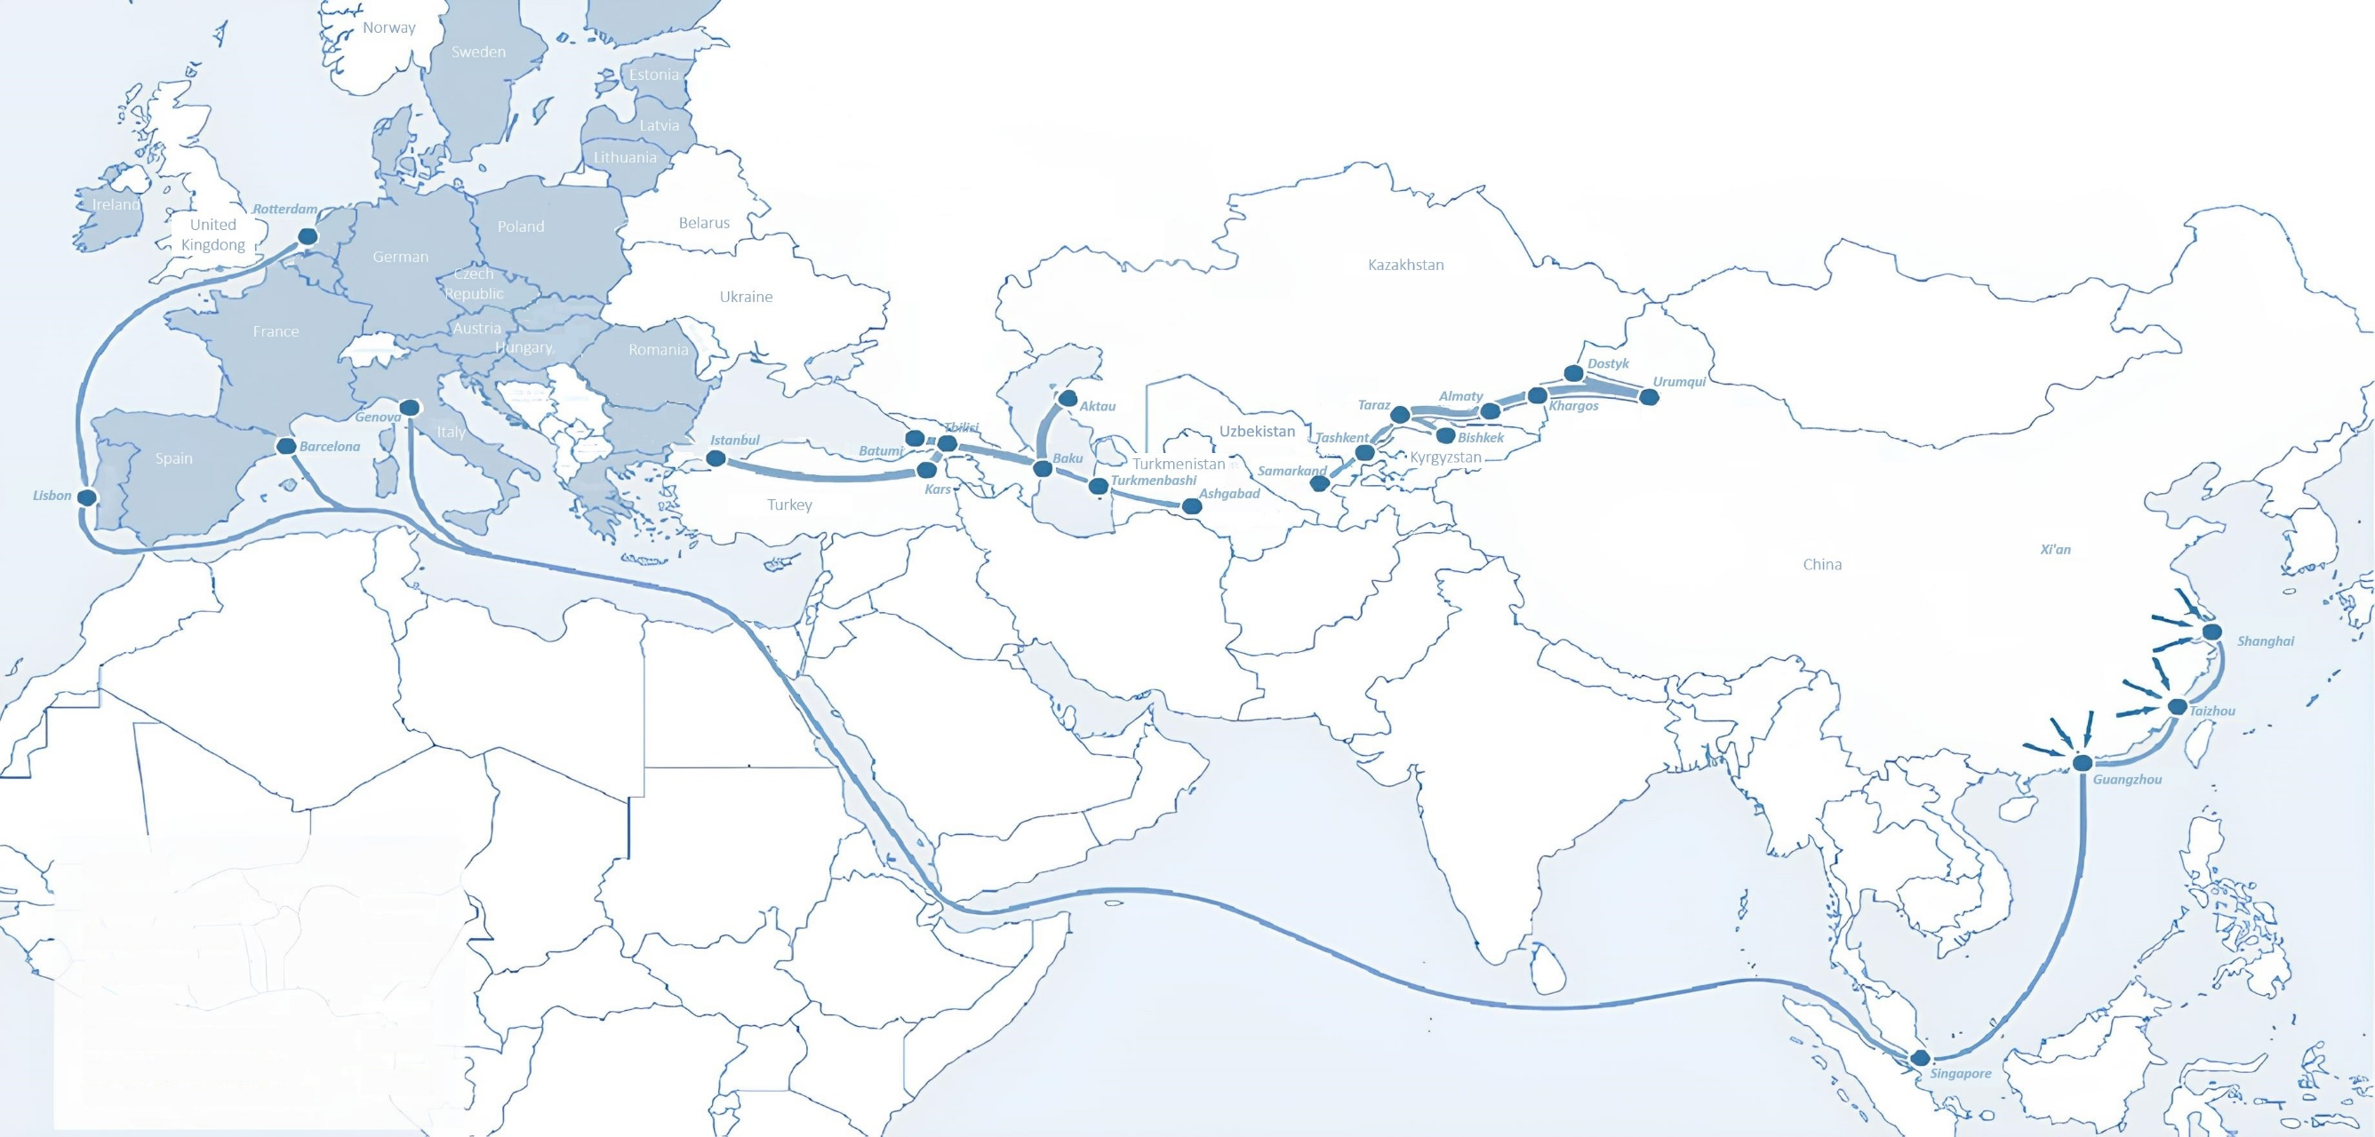
International logistics transport corridors
Tallin
Sankt-Peterburg
Riga
Latvia
Moscow
Klaipeda
Hamburg
Minsk
Berlin
Brest
Povorina
Essen
Lviv
Kyiv
Paris
Chop
Volgograd
Kandiagash
Aktogay
Astraxan
Beyney
Saksaulskaya
Ulan-Bator
Osh
Bayangal-Mangal
Mersin
Malatya
Saraxa
Mazar-i-Sharif
Kashgar
Xirat
Afghanistan
Peshavar
Iran
Pakistan
Bandar-e-Abbas
Chakhbahar
Karachi

Slide 3
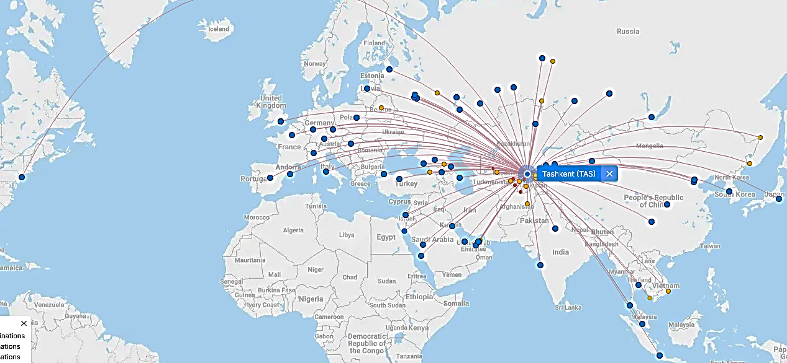
Flights from Tashkent and other airports in Uzbekistan
New York
Visa-free travel for tourists from
90 countries
There are 59 different airlines operating at the airport of Uzbekistan
There are 11 airports across the country, the main of which are Tashkent, Samarkand and Bukhara

