Slide 1
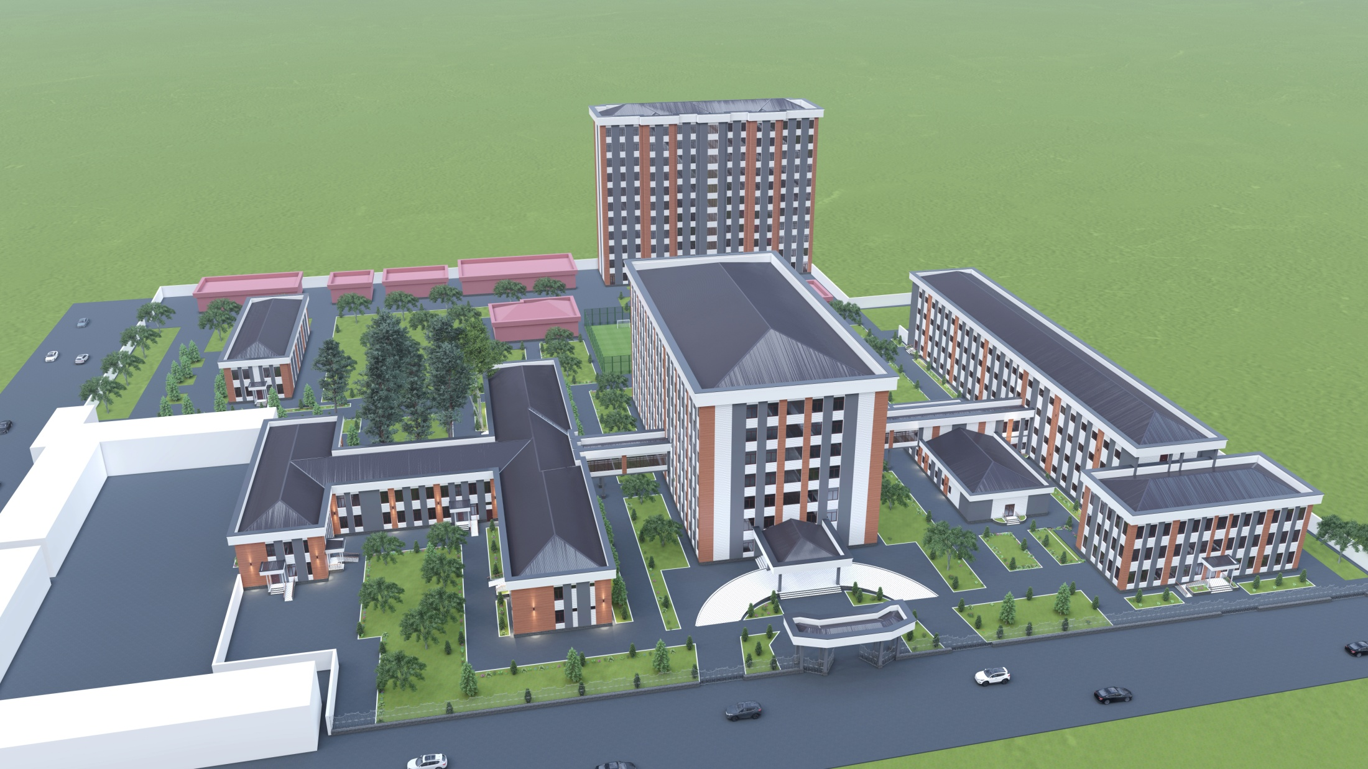
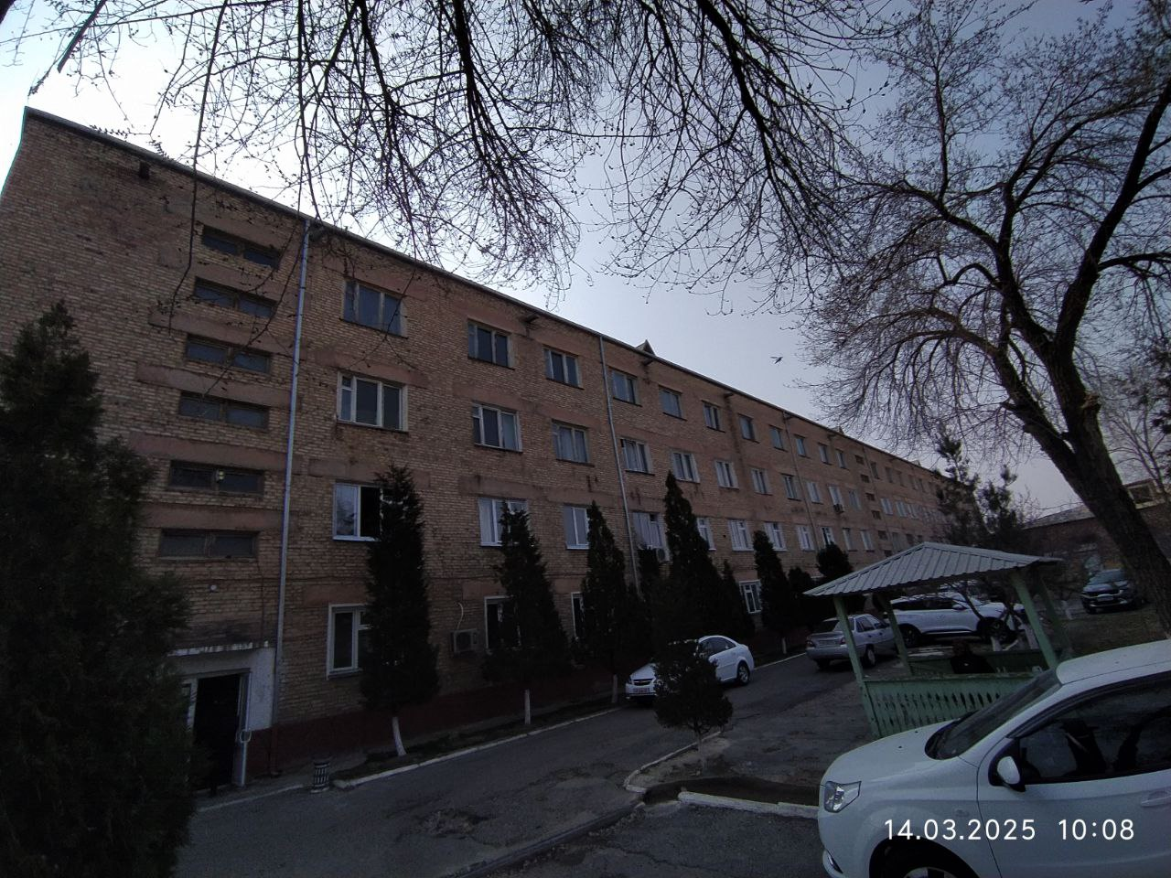
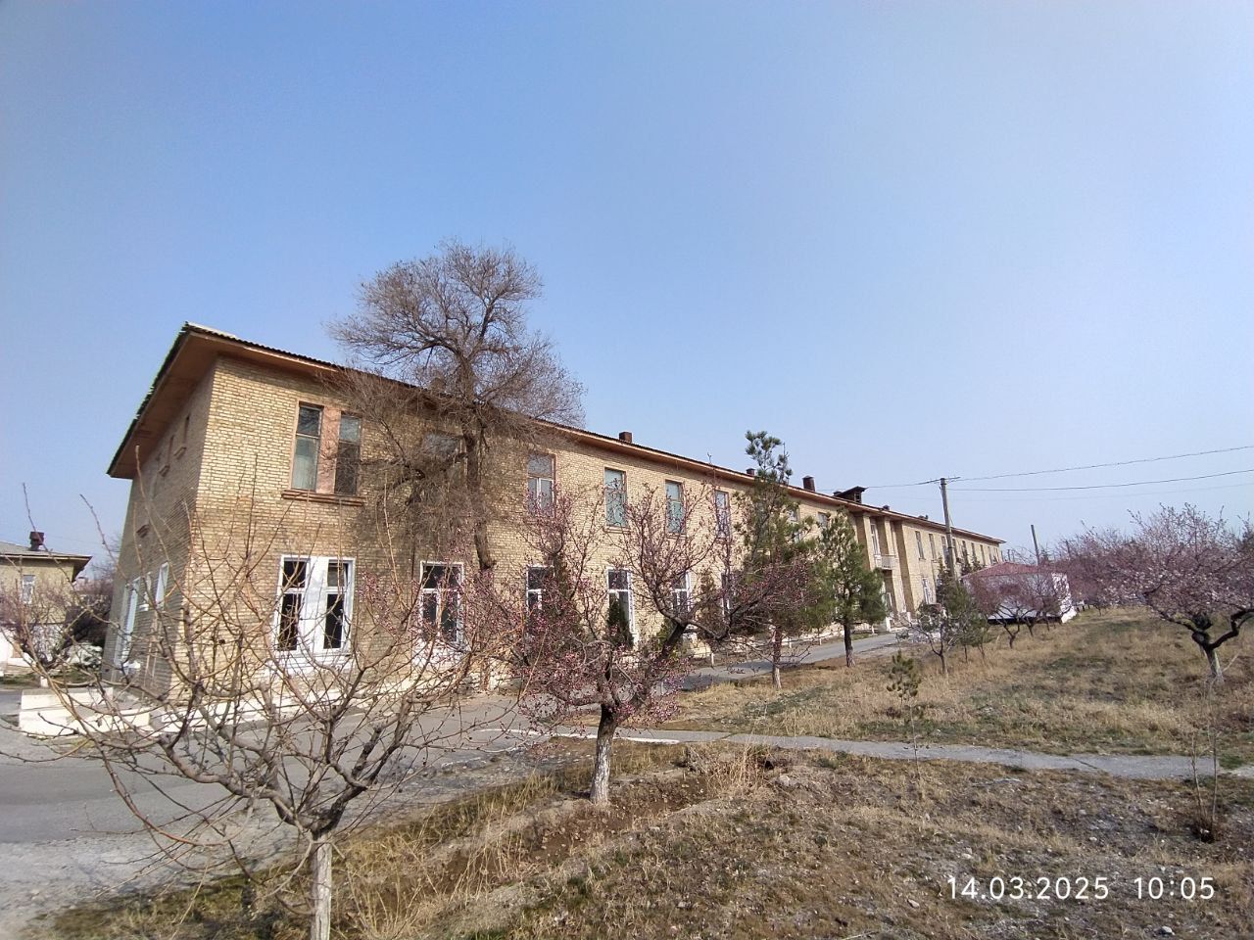
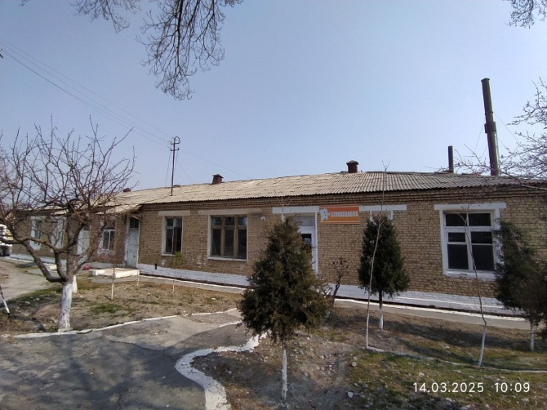
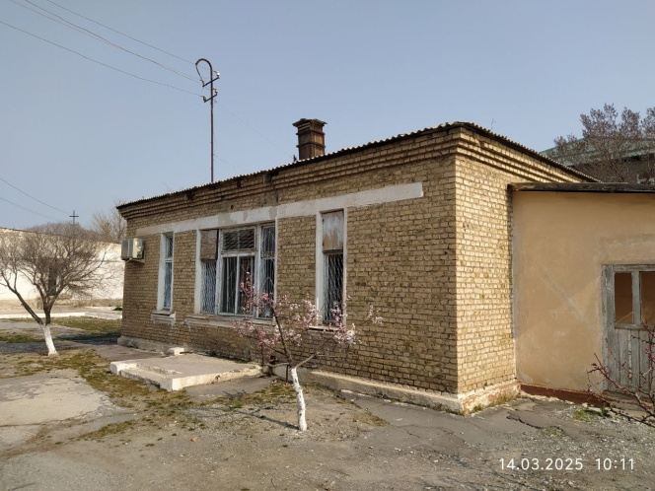
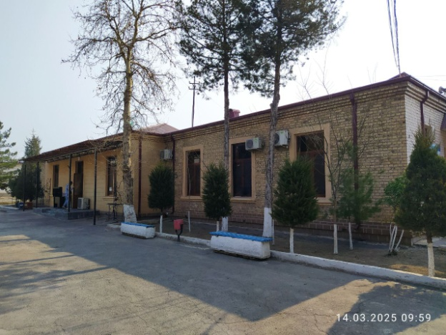
Establishment and expansion of a modern medical clinic of Fergana medical institute of public health
Ministry of Investment,
Industry and Trade of the Republic of Uzbekistan
Project overview
Business model: Establishment and expansion of a modern medical clinic of Fergana medical institute of public health with capacity of 280 beds.
Project scope
To create a sustainable, revenue-generating healthcare clinic of university
Current condition of clinic:
Financing
6 mln USD
Incentives
It is given for free use clinics for 30 years, and revenue sharing will be 60% for investors, and 40 % for institute.
Total area of 1st therapy building – 1287 m2
Total area of 2nd therapy building – 2104 m2
Total area of Pharmacy building – 302 m2
Total area of Autoclave building – 112 m2
Total area of Administration building – 483 m2
Total population of Fergana city :
350.000
Total population in the area where the clinic is located:
50.000
The best Location:
There is no other clinic in the area where the clinic is located
Level of risk for investors
Free from all taxes 5 to 10 years
Advantages
Project description (Departments that are planned to be opened)
Departments in 1st therapy building:
Cardiosurgery, Neurosurgery,
Endoscopic surgery, Thoracic surgery,
Vascular surgery,
Otolaryngology
Departments in 2nd therapy building:
Surgery
Gynecology
Rheumatology
Department of folk medicine
Infrastructure
Gas 12 cent/m³
Electricity 7 cent/kWh
Water 20 cent/m³

Slide 2
Ministry of Investment,
Industry and Trade of the Republic of Uzbekistan
We invite to invest in building healthcare clinic of Fergana medical institute in Fergana region, Republic of Uzbekistan
Project overview
Trade agreements
The growing demand for quality healthcare services and the global need for skilled medical professionals position this project at the intersection of two high-growth sectors. The clinic is expected to attract a steady flow of patients from local, regional areas and two neighbour countries – Kyrgyzstan, Tajikistan, and become a center of excellence for medical education and clinical training.
Uzbekistan is a full member of World Health Organization
(since 1992).
WTO (observer), GSP, Shanghai, CIS, CAREC Trade Agreements create more integrated and open markets
STEPS OF INVESTMENT PROCEDURE IN BUILDING FERGANA MEDICAL INSTITUTE CLINIC (2025-2027)
The investor is registered in Uzbekistan as an independent legal entity
A memorandum of cooperation is signed between the medical institute and the investor
The state institute and foreign investors will build the clinic together
The land plot of the clinic will be given to the investor according to the established procedure
Location
Fergana region
Fergana region
Size | 6800 km²
Population | 4.1 million
Financial benefits for investors in building public institute clinic
Investors can benefit from:
Income through both healthcare services (outpatient/inpatient care, diagnostics, procedures) and academic operations (tuition, training programs, international student enrollments).
The integration of clinical care, teaching, and research offers a unique business model with fewer direct competitors in the region, ensuring market dominance and long-term sustainability.
Imported medical equipment and technologies are exempt from customs duties
Exempt from VAT (NDS).
Exemption from land tax and property tax for up to 10 years.

Slide 3
On the strategic international logistics corridor
Ministry of Investment,
Industry and Trade of the Republic of Uzbekistan
Tallin
Sankt-Peterburg
Riga
Latvia
Moscow
Klaipeda
Hamburg
Minsk
Berlin
Brest
Povorina
Essen
Lviv
Kyiv
Paris
Chop
Volgograd
Kandiagash
Aktogay
Astraxan
Beyney
Saksaulskaya
Ulan-Bator
Osh
Bayangal-Mangal
Mersin
Malatya
Saraxa
Mazar-i-Sharif
Kashgar
Xirat
Afghanistan
Peshavar
Iran
Pakistan
Bandar-e-Abbas
Chakhbahar
Karachi

Slide 4
Excellent air connectivity from Tashkent, Fergana and other Uzbek airports
Ministry of Investment,
Industry and Trade of the Republic of Uzbekistan
A visa-free policy for tourists from 90 countries
Diverse range of 59 carriers in Uzbekistan’s airport
11 airports across the Country, the main airports are Tashkent, Samarkand Bukhara, and Fergana
https://www.flightconnections.com/flights-from-tashkent-tas

Slide 5
The new project look of the university clinic
Ministry of Investment,
Industry and Trade of the Republic of Uzbekistan

Slide 6
Project description
Ministry of Investment,
Industry and Trade of the Republic of Uzbekistan
Taking into account the growing global demand for multidisciplinary medical services and the consistent development of high-quality healthcare systems, it is planned to reconstruct and modernize the clinic (hospital) of the Fergana Medical Institute in the Republic of Uzbekistan based on contemporary infrastructure.
This project is open to foreign investors and aims to establish a medical center that meets international standards.

Slide 7
Objectives of cooperation
Ministry of Investment,
Industry and Trade of the Republic of Uzbekistan
Creating a brand of high-quality medical services : Creation of the first elite medical center in Fergana region, Uzbekistan.
Achieving economic benefit: Realizing profits through an agreed upon revenue sharing model.
Improving Local Healthcare: Improving the overall level of health care in Fergana region, Uzbekistan through technology transfer and staff training.

Slide 8
Model distributions income
Ministry of Investment,
Industry and Trade of the Republic of Uzbekistan
The income is distributed between the parties in an agreed proportion (for example, 60% to our side and 40% to the Uzbek side).
Calculations are made monthly to ensure financial transparency.

Slide 9
Stages of implementations
Ministry of Investment,
Industry and Trade of the Republic of Uzbekistan
Preparatory stage (1-3 months ) :
Signing a cooperation agreement and defining responsibilities.
Preparation of premises and its renovation by the Uzbek side.
Purchase of equipment and dispatch of a team of experts.

Slide 10
Stages of implementations
Ministry of Investment,
Industry and Trade of the Republic of Uzbekistan
2. Pilot launch ( 3 months ) :
Start of trial operation of the center with the admission of a limited number of patients.
Optimization of service processes and training of local medical staff.

Slide 11
Stages of implementations
Ministry of Investment,
Industry and Trade of the Republic of Uzbekistan
3. Full-fledged operation (from 7th month ) :
Official opening of the center and active promotion of services.
Regular assessment of the center's performance and optimization of services

Slide 12
Expected results
Ministry of Investment,
Industry and Trade of the Republic of Uzbekistan
Economic benefit : Generating high profits through providing elite medical services.
Social benefit : Improving the level of health care in Fergana region, Uzbekistan.
Brand strengthening : To create an internationally recognized brand in the field of high-quality medical services.

Slide 13
Contact information
Ministry of Investment,
Industry and Trade of the Republic of Uzbekistan
Sidikov Akmal – rector of Fergana medical institute, phone: +998995751111 (Whatsapp, Telegram), email : Medik-85@bk.ru.
Komilov Nodirbek – vice rector,
phone: +998991151149 (Whatsapp, Telegram),
email: n_komilov@inbox.ru

