Slide 1
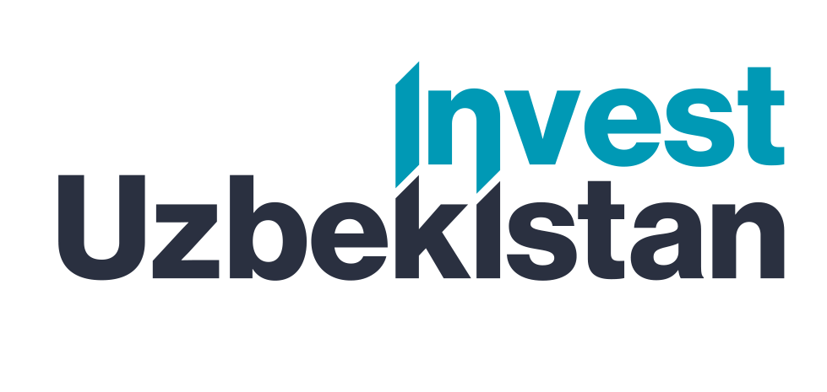



Projects of the Jizzakh region that require investment for implementation
Jizzakh region
Jizzakh region
It is located in the central part of Uzbekistan. The administrative center is the city of Jizzakh. It was established in March 1973. The area is 21,210 sq. km. The population is 1.4 million people. The climate is continental, arid, with hot summers and moderately cold winters.
According to the decision of the Government of the Republic of Uzbekistan (PP-146 dated 02.05.2023)
20 projects are being implemented in the region for a total of 449.8 million US dollars.
List of project proposals by industry
Chemical
Building materials
Projects
3
Cost
$32.0 mln.
Projects
2
Cost
$48.0 mln.
Cement
Food industry
Projects
2
Cost
$150.0 mln.
Projects
3
Cost
$20.8 mln.
Why is it worth investing in Jizzakh region?
Dynamic development of the region. The region is gradually turning into an industrial and scientific center of Uzbekistan. The main areas of development are the automobile, textile, food, construction, leather and footwear, chemical industries and others.
Natural resource potential. The subsoil of Jizzakh is rich in gold, copper, tungsten, wollastonite, lead, zinc, lime, marble, silicates and other minerals.
Potential of agriculture. The region produces about 1 million tons of fruit and vegetable products,
a significant portion of which is exported.
Foreign trade activities. Jizzakh region closely interacts and conducts foreign trade activities with more than 30 countries of the world.
Potential for tourism development. Jizzakh region has great potential for developing the tourism industry. The region is home to the largest lake in Uzbekistan, Tuzkan, and the mountains, rivers and steppes also attract travelers.
Over the past seven years, the region has attracted investments worth more than $5 billion, of which
$3 billion are direct investments. This has created 45,000 new jobs.
Textile industry
Metallurgy
Projects
5
Cost
$72.0 mln.
Projects
3
Cost
$101.0 mln.
Cost
$17.0 mln.
Pharmaceuticals
Cost
$9.0 mln.
Projects
1
Projects
1
Proposals for project placement
Jizzakh SEZ
Jizzakh SIZ
New industrial zones
Tax benefits for land, property, and water
Tax exemption
3 years
(Investment
0,3 – 3 mln. USD)
5 years
(Investment
3 – 5 mln. USD))
7 years
(Investment
5 – 10 mln. USD)
10 years
(Investment
10 mln. USD
Indicators of the proposed projects
Number of projects
17 projects
Total cost
$ 449.8 mln.
New jobs
2590 worker
Need for investment
$ 334.5 mln.

Slide 2

International logistics transport corridors
Tallin
Sankt-Peterburg
Riga
Latvia
Moscow
Klaipeda
Hamburg
Minsk
Berlin
Brest
Povorina
Essen
Lviv
Kyiv
Paris
Chop
Volgograd
Kandiagash
Aktogay
Astraxan
Beyney
Saksaulskaya
Ulan-Bator
Osh
Bayangal-Mangal
Mersin
Malatya
Saraxa
Mazar-i-Sharif
Kashgar
Xirat
Afghanistan
Peshavar
Iran
Pakistan
Bandar-e-Abbas
Chakhbahar
Karachi

Slide 3

Air connections from Tashkent and other airports of Uzbekistan
New York
A visa-free policy for tourists from
90 countries
Diverse range of 59 carriers in Uzbekistan’s airport
11 airports across the Country, the main airports are Tashkent, Samarkand and Bukhara

Slide 4
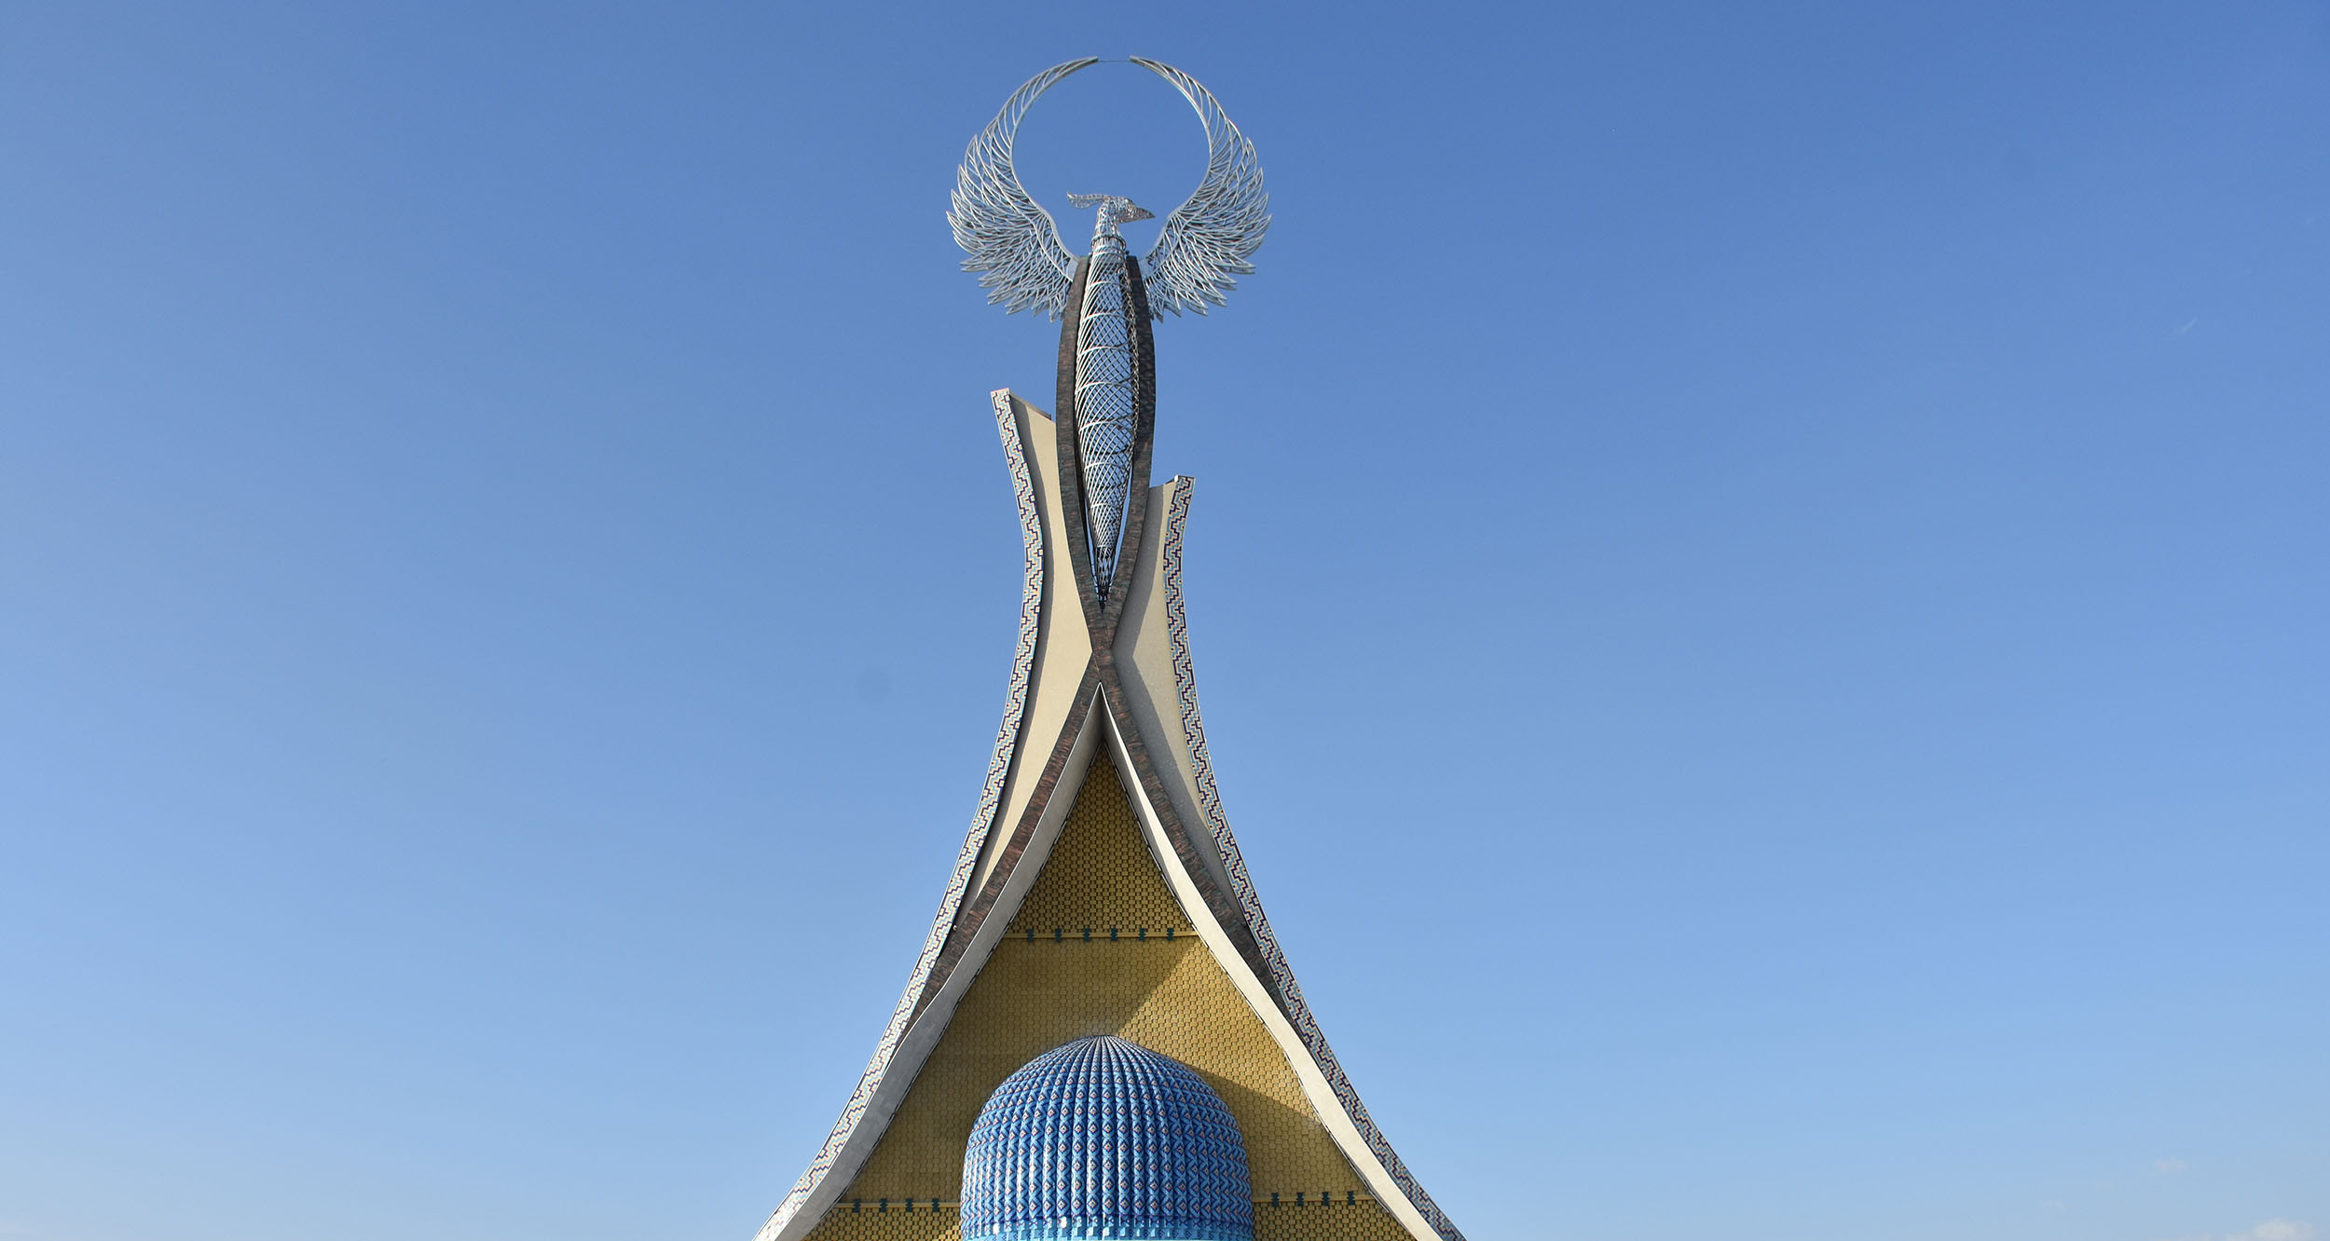
Project proposals

Slide 5
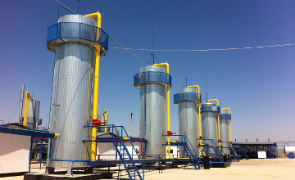
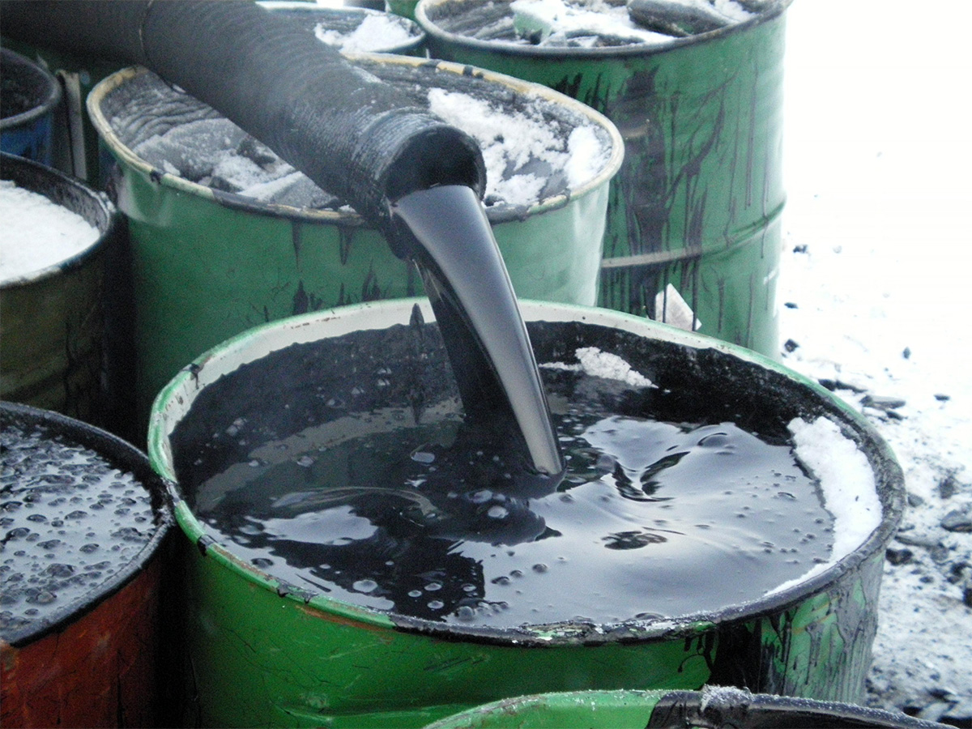





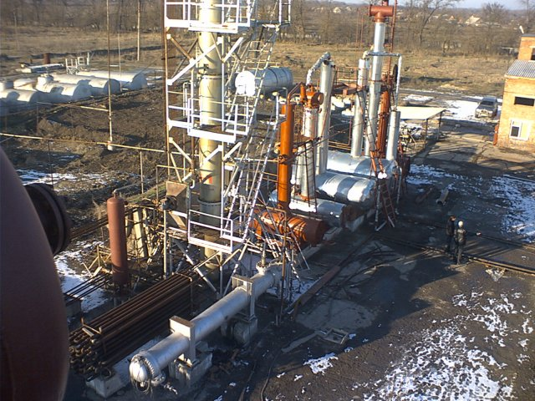




INVESTMENT OFFER
Bitumen production
The global bitumen market size has been valued at US$84.6 billion and is expected to reach US$116.2 billion. by 2027, increasing by an average of 4.2%.
Capacity: 300 тhousands of tons
Project cost:$ 26,0 mln.
Investment requirement:$ 20,0 mln.
IRR 90,7%
NPV:$ 210,5 mln.
PP: 18 month
Location: Jizzakh region, Zaamin district
CONTACT US
Project partner: "Ta Group" LLC
uzipa@invest.gov.uz
+ 998 90 961 74 04
Support required? - Investment promotion Agency
+998 (71) 202-02-10

Slide 6
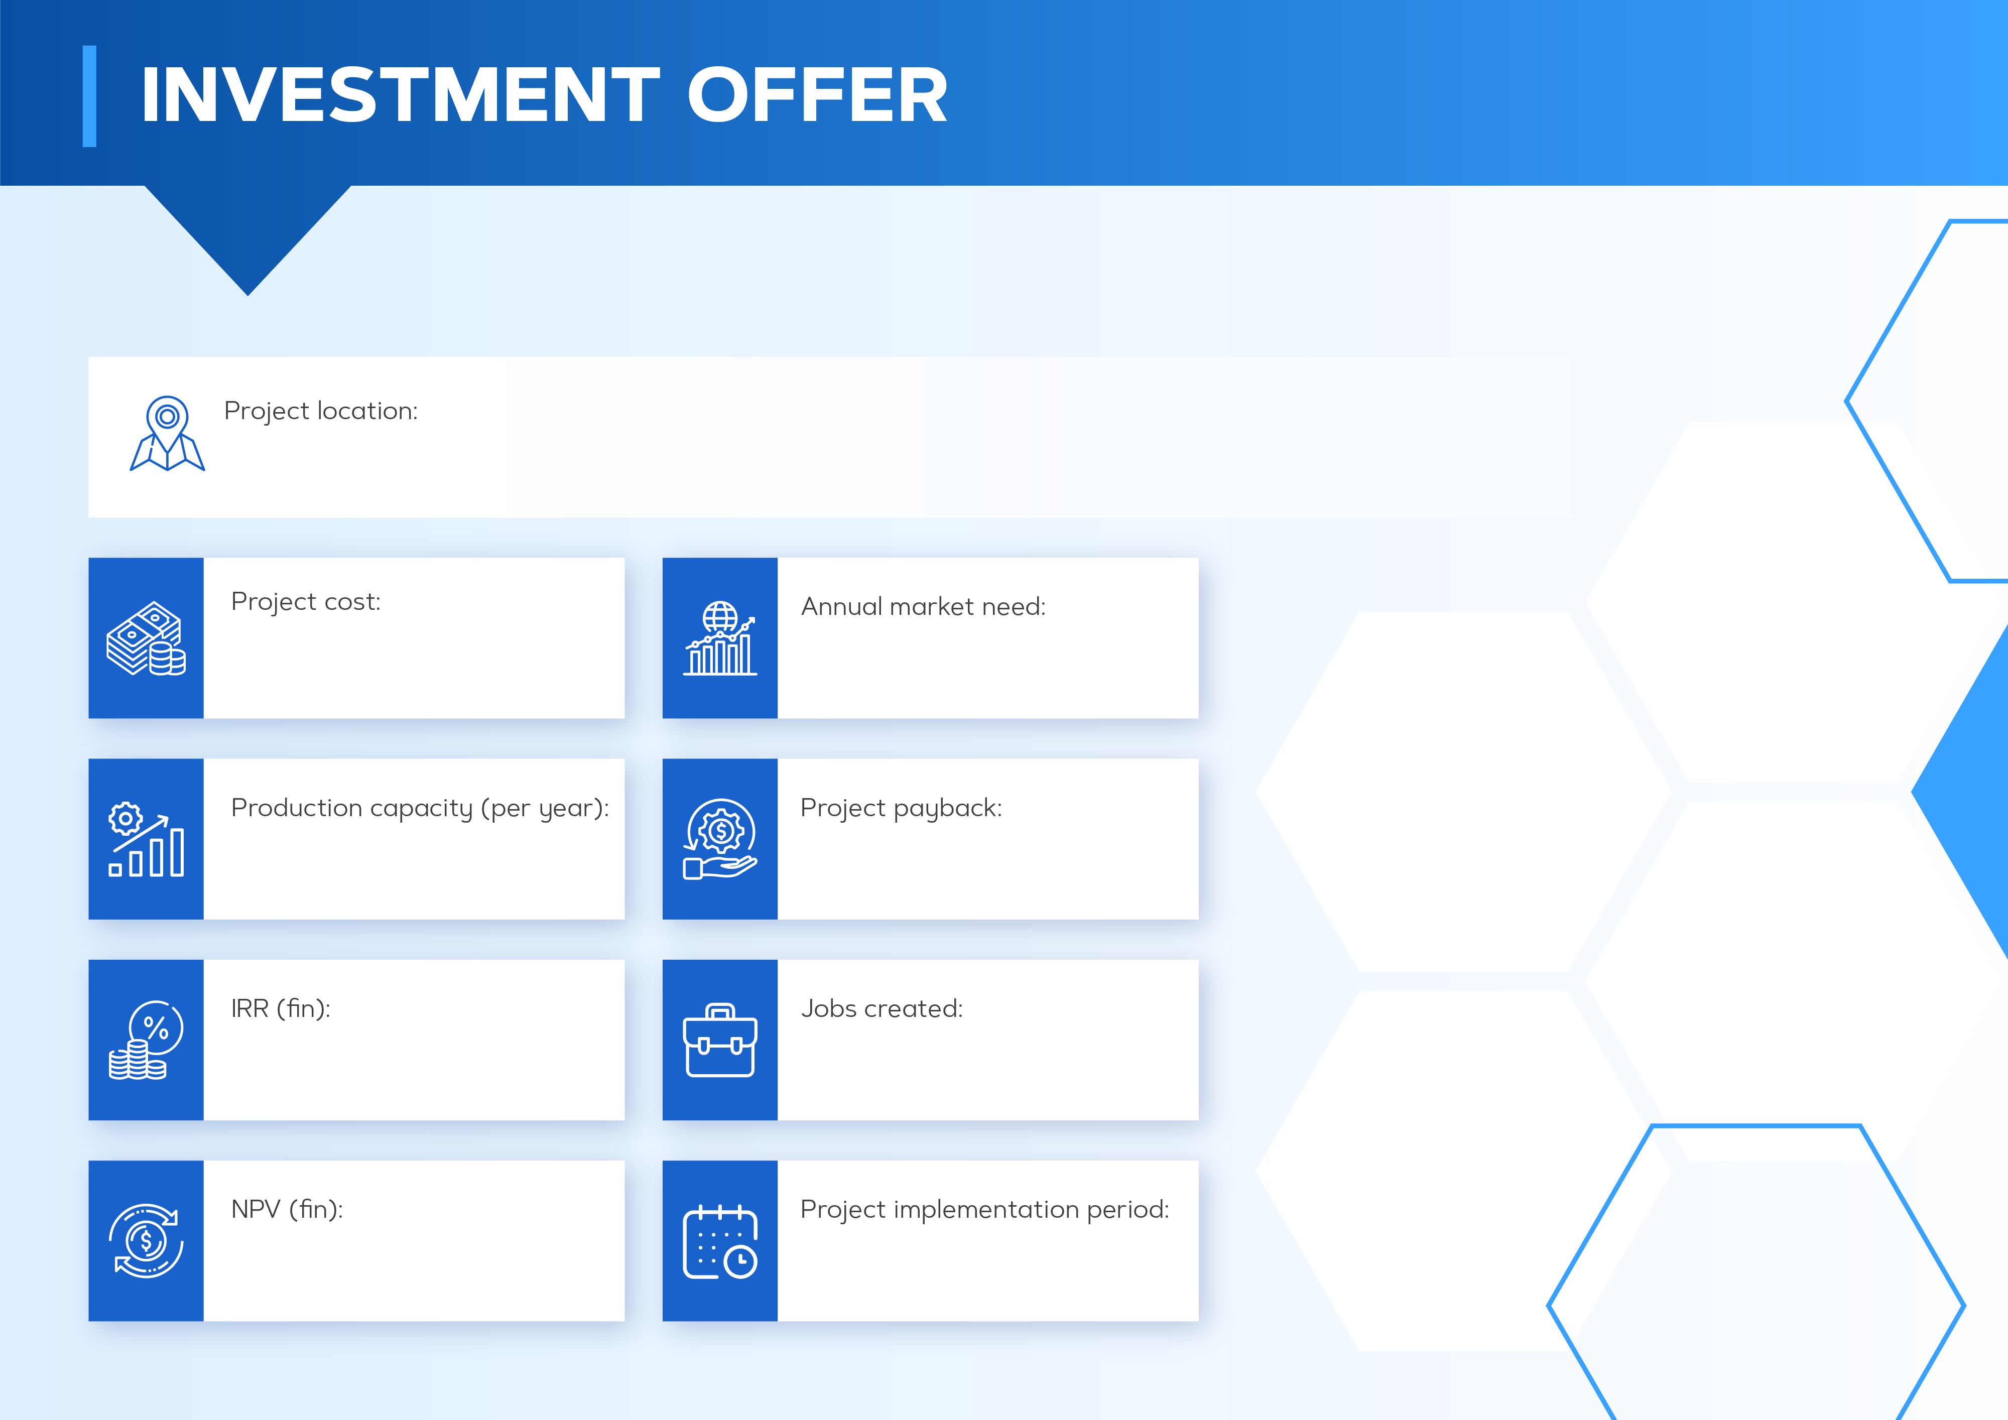
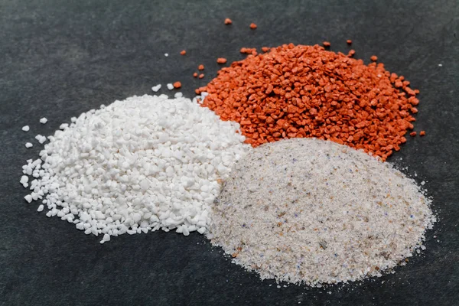
Production of chemical fertilizers
Mirzachul district, jizakh region
$1,0 million
60 000 piece
($0,3 million own resources,
$0,7 million bank loans)
5 000 tons
3 years
12,8%
10 people
$0,0 million
6 months

Slide 7
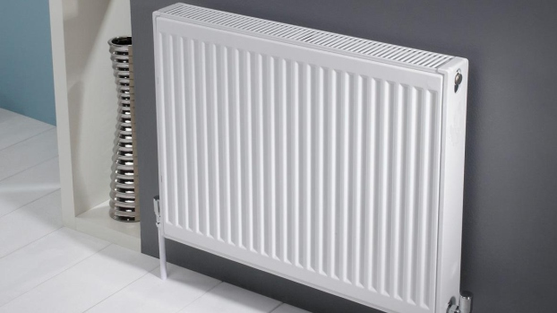
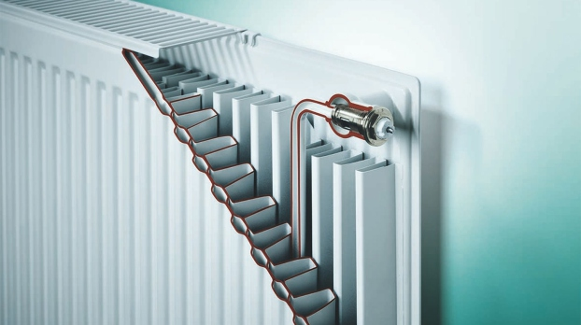
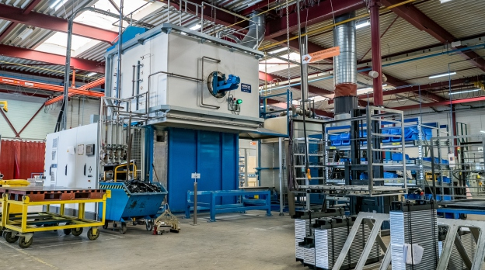
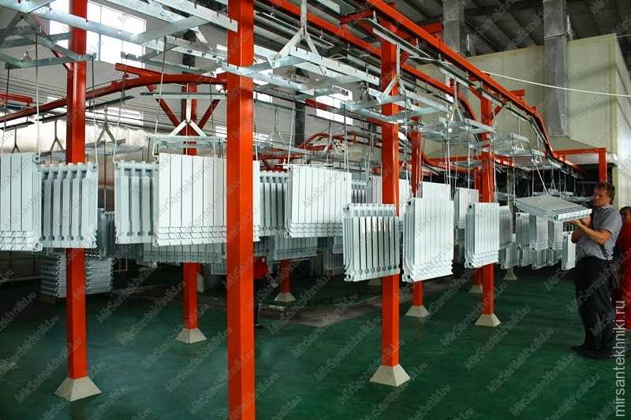
Production of flat heating radiators
INVESTMENT OFFER
The estimated market volume of Uzbekistan for 2022 in flat heating radiators is predicted to be 17.51 ​​thousand tons or 34.9 million US dollars.
Capacity: 640 thousand pieces
Project cost:$ 23,14 mln.
Investment requirement:$ 10,6 mln.
IRR 35,8%
NPV:$ 53,8 mln.
PP: 34 month
Location: Jizzakh region,
Mirzachul district
CONTACT US
Project partner: JSC "Gagarin invest group"
uzipa@invest.gov.uz
+ 998 94-651-50-07
Support required? - Investment promotion Agency
+998 (71) 202-02-10

Slide 8
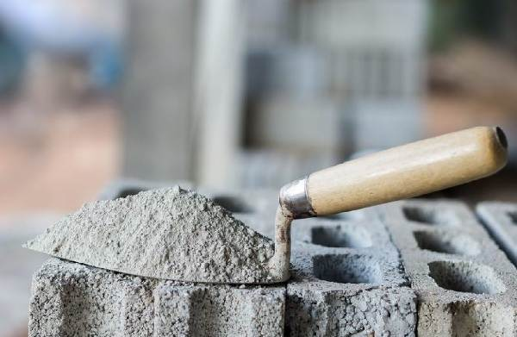
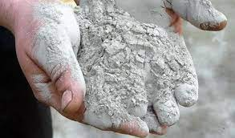



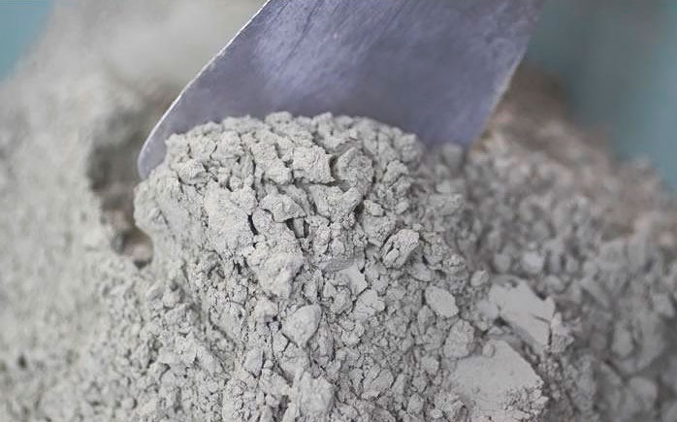



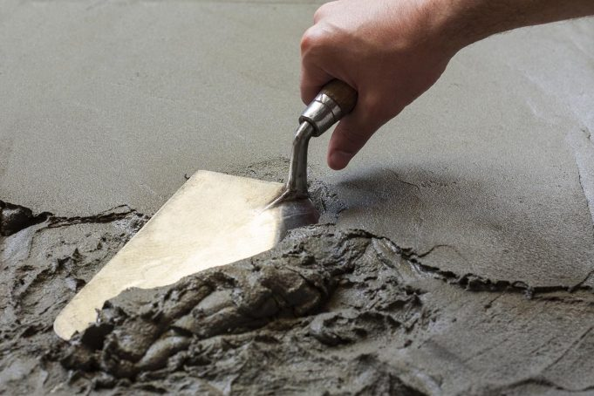




INVESTMENT OFFER
Cement production
Production Capacity: 1,3 mln tons
Сost of the Project: $ 87 million
IRR: 39 %
NPV: $ 78 million
Payback Period: 72 months
No. of Working Places: 90
Project Location: Forish of the district
Initiator: "JIZZAKH ZAAMIN CEMENT" LLC
контакт
Telephone: +998 (71) 202-02-10
Email: uzipa@investgov.uz
www.investgov.uz

Slide 9
INVESTMENT OFFER
Cement production
Production Capacity: 1,0 mln tons
Сost of the Project: $ 63 million
IRR: 23 %
NPV: $ 46 million
Payback Period: 72 months
No. of Working Places: 120
Project Location: Forish of the district
Initiator: "JIZZAX SEMENT" LLC
контакт
Telephone: +998 (71) 202-02-10
Email: uzipa@investgov.uz
www.investgov.uz

Slide 10

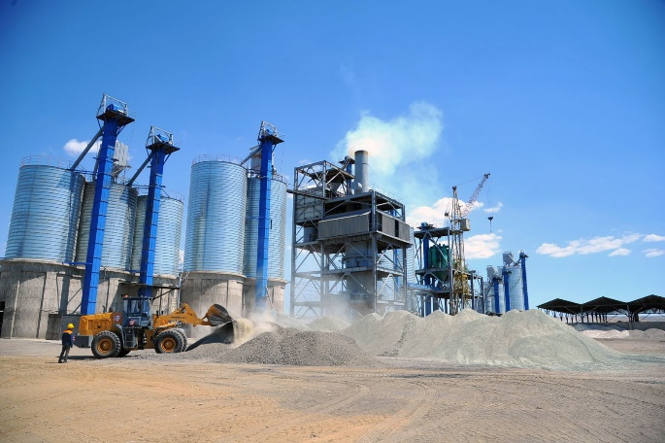

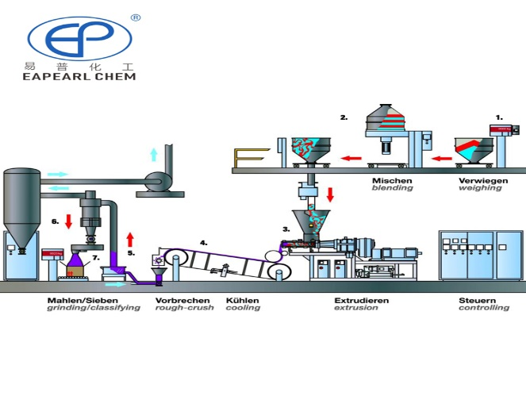



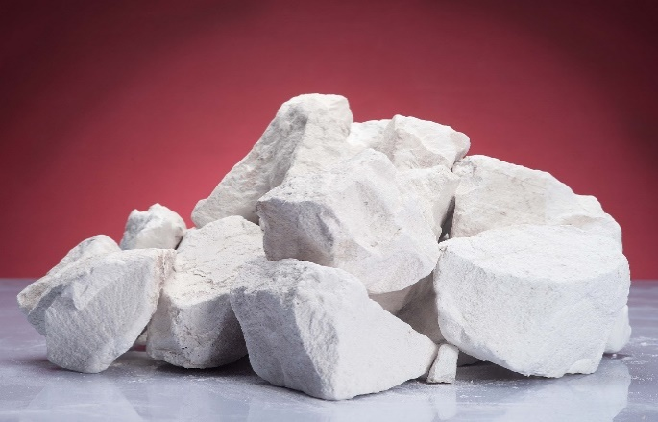

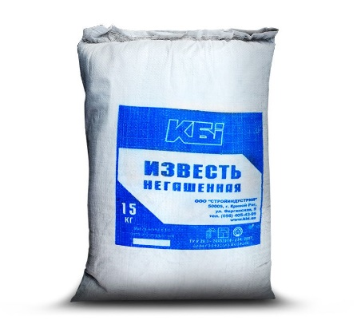



ENG
Lime plant (SO2 and lime).
Project cost: $ 1,5 million ($ 0,5 million own resources, $1,1 million bank loans)
Production capacity (per year):
4500 tons.
IRR (fin):
2,2 %
NPV (fin):
0,5 million dollar
Annual market need:
1,1 million tons
Project payback:
24 months
Jobs:
25 people
Project implementation period:
12 months
Project location:
Zafarabad district, jizakh region
INVESTMENT OFFER

Slide 11
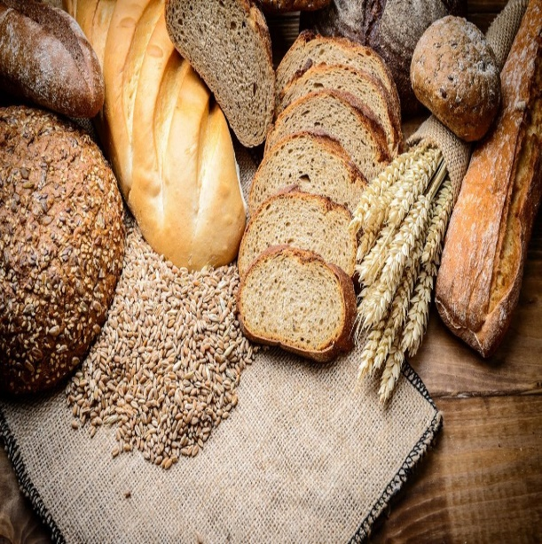
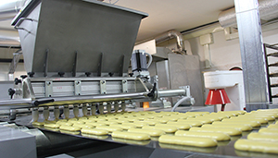


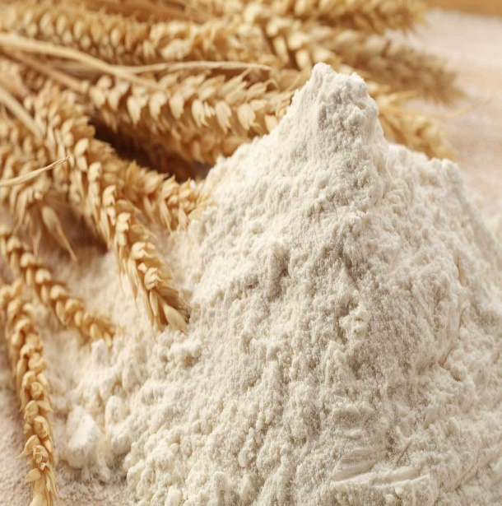


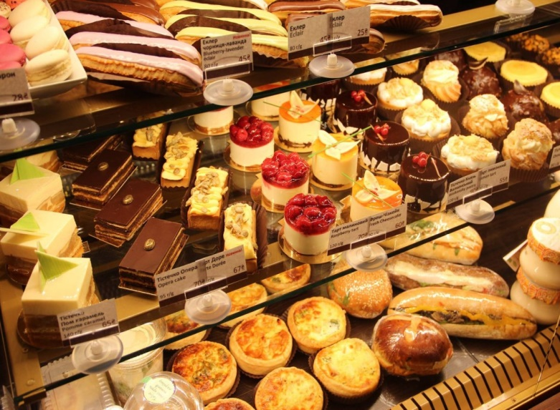




INVESTMENT OFFER
Production of high quality flour products
The global market for flour confectionery products amounted to 76.9 million tons, equivalent to $516.3 billion.
Capacity: 3246 tons
Project Сost : $1,3 million
Need for investment : 1 million
IRR: 26,6 %
NPV: $ 1,99 million
PP: 50 months
Location: Jizzakh region,
Jizzakh city
CONTACT US
Project partner: «Jizzakh Kentex» LLC
uzipa@invest.gov.uz
+998 97 295 00 50
Support required? - Investment promotion Agency
+998 (71) 202-02-10

Slide 12
Arnasoy District, Jizzakh Region, "AGRO FOOD COOPERATION" LLC, a project to organize
Machine Translated by Google
the production of food products on a cooperative basis
OBJECTIVE OF THE PROJECT
Increasing the efficiency of production of agricultural products on the basis of
cooperation, creating new jobs
ANNUAL PRODUCTION CAPACITY
148 billion ready-made food products
23 billion soum pure foya
WORKSHOP AND EQUIPMENT SUPPLIERS
ANNUAL EXPORT VOLUME
LAND AREA REQUIRED
EUROPEAN AND ASIAN COUNTRIES
11 mln. DOLLARS
500 ha
TURNIP GROWING:
Financial costs - 1 million for planting and harvesting.
US dollars.
PRODUCTION OF CATTLE FEED:
Production of fodder based on turnip processing waste
and other wild plants - 1.5 million US dollars.
1000 HEAD BLACK CATTLE FARM:
For meat products - 250 bulls;
750 cows for dairy products
Construction of a farm complex -
5 million US dollars.
DAIRY PRODUCT
PRODUCTION:
Milk processing and milk powder production factory - 8
million US dollars.
PROVIDING EMPLOYMENT OF THE POPULATION:
Teaching, training and counseling
Providing seeds, providing agrotechnical services
Providing chemical and natural fertilizers
With fuel and lubricants
provide
TURNIP STORAGE WAREHOUSE:
Storage period - 1 year. Financial expenses for the refrigerator warehouse - 0.2 million US dollars.
TURNIP PROCESSING AND JUICE PRODUCTION:
Financial expenses - 4.8 million US dollars for technical workshops.
POPULATION INCOME:
48 million soums net profit per year from 10 hectares of land
Own funds:
6.5 mln. dollar
19 mln. dollar
400 people
Bank loans:
Jobs to be created:
PROJECT COST:
25.5
MLN. dollar.
Families involved in work on the basis of cooperation :
1000 - 1500 apartments
Start-up period: 4th quarter of 2022
Advantages:
Providing employment to the local unemployed and needy population Orientation of manufactured products
for export
Food stock
provide and new modern work
create places
Product export:
Turnip products - Arabia and European countries
Milk powder products - Asian and European countries
2022-2026
development of the intended New Uzbekistan
strategy implementation

Slide 13
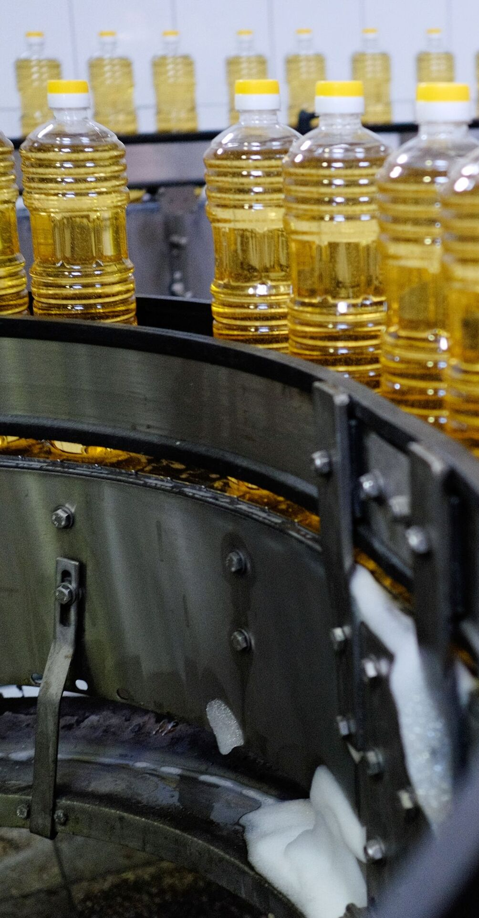
PRODUCTION OF VEGETABLE OIL
Jizzakh district, the city of Jizzakh
$4,5 million
56 700 thousand tons
($,1,35 million own resources,
$3,15 million bank loans)
6300 thousand tons
5 years
14%
60 people
$1,2 million
12 months

Slide 14

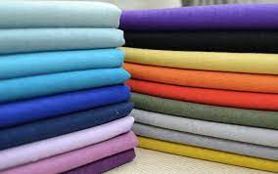
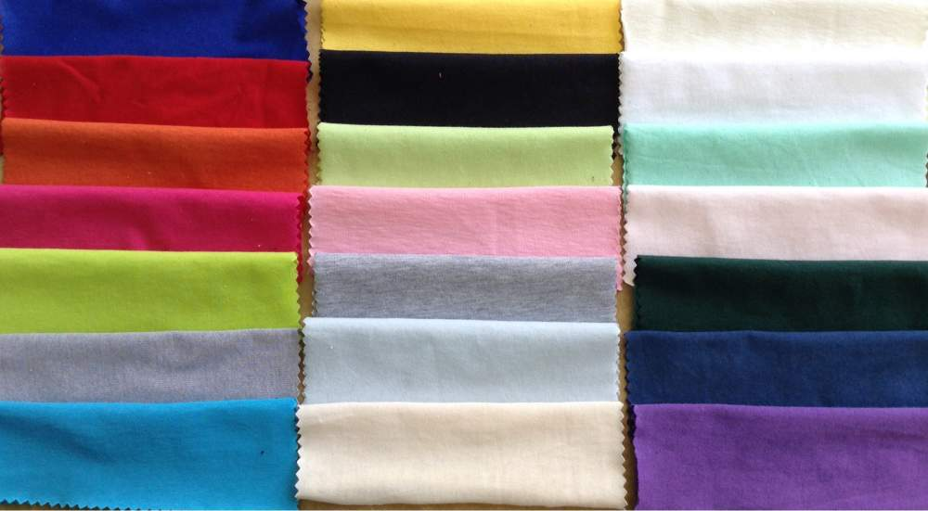
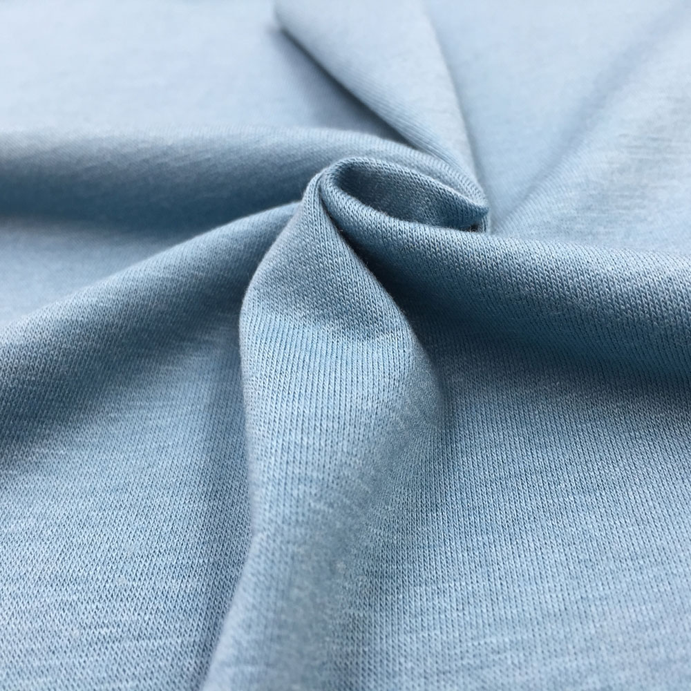
INVESTMENT OFFER
Production of knitted and crocheted products from synthetic fiber fabrics
Production Capacity: 7 300 tons
Сost of the Project: $ 17,0 million
IRR: 60-80 %
NPV: $ 1,4 million
Payback Period: 120 months
No. of Working Places: 100 piec`es
Project Location:Sharof Rashidov District Takhlik MFY
Initiator: Timlord trade cluster LLC
контакт
Telephone: +99871 202 02 10
Email: uzipa@invest.gov.uz
www.invest.gov.uz

Slide 15
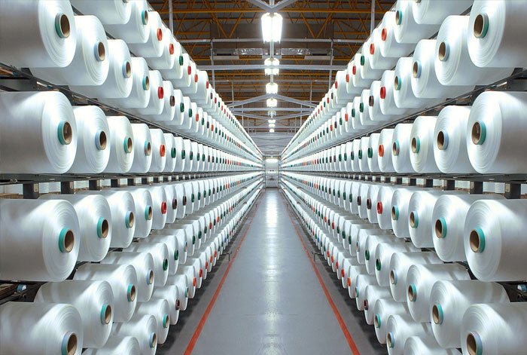
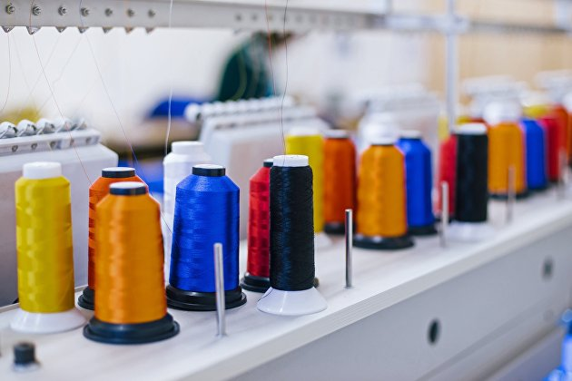
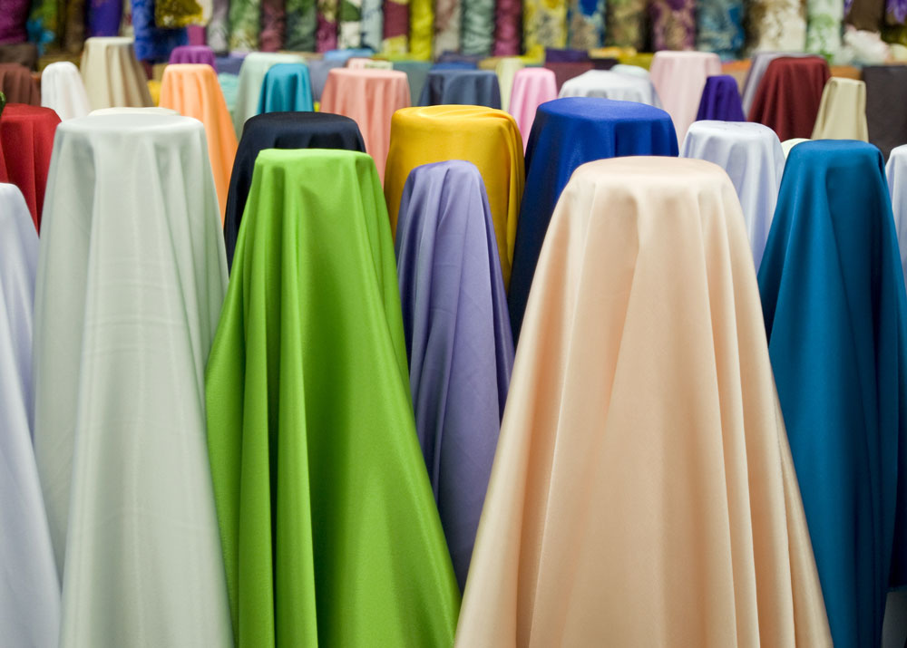
INVESTMENT OFFER
Production of yarn and knitwear
Production Capacity: 5 thousand tons (yarn)
Сost of the Project: $ 8,5 million
IRR: 22 %
NPV: $ 9,2 million
Payback Period: 52 months
No. of Working Places: 200
Project Location: Pakhtakor region
Bakhmal districtInitiator: “Pakhtakor Gold Textile”
Contact
Telephone: +998 (71) 202 02 10
Email: uzipa@invest.gov.uz
www.invest.gov.uz

Slide 16
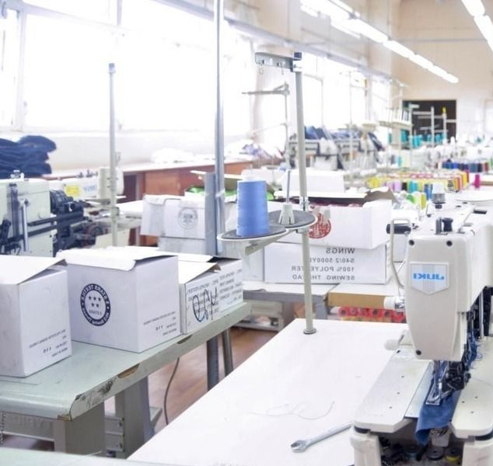
ORGANIZATION OF A SEWING FACTORY
Zafarabad district, jizakh region
$3,5 million
572,4 thousand units
592,2 thousand set
($1,05 million own resources,
$2,45 million bank loans)
95,4 thousand units
98,7 thousand set
6 years
6%
60 people
$0,2 million
12 months

Slide 17
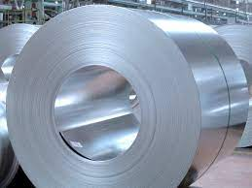
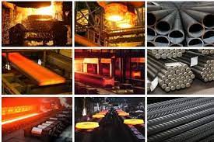
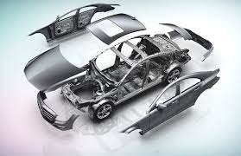
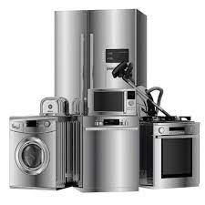
INVESTMENT OFFER
Organization of cold metal rolling complex
The demand for the products of the project exceeds more than
$3,5 million in the local market
In the neighboring countries of Uzbekistan $ 2,5 million
Potential non-CIS countries $ 1,5 million
Production Capacity: 500 tn.
Сost of the Project: $ 55 million
IRR: 28 %
NPV: $ 12,1 million
Payback Period: 80 months
No. of Working Places: 150
Project Location: Gobdin QFY of Gallaorol district
Initiator: "TRIANGUL METALS GALLAARAL" МЧЖ
контакт
Telephone: +998 (71) 202-02-10
Email: uzipa@invest.gov.uz
www.invest.gov.uz

Slide 18
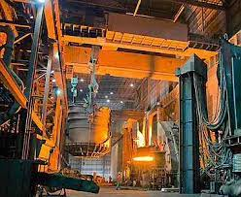
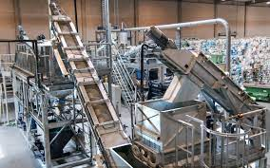
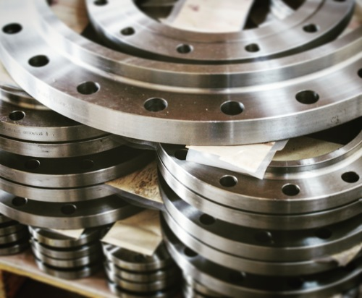
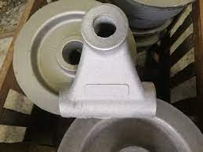
INVESTMENT OFFER
Metal casting factory
Production Capacity: 26 000 tn.
Сost of the Project: $ 26 million
IRR: 15 %
NPV: $ 29 million
Payback Period: 68 months
No. of Working Places: 100
Project Location: Gallaorol district
Initiator: "TRIANGUL METALS GALLAARAL" МЧЖ
контакт
Telephone: +998 (71) 202-02-10
Email: uzipa@invest.gov.uz
www.invest.gov.uz

Slide 19
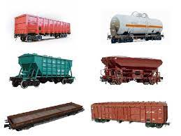
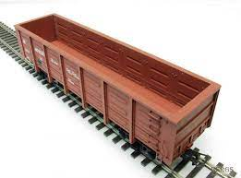
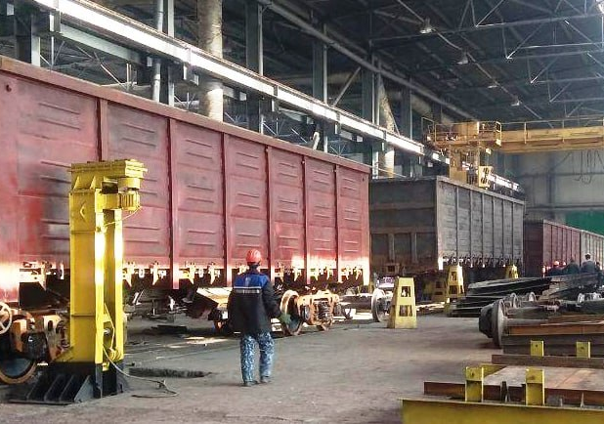
INVESTMENT OFFER
Production of semi-trucks
The demand for the products of the project exceeds more than
$ 380 million in the local market
In the neighboring countries of Uzbekistan $ 920 million
Potential non-CIS countries $ 4,5 billion
Production Capacity: 2 thousand pieces
Сost of the Project: $ 20 million
IRR: 10,2 %
NPV: $ 18 million
Payback Period: 45 months
No. of Working Places: 120
Project Location: Gallaorol district
Initiator: "TRIANGUL METALS GALLAARAL" МЧЖ
контакт
Telephone: +998 (71) 202-02-10
Email: uzipa@invest.gov.uz
www. invest.gov.uz

Slide 20

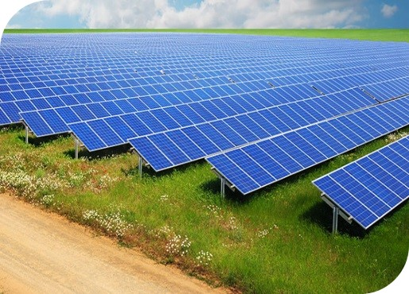
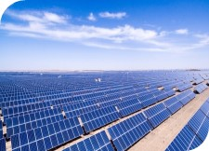

Construction of a solar photovoltaic power plant
INVESTMENT OFFER
By 2030, Uzbekistan will need to generate 2 times more electricity than it does today to meet the needs of the economy and the population, or, in other words, to ensure the country's energy security. To achieve this goal set by the country's leadership, the Ministry of Energy of the Republic of Uzbekistan is gradually implementing large-scale projects and coordinating the processes of reforming the industry in order to transfer it to market relations.
Capacity: 50 МW.
Project cost:$ 17 mln.
Investment requirement:$ 14,45 mln.
IRR 38,82%
NPV:$ 45,9 mln.
PP: 30 month
Location: Jizzakh region, Zarbdar district
CONTACT US
Project partner: "Boston Solar Group" LLC
uzipa@invest.gov.uz
+ 998 98-261-09-99
Support required? - Investment promotion Agency
+998 (71) 202-02-10

Slide 21
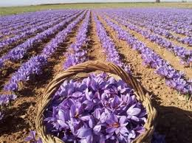
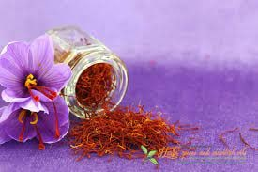
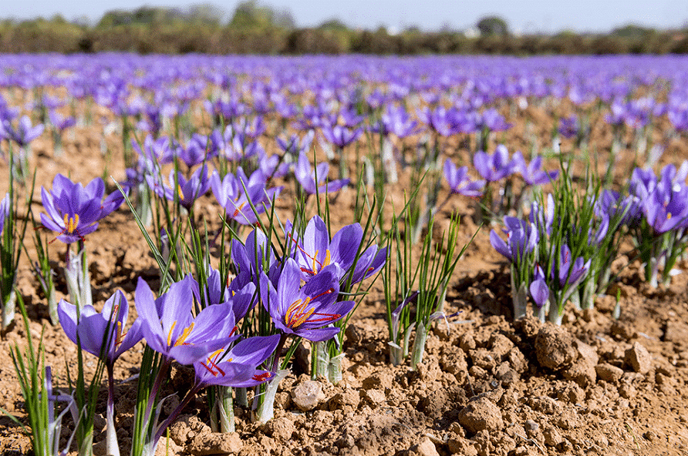
INVESTMENT OFFER
Cultivation of saffron plant and packing
Production Capacity: 200
Сost of the Project: $ 9,0 million
IRR: 22 %
NPV: $ 11,2 million
Payback Period: 48 months
No. of Working Places: 30
Project Location: Bakhmal districtInitiator: JV "BMB OPERA ZAFFERANO" LLC
Contact
Telephone: +998 (71) 202 02 10
Email: uzipa@invest.gov.uz
www.invest.gov.uz

