Slide 1
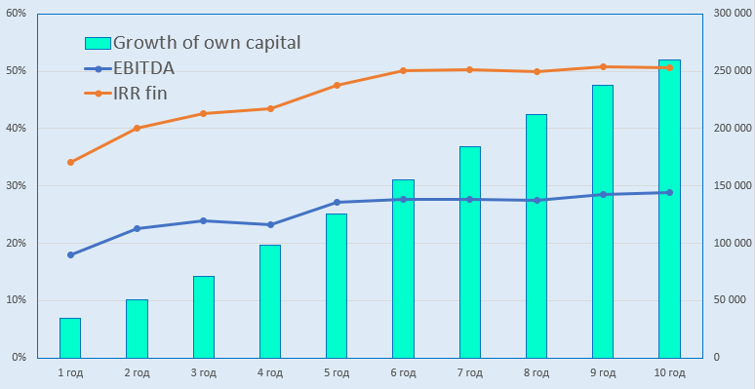
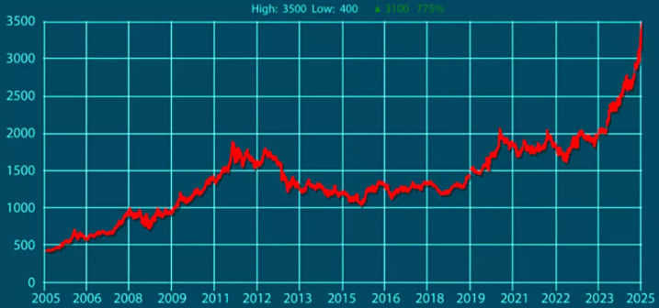
Development of gold and other precious metal deposits in the Navoiy Region
Industry
Geology and non-ferrous metallurgy
Project cost
The average cost of exploration expenses for gold reserves is $75 per ounce. The average capital expenditures for these projects will amount to approximately $200 per ounce.
The purpose of the project
The project provides for the development of deposits in the Navoiy region and the production of gold and other precious metals.
Investors will be offered 6 ore sites on a competitive basis for the extraction and production of precious metals.
Financing plan:
Project cost
100%
$32.0 million
Local contribution– 34,4% ($11.0 million)
Attracted loans– 30,6% ($9,8 million)
Direct investments - 35,0% ($11.2 million).
Machinery equipment
51%
$16.3 million
Construction
10,3%
$3.3 million
The final cost and financing structure of the project will be determined based on the results of negotiations with the investor.
Working capital
36,4%
$11.65 million
Deposits and forecast reserves
At the current mining rate, the remaining gold on earth will be mined in 15 years. However, there are an additional 110 thousand tons of gold in known mineral resources, which is quite enough to produce even after 2048.
Investment attractiveness of the project:
NPV, US$ million –164,3
IRR, % – 68,5%
PI – 8,4
DPP, years - 2,5
№ | Deposit name | Ore volume (million tons) | Gold reserves (kg) | Gold content in ore, g/ton
1 | Pirali | 10 487 | 15 812,7 | 1,51
2 | Ayakkuduk | 333 | 1000 | 3
3 | Jankeldy | 582,3 | 4056 | 7,7
4 | Akkazat | 4301,7 | 4605 | 1,07
5 | Korumdi | 221,6 | 1714 | 6,5
6 | Aydinbulak | 213,6 | 1265 | 5,92
 | Total | 16 139,2 | 28 453 | 4,28
Project placement
Navoiy Region
Market
Gold futures reached $3,500, and the spot price also briefly exceeded this level during intraday trading. This marks a staggering 775% increase in just 20 years.
The Initiator
The Ministry of Mining and Geology of the Republic of Uzbekistan implements a unified policy for the study, use, and protection of mineral resources, as well as ensuring the increase of mineral reserves and the reproduction of the mineral raw material base and industrial capacities on-site.
The interested investors will be provided with the available technical documentation for review after signing the NDA agreement.
What is the appeal of the project?
All signs point to gold being in the midst of a historical rise, with gold prices regularly reaching historic highs. Here are some forecasts supporting gold's upward momentum and strong macroeconomic foundation: Goldman Sachs: $4,500 by 2025; J.P. Morgan: $4,000 by the second quarter of 2026; R. Kiyosaki: $5,000 in 2025.
Navoi Region
Size | 110,8 km²
Population | 1,1 million
Required area
~ 5,0 ha

Slide 2
On the strategic international logistics corridor
Tallin
Sankt-Peterburg
Riga
Latvia
Moscow
Klaipeda
Hamburg
Minsk
Berlin
Brest
Povorina
Essen
Lviv
Kyiv
Paris
Chop
Volgograd
Kandiagash
Aktogay
Astraxan
Beyney
Saksaulskaya
Ulan-Bator
Osh
Bayangal-Mangal
Mersin
Malatya
Saraxa
Mazar-i-Sharif
Kashgar
Xirat
Afghanistan
Peshavar
Iran
Pakistan
Bandar-e-Abbas
Chakhbahar
Karachi

Slide 3
Excellent air connectivity from Tashkent and other Uzbek airports
New York
A visa-free policy for tourists from 90 countries
Diverse range of 59 carriers in Uzbekistan’s airport
11 airports across the Country, the main airports are Tashkent, Samarkand and Bukhara

