Slide 1
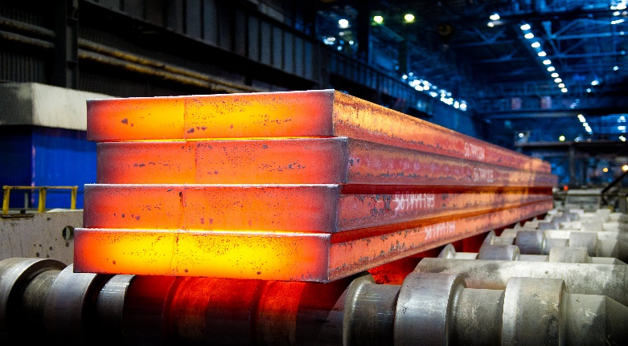
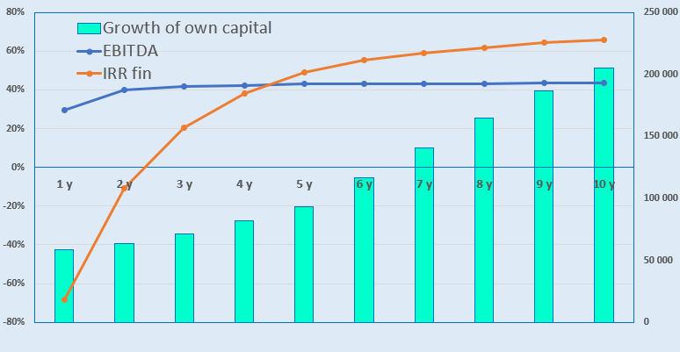
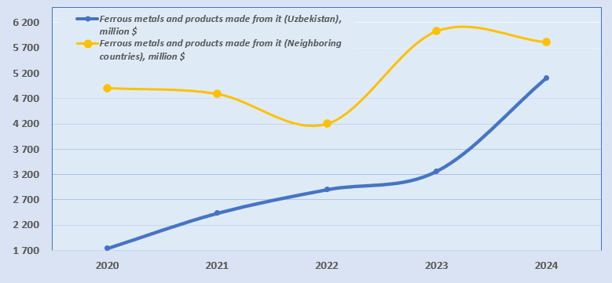
Development of iron ore fields
Industry
Geology and metallurgy
Project value
Financing plan :
Project goal
The project envisages the development of iron ore deposits in the Tashkent and Samarkand regions and the construction of a metallurgical plant.
More than 3 iron ore plots will be offered to investors on a competitive basis for the organization of ore extraction and metallurgical production.
Project value
100%
$106.35 mln.
Local contribution– 18,5% ($19.6 mln.)
Attracted loans– 45,8% ($48,7 mln.)
Direct investments - 35,7% ($37.99 mln.).
Machines and equipment
66,2%
$70.35mln.
Construction of buildings and structures
22,0%
$23.4mln.
The final cost and financing structure of the project will be determined after the feasibility study and the results of negotiations with the investor..
Working capital
8,8%
$9.34 mln.
Deposits and forecasted reserves
According to 2024 data, the global rate of iron ore extraction is about 2.5 billion tons per year. At the current rate of iron ore extraction, its deposits will be depleted in approximately 250 years.
Investment attractiveness of the project:
NPV, US$ million –82,2
IRR, % – 22,2%
PI – 2,43
DPP, years - 5,0
N | Name of deposit | Volume of ore, million tons | Iron reserves, million tons | Iron content in the ore, %
1 | Chigatay | 2,55 | 0,58 | 22,81%
2 | Temirli | 6,52 | 1,79 | 29,16%
3 | Laylakhona | 8,01 | 1,55 | 25,76%
 | In total | 17,07 | 3,92 | 25,9%
In the long term (2030), Uzbekistan plans to reduce import dependence and provide enterprises with competitive rolled metal, non-ferrous, rare-earth, and precious metals. The development of our own metallurgy contributes to the establishment of domestic high-tech industries and allows the country to occupy a worthy place in the world market.
Initiator
The Ministry of Mining Industry and Geology of the Republic of Uzbekistan implements a unified policy for the study, use, and protection of subsoil resources, as well as ensures the growth of mineral reserves and the reproduction of the mineral resource base and industrial capacities at the local level.
Interested investors will be provided with available technical documentation for review after signing the NDA agreement.
Project placement
Tashkent region
Demand
In 2024, the volume of Uzbekistan's imports of ferrous metal and its products amounted to more than 5.1 billion US dollars.
Tashkent region
Area | 15 300 km²
Population | 3,1 million
Required area ~ 65,0 hа
6%

Slide 2
On the strategic international logistics corridor
Tallin
Sankt-Peterburg
Riga
Latvia
Moscow
Klaipeda
Hamburg
Minsk
Berlin
Brest
Povorina
Essen
Lviv
Kyiv
Paris
Chop
Volgograd
Kandiagash
Aktogay
Astraxan
Beyney
Saksaulskaya
Ulan-Bator
Osh
Bayangal-Mangal
Mersin
Malatya
Saraxa
Mazar-i-Sharif
Kashgar
Xirat
Afghanistan
Peshavar
Iran
Pakistan
Bandar-e-Abbas
Chakhbahar
Karachi

Slide 3
High-quality air communication from Tashkent and
other airports of Uzbekistan.
New York
Visa-free regime for tourists from 90 countries
A wide range of 59 air lines represented at Uzbekistan's airports
There are 11 airports across the country, the main ones being in Tashkent, Samarkand, and Bukhara.

