Slide 1

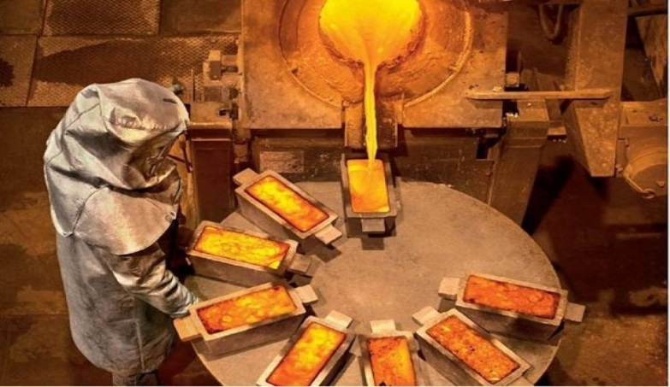

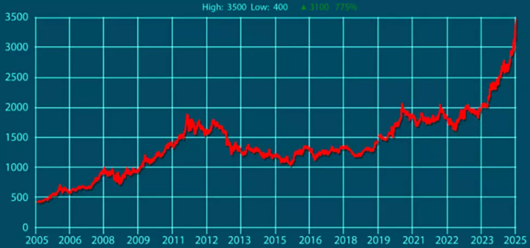
Investment Projects for the Development of Gold and Other Metal Deposits in the Republic of Uzbekistan
Industry
Geology and Non-Ferrous Metallurgy
General Information on Deposits
Number of Deposits
38 units
Value of Reserves
$ 11,4 billion
Employment Opportunities
2248 people
Project goal
The development of the sector is driven by the expansion of exploration activities for new raw material sources within known ore regions and new promising areas in Meso-Cenozoic formations. The project provides for the auction-based sale of exploration and mining rights for gold and other metals at approximately 38 deposits across the Republic of Uzbekistan.
The average exploration cost for gold reserves is estimated at $75 per ounce.
The average capital expenditures for these projects are expected to be around $200 per ounce.
The final cost and financing structure of the project will be determined based on the results of negotiations with the investor.
Tashkent region
Bukhara region
Number of Deposits
5
Value of Reserves
Number of Deposits
3
Value of Reserves
Deposits and Estimated Reserves
Proven gold reserves in Uzbekistan amount to 6,4 thousand tons. The country also holds large deposits of silver — 24,6 thousand tons, and copper — 21,3 million tons. Significant reserves of non-ferrous metals create opportunities for investment in extraction and processing.
According to the State Committee on Geology and Mineral Resources of Uzbekistan, the country has 41 registered gold deposits, including 33 primary gold ore deposits.
Uzbekistan’s estimated gold resources are more than twice the volume of its explored reserves.
For example:
4260 tons — resources of primary gold ore bodies, the majority of which are located in the Kyzylkum region (2434 tons) and the Samarkand region (1571 tons).
2500 tons — resources of gold-bearing deposits, most of which are located in the Pre-Tashkent region (2445 tons).
$ 2,3 billion
$ 3,0 billion
Jizzakh region
Kashkadarya region
Number of Deposits
4
Value of Reserves
Number of Deposits
1
Value of Reserves
$ 1,2 billion
$ 1,5 billion
Navoiy region
The Republic of Karakalpakstan
Number of Deposits
12
Value of Reserves
Number of Deposits
1
Value of Reserves
$ 2,0 billion
$ 0,45 billion
Samarkand region
Surkhandarya region
Market
Gold futures reached $3,500, and the spot price also briefly surpassed this level during intraday trading. This is a stunning increase of 775% in just 20 years!
Number of Deposits
4
Value of Reserves
Number of Deposits
8
Value of Reserves
$ 0,5 billion
$ 0,9 billion
Initiator
The Ministry of Mining Industry and Geology of the Republic of Uzbekistan is responsible for implementing a unified policy on the exploration, use, and protection of subsoil resources, as well as ensuring the growth of mineral reserves and the development of local mineral resource bases and industrial capacities.
Interested investors will be provided with available technical documentation for review upon signing a Non-Disclosure Agreement (NDA).
What makes the project attractive?
All signs indicate that gold is in the midst of a historic rally, with prices consistently reaching record highs. Here are some forecasts supporting gold’s upward momentum and solid macroeconomic foundation: Goldman Sachs: $ 4,500 in 2025 ;J.P. Morgan: $4,000 by Q2 2026;R. Kiyosaki: $5,000 in 2025.

Slide 2
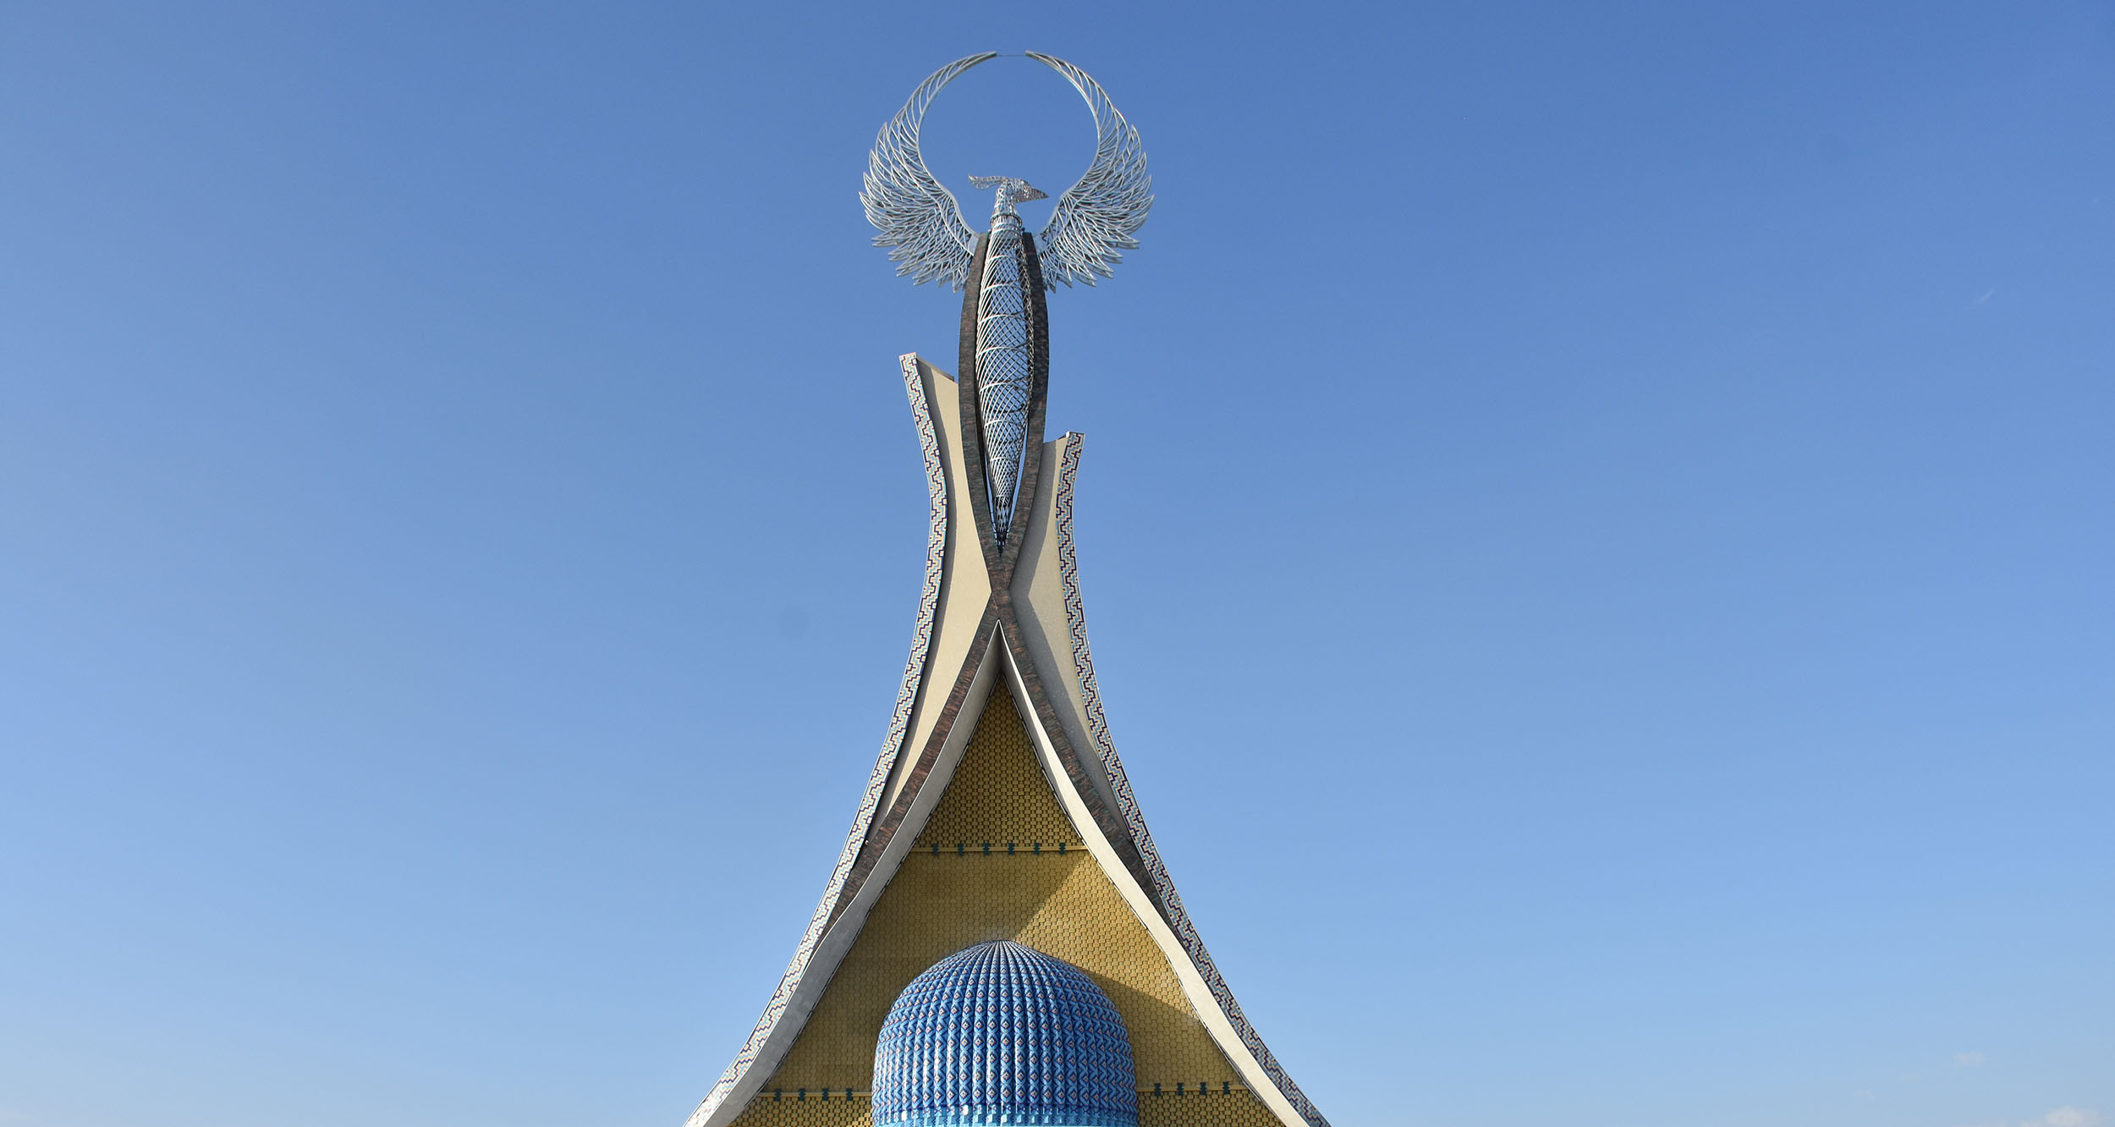
Project Proposals

Slide 3


List of Investment Projects
for the Development of Gold and Other Metal Deposits
№ | Project Names | Mineral Name | Estimated Reserves, in Tons |  | Metal Content, g/t | Deposit Location | Jobs | Reserve Value (USD billion) | Стоимость запаса
 |  |  | Ores | Metal
 |  |  |  |  |  |  | 2 282 | 11,4 | 11,4
1 | Gold Extraction at the “AKBA” Deposit | Gold | 3 106 730,0 | 13,97 | 4,50 | Kashkadarya Region, Kitab District (50 km southwest of the city of Shakhrisabz and 42 km from the city of Kitab, 1.5–2 km south of the village of Madmon)Спросить | 301 | 1,5 | 1,5
2 | Exploration and Extraction of Gold at the “Yambyskak” Deposit | Gold, silver | To Be Estimated After Geological Exploration |  |  | Navoi Region, Tamdy District, 62 km from the district center Tomdy, 72 km from the city of Zarafshan, 19 km from the settlement of Ayakuduk | To be specified and estimated after geological exploration works
3 | Exploration and Mining of Gold at the “Balakarak” Deposit | Gold | To Be Estimated After Geological Exploration |  |  | Navoi Region, Kanimekh District (16 km east of the Karakata railway station, 20 km east of the Chengeldu settlement, and 10 km northeast of the Balakarak settlement) | To be specified and estimated after geological exploration works
4 | Gold Mining at the “Temirchi” Deposit | Gold | 2 967 000,0 | 6,0 | 2,02 | Navoi Region, Nurata District (21 km from the settlement of Debaland, 23 km from the city of Kanimekh) | 129 |  | 0,6
5 | Gold Mining at the “Pirali” Deposit | Gold | 15 696 000,0 | 22,9 | 1,46 | Bukhara Region, Gijduvan District (20 km from the city of Zafarabad, 23 km from the city of Kanimekh) | 494 |  | 2,5
6 | Gold Mining at the “Ayakuduk” Deposit | Gold | 333 300,0 | 1,0 | 3,00 | Navoi Region, Tomdy District (within the territory of the Ayakkuduk settlement, 50 km from the city of Aristantau) | 22 |  | 0,11
7 | Gold Mining at the “Zhonkeldi” Deposit | Gold | 582 300,0 | 4,0 | 6,87 | Navoi Region, Nurata District (21 km from the Debaland settlement, 23 km from the city of Kanimekh) | 86 |  | 0,4
8 | Gold Mining at the “Zhonkeldi” Deposit | Silver | 582 300,0 | 13,9 | 23,87 | Navoi Region, Nurata District (21 km from the Debaland settlement, 23 km from the city of Kanimekh) | 3 |  | 0,017
9 | Gold Mining at the “Akkazat” Deposit | Gold | 4 301 700,0 | 4,6 | 1,07 | Navoi Region, Tamdy District (62 km from the district center Tomdy, 72 km from the city of Zarafshan, 23 km from the settlement of Ayakuduk) | 99 |  | 0,5
Why Invest in the Mining and Geological Sector?
1. Constant Demand for Natural Resources. They form the foundation of all production processes and are essential for building global infrastructure as well as maintaining and repairing existing facilities.

Slide 4
List of Investment Projects
for the Development of Gold and Other Metal Deposits
№ | Project Names | Mineral Name | Estimated Reserves, in Tons |  | Metal Content, g/t. | Deposit Location | Jobs | Reserve Value (USD billion) | Стоимость запаса, (млрд. долл.)
 |  |  | Ores | Metal
10 | Gold Mining at the “Korumdi” Deposit | Gold | 221 600,0 | 1,7 | 7,67 | Navoi Region, Konimekh District (17 km from the village of Shamurat, 23 km from the city of Konimekh) | 37 | 0,2 | 0,2
11 | Gold Mining at the “Korumdi” Deposit | Silver | 221 600,0 | 3,6 | 16,25 | Navoi Region, Konimekh District (17 km from the village of Shamurat, 23 km from the city of Konimekh) | 1 | 0,004 | 0,004
12 | Exploration and Mining of Gold at the “Ayrak” Deposit | Gold | To Be Estimated After Geological Exploration |  |  | Navoi Region, Tamdy District (62 km from the district center Tomdy, 72 km from the city of Zarafshan, 23 km from the settlement of Ayakuduk) | To be specified and estimated after geological exploration works
13 | Gold Mining at the “Aydynbulak” Deposit" | Gold | 213 600,0 | 1,2 | 5,62 | Navoi Region, Nurata District (20 km from the Debaland settlement, 22 km from the city of Kanimekh) | 26 |  | 0,1
14 | Gold Mining at the “Aydynbulak” Deposit | Silver | 213 600,0 | 7 | 32,77 | Navoi Region, Nurata District (20 km from the Debaland settlement, 22 km from the city of Kanimekh) | 2 |  | 0,008
15 | Gold Mining at the “Chettik” Deposit | Gold | 2 231 470,0 | 4,57 | 2,05 | Bukhara Region, Gijduvan District (15 km from the city of Zafarabad, 21 km from the city of Kanimekh) | 98 |  | 0,5
16 | Gold Mining at the “Beltau” Deposit | Gold | 547 000,0 | 0,44 | 0,80 | Peshku District, Bukhara Region (in the northwestern part of the Kuldzhuktau mountain system, 7.5 km west of the settlement of Kalaata) | 9 |  | 0,047
17 | Gold Mining at the “Avliyo” Deposit | Gold | 4 438 600,0 | 11,01 | 2,48 | Jizzakh Region, Gallyaaral District (20 km from the district center Gallyaaral, 6 km from the village of Uzunbulak) | 237 |  | 1,2
18 | Gold Mining at the “Avliyo” Deposit | Silver | 4 438 600,0 | 1,6 | 0,36 | Jizzakh Region, Gallyaaral District (20 km from the district center Gallyaaral, 6 km from the village of Uzunbulak) | 0 |  | 0,0019
19 | Exploration and Mining of Gold at the “Yulsay” Deposit | Gold | To Be Estimated After Geological Exploration |  |  | Jizzakh Region, Zaamin District, 30–40 km from the district center Zaamin; the nearest settlements, Yettykechu, are located 7–8 km from the project site | To be specified and estimated after geological exploration works
Why Invest in the Mining and Geological Sector?
2. Presence of Strategically Important Mineral Potential. The country has made a strategic decision to focus on the extraction of high-income mineral resources (such as gold, silver, copper, uranium, hydrocarbons, and zinc), minerals with high added value (including copper, iron, lead, and other technological metals), as well as metals essential for the transition to green energy (such as lithium, copper, tungsten, molybdenum, niobium, magnesium, tantalum, and graphite).

Slide 5
List of Investment Projects
for the Development of Gold and Other Metal Deposits
№ | Project Names | Mineral Name | Estimated Reserves, in Tons |  | Metal Content, g/t | Deposit Location | Jobs | Reserve Value (USD billion)
 |  |  | Ores | Metal
20 | Exploration and Mining of Gold at the “Zargar” Deposit | Gold | To Be Estimated After Geological Exploration |  |  | Jizzakh Region, Gallyaaral District (10 km from the district center Gallyaaral, 19 km from the city of Jizzakh) | To be specified and estimated after geological exploration works
21 | Exploration and Mining of Gold at the “Kayraktas” Deposit" | Gold | To Be Estimated After Geological Exploration |  |  | Republic of Karakalpakstan, Beruni District (10 km northwest of the village of Kalandarkhana, 35 km from the city of Buston) | To be specified and estimated after geological exploration works
22 | Iron Mining at the “Chigatay” Deposit | Iron | 2 546 010,0 | 580 490,3 |  | Samarkand Region (8.2 km east of the district center Koshrabat, 23.2 km south of the city of Mitan) | 70 | 0,35
23 | Exploration and Mining of Gold at the “Zargar 1” Deposit | Gold | To Be Estimated After Geological Exploration |  |  | Samarkand Region, Kushrabad District (25 km northeast of the town of Kushrabad, 22 km from the settlement of Zarmitan) | To be specified and estimated after geological exploration works
24 | Gold Mining at the “Akbel” Deposit | Gold | 4 180 000,0 | 1,0 | 4,18 | Samarkand Region, Kushrabad District (25 km northwest of the town of Kushrabad, 22 km west of the settlement of Zarmitan) | 22 | 0,11
25 | Exploration and Mining of Tin at the “Lapas” Deposit" | Tin | To Be Estimated After Geological Exploration |  |  | Samarkand Region, Nurabad District (11 km from the village of Tim, 25 km from the city of Aktash, 24 km from the city of Ingichka) | To be specified and estimated after geological exploration works
26 | Gold Mining at the “BAYRAM-1 (Yubileynoye)” Deposit | Gold | 5 740 000,0 | 1,40 | 4,10 | Surkhandarya Region, Sariosiyo District (4 km from the village of Yangaklyk, 20 km from the city of Shargun)) | 30 | 0,2
27 | Gold Mining at the “Karakan” Deposit | Gold | 31 960 000,0 | 4,70 | 6,80 | Surkhandarya Region, Sariasiyo District (7 km from the village of Yangaklyk, 18 km from the city of Shargun) | 101 | 0,5
28 | Gold Mining at the “Karakan” Deposit | Silver | 31 960 000,0 | 70,50 | 4068,00 | Surkhandarya Region, Sariasiyo District (7 km from the village of Yangaklyk, 18 km from the city of Shargun) | 17 | 0,1
29 | Gold Mining at the “Karakan” Deposit | Lead | 31 960 000,0 | 17551,00 | 12,30 | Surkhandarya Region, Sariasiyo District (7 km from the village of Yangaklyk, 18 km from the city of Shargun) | 7 | 0,036
Why Invest in the Mining and Geological Sector?
3. Stimulation of Growth in Related Sectors. The mining and metallurgical industry supplies raw materials for electrical engineering, construction materials production, the chemical industry, and jewelry manufacturing

Slide 6
List of Investment Projects
for the Development of Gold and Other Metal Deposits
№ | Project Names | Mineral Name | Estimated Reserves, in Tons |  | Metal Content, g/t. | Deposit Location | Jobs | Reserve Value (USD billion)
 |  |  | Ores | Metal
30 | Gold Mining at the “Karakan” Deposit | Zinc | 31 960 000,0 | 39150,00 | 7,90 | Surkhandarya Region, Sariasiyo District (7 km from the village of Yangaklyk, 18 km from the city of Shargun) | 21 | 0,1
31 | Exploration and Mining of Lead at the “Yangaklyk” Deposit | Lead | To Be Estimated After Geological Exploration |  |  | Surkhandarya Region, Sariasiyo District (4 km from the village of Yangaklyk, 20 km from the city of Shargun) | To be specified and estimated after geological exploration works
32 | Exploration and Mining of Lead at the “Yangaklyk” Deposit | Zinc | To Be Estimated After Geological Exploration |  |  | Surkhandarya Region, Sariasiyo District (4 km from the village of Yangaklyk, 20 km from the city of Shargun) | To be specified and estimated after geological exploration works
33 | Exploration and Mining of Lead and Zinc at the “Kirgakli” Deposit" | Lead, Zinc | To Be Estimated After Geological Exploration |  |  | Surkhandarya Region, Sariasiyo District (8 km from the village of Yangaklyk, 15 km from the city of Darband) | To be specified and estimated after geological exploration works
34 | Gold Mining at the “Terekli” Deposit" | Gold | 432 000,00 | 2,2 | 5,0 | Ahangaran District, Tashkent Region (Nearby: 10 km from the settlement of Shaugaz, 2 km from the settlement of Kurgan) | 47 | 0,2
35 | Gold Mining at the “Tolbulok” Deposit | Gold | 209 300,00 | 1,0 | 4,7 | Tashkent Region, Akhangaran District (27 km from the city of Almalyk, along the Tashkent–Kokand highway, with a power transmission line from the Novo-Angren Thermal Power Plant; a railway station is located 5 km away) | 21 | 0,1
36 | Gold Mining at the “Tolbulok” Deposit | Silver | 209 300,00 | 4,0 | 18,9 | Tashkent Region, Akhangaran District (27 km from the city of Almalyk, along the Tashkent–Kokand highway, with a power transmission line from the Novo-Angren Thermal Power Plant; a railway station is located 5 km away) | 1 | 0,005
37 | Iron Mining at the “Laylakhona” Deposit | Iron | 8 006 400,0 | 1 545 235,2 |  | Tashkent Region, Parkent District (4.5 km from the settlement of Kumushkan, 15 km from the city of Parkent) | 185 | 0,9
38 | Iron Mining at the “Temirli” Deposit | Iron | 6 516 400,0 | 1 792 010,0 |  | Tashkent Region, Parkent District (5.25 km from the settlement of Changir, 9.5 km from the city of Parkent) | 215 | 1,1
Why Invest in the Mining and Geological Sector?
4. The Ministry of Mining Industry and Geology of the Republic of Uzbekistan implements a unified policy for the study, use, and protection of subsoil resources, as well as ensuring the increase of mineral reserves and the development of the mineral resource base and local production capacities. Technical documentation will be provided to interested investors for review after the signing of a Non-Disclosure Agreement (NDA).

Slide 7

International logistics transport corridors
Tallin
Sankt-Peterburg
Riga
Latvia
Moscow
Klaipeda
Hamburg
Minsk
Berlin
Brest
Povorina
Essen
Lviv
Kyiv
Paris
Chop
Volgograd
Kandiagash
Aktogay
Astraxan
Beyney
Saksaulskaya
Ulan-Bator
Osh
Bayangal-Mangal
Mersin
Malatya
Saraxa
Mazar-i-Sharif
Kashgar
Xirat
Afghanistan
Peshavar
Iran
Pakistan
Bandar-e-Abbas
Chakhbahar
Karachi

Slide 8

Air connections from Tashkent and other airports of Uzbekistan
New York
A visa-free policy for tourists from
90 countries
Diverse range of 59 carriers in Uzbekistan’s airport
11 airports across the Country, the main airports are Tashkent, Samarkand and Bukhara

