Slide 1

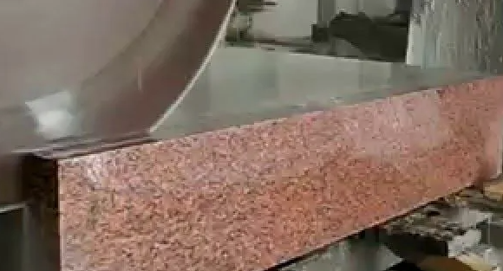

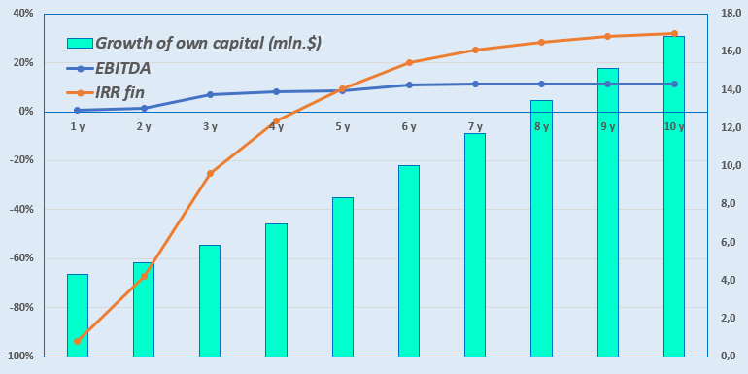
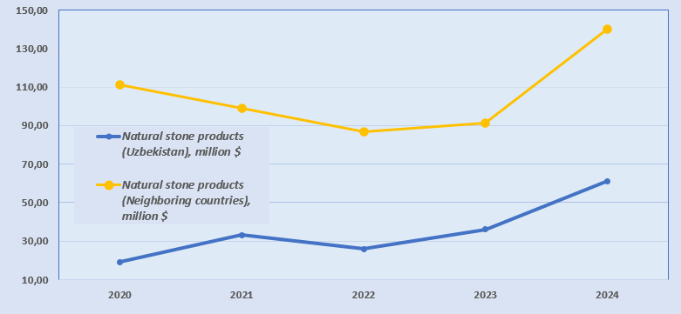
Production of facing slabs and products from granite blocks
Industry
Building materials industry
Project cost:
Total cost– US$ 4,1 million
Investment proposal
The investment volume is USD 4.1 million, of which:
Project goal
The company SARMISH-INVEST LLC plans to further process stone blocks mined in its own quarry into slabs and other products made of natural stone.
Buildings and structures
34,1%
$1,4 million
Contribution of the initiator- 48,0% ($1,72 mln.)
Kredits- 0,0% ($0,0 mln.)
Direct investment- 52,0% ($2,39 mln.).
Equipment
33,9%
$1,39 million
Working capital
23,4%
$1,0 million
The final cost and financing structure of the project will be determined after negotiations with investors..
Project products
Facing slabs (0.6x0.6m) and other products made of natural stone.
Other
7,2%
$0,29 million
What is the appeal of projects in this industry?
Possibility of using raw materials for the production of building materials.
Natural stone deposits (granite, marble, limestone, etc.) are a source of raw materials for the manufacture of products for the construction and cladding of buildings, architectural and construction products, and interior items.
Prospects for export of products. The development of deposits can contribute to the development of exports of natural stone products, such as marble products and building materials.
Possibility of rational use of reserves. For example, integrated development of deposits, organization of joint extraction of blocks and waste disposal, which increases the efficiency of development.
According to Future Market Report, the global natural stone market was valued at US$37.99 billion in 2024. It is projected to reach US$62.37 billion by the end of 2032.
Profitability:
Investment indicators:
NPV, US$ million–5,99
IRR, % – 20,9%
EBITDA, % – 11,0%
PI – 2,46
DPP, year- 5,3
Initiator
«SARMISH-INVEST» LLC
Location
Navoiy region
Demand
In 2024, the volume of imports of natural stone products in Uzbekistan amounted to 61 million US dollars, and in neighboring countries over 139 million US dollars.
Created in 2019 for the development of the SARMISH natural stone deposit (License series HY No. 0412)Authorized capital - 7,350,000 soums.
Address: Navoi region, Navbahor district, MFI Pakhtakor, Pakhtakor street, 12
Navoiy region
Area | 110 800 km²
Population | 1,0 million
Project area
~ 0,7 ha
6%

Slide 2
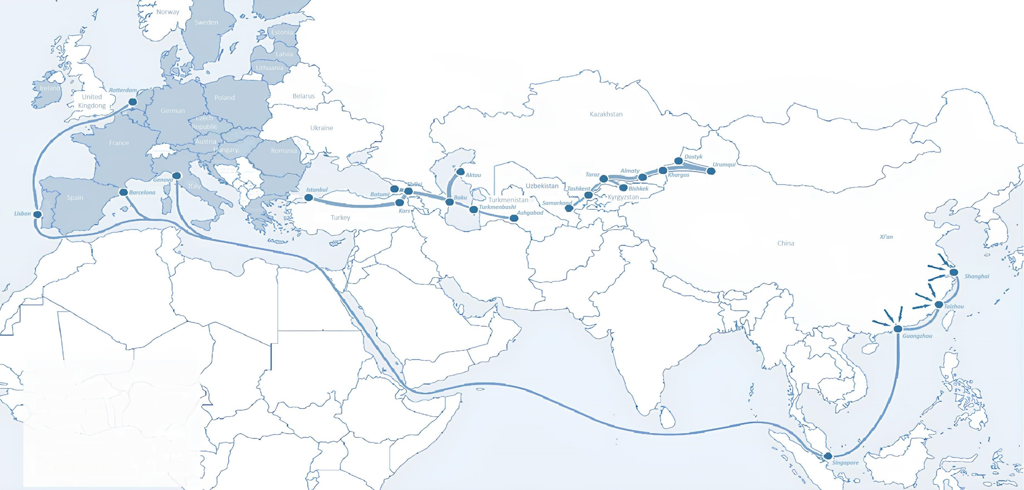
International logistics transport corridors
Tallin
Sankt-Peterburg
Riga
Latvia
Moscow
Klaipeda
Hamburg
Minsk
Berlin
Brest
Povorina
Essen
Lviv
Kyiv
Paris
Chop
Volgograd
Kandiagash
Aktogay
Astraxan
Beyney
Saksaulskaya
Ulan-Bator
Osh
Bayangal-Mangal
Mersin
Malatya
Saraxa
Mazar-i-Sharif
Kashgar
Xirat
Afghanistan
Peshavar
Iran
Pakistan
Bandar-e-Abbas
Chakhbahar
Karachi

Slide 3
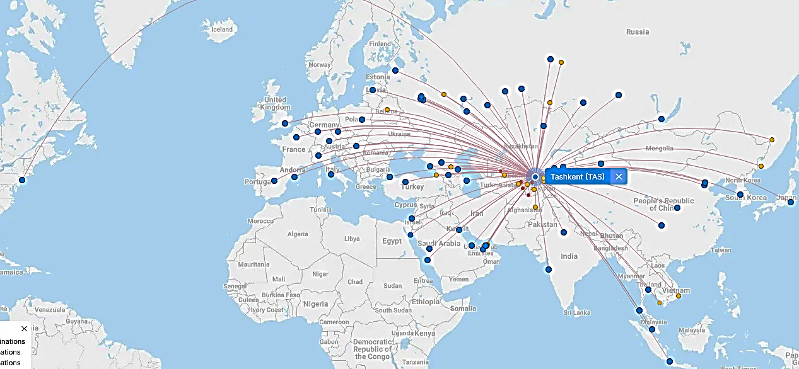
Flights from Tashkent and other airports in Uzbekistan
New York
Visa-free travel for tourists from 90 countries
There are 59 different airlines operating at Uzbekistan airport
11 airports across the country, the main ones being Tashkent, Samarkand and Bukhara.

