Slide 1

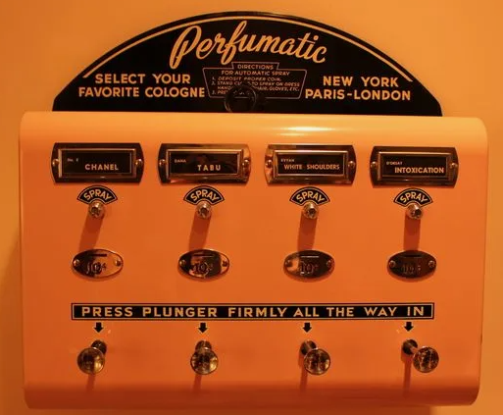

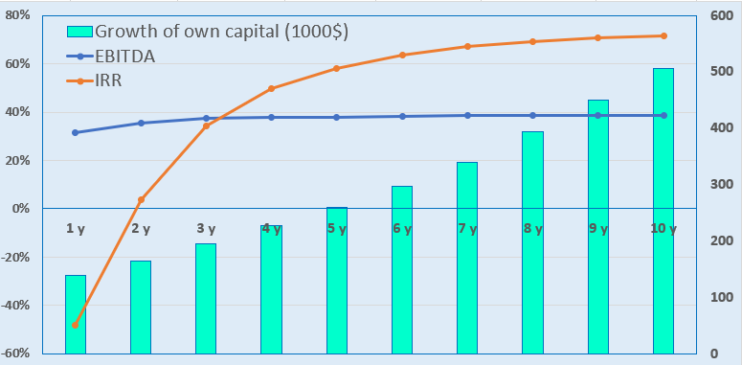
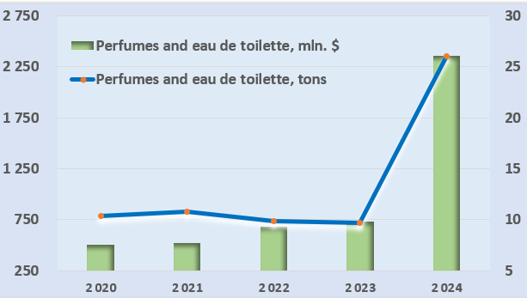
Creation of a network of commercial perfume and cologne spraying machines
Industry
Perfumery industry and retail trade
Project cost:
Total cost $ 22,3 million
Investment plan
Total investment amount— 27,0 mln US dollars, of which:
Project objective
Creation of a modern retail network of stationary street perfumes and other liquid perfume products.
The project is aimed at increasing the availability of high-quality and expensive perfumery products for the population. At the initial stage, the project provides for the installation of about 60 street vending machines providing perfume and cologne spraying services.
Buildings and structures
5,4%
$1,2 million
82,4%
$18,4 million
Initiator contribution 8,5% ($ 1,89 million)
Direct investments 91,5% ($ 20,4 million)
Equipment
Others
6,7%
$1,499 million
The final cost and financing structure of the project will be determined based on the results of negotiations with investors.
Working capital
5,5%
$1,23 million
Why invest in street vending machines for perfume products?
Profitability:
Investment indicators:
High product margin in the perfume industry, which can lead to high profits. The profit from selling perfume through street vendors can reach 1000%.
Repeated purchase incentives - perfumes are regularly used, and customers often need to replenish their inventory, leading to constant demand.
Process automation and online management. The machines operate around the clock, and the monitoring system allows owners to remotely track sales, remaining fragrances, and the technical condition of the device.
Free market niches. In most regions, the direction remains new and unexplored. This allows us to occupy promising equipment locations without high competition.
Economic benefit for clients. Instead of buying a whole bottle of perfume, which a person can rarely use or which may become obsolete, a single spray allows you to enjoy a variety of fragrances while saving significant funds.
NPV, US$ million – 86,2
IRR, % – 35,2%
EBITDA, % – 53,0 %
Payback period (DPP),
years —4,14
Бухарская область
Dynamics of imports (Uzbekistan):
Project initiator
Location
Market
The global market volume in 2024 exceeded $52.49 billion, and the average annual growth rate will be around 5.1%.
The volume of the perfume market in Uzbekistan will reach $134.77 million in 2025. From 2025 to 2030, the market is expected to grow by 4.05% annually.
Private entrepreneur
Tukhtaev Ikromjon Islamovich
Contacts: +998 91 448 32 26
Address: Bukhara region, Bukhara city.
Placement of equipment in
Bukhara and Tashkent city
Bukhara region
Area | 40200 km²
Population | 2,1 million
6%

Slide 2


International transport logistics
Tallin
Sankt-Peterburg
Riga
Latvia
Moscow
Klaipeda
Hamburg
Minsk
Berlin
Brest
Povorina
Essen
Lviv
Kyiv
Paris
Chop
Volgograd
Kandiagash
Aktogay
Astraxan
Beyney
Saksaulskaya
Ulan-Bator
Osh
Bayangal-Mangal
Mersin
Malatya
Saraxa
Mazar-i-Sharif
Kashgar
Xirat
Afghanistan
Peshavar
Iran
Pakistan
Bandar-e-Abbas
Chakhbahar
Karachi

Slide 3

Flights from Tashkent and other airports of Uzbekistan
New York
Visa-free travel for tourists from 90 countries
59 different airlines operate at the Uzbekistan airport.
There are 11 airports across the country, the main ones being Tashkent, Samarkand, and Bukhara.

