Slide 1
Investment projects of ecological tourism in the Republic of Uzbekistan
Republic of Uzbekistan
The area is 448,924 sq. km.
Population - 38 million people.
The ecotourism potential of Uzbekistan is associated with the diversity of natural landscapes. The country has unique natural objects favorable for ecotourism.
The area of protected natural areas preserving biological diversity is about 13.2 million hectares.
We invite investors for ecotourism projects in the Republic of Uzbekistan.
Indicators of proposed projects
Total area of eco-zones
Investment needs
New employee vacancies
279,1 ha
$ 10,9 mln.
568 employees
List of project proposals by sector
Andijan
region
Jizzakh
region
Kashkadarya
region
Ecozone area
8,2 ha
Ecozone area
21,9 ha
Ecozone area
0,02 ha
Why do we need to invest in ecotourism?
Ecological tourism is the only direction in the tourism industry that is interested in preserving the main resource - the natural environment or its individual components (monuments of nature, certain types of animals and plants, natural landscapes, etc.).
The presence of bio, hydro, geological, and paleontological heritage. 16 biological objects consisting of forested areas, juniper forests, shrubs and natural zones, 50 springs, 14 lakes, 3 rivers, 10 waterfalls, 4 canals and 82 hydrological objects including the Aral Sea, 10 caves, 5 ravines, 10 mountains, rocks and stones, 6 deserts, 31 geological objects including sand dunes and rocks, as well as the paleontological object "Dino Trace.“
Investments. By the end of 2025, Uzbekistan plans to attract $500 million in investments for the development of ecotourism within the framework of the State Program "Uzbekistan-2030." According to the Global Ecotourism Market report, the market size is $238.48 billion, and by 2032, the market size will reach $439.46 billion with an average annual growth rate (CAGR) of 7.94 percent.
Value
$1,02 mln.
Value
$3,85 mln.
Value
$0,07 mln.
Namangan region
Samarkand region
Surkhandarya
region
Ecozone area
20,1 ha
Ecozone area
2,0 ha
Ecozone area
22,5 ha
Value
$1,3 mln.
Value
$0,07 mln.
Value
$0,81 mln.
Tashkent
region
Syrdarya
region
Fergana
region
Ecozone area
186,7 ha
Ecozone area
3,0 ha
Ecozone area
14 ha
Market
The ecotourism market is estimated at 270.5 billion US dollars in 2025 and is projected to reach 551.8 billion US dollars by 2035, which will average 7.4% between 2025-2035.
Value
$2,5 mln.
Value
$0,11 mln.
Value
$1,1 mln.
Benefits
Reduction of taxes for hotels, SPA-hotels, sanatoriums and camps or theme parks in desert areas by 50% and exemption from land tax for a period of 10 years.
Reimbursement of VAT up to 40% of the share of non-cash settlements for entrepreneurs in this area.
Initiator of the project
Ministry of Ecology, Environmental Protection and Climate Change of the Republic of Uzbekistan

Slide 2
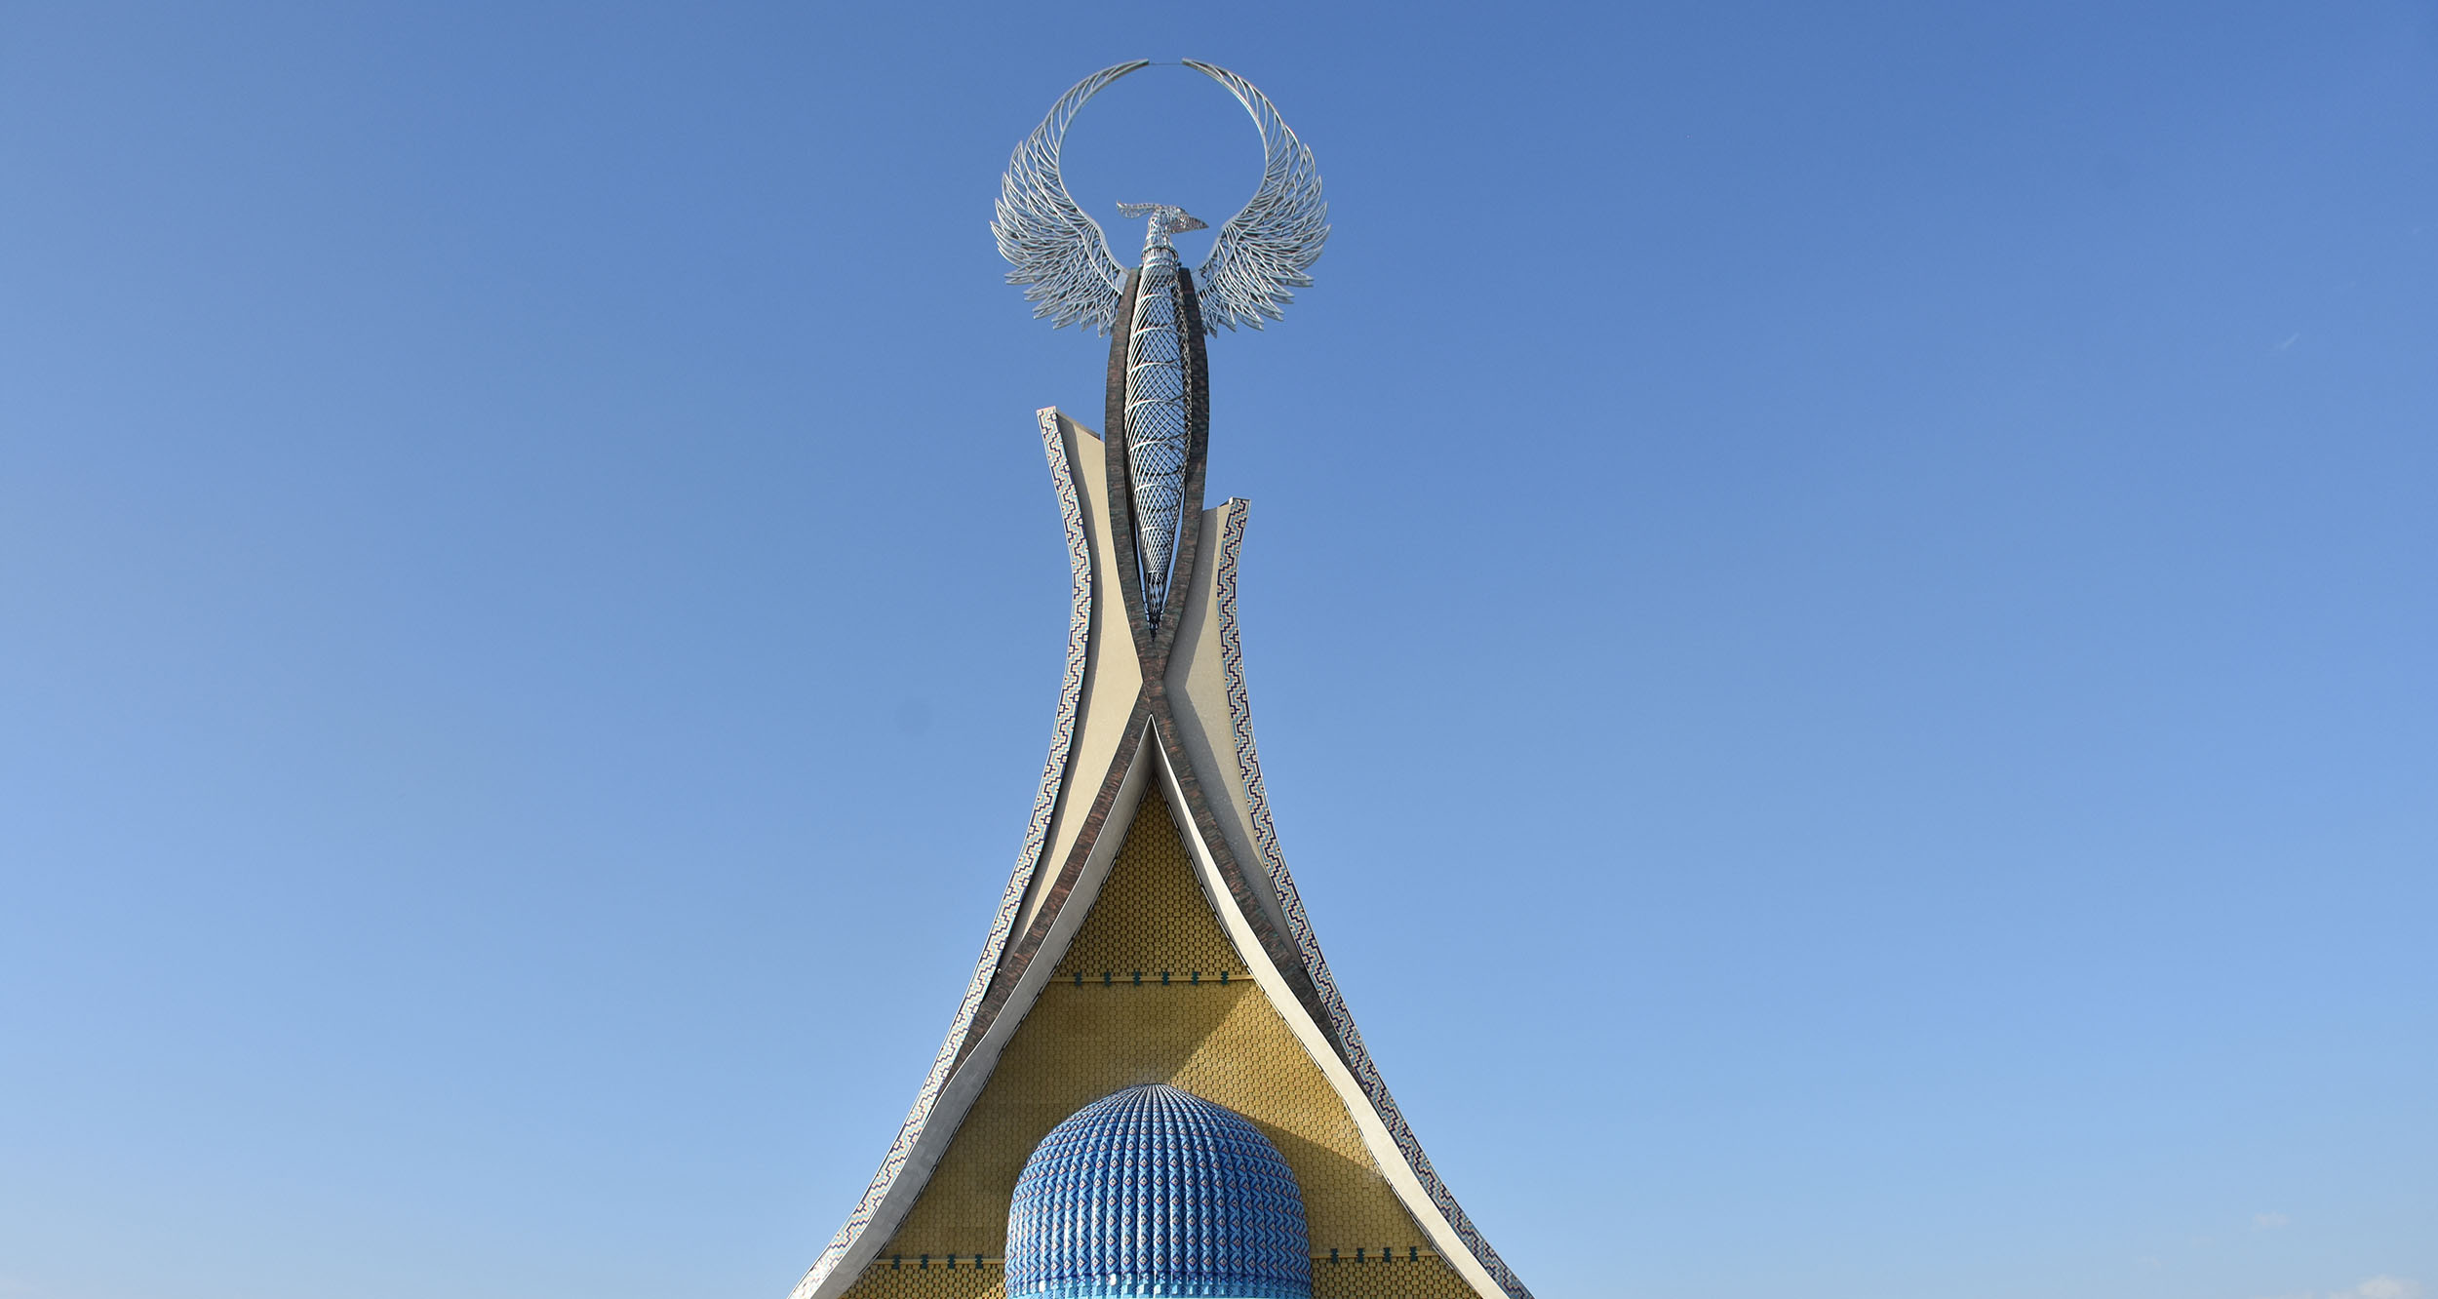
Project suggestions

Slide 3
List of project proposals. Ecotourism
№ | Name of projects | Farm area, ha | Placement | Project cost, mln.$
1 | Andijan DO‘X ecotourism center-1 in Khojaabad district | 1,0 | Andijan region | 111,1
2 | Andijan DUK ecotourism center-2 of Khojaabad district | 0,7 | Andijan region | 111,1
3 | Ecotourism center in Khanabad district of Andijan region | 6,0 | Andijan region | 700,0
4 | Ecotourism center in the Khojaabad district of Andijan region | 0,5 | Andijan region | 100,0
5 | Ecotourism center in the territory of the Karavultepa Reservoir, Gallyaaral District | 0,7 | Jizzakh region | 222,2
6 | Ecotourism center in the "Pitomnik" (deer herding) area of Zaamin district | 0,7 | Jizzakh region | 222,2
7 | Ecotourism center in the territory of the Zaamin State Forestry, Sh.Rashidov district | 0,2 | Jizzakh region | 111,1
8 | Ecotourism center in the territory of the Zaamin State Forestry, Zaamin District | 0,4 | Jizzakh region | 222,2
9 | Ecotourism sites in the territory of the Farish State Forestry of the Farish District | 0,7 | Jizzakh region | 444,4
10 | Ecotourism center in the Uchma Forestry Department of the Farish State Forestry Territory of the Farish District | 0,1 | Jizzakh region | 111,1

Slide 4
List of project proposals. Ecotourism
№ | Name of projects | Farm area, ha | Placement | Project cost, mln.$
11 | Ecotourism sites in the Bogdon Forestry Department of the Farish State Forestry Territory of the Farish District | 0,3 | Jizzakh region | 222,2
12 | Ecotourism center in the Farish State Forestry of the Gallyaaral District | 2,00 | Jizzakh region | 500,0
13 | Creation of a Deer Farm in the Zaamin District | 10,00 | Jizzakh region | 400,0
14 | Ecotourism center in Zaamin district | 2,00 | Jizzakh region | 200,0
15 | Ecotourism center in Sh.Rashidov district | 1,00 | Jizzakh region | 500,0
16 | Ecotourism center in Zaamin district | 1,00 | Jizzakh region | 500,0
17 | Ecotourism destination in Farish district | 3,00 | Jizzakh region | 200,0
18 | Ecotourism sites in the Mingchinor Forestry Department of the Kitab State Forestry Territory, Kitab District | 0,02 | Kashkadarya region | 74,1
19 | Ecotourism sites in the territory of the Pap State Forestry Enterprise, Pap District | 2,8 | Namangan Region | 333,3
20 | Ecotourism center in the Kasansay district of the Namangan region | 1,00 | Namangan Region | 120,0

Slide 5
List of project proposals. Ecotourism
№ | Name of projects | Farm area, ha | Placement | Project cost, mln.$
21 | Ecotourism center in the Pap district of Namangan region | 3,00 | Namangan Region | 250,0
22 | Ecotourism cluster in the Pap district of Namangan region: car camping, container town, cable car park | 12,00 | Namangan Region | 500,0
23 | Tourist destination in the Pap district of Namangan region (zipline, horseback riding service and picnic zone) | 2,00 | Namangan Region | 100,0
24 | Ecotourism center in the "Koradaryo" forestry department of the Ishtikhan State Forestry Territory, Ishtikhan District | 2 | Samarkand region | 74,1
25 | Ecotourism destination in the Bobotog Regional Natural Park, Uzun district | 0,50 | Surkhandarya region | 74,1
26 | Land plot selected for the creation of an ecotourism center in the Termez district of Surkhandarya region | 4,00 | Surkhandarya region | 140,0
27 | Land plot selected for the creation of an ecotourism center in the Bobotog Regional Natural Park of Uzun district | 12,00 | Surkhandarya region | 200,0
28 | Visiting center and ecotourism destination in the Bobotog Regional Natural Park of Uzun district | 2 | Surkhandarya region | 150,0
29 | Land plot selected for the creation of an ecotourism center in the Bobotog Regional Natural Park of Uzun district | 2 | Surkhandarya region | 100,0
30 | Visitor center and ecotourism destination in the Yukori Tupalang Regional Natural Park of the Sariosiyo district | 2 | Surkhandarya region | 150,0

Slide 6
List of project proposals. Ecotourism
№ | Name of projects | Xo‘jalik maydoni, ga | Placement | Project cost, mln.$
31 | Ecotourism destination in Burchmulla DO‘X Nanay Community Citizens' Assembly, Bostanlyk district | 10,00 | Tashkent region | 148,1
32 | Ecotourism destination in Yangiqo'g'on Community Citizens' Assembly, Burchmulla DO‘X, Bostanliq District | 6,00 | Tashkent region | 88,9
33 | Bostanlyk district, Burchmulla DO‘X ecotourism destination in Yangiqo'g'on Community Citizens' Assembly | 2,00 | Tashkent region | 29,6
34 | Ecotourism center in the territory of the "Central Ring of the 4R12 Department" of the Burchmulla State Farm, Bostanlyk district | 0,75 | Tashkent region | 37,0
35 | Ecotourism center in the "Beldersoy" turnaround area of the "Jurakbay" department of the Burchmulla State Farm, Bostanlyk district | 8,00 | Tashkent region | 74,1
36 | Ecotourism center in the territory of the "Sukok" forestry department, "Saksonota" State Forestry Production Enterprise, "Parkent" district | 2,00 | Tashkent region | 111,1
37 | Tourist Center of the Akhangaran State Forestry in the village of Ertashsay | 22,00 | Tashkent region | 560,0
38 | Tourist Center of the Lashkerak Department of the Akhangaran State Forestry | 3,00 | Tashkent region | 150,0
39 | Tourist Center of the Yangiabad Department of the Akhangaran State Forestry | 1,95 | Tashkent region | 200,0
40 | Parkent District Tourism Center of the Saksonota State Forestry | 50,00 | Tashkent region | 70,0

Slide 7
List of project proposals. Ecotourism
№ | Name of projects | Farm area, ha | Placement | Project cost, mln.$
41 | Tourism Center of the Bekabad State Forestry of the Bekabad District | 2,0 | Tashkent region | 30,0
42 | Selected for the creation of an ecotourism center in the Akhangaran district | 27,0 | Tashkent region | 910,0
43 | Ecotourism center in Parkent district | 50,0 | Tashkent region | 70,0
44 | Creation of an ecotourism center in the Bekabad district | 2,0 | Tashkent region | 30,0
45 | Ecotourism center in Gulistan district of Syrdarya region | 1,0 | Syrdarya region | 50,0
46 | Ecotourism center in the Saykhunabad district of Syrdarya region | 2,0 | Syrdarya region | 60,0
47 | Creation of an ecotourism center in the Beshariq district | 10,0 | Fergana region | 500,0
48 | Ecotourism destination in Kuva district | 2,0 | Fergana region | 500,0
49 | Land plot selected for the creation of an ecotourism center in the Dangara district | 2,0 | Fergana region | 100,0

Slide 8
International logistics transport corridors
Tallin
Sankt-Peterburg
Riga
Latvia
Moscow
Klaipeda
Hamburg
Minsk
Berlin
Brest
Povorina
Essen
Lviv
Kyiv
Paris
Chop
Volgograd
Kandiagash
Aktogay
Astraxan
Beyney
Saksaulskaya
Ulan-Bator
Osh
Bayangal-Mangal
Mersin
Malatya
Saraxa
Mazar-i-Sharif
Kashgar
Xirat
Afghanistan
Peshavar
Iran
Pakistan
Bandar-e-Abbas
Chakhbahar
Karachi

Slide 9
High-quality flights from Tashkent and
Other airports of Uzbekistan.
New York
Visa-free regime for tourists from 90 countries
A wide range of 59 air carriers presented at the airports of Uzbekistan.
There are 11 airports throughout the country, the main ones of which are located in Tashkent, Samarkand, and Bukhara.

