Slide 1
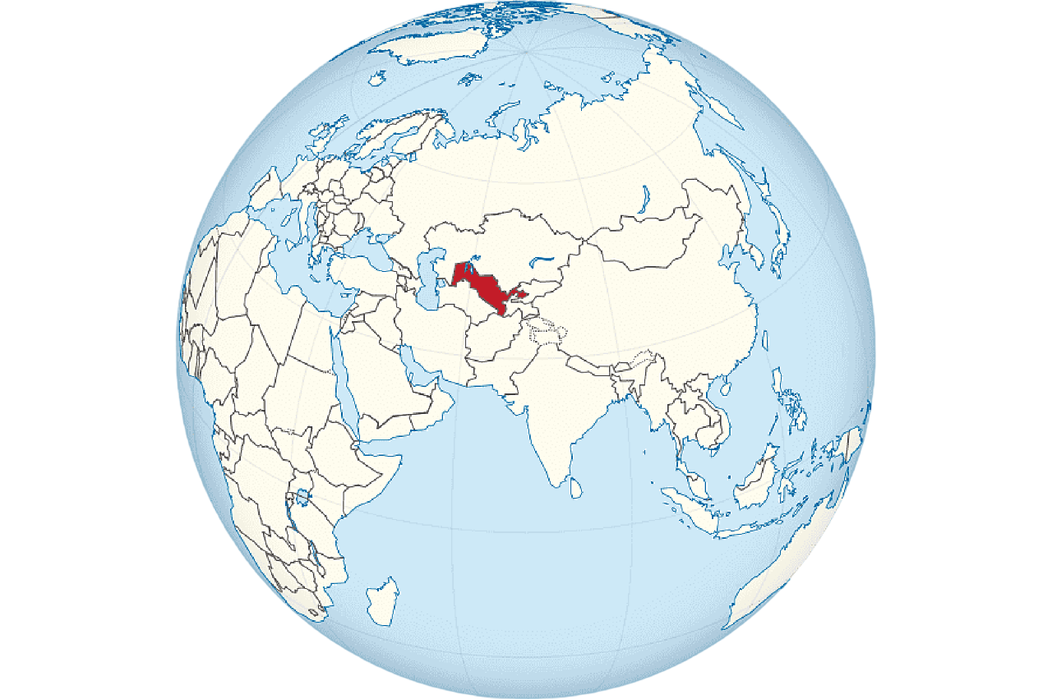
Investment projects of hunting tourism in the Republic of Uzbekistan
Republic of Uzbekistan
Republic of Uzbekistan
Area - 448 924 sq. km.
Forest fund area - 11.9 million hectares, including,
Desert territory - 81% (7.9 million hectares).
Mountain zone - 16.1% (1.6 million ha).
The plain area is 1.8% (1.7 million hectares).
Forest areas - 1.1% (1.09 million ha).
We invite investors to hunting tourism projects in the Republic of Uzbekistan
Indicators of proposed projects
Total area of hunting
Investment needs
New workers
places
3,1 thousand ha
$ 10,1 mln.
600 employees
List of project proposals by industry
Tashkent region
Namangan region
Hunting area
1,03 thousand
ha
Value
$2,96 mln.
Hunting area
0,11 thousand ha
Value
$0,296 mln.
Why invest in the hunting industry?
Rich natural resources. Uzbekistan holds a leading position in the world in terms of forests, rivers, lakes, and the abundance of wildlife species creates ideal conditions for the development of hunting-related businesses.
Tourism. The growing interest in active recreation contributes to increased demand for services provided in the field of hunting. Nature lovers are looking for unique and captivating experiences.
Technological possibilities. The application of modern technologies, such as online booking, social media marketing, and e-commerce, helps businesses of all directions expand their audience and increase the efficiency of business processes.
Implementation of environmentally beneficial initiatives. Identification of habitats of rare species of birds and animals, satellite monitoring of wild animals using GPS technologies, assistance in restoring the population of wild animals, rational use of wild animal reserves and their reproduction.
Investments in the organization of hunting safari and the development of hunting farms in the world amounted to about 200-250 million dollars.
Fergana region
Sirdaryo Region
Hunting area
0,11 thousand ha
Value
$0,296 mln.
Hunting area
0,22 thousand ha
Value
$0,59 mln.
Jizzakh region
Samarkand region
Hunting area
0,22 thousand ha
Value
$0,59 mln.
Hunting area
0,11 thousand ha
Value
$0,296 mln..
Kashkadarya region
Surkhandarya region
Hunting area
0,11 thousand ha
Value
$0,296 mln.
Hunting area 0,54 thousand ha
Value
$2,74 mln.
Navoi region
Bukhara region
Hunting area
0,11 thousand ha
Value
$0,296 mln.
Hunting area
0,33 thousand ha
Value
$0,89 mln.
Market
The global hunting tourism market is estimated at $369.6 million. According to forecasts, this amount will reach $1,775.7 million by 2030, with an annual growth rate of 21.7%.
Khorezm region
Republic of Karakalpakstan
Benefits
50% profit tax for public catering and VAT compensation of 20% of the share of non-cash settlements for hotels and tour operators.
VAT compensation of 40% of the share of non-cash payments for entrepreneurs in this area.
Hunting area
0,11 thousand ha
Value
$0,296 mln.
Hunting area
0,22 thousand ha
Value
$0,59 mln.
Project initiator
Ministry of Ecology, Environmental Protection and Climate Change of the Republic of Uzbekistan

Slide 2
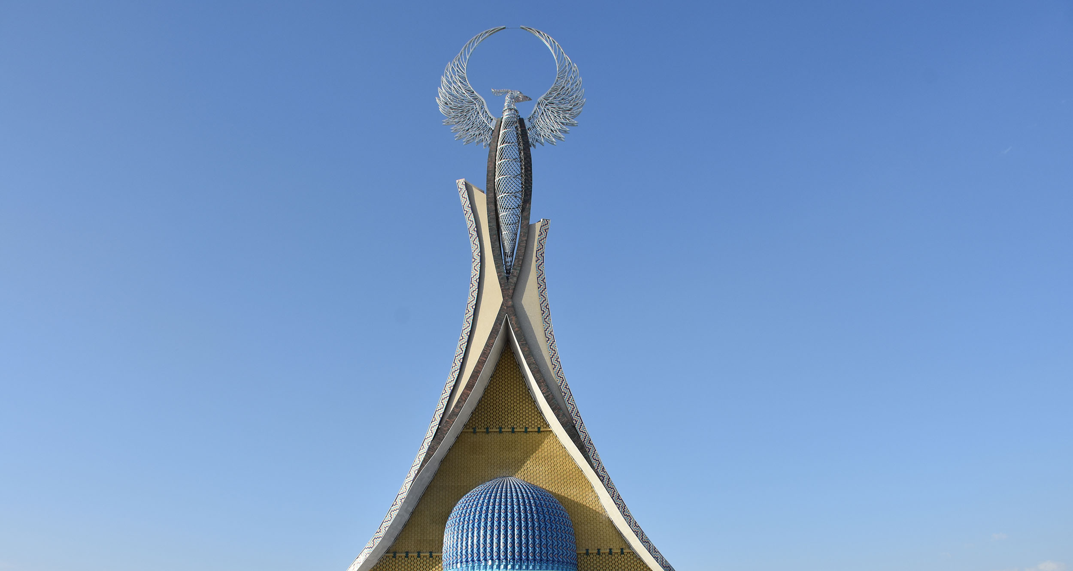
Project proposals

Slide 3
List of project proposals. Hunting tourism
№ | Name of projects | Farm area, ha | Placement | Project cost, thousand$
1 | Hunting Farm in the territory of the Akhangaran State Forestry Enterprise (Navgarzan Department, Karagash Territory, 49th block 1-2-3-4-5-6-7-8-9-14 views) | 110 | Tashkent region | 296,3
2 | Hunting Farm in the territory of the Akhangaran State Forestry Enterprise (Yangiobod Department, Akcha District, 88th block, 12-15-28-29 views) | 110 | Tashkent region | 296,3
3 | Hunting Farm in the territory of the Akhangaran State Forestry Enterprise (Akchasoy District, Akchasoy District, 95th block) | 110 | Tashkent region | 296,3
4 | Hunting Farm in the territory of the Akhangaran State Forestry Enterprise (Karagash area, 49th block 1-2-3-4-5-6-7-8-9-14 views) | 40 | Tashkent region | 296,3
5 | Hunting Farm in the territory of the Akhangaran State Forestry Enterprise (near the city of Yangiobod) | 110 | Tashkent region | 296,3
6 | Hunting Farm on the territory of the Akhangaran State Forestry Enterprise (near the village of Tokberdi) | 110 | Tashkent region | 296,3
7 | Hunting Farm on the territory of the Akhangaran State Forestry Enterprise (north of the village of Irtysh) | 110 | Tashkent region | 296,3
8 | Hunting Farm on the territory of the Burchmulla State Forestry Enterprise of the Bostanlyk District | 110 | Tashkent region | 296,3
9 | Hunting Farm in the territory of the Tashkent State Forestry Enterprise, Urtachirchik District (Tuyabugiz (Tashmore) Territory) | 110 | Tashkent region | 296,3
10 | Hunting Farm in the territory of the Bekabad State Forestry Enterprise, Bekabad District | 110 | Tashkent region | 296,3

Slide 4
List of project proposals. Hunting tourism
№ | Name of projects | Farm area, ha | Placement | Project cost, thousand$
11 | Hunting Farm on the territory of the Pop State Forestry Enterprise, Pop District | 110 | Namangan Region | 296,3
12 | Hunting Farm in the territory of the Kokand State Forestry Enterprise, Beshariq District | 110 | Fergana region | 296,3
13 | Hunting Farm on the territory of the Kalgansyr State Forestry Enterprise, Sirdarya District | 110 | Sirdaryo Region | 296,3
14 | Hunting Farm in the territory of the Syrdarya State Forestry Enterprise, Saykhunabad District | 110 | Sirdaryo Region | 296,3
15 | Hunting Farm on the territory of the Farish State Forestry Enterprise, Farish District | 110 | Jizzakh Region | 296,3
16 | Hunting Farm on the territory of the Farish State Forestry Enterprise, Farish District | 110 | Jizzakh Region | 296,3
17 | Hunting Farm in the territory of the Kattakurgan State Forestry Enterprise, Nurabad District | 110 | Samarkand region | 296,3
18 | Hunting Farm on the territory of the Kitab State Forestry Enterprise, Kitab District | 110 | Kashkadarya Region | 296,3
19 | Hunting Farm in the territory of the Aktepa Reservoir, Djarkurgan District | 110 | Surkhandarya region | 296,3
20 | Hunting Farm in the territory of the DO‘X Surkhandarya District, Angor District | 110 | Surkhandarya region | 740,7

Slide 5
List of project proposals. Hunting tourism
№ | Name of projects | Farm area, ha | Placement | Project cost, thousand$
21 | Hunting Farm in the territory of the Boysun DO’X of Boysun District | 110 | Surkhandarya region | 740,7
22 | Hunting Farm in the territory of the Babatag State Forestry Enterprise, Uzun District | 110 | Surkhandarya region | 740,7
23 | Land plot selected for the creation of a hunting farm in the Boysun DO‘X of Boysun district | 14 | Surkhandarya region | 220,0
24 | Hunting Farm in the territory of the Tomdi State Forestry Enterprise, Tomdi District | 110 | Navoi region | 296,3
25 | Karaulbazar District, Karaulbazar DO‘OX Hunting Farm on the Territory of the State Forest Hunting Farm | 110 | Bukhara region | 296,3
26 | Hunting Farm in the territory of the Gijduvan State Forestry Enterprise, Gijduvan District | 110 | Bukhara region | 296,3
27 | Hunting Farm in the territory of the Karakul State Forestry Enterprise, Karakul District | 110 | Bukhara region | 296,3
28 | Hunting Farm in the territory of the Khorezm DO‘OX State Forest Hunting Farm, Tuproqqala District | 110 | Khorezm Region | 296,3
29 | Muynak District, Hunting Farm on the Territory of the Kazakhdarya DO‘OX State Forest Hunting Farm | 110 | Republic of Karakalpakstan | 296,3
30 | Hunting Farm in the territory of the Nukus State Forestry Enterprise, Kegeyli District | 110 | Republic of Karakalpakstan | 296,3

Slide 6
International logistics transport corridors
Tallin
Sankt-Peterburg
Riga
Latvia
Moscow
Klaipeda
Hamburg
Minsk
Berlin
Brest
Povorina
Essen
Lviv
Kyiv
Paris
Chop
Volgograd
Kandiagash
Aktogay
Astraxan
Beyney
Saksaulskaya
Ulan-Bator
Osh
Bayangal-Mangal
Mersin
Malatya
Saraxa
Mazar-i-Sharif
Kashgar
Xirat
Afghanistan
Peshavar
Iran
Pakistan
Bandar-e-Abbas
Chakhbahar
Karachi

Slide 7
High-quality air service from Tashkent and
other airports of Uzbekistan.
New York
Visa-free regime for tourists from 90 countries
A wide range of 59 air carriers represented at Uzbekistan's airports.
There are 11 airports across the country, the main ones being in Tashkent, Samarkand, and Bukhara.

