Slide 1

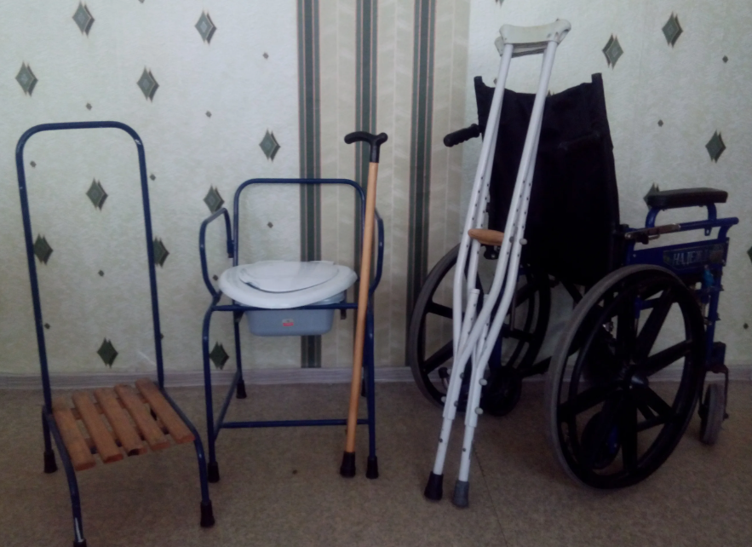






Manufacture of wheelchairs and other products for persons with limited physical abilities
Industry
Project indicators
Mechanical engineering and craftsmanship
Goal of the project
Cost of the project:
Investment requirements
Manufacture of wheelchairs, prosthetic and orthopedic devices, and rehabilitation equipment
$ 0,5 mln.
$ 0,4 mln.
Final products
Capacity:
Domestic market – 80%
Export – 20%
Wheelchairs, canes, crutches, and other devices
3000 products (per year)
Trends in the market of disability products
The wheelchair market is an important segment in the healthcare and assistive technology sectors, which affects the quality of life of people with mobility issues.
Investments in this industry are associated with growing demand for wheelchairs, technological innovations, and government initiatives aimed at promoting accessibility.
Growth in demand due to the increasing prevalence of disability, aging population, and awareness of mobility aids. For example, in 2024, the wheelchair market volume exceeded USD 5.64 billion and is forecasted to reach USD 14.44 billion by 2037.
Job creation for people with disabilities. Companies founded by people with disabilities often employ other individuals with limited abilities, contributing to their integration into society and improving their quality of life.
Payback period :
3,3 years
~35 employees
Technological process
Manufacturing
of parts and assemblies
Supplementary completion with components
Assembly and painting
Quality control and packaging
Project initiator
ОК «ZARINA MARIYAM»
Location
Fergana region
Benefits and preferences of the project
Exemption from the Single Tax Payment (UTP) and mandatory contributions to state targeted funds (except the Unified Social Tax, USP).
Exemption from customs duties (except fees for customs clearance) on component parts and spare parts, tools and instruments, computer and diagnostic equipment.
The banking sector was recommended to issue loans at the Central Bank refinancing rate to enterprises producing prosthetic and orthopedic products and technical rehabilitation aids.
Established on February 1, 2024.
Authorized capital – 10.0 million sums.
Founders: Sh. Inobiddinov – 50.0%
I. Arentoev – 50.0%
Fergana Region, Fergana District, Lyangar Street, House 15
Fergana region
Size | 6 800 km²
Population | ~4,1 million

Slide 2


International logistics transport corridors
Tallin
Sankt-Peterburg
Riga
Latvia
Moscow
Klaipeda
Hamburg
Minsk
Berlin
Brest
Povorina
Essen
Lviv
Kyiv
Paris
Chop
Volgograd
Kandiagash
Aktogay
Astraxan
Beyney
Saksaulskaya
Ulan-Bator
Osh
Bayangal-Mangal
Mersin
Malatya
Saraxa
Mazar-i-Sharif
Kashgar
Xirat
Afghanistan
Peshavar
Iran
Pakistan
Bandar-e-Abbas
Chakhbahar
Karachi

Slide 3

Air connections from Tashkent and other airports of Uzbekistan
New York
A visa-free policy for tourists from
90 countries
Diverse range of 59 carriers in Uzbekistan’s airport
11 airports across the Country, the main airports are Tashkent, Samarkand and Bukhara

