Slide 1
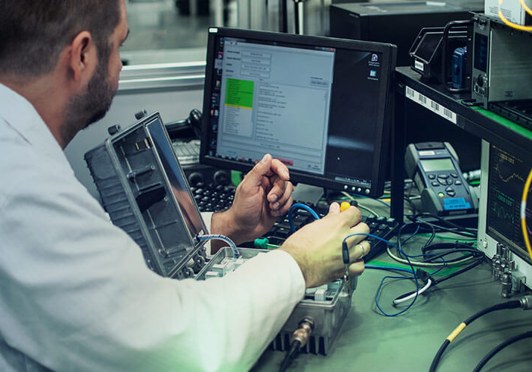
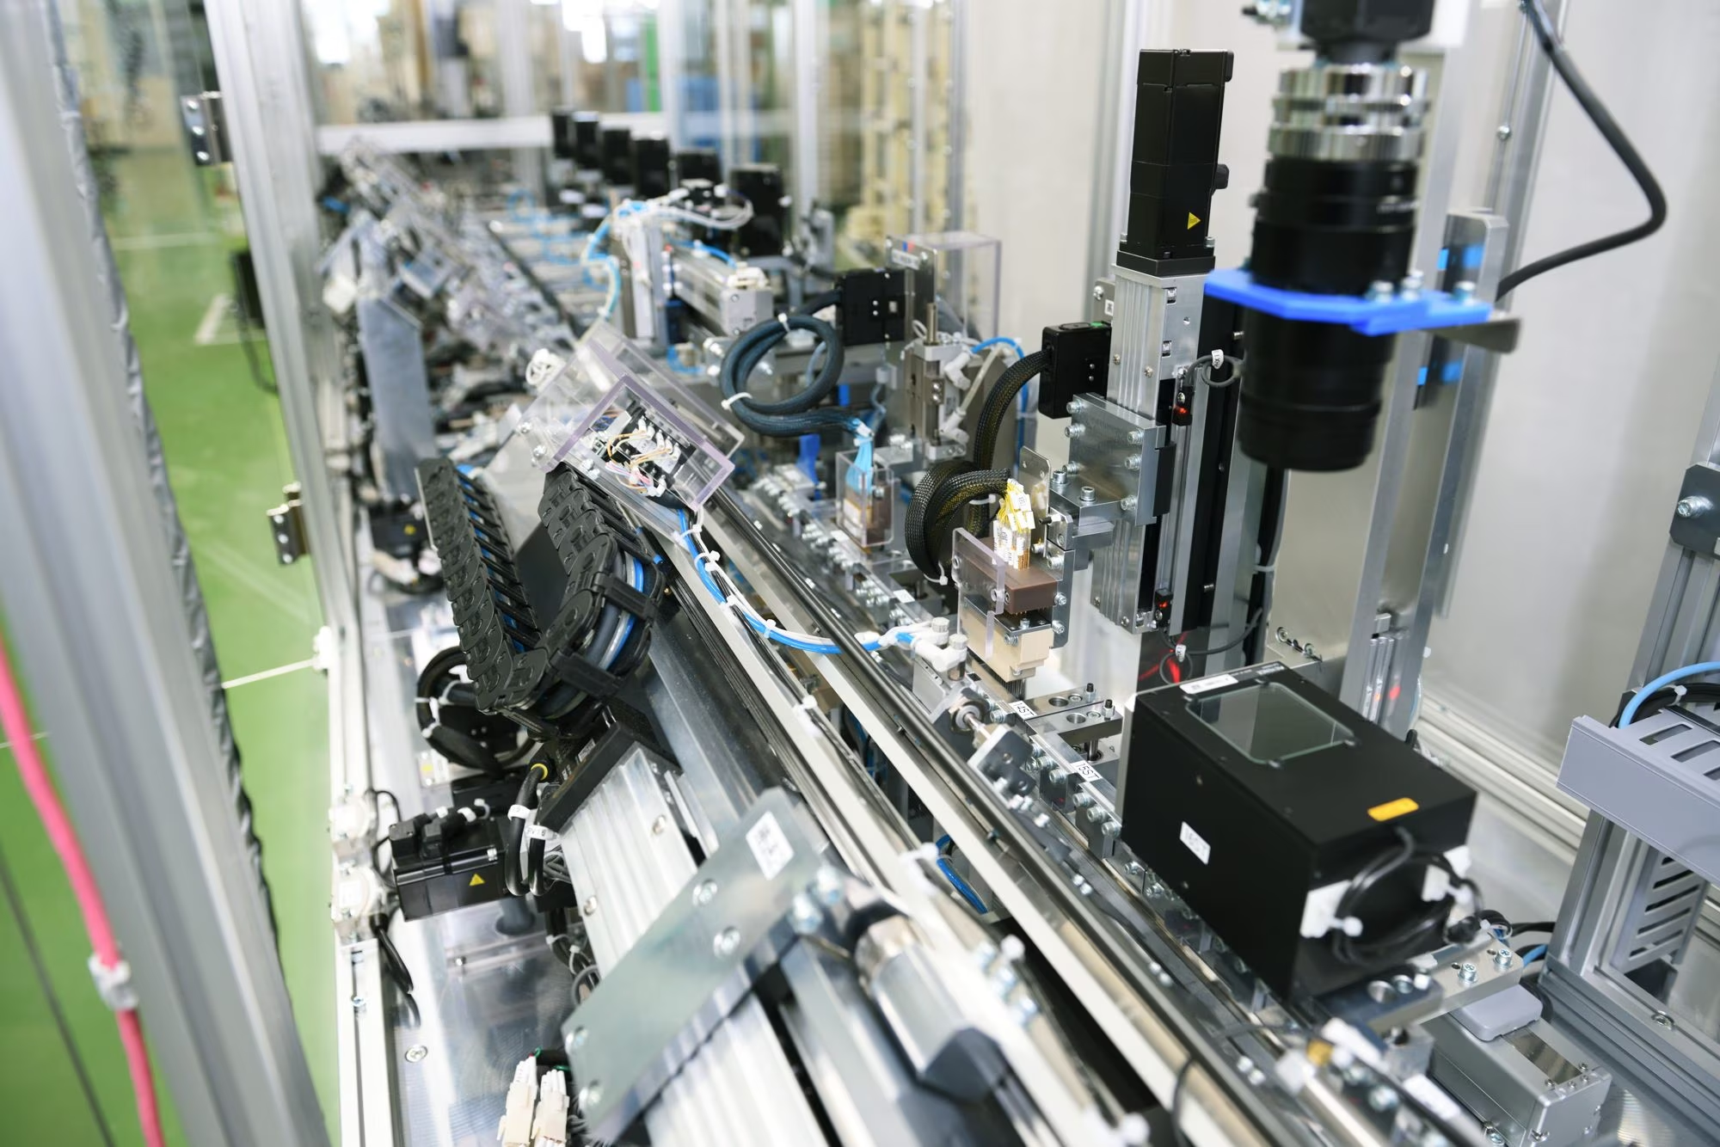
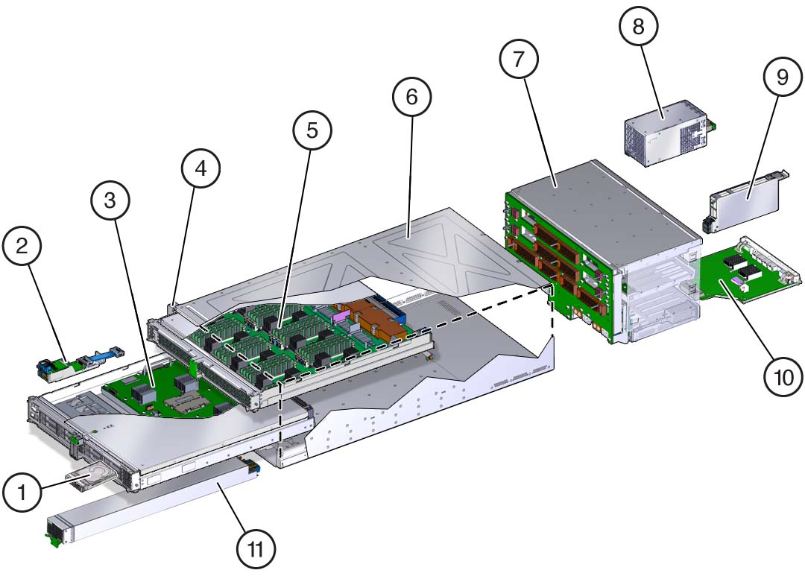
Ministry of Investment,
Industry and Trade of the Republic of Uzbekistan
Production of hemodialysis machines
Project overview
Business model: Production of 6 thsd units of hemodialysis machines per year
Project scope
Establishment of plant manufacturing dialysis machines
Financing
50 mln USD
Production process of hemodialysis machines
Incentives
Infrastructure development at state cost* (project cost exceeding 15 mln USD)
Across the Republic, 6 FEZs specialized for pharmaceutical industry offer tax breaks on land, property, water and CIT.
(CIT - applied for investments over 3 mln USD)
Design and development
Component manufacturing
Subassembly
Main assembly
Testing and quality control
Project description
Domestic market
Existing 5 neighbor markets
Russia, Europe, Middle East markets
Exemption from taxes
3 years if investment is between 0,3 – 3 mln USD
5 years if investment is between 3 – 5 mln USD
7 years if investment is between 5 – 10 mln USD
10 years if investment is over 10 mln USD
4 production lines
Capability to produce various medical machines and devices
~250 employees
Number of people suffering from cirrhosis in CA (2024)
Infrastructure
Gas 12 cents/m³
Electricity 7 cents/kWh
Water 20 cents/m³
Uzbekistan
Kazakhstan
Tajikistan
Kyrgyzstan
Turkmenistan
30 thsd
22 thsd
12 thsd
15 thsd
21 thsd

Slide 2
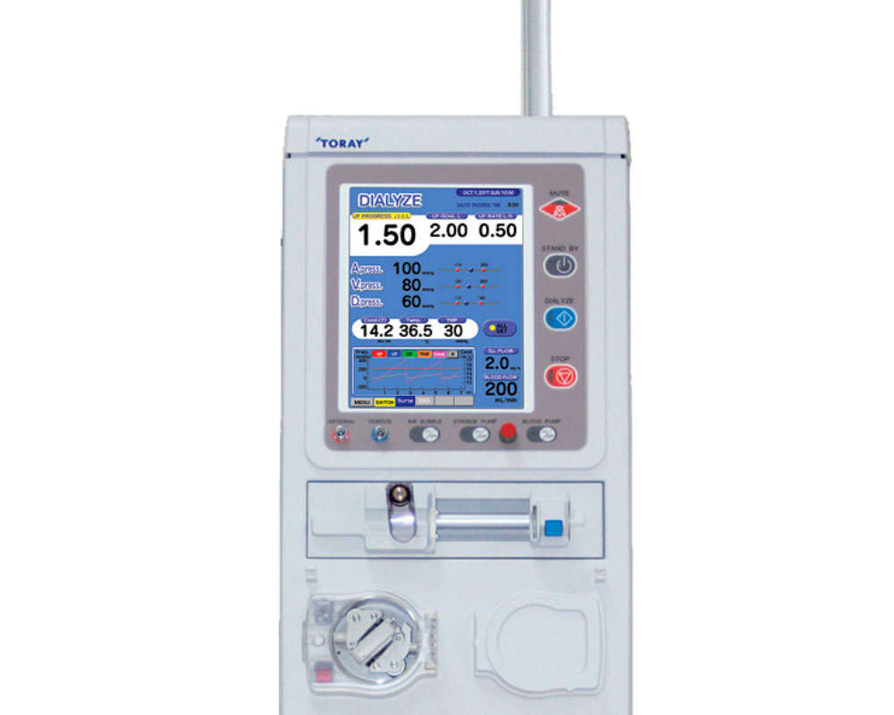
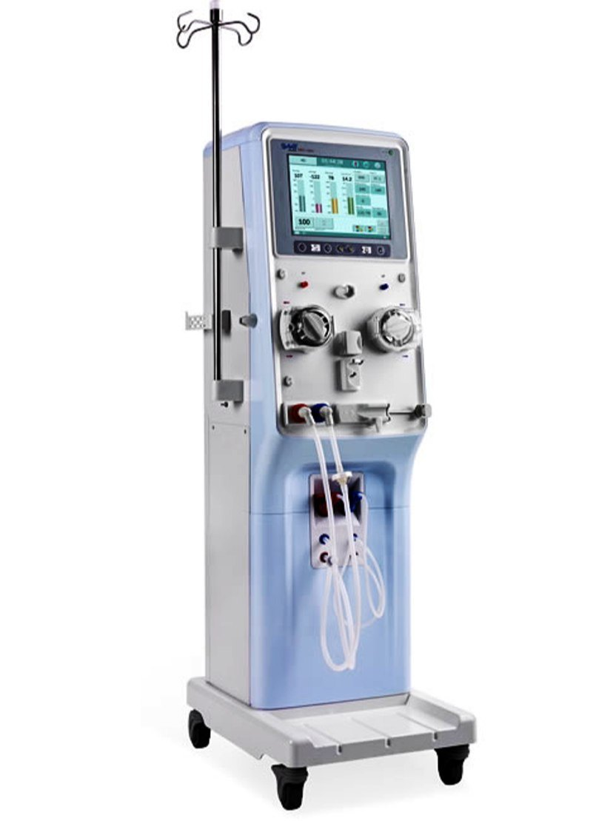
Ministry of Investment,
Industry and Trade of the Republic of Uzbekistan
We invite to invest in dialysis machines manufacturing in Uzbekistan
Machines commonly used in local hospitals
Trade agreements
GSP+ agreement allows to export to EU at reduced or zero tariff for 6 200 products.
CIS Free Trade Agreement creates more integrated and open market with CIS countries.
Toray TQS-88
Retail Price – $15 thsd
Toray TR-8000
Retail Price – $9 thsd
Location
Namangan region
“Kosonsoy-Pharm”
FEZ
Syrdarya region
Size | 7 900 km²
Population | 2,7 million
SWS-4000A
Retail Price – $7,2 thsd
Availability of labor in medical industry
Higher education institutions: 7
Faculties of higher education: 9
Number of graduates: 1 200
Local pharmaceuticals manufacturers can benefit from:
- High level of illness in the region and demand on dialysis machines in rural areas
- Availability of skilled & unskilled labor
- Opportunity to fill an empty niche in CA market
- Infrastructure development at state cost
- Incentives: Free economic zones offer tax breaks on land, CIT, water

Slide 3
On the strategic international logistics corridor
Ministry of Investment,
Industry and Trade of the Republic of Uzbekistan
Tallin
Sankt-Peterburg
Riga
Latvia
Moscow
Klaipeda
Hamburg
Minsk
Berlin
Brest
Povorina
Essen
Lviv
Kyiv
Paris
Chop
Volgograd
Kandiagash
Aktogay
Astraxan
Beyney
Saksaulskaya
Ulan-Bator
Osh
Bayangal-Mangal
Mersin
Malatya
Saraxa
Mazar-i-Sharif
Kashgar
Xirat
Afghanistan
Peshavar
Iran
Pakistan
Bandar-e-Abbas
Chakhbahar
Karachi

Slide 4
Excellent air connectivity from Tashkent and other Uzbek airports
Ministry of Investment,
Industry and Trade of the Republic of Uzbekistan
New York
A visa-free policy for tourists from 90 countries
Diverse range of 59 carriers in Uzbekistan’s airport
11 airports across the Country, the main airports are Tashkent, Samarkand and Bukhara

