Slide 1
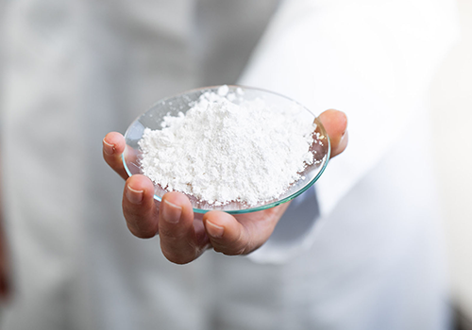
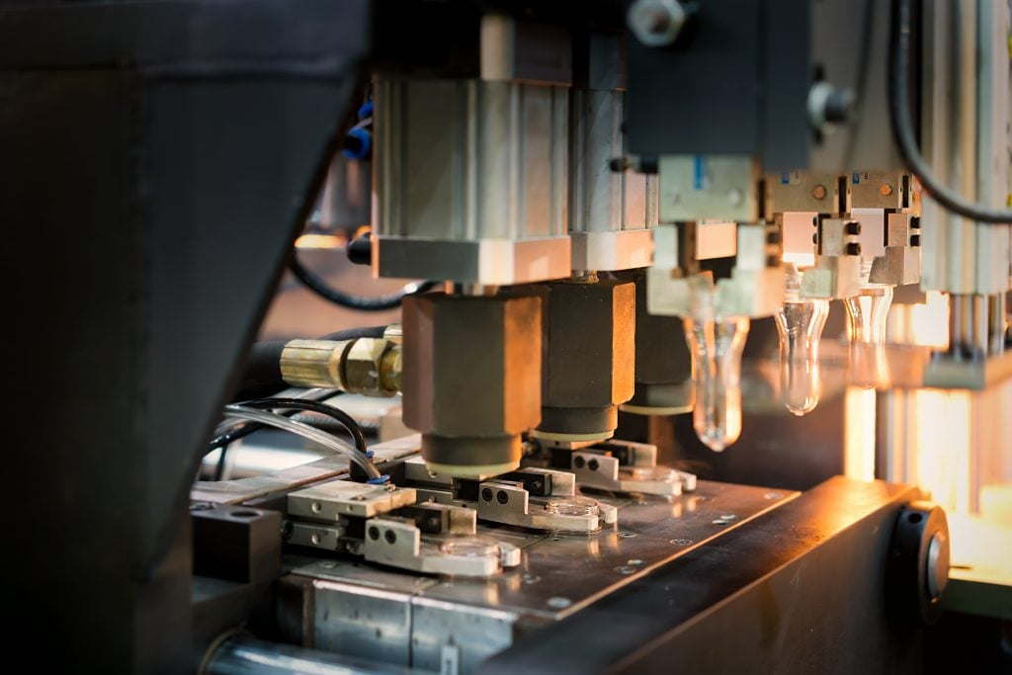
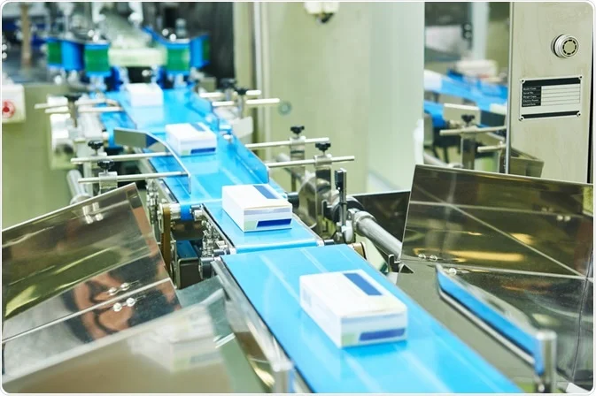
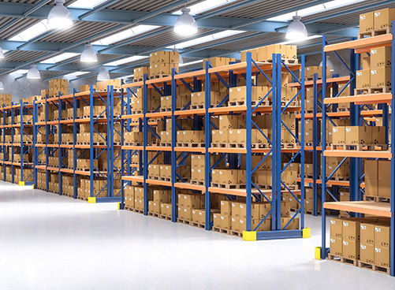
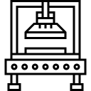
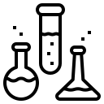
Ministry of Investment,
Industry and Trade of the Republic of Uzbekistan
Production of interferon suppositories
Project overview
Business model: Production of 3 mln packages of human interferon and 1 mln packages of interferon alpha per year.
Project scope
Establishment of plant manufacturing interferon suppositories
Financing
30 mln USD
Production process for medicines production
Incentives
Infrastructure development at state cost* (project cost exceeding 15 mln USD)
Across the Republic, 6 FEZs specialized for pharmaceutical industry offer tax breaks on land, property, water and CIT.
(CIT - applied for investments over 3 mln USD)
APIs procurement
Formulation development
Molding and solidification
Packaging
Storage and distribution
Project description
Domestic market
Existing 5 neighbor markets
Russia, Europe, Middle East markets
Exemption from taxes
3 years if investment is between 0,3 – 3 mln USD
5 years if investment is between 3 – 5 mln USD
7 years if investment is between 5 – 10 mln USD
10 years if investment is over 10 mln USD
2 production lines
Research and development of API and lab grown hormones
~100 employees
Production and trade volume of interferon suppositories (2024)
Infrastructure
Gas 12 cents/m³
Electricity 7 cents/kWh
Water 20 cents/m³
Production
Export
Import
Demand
Consumption (CA)
-
-
3.3 mln packages
3,5 mln packages
10 mln packages

Slide 2
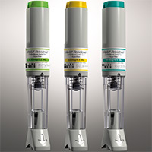
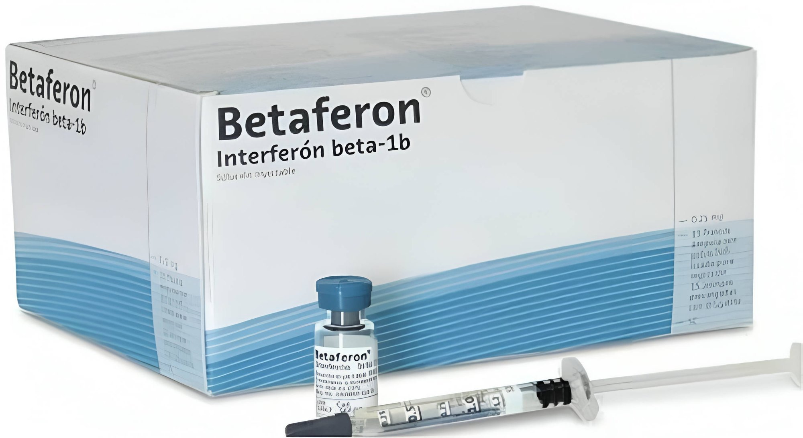
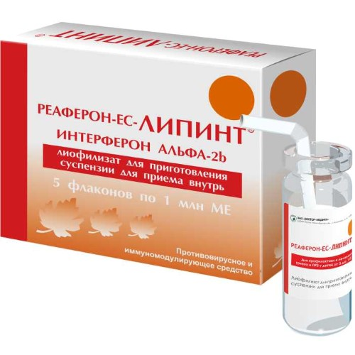
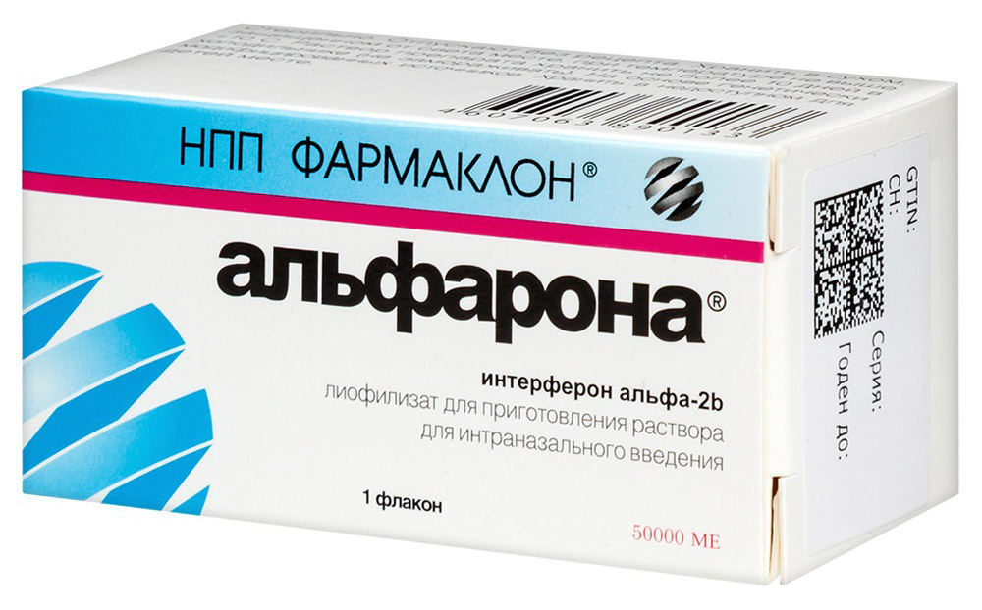
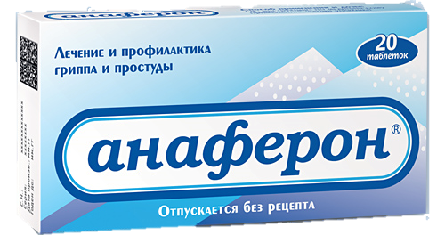
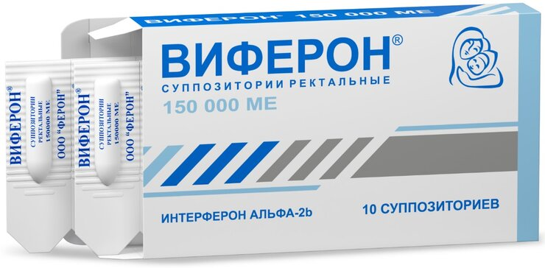
Ministry of Investment,
Industry and Trade of the Republic of Uzbekistan
We invite to invest in interferon manufacturing in Uzbekistan
Preparations containing the active ingredient - interferon
Trade agreements
GSP+ agreement allows to export to EU at reduced or zero tariff for 6 200 products.
CIS Free Trade Agreement creates more integrated and open market with CIS countries.
Rebif human Interferon Injections
Retail Price : 950 thsd Uzbek Soums
Betaferon Interferon beta-1b Injections
Retail Price : 2,5 mln Uzbek Soums
Reaferon Interferon alpha-2b suspension
Retail Price : 140 thsd Uzbek Soums
Location
Namangan Region
“Kosonsoy-Pharm”
FEZ
Syrdarya region
Size | 7 900 km²
Population | 2,7 million
Viferon suppositories
Retail Price : 85 thsd Uzbek Soums
Alfarona solution
Retail Price : 150 thsd Uzbek Soums
Anaferon tablets
Retail Price : 50 thsd Uzbek Soums
Availability of labor in medical industry
Local pharmaceuticals manufacturers can benefit from:
- Universal usage of acid in food, cosmetics and pharm industries
- Availability of skilled & unskilled labor
- Opportunity to fill an empty niche in CA market
- Infrastructure development at state cost
- Incentives: Free economic zones offer tax breaks on land, CIT, water
Higher education institutions: 7
Faculties of higher education: 9
Number of graduates: 1 200

Slide 3
On the strategic international logistics corridor
Ministry of Investment,
Industry and Trade of the Republic of Uzbekistan
Tallin
Sankt-Peterburg
Riga
Latvia
Moscow
Klaipeda
Hamburg
Minsk
Berlin
Brest
Povorina
Essen
Lviv
Kyiv
Paris
Chop
Volgograd
Kandiagash
Aktogay
Astraxan
Beyney
Saksaulskaya
Ulan-Bator
Osh
Bayangal-Mangal
Mersin
Malatya
Saraxa
Mazar-i-Sharif
Kashgar
Xirat
Afghanistan
Peshavar
Iran
Pakistan
Bandar-e-Abbas
Chakhbahar
Karachi

Slide 4
Excellent air connectivity from Tashkent and other Uzbek airports
Ministry of Investment,
Industry and Trade of the Republic of Uzbekistan
New York
A visa-free policy for tourists from 90 countries
Diverse range of 59 carriers in Uzbekistan’s airport
11 airports across the Country, the main airports are Tashkent, Samarkand and Bukhara

