Slide 1
Ministry of Investment,
Industry and Trade of the Republic of Uzbekistan
Construction of Schools in Tashkent and Tashkent Region
Project overview
Business model:
PPP with private management of schools under a concession agreement on 30 ha of allocated land. Investors will manage educational facilities and revenue.
Project scope
Construction of 13 schools with 14,000 seats equipped with modern educational technologies
Investment terms:
Investor will operate and manage the schools under a PPP concession agreement for 20-25 years.
Timeline
2025
2026
Completion of construction and operational launch
Tender announcement and contractor selection
Financing
$97 million
Location
Tashkent city and Tashkent region
Advantages and Potential
High social impact addressing educational needs.
Low investment volume with quick implementation.
Growing demand for quality education in Uzbekistan.

Slide 2
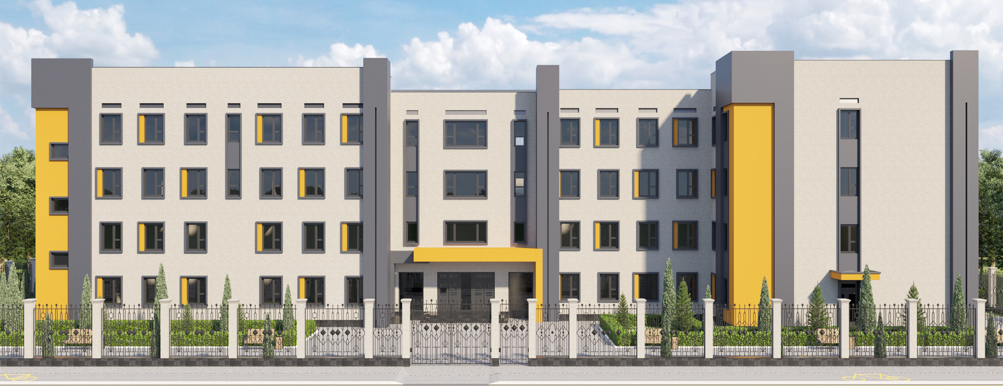
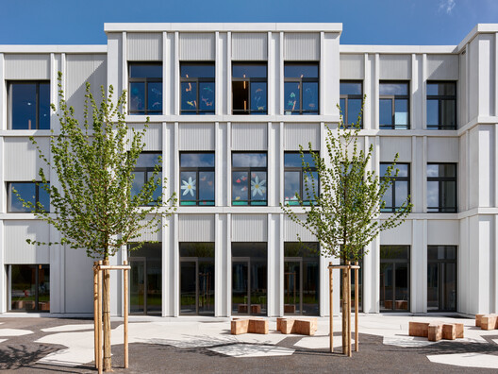
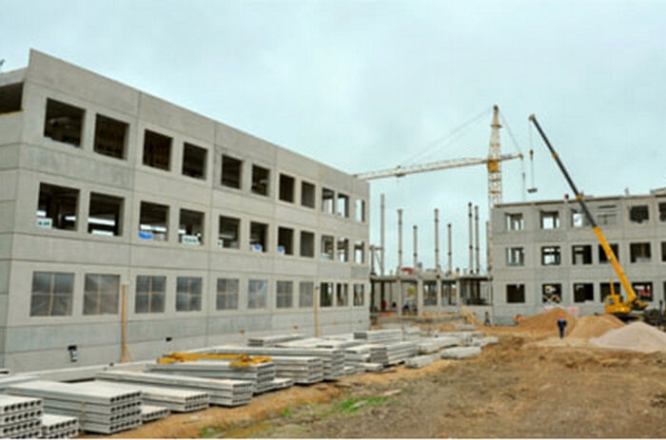
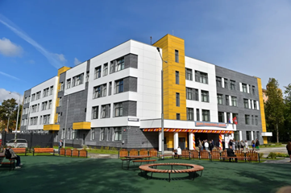
Ministry of Investment,
Industry and Trade of the Republic of Uzbekistan
We invite to invest in Construction of Schools in Tashkent and Tashkent Region
Project overview
Location
Tashkent region
School-Age Population | 1,0 million
Population | 3,2 million
Tashkent city
Tashkent city
School-Age Population | 0,9 million
Population | 3,0 million
Competitive landscape
High demand for modern educational facilities in Tashkent.
The project will address 15% of regional educational needs by 2027.
Tashkent Region
NPV
$20 million
IRR
16%
PI
1.40
PP
6 years

