Slide 1
Ministry of Investment,
Industry and Trade of the Republic of Uzbekistan
Construction of Tashkent — Samarkand Toll Highway
Project overview
Business model:
Public-Private Partnership (PPP) with private ownership and operation of the highway. Investors will manage toll collection and maintenance on 300 ha of allocated land.
Project scope
Construction of a 300-km modern toll highway connecting Tashkent and Samarkand to enhance transport infrastructure and reduce travel time.
Investment terms:
Investor will operate and manage the highway under a PPP concession agreement for 25-30 years.
Timeline
2025
2028
Completion of construction and operational launch
Development of project design and tender announcement
Financing
$2 200 million
Location
Tashkent, Syrdarya, Jizzakh, and Samarkand regions
Advantages and Potential
High economic efficiency through reduced transport costs.
Significant social impact by improving regional connectivity.
Stable demand due to high traffic between major economic hubs.

Slide 2
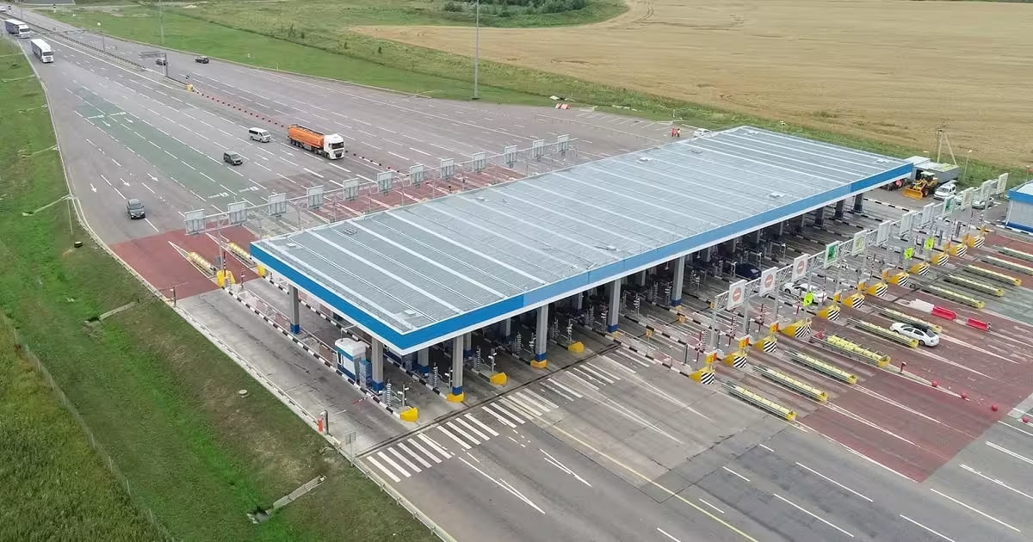
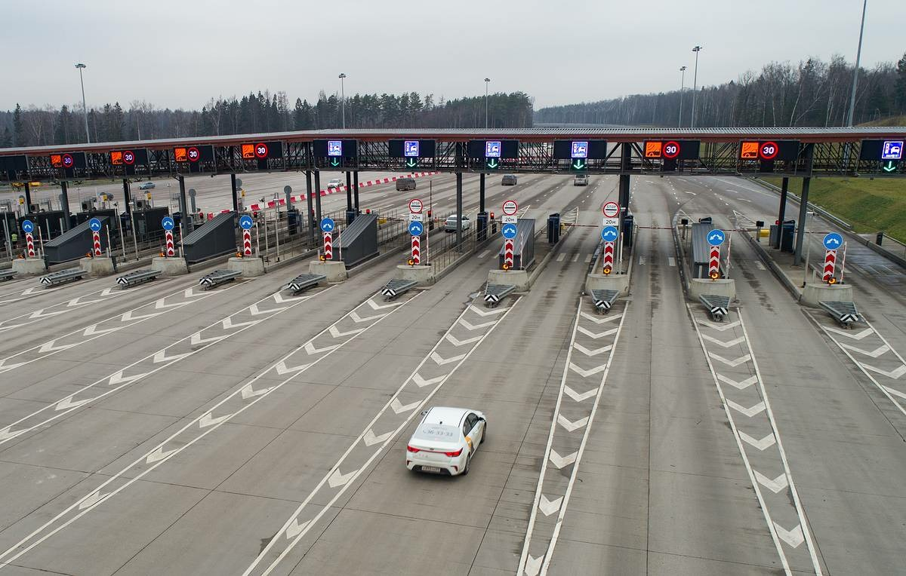
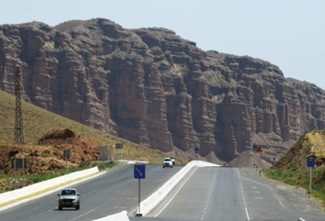
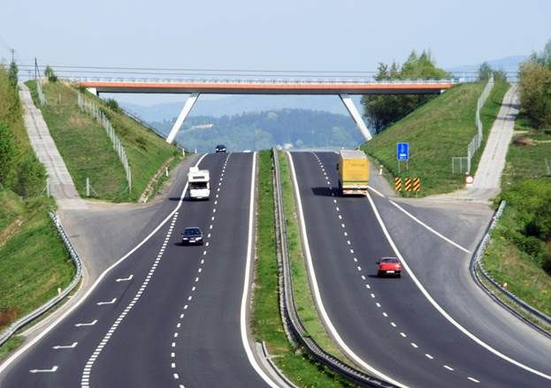
Ministry of Investment,
Industry and Trade of the Republic of Uzbekistan
We invite to invest in Construction of Tashkent — Samarkand Toll Highway
Project overview
Location
Tashkent region
Population | 3,2 million
Samarkand Region
Syrdarya region
Population | 0,9 million
Tashkent Region
Jizzakh region
Population | 1,5 million
Samarkand region
Population | 4,0 million
Syrdarya Region
Jizzakh Region
Competitive landscape
Current road infrastructure lacks high-capacity toll highways.
The project will capture 10-15% of Uzbekistan’s logistics market share by 2030.
NPV
$825 million
IRR
29.45%
PI
2.65
PP
3.5 years

