Slide 1
Ministry of Investment,
Industry and Trade of the Republic of Uzbekistan
Modernization and Management of Urgench Airport
Project overview
Business model:
PPP with private operation and management of the airport under a concession agreement on 50 ha of allocated land. Investors will manage revenue streams from passenger services
Project scope
Modernization of Urgench International Airport with private management to enhance tourism and passenger services
Investment terms:
Investor will operate and manage the airport under a PPP concession agreement for 20-25 years.
Timeline
2025
2026
Completion of modernization and operational launch
Tender announcement and contractor selection
Financing
$181 million
Location
Urgench, Khorezm region
Advantages and Potential
High tourism potential in Khorezm (Khiva, UNESCO sites).
Quick implementation timeline with moderate investment.
Growing passenger traffic in Uzbekistan’s aviation sector.

Slide 2
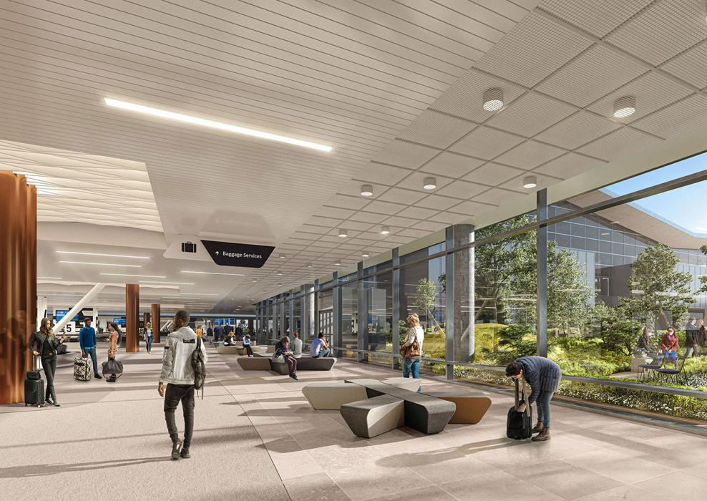
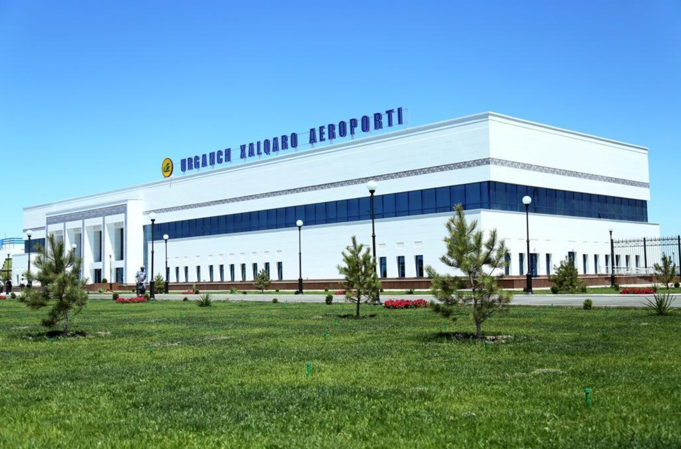
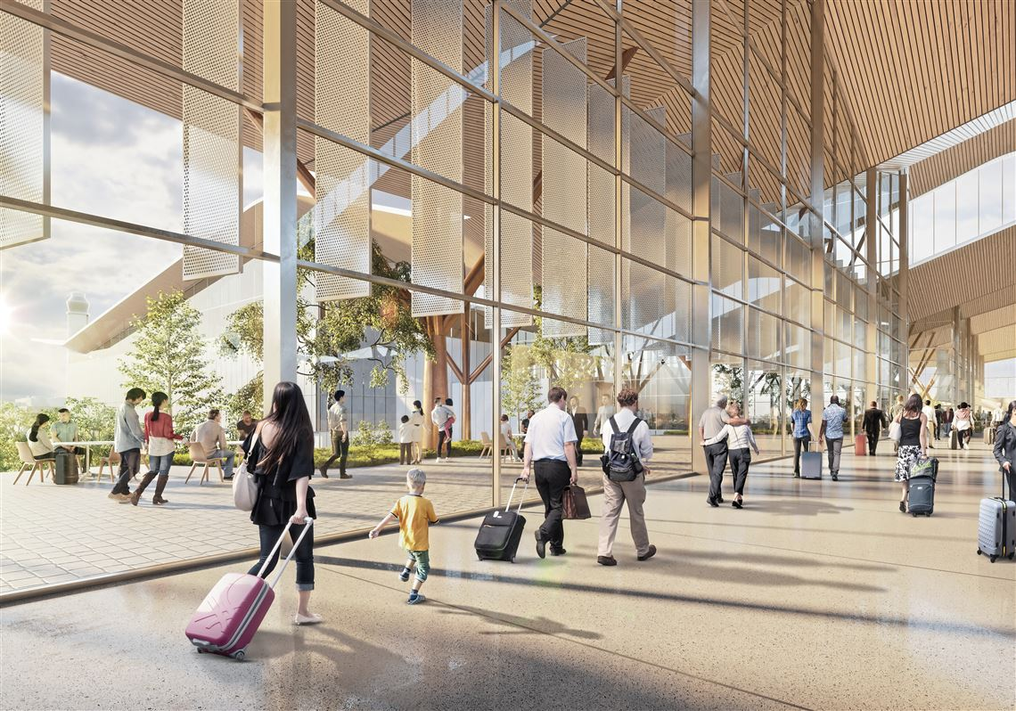
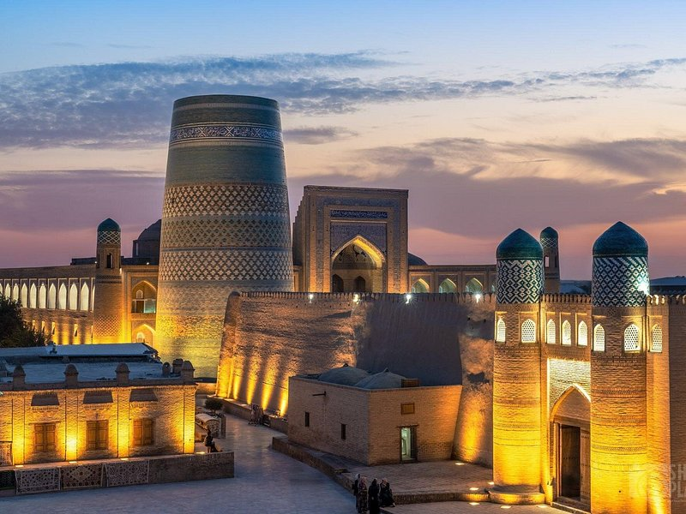
Ministry of Investment,
Industry and Trade of the Republic of Uzbekistan
We invite to invest in Modernization and Management of Urgench Airport
Project overview
Location
Khorezm region
Population | 1,9 million
Khorezm Region
Tashkent region
Size | 6 050 km²
Tourism Revenue | $700 million
Competitive landscape
Current airport capacity is limited, with growing tourism demand (11% annual increase in visitors).
The project will capture 20% of regional air traffic by 2027.
NPV
$60 million
IRR
22%
PI
1.80
PP
4.5 years

