Slide 1

Ministry of Investment,
Industry and Trade
of the Republic of Uzbekistan
Modernization of Electricity Grids in Samarkand Region
Project overview
Business model:
PPP with private operation of electricity grids under a concession agreement on 50 ha of allocated land. Investors will manage infrastructure and revenue.
Project scope
Modernization of electricity grids with smart technologies to reduce energy losses
Investment terms:
Investor will operate and manage the electricity grids under a PPP concession agreement for 20-25 years.
Timeline
2025
2026
Completion of modernization and operational launch
Project design and tender announcement
Financing
$250 million
Location
Samarkand region
Advantages and Potential
High economic efficiency reducing energy losses.
Innovative smart grid technologies.
Stable demand for electricity in a key region.

Slide 2
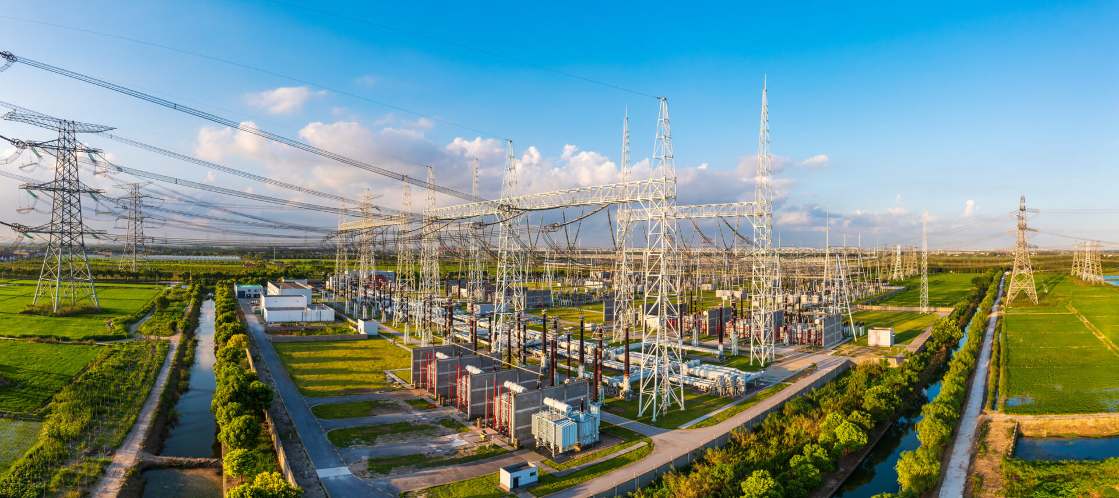

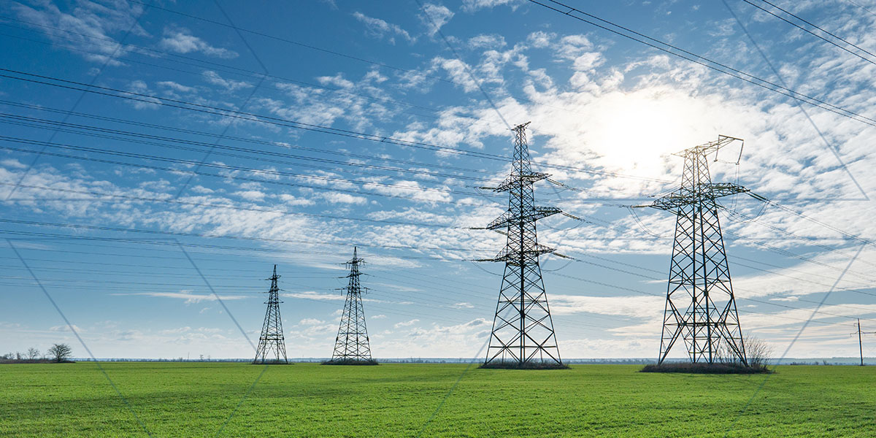
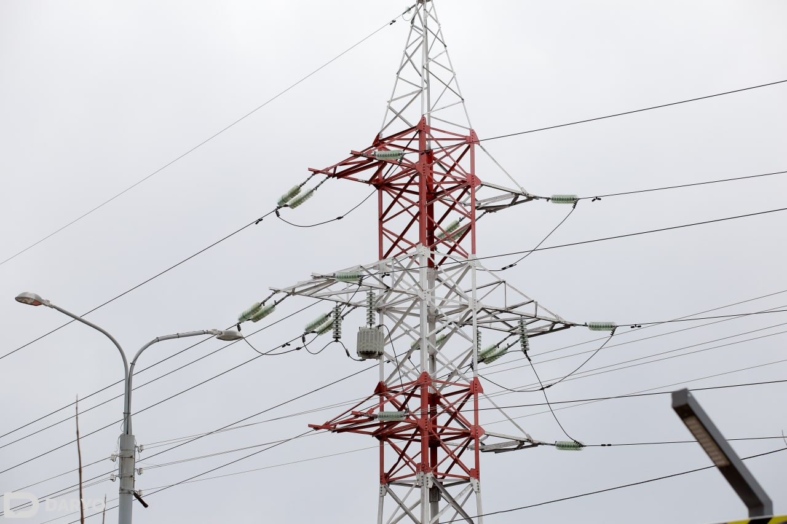
Ministry of Investment,
Industry and Trade
of the Republic of Uzbekistan
We invite to invest in Modernization of Electricity Grids in Samarkand Region
Project overview
Location
Samarkand region
Population | 4,0 million
Tashkent region
Area | 16 773 km²
Electric Networks | 340 km
Samarkand Region
Competitive landscape
Current grids suffer from 20-30% energy losses.
The project will enhance 25% of regional electricity supply efficiency by 2027.
NPV
$40 million
IRR
19%
PI
1.70
PP
4.8 years

