Slide 1
Ministry of Investment,
Industry and Trade of the Republic of Uzbekistan
Modernization of Heating System in Bukhara Region
Project overview
Business model:
PPP with private operation of heating systems under a concession agreement on 20 ha of allocated land. Investors will manage infrastructure and revenue.
Project scope
Upgrading the heating system with energy-efficient technologies and private management
Investment terms:
Investor will operate and manage the heating system under a PPP concession agreement for 20-25 years.
Timeline
2025
2026
Completion of modernization and operational launch
Project design and tender announcement
Financing
$122 million
Location
Bukhara region
Advantages and Potential
High social impact improving heating access.
Moderate investment with quick payback.
Innovative energy-efficient technologies.

Slide 2
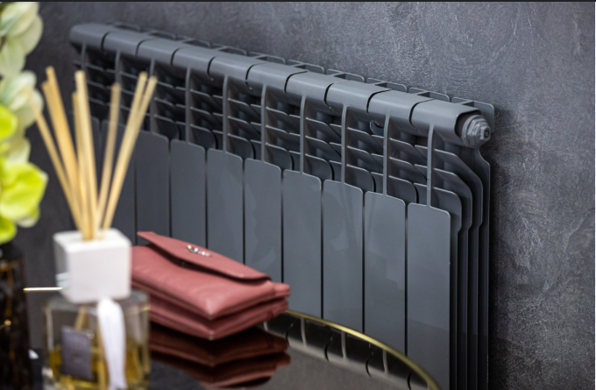
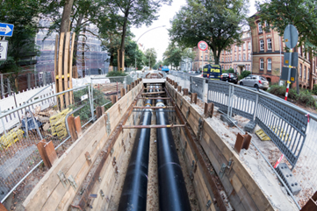
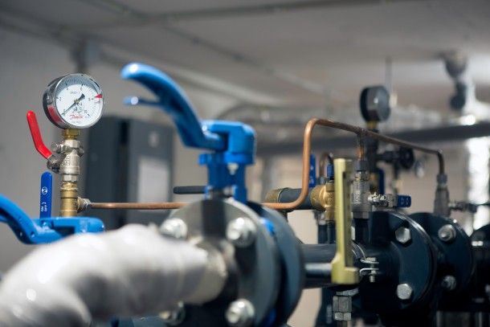
Ministry of Investment,
Industry and Trade of the Republic of Uzbekistan
We invite to invest in Modernization of Heating System in Bukhara Region
Project overview
Location
Bukhara region
Population | 2,0 million
Tashkent region
Size | 40 216 km²
Centralized Heating Coverage | ~40%
Competitive landscape
Outdated heating systems with high energy losses.
The project will improve 20% of regional heating efficiency by 2027.
Bukhara Region
NPV
$30 million
IRR
17%
PI
1.50
PP
5.5 years

