Slide 1

Ministry of Investment,
Industry and Trade
of the Republic of Uzbekistan
Construction of Pumped-Storage Hydropower Plant in Tashkent Region
Project overview
Business model:
PPP with private operation of the plant under a concession agreement on 100 ha of allocated land. Investors will manage energy production and sales.
Project scope
Construction of a 200 MW pumped-storage hydropower plant to ensure stable renewable energy supply
Investment terms:
Investor will operate and manage the plant under a PPP concession agreement for 25-30 years.
Timeline
2025
2026
Completion of construction and operational launch
Project concept development and tender announcement
Financing
$320 million
Location
Bostanlyk district, Tashkent region
Advantages and Potential
Innovative renewable energy project with high sustainability.
Stable energy demand in Tashkent region.
Potential for export to neighboring countries.

Slide 2
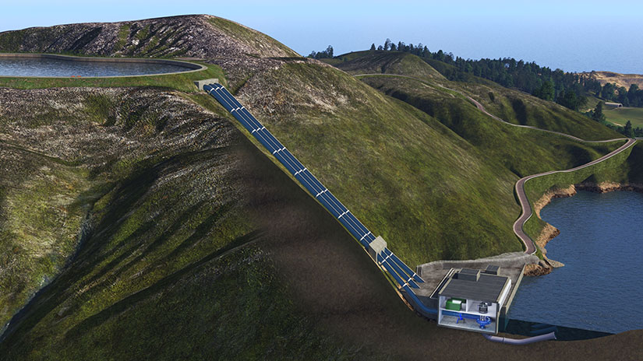
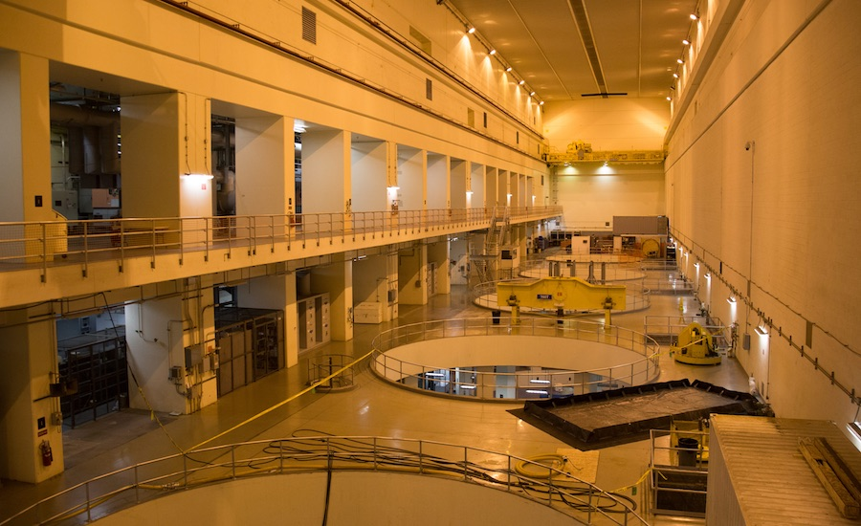
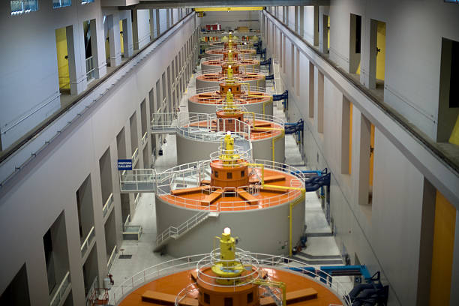
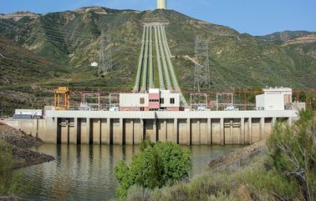
Ministry of Investment,
Industry and Trade
of the Republic of Uzbekistan
We invite to invest in Construction of Pumped-Storage Hydropower Plant in Tashkent Region
Project overview
Location
Tashkent region
Population | 3,2 million
Tashkent region
Size | 15 300 km²
Electricity Demand | 8,8 GWh
Tashkent Region
Competitive landscape
Limited renewable energy projects in Uzbekistan.
The project will contribute 10% to regional renewable energy supply by 2028.
NPV
$70 million
IRR
21%
PI
1.85
PP
4.3 years

