Slide 1

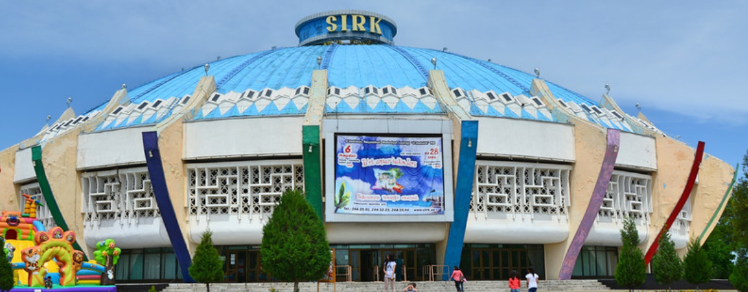
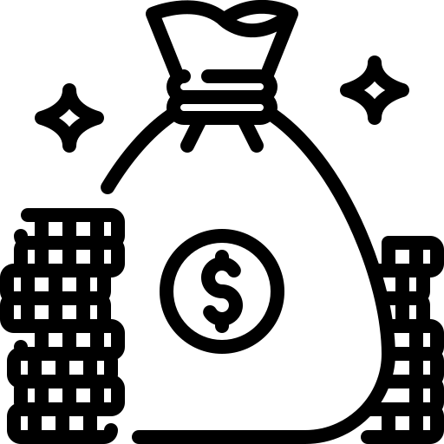
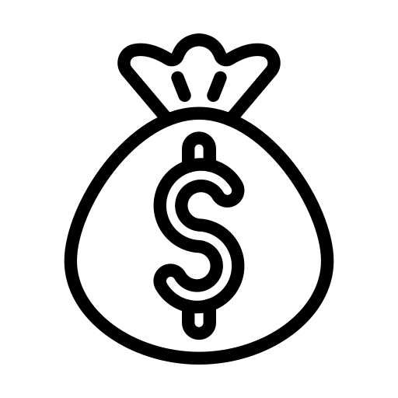
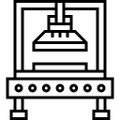

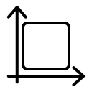

Project for the Reconstruction and Development of Uzbek circus Based on a Public-Private Partnership (PPP)
Industry
Project indicators
Entertainment and cultural services
Project services
Cost of the project:
Investment requirements
The project offers entertainment-oriented services, including acrobatics, juggling, clown acts, animal training, extreme performances, and variety shows.
$ 18,3 mln.
$ 13,3 mln.
Capacity
Domestic market – 90%
Export – 10%
Goal of the project
2700 seats
Improving the efficiency and quality of circus services, expanding the artistic level and scale of circus programs, and strengthening the material and technical base through the implementation of public-private partnership principles, as well as enhancing circus-related services.
Payback period :
Up to 5 years
~400 employees
Is it worth investing in the circus business?
Popularity of circus arts. Attending circus performances remains one of the most popular forms of entertainment.
Opportunities for growth and development. Services can be expanded, new audiences attracted, and new technologies introduced.
Revenue growth. According to research.techart.ru, the largest Western circuses earn up to $100 million (up to $120 million) in net annual profit.
Additional product sales. Circuses usually sell snacks, toys, DVDs, and other merchandise, generating income equal to up to 10% of ticket sales.
Circus is a fairly profitable business. For example, in Russia, the cost of a single circus performance is nearly 1 million rubles. A modern circus has a capacity of about 3,000 seats. The average ticket price is 1,000 rubles. As a result, revenue is three times higher than the cost of the performance.
Types of circus genres
Acrobatics and extreme performances
Clowning
and juggling
Circus without animals and animal training
Variety and staged shows
Project initiator
Location
UE "Uzbekcircus"
Established – in 1914
Building constructed – in 1976.
Tashkent Circus is visited by over 0.4 million visitors.
Founder – Ministry of Culture of the Republic of Uzbekistan
Address – Tashkent, G. Gulyam Street
Tashkent city
Market
Investments in Cirque du Soleil productions reached 200 million dollars (including theater construction);
Touring circus shows cost on average 20–25 million dollars;
Stationary circus performances cost about 40–50 million dollars;
A regular production of an ordinary circus costs around 1 million dollars.
Tashkent city
Size | 435 km²
Population | ~3,1 million

Slide 2
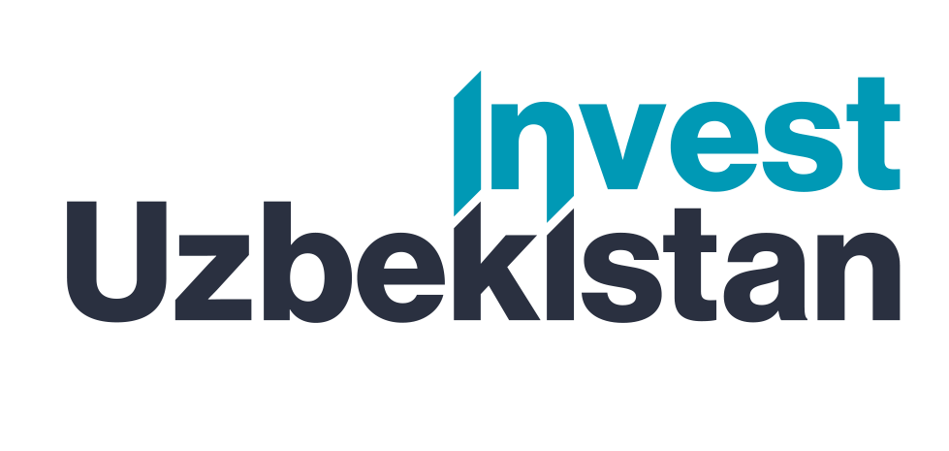

International logistics transport corridors
Tallin
Sankt-Peterburg
Riga
Latvia
Moscow
Klaipeda
Hamburg
Minsk
Berlin
Brest
Povorina
Essen
Lviv
Kyiv
Paris
Chop
Volgograd
Kandiagash
Aktogay
Astraxan
Beyney
Saksaulskaya
Ulan-Bator
Osh
Bayangal-Mangal
Mersin
Malatya
Saraxa
Mazar-i-Sharif
Kashgar
Xirat
Afghanistan
Peshavar
Iran
Pakistan
Bandar-e-Abbas
Chakhbahar
Karachi

Slide 3

Air connections from Tashkent and other airports of Uzbekistan
New York
A visa-free policy for tourists from
90 countries
Diverse range of 59 carriers in Uzbekistan’s airport
11 airports across the Country, the main airports are Tashkent, Samarkand and Bukhara

