Slide 1
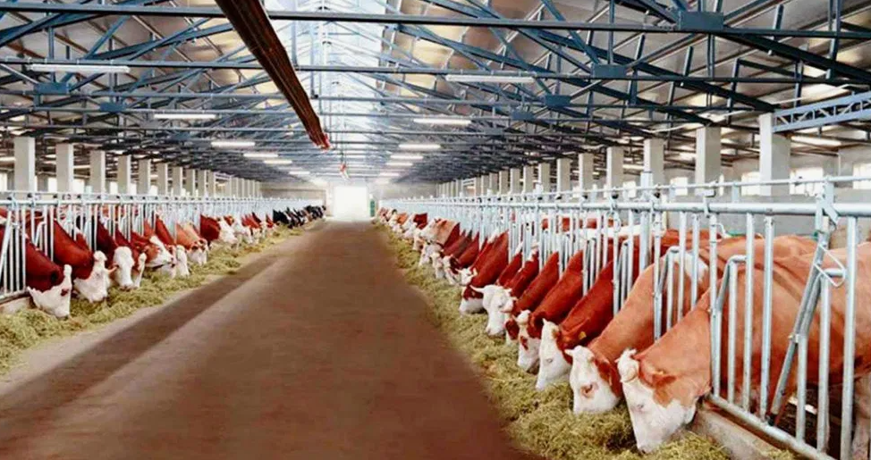
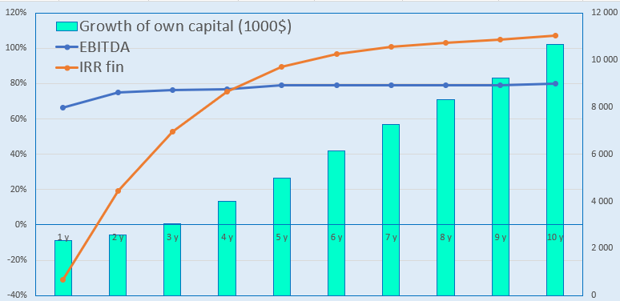
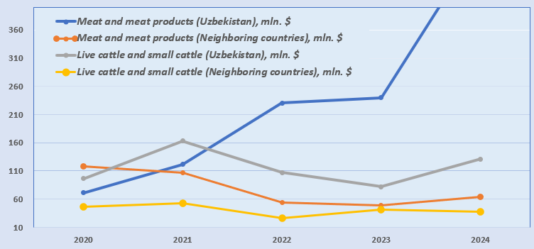
Creation of a livestock complex
Industry
Livestock and food industry
Project cost:
Total cost – US$ 2,79 million
Investment plan
Total investment: US$2.79 million, of which:
Project goal
Creation of a livestock complex
(in the initial stage 500 heads of cattle).
For the production of fresh meat and meat and dairy products, the project will be equipped with modern farm equipment and meat and milk processing.
Buildings and structures
49,5%
$1.38 million
Initiator's contribution - 22.4% ($0.62 million)
Credit - 14.3% ($0.4 million)
Direct investment - 63.2% ($1.76 million).
Equipment
12,4%
$0.35 million
Other
34,4%
$0.96 million
The final cost and financing structure of the project will be determined after negotiations with investors..
Working capital
3,7%
$0.1 million
Project products
The project will annually produce fresh meat, meat and dairy products in the amount of 2150 tons.
Profitability :
Investment indicators:
Raw material supply
To support the project, a special government decision (PP-285 of 08/23/2023) on livestock farming was adopted, according to which 100-150 hectares of land will be allocated for the project in the Akhangaran district for fodder crops, at the expense of reducing the area under cotton and grain crops.
NPV, US$ million – 5,2
IRR, % – 27,1%
EBITDA, % – 80%
DPP, years - 5,2
Market
Since December 2024, the meat market in physical terms has grown by 1.1%, while within the segments there were sharper fluctuations for canned meat - growth of 19.9%, for chilled semi-finished products - growth of 7.4%, for fresh beef - growth of 6%. Restrictions on the export of meat products by neighboring countries have led to an increase in the price of meat in Uzbekistan. According to forecasts, by 2032 the size of the cattle and beef market will reach 136.9 billion US dollars. From 2025 to 2032, the market will grow at a rate of 4%.
Initiator
LLC “SMARTPRIME”
Created – 2022.
Authorized capital – 250 million UZS
The project will be located on a territory of 25 hectares at the address Tashkent region Akhangaran district, MFY Yangihayot
The territory allows for the placement of new production facilities
Location
Tashkent region
Demand
In January-April 2025, Uzbekistan imported meat products worth $197 million. This is 66% more than the same period last year ($118.5 million).
Tashkent
Area | 15 300 km²
Population | 3,1 million
Required area
~ 252 ha
6%

Slide 2
On the strategic international logistics corridor
Tallin
Sankt-Peterburg
Riga
Latvia
Moscow
Klaipeda
Hamburg
Minsk
Berlin
Brest
Povorina
Essen
Lviv
Kyiv
Paris
Chop
Volgograd
Kandiagash
Aktogay
Astraxan
Beyney
Saksaulskaya
Ulan-Bator
Osh
Bayangal-Mangal
Mersin
Malatya
Saraxa
Mazar-i-Sharif
Kashgar
Xirat
Afghanistan
Peshavar
Iran
Pakistan
Bandar-e-Abbas
Chakhbahar
Karachi

Slide 3
Excellent air connectivity from Tashkent and other Uzbek airports
New York
A visa-free policy for tourists from 90 countries
Diverse range of 59 carriers in Uzbekistan’s airport
11 airports across the Country, the main airports are Tashkent, Samarkand and Bukhara

