Slide 1

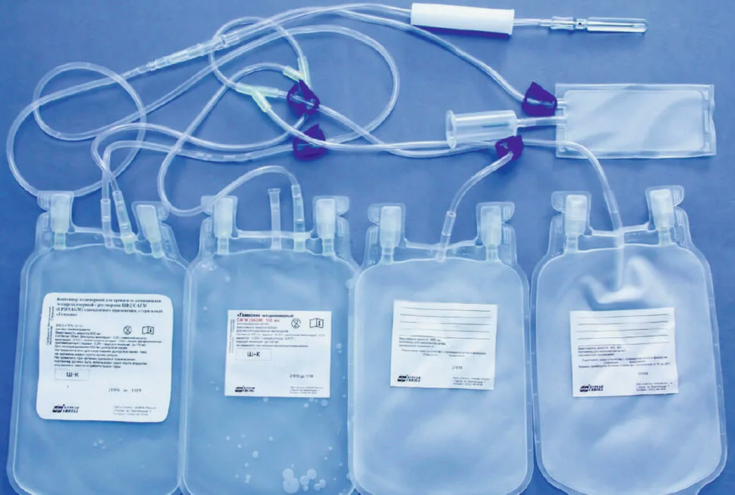

Expansion of production of infusion solutions
Industry
Pharmaceuticals
Project cost:
Total cost – US$ 10.8 million
Investment proposal
The Project requires investment of US$ 10,8 million, of which:
Project goal
Expansion of production of infusion solutions at the existing enterprise. "SOFT INTER MEDICAL". The plant was put into operation in 2023 and received a GMP certificate in 2024.
To increase the existing capacity (by automating production, etc.), it is planned to attract direct investment
33%
$3.6 million
Buildings and structures
Initiator's contribution - 51% ($5.46 million)
Credit - 27.5% ($2.9 million)
Participation of the Investor from 21.5% ($2.3 million).
Equipment
48%
$5.1 million
Working capital
17%
$1.9 million
The final cost and financing structure of the project will be determined after negotiations with investors..
Other
2%
$0.2 million
Project products
Infusion dosage forms of 10 types in plastic bottles of 100, 200 and 250 ml.
Profitability:
Investment indicators:
Technological process of production
Preparation of PET bottles and water treatment – ​​solution preparation – solution bottling – sterilization – quality control – warehousing.
NPV, US$ million –9,7
IRR, % – 18,3%
EBITDA, % – 37%
PI – 2,25
DPP, years - 5,9
What makes projects in this industry attractive??
Growing demand for medicines. An aging population, increasing prevalence of chronic diseases and the emergence of new infectious diseases lead to a steady increase in demand for medicines.
Increasing demand for biologics. The market for biological drugs will reach $1 trillion by 2030 with an average annual growth rate of 10%.
Automation of processes in pharmacies. Robots, automated systems and intelligent terminals will help speed up the process of selecting and dispensing drugs.
It is predicted that by 2028, global consumption of drugs in kind will increase by another 12%.
Initiator
SOFT INTER MEDICAL LLC
Created – 2018.
Commissioned – 2023
Capital - $ 5.4 million
Turnover 2024 (9 months)/profit - $ 1.9/ $ 0.2 million
The production is located on a territory of 1.2 hectares in the Yashnabad district of Tashkent. The territory allows for the placement of new production facilities.
Location
Tashkent city
Demand
In 2024, the volume of imports of medicines in Uzbekistan and neighboring countries amounted to about 4.5 billion US dollars.
Tashkent
Area | 435 km²
Population | 3,1 million
Required area
~ 1,2 ha
6%

Slide 2

On the strategic international logistics corridor
Tallin
Sankt-Peterburg
Riga
Latvia
Moscow
Klaipeda
Hamburg
Minsk
Berlin
Brest
Povorina
Essen
Lviv
Kyiv
Paris
Chop
Volgograd
Kandiagash
Aktogay
Astraxan
Beyney
Saksaulskaya
Ulan-Bator
Osh
Bayangal-Mangal
Mersin
Malatya
Saraxa
Mazar-i-Sharif
Kashgar
Xirat
Afghanistan
Peshavar
Iran
Pakistan
Bandar-e-Abbas
Chakhbahar
Karachi

Slide 3

Excellent air connectivity from Tashkent and other Uzbek airports
New York
A visa-free policy for tourists from
90 countries
Diverse range of 59 carriers in Uzbekistan’s airport
11 airports across the Country, the main airports are Tashkent, Samarkand and Bukhara

