Slide 1
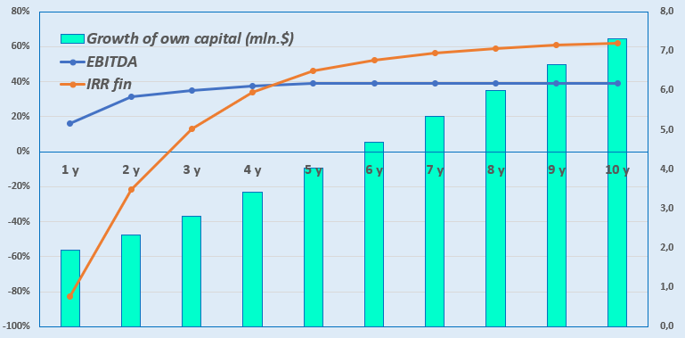
Establishment of a school that meets international IB (International Baccalaureate ) standards
Industry
Public education
Project cost :
Total cost – US $ 1,73 million
Offer to the investor
Total Investments US $ 1.73 million , of which:
Project goal
The project envisages the creation of a school providing education according to international IB standards (https://www.ibo.org/). We strive to educate a new generation of leaders ready for global challenges. We invite companies as potential investors.
Buildings and structures
32.0 %
$ 0.55 million
Initiator's contribution – 36,5 % ($ 0,63) million )
Investments and loans - 63,5 % ($ 1,1) million ) .
Equipment
7.5 %
$ 0 ,13 million
The project financing structure will be determined after negotiations with the investor .
The distribution of profits will be carried out in a 70:30 ratio until the full reimbursement of investments, and then 50:50.
.
Working capital
56.8 %
$ 0.98 million
Other
3.7 %​
$ 0 ,06 million
Project services
School and preschool education. The school educates children from three to nineteen years old and provides certificates and diplomas of secondary education that meet IB standards .
Profitability :
Investment indicators :
NPV, US$ million – 2.7
IRR, % – 23,0 %
EBITDA, % – 39.0 %
PI – 2 , 55
DPP, year - 4 , 7
Why invest in education?
Long-term benefits : Education is an investment in the future, and the more people receive quality education, the stronger the economy and society.
Fast payback. New educational projects, unlike traditional ones, quickly move from the product creation stage to the first sales.
Personalized learning technologies. Technological educational projects integrated with artificial intelligence will become increasingly valuable, allowing learning to be customized for each student.
State support for the industry . In the next 3-4 years, Uzbekistan plans to increase preschool education coverage to at least 80% of children. To this end, they are planning to create kindergartens for 240 thousand places with the involvement of the private sector. It is also planned to create 112 thousand new student places in 58 modern schools in the regions at the expense of budget funds, attracting funds from the International Financial Institutions.
Initiator
Milestone International Education Group LLC
Location
Tashkent city
Demand
Uzbekistan's schools lack 1.2 million student places, while the country's figure is considered the largest among the Central Asian states.
The IB program is renowned for its high level of academic preparation, critical thinking and interdisciplinary approach, and the school being created provides guarantees of admission to the top 50 universities in the world, which creates an advantage in the education market and additional confidence for parents and students.
Founder and director of the project
Niyozov Shahboz Shahobiddinovich
Contact tel.: +998972141888
Email: cadetnone@gmail.com
https://mischool.uz
City of Tashkent
Square | 435 km²
Population | 3.1 million
Required area
~ 1, 6 ha
6%

Slide 2
International logistics transport corridors
Tallin
Saint Petersburg
Riga
Latvia
Moscow
Klaipeda
Hamburg
Minsk
Berlin
Brest
Povorina
Essen
Lviv
Kyiv
Paris
Chop
Volgograd
Kandiagash
Aktogay
Astraxan
Beyney
Saksaulskaya
Ulan Bator
Osh
Bayangal - Mangal
Mersin
Malatya
Saraxa
Mazar- i -Sharif
Kashgar
Xirat
Afghanistan
Peshawar
Iran
Pakistan
Bandar-e-Abbas
Chakhbahar
Karachi

Slide 3
And air connections from Tashkent and other airports in Uzbekistan
New York
Visa-free travel for tourists from 90 countries
59 different airlines operating at Uzbekistan airport
There are 11 airports throughout the country, the main ones being Tashkent, Samarkand and Bukhara.

