Slide 1
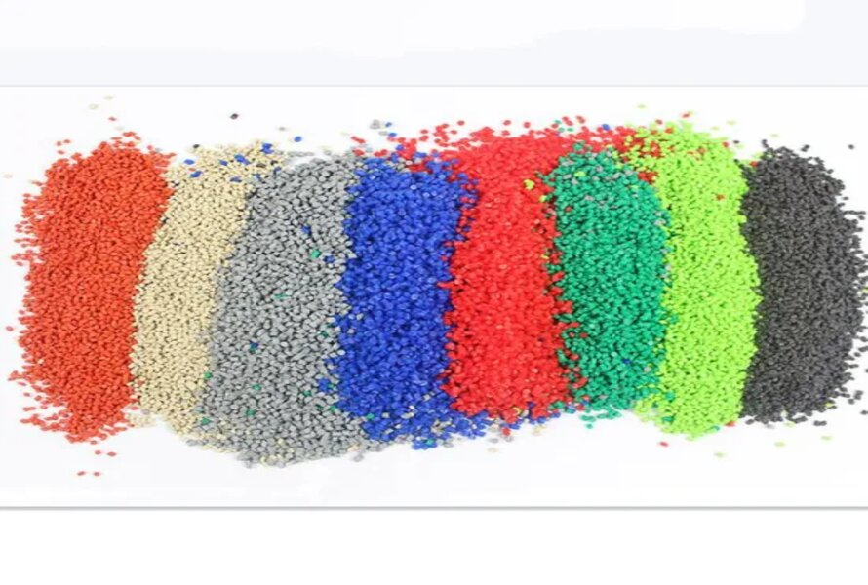
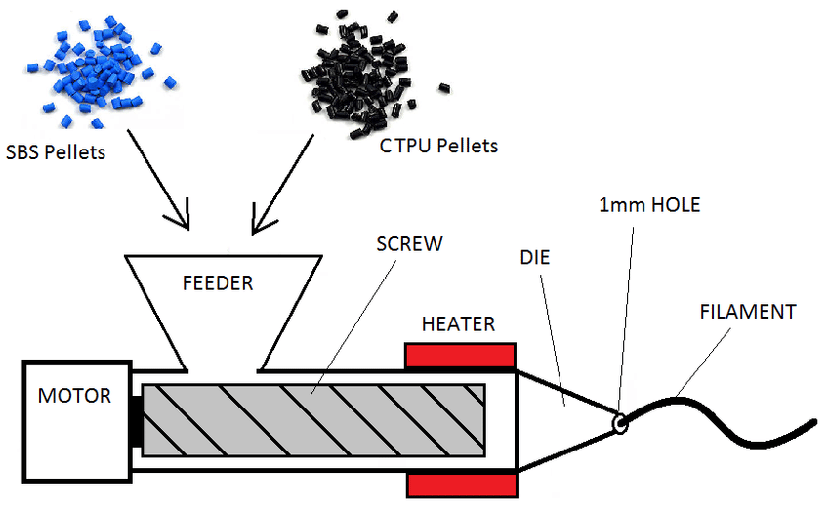
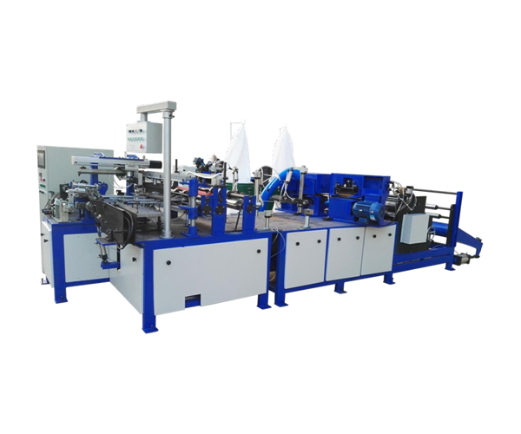
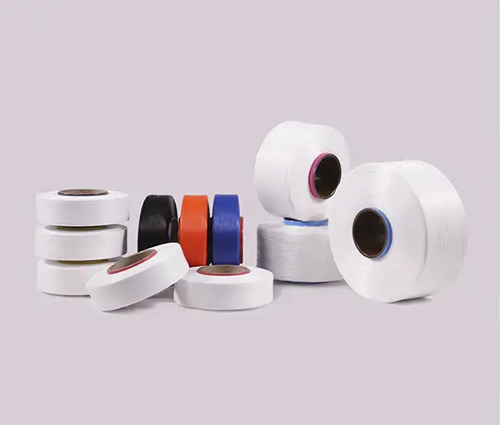
Ministry of Investment,
Industry and Trade of the Republic of Uzbekistan
Production of spandex fiber
Project overview
Business model: manufacturing facility with production capacity of 10 thsd tons of spandex fiber per year
Project scope
Production of spandex fiber
Financing
28 mln USD
Production process for spandex fiber
Incentives
Infrastructure development at state cost* (project cost exceeding 15 mln USD)
Across the Republic, 27 FEZs and 4 TIZs offer tax breaks on land, property, water and CIT.
(CIT - applied for investments over 3 mln USD)
Procurement of materials (polyester, polypropylene granules and etc.)
Polymer feeding, extrusion and filament drawing
Bonding, winding and cutting
Quality control and packaging:
Project description
Exemption from taxes
3 years if investment is between 0,3 – 3 mln USD
5 years if investment is between 3 – 5 mln USD
7 years if investment is between 5 – 10 mln USD
10 years if investment is over 10 mln USD
Domestic market
Existing 5 neighbor markets
Russia, Europe, Middle East markets
7 production lines
Products: - special medical clothing
- medical masks
- special bags
~300 employees
Production and trade volume of synthetic fiber (2024)
Infrastructure
Gas 12 cents/m³
Electricity 7 cents/kWh
Water 20 cents/m³
Import
Consumption
Consumption (CA)
23 thsd tons
26 thsd tons
130 thsd tons

Slide 2
Ministry of Investment,
Industry and Trade of the Republic of Uzbekistan
We invite to invest in textile production in Uzbekistan
Project overview
Trade agreements
Competition: Uzbekistan offers highly competitive structure of operating costs for manufacturing of woven fabric internationally
GSP+ agreement allows to export to EU at reduced or zero tariff for 6 200 products.
CIS Free Trade Agreement creates more integrated and open market with CIS countries.
Top-7 woven fabric exporters, USD bln
Woven fabric import to Uzbekistan, USD mln
Average wage, USD ths per month
Average electricity cost,
US cents per kWh
China | 3,8 | 16,4 | 1,3 | 12
Germany | 2 | 2 | 3,5 | 25
USA | 1,9 |  | 4,5 | 10
Italy | 1,3 | 0,1 | 2,4 | 20
Japan | 0,9 |  | 3 | 20
Turkey | 0,7 | 12,6 | 0,7 | 13
France | 0,5 |  | 3 | 12
 | 0,005 |  | 0,4 | 7
Location
Andijan region
Andijan region
Size | 4 200 km²
Population | 2,9 million
Uzbekistan
Availability of labor in textile industry
Local textile products manufacturers can benefit from:
- Stable economical and political situation
- Availability of skilled & unskilled labor
- Building on existing infrastructure and distribution networks
- Infrastructure development at state cost*
- Incentives: Free economic zones offer tax breaks on land, CIT, water.
Higher education institutions: 10
Faculties of higher education: 12
Number of graduates: 2 000

