Slide 1
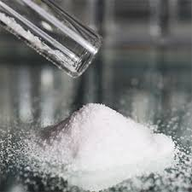
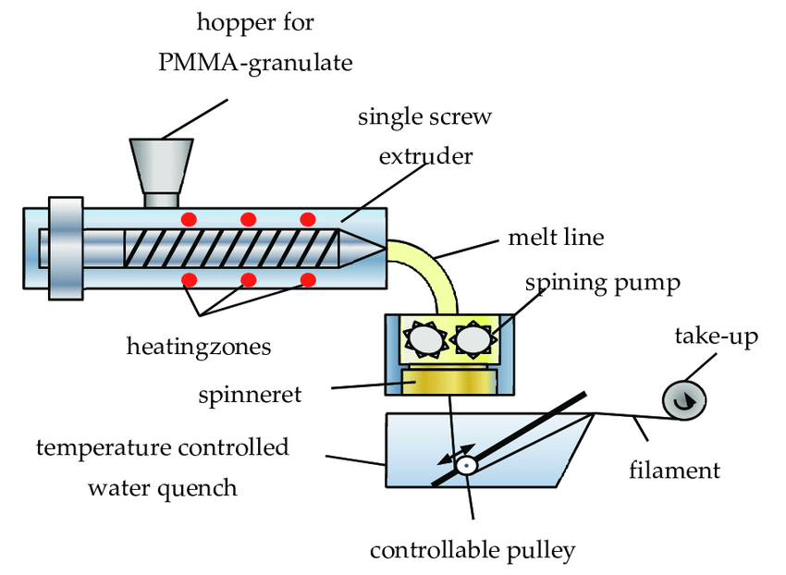
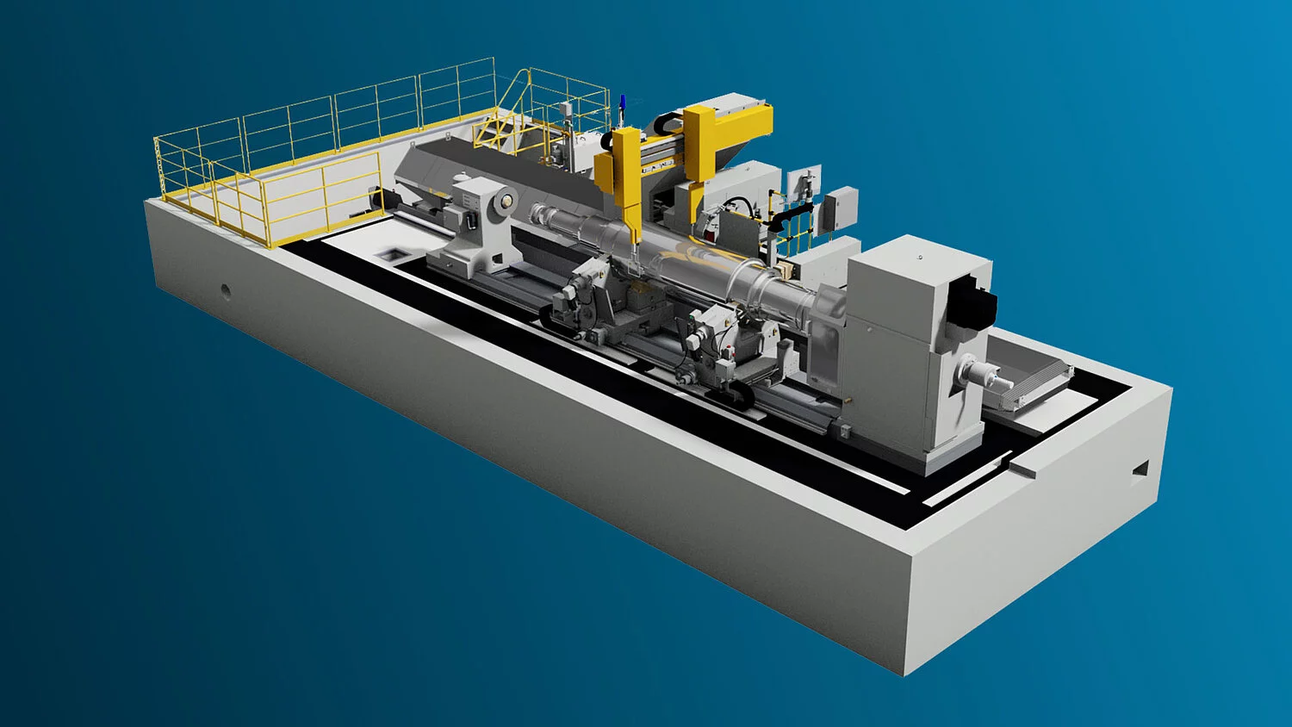
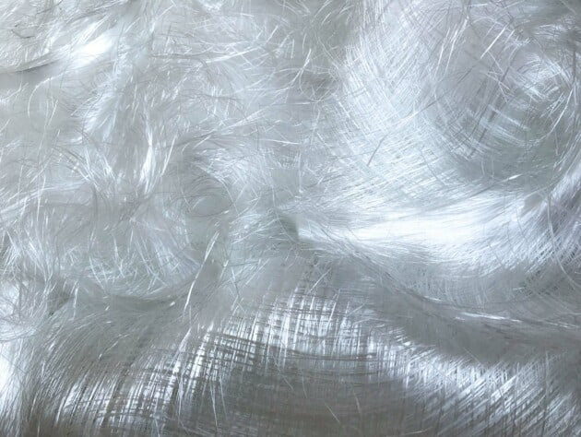
Ministry of Investment,
Industry and Trade of the Republic of Uzbekistan
Production of synthetic polyester fiber
Project overview
Business model: manufacturing facility with production capacity of 40 thsd tons of polyester and polypropylene fiber per year
Project scope
Production of synthetic polyester fiber
Financing
50 mln USD
Production process for synthetic polyester fiber
Incentives
Infrastructure development at state cost* (project cost exceeding 15 mln USD)
Across the Republic, 27 FEZs and 4 TIZs offer tax breaks on land, property, water and CIT.
(CIT - applied for investments over 3 mln USD)
Procurement of materials (PTA, EG, propylene, chemicals and etc.)
Polymerization, extrusion and spinning
Quality control and packaging
Texturing, cutting and baling
Project description
Exemption from taxes
3 years if investment is between 0,3 – 3 mln USD
5 years if investment is between 3 – 5 mln USD
7 years if investment is between 5 – 10 mln USD
10 years if investment is over 10 mln USD
Domestic market
Existing neighbor markets
International markets
6 production lines
Import of raw materials:
- purified terephthalic acid
- ethylene glycol
- propylene and chemicals
~300 employees
Production and trade volume of synthetic fiber (2024)
Infrastructure
Gas 12 cents/m³
Electricity 7 cents/kWh
Water 20 cents/m³
Import
Consumption
Consumption (CA)
23 thsd tons
26 thsd tons
130 thsd tons

Slide 2
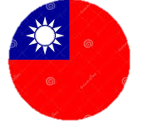
Ministry of Investment,
Industry and Trade of the Republic of Uzbekistan
We invite to invest in textile production in Uzbekistan
Project overview
Trade agreements
Competition: Uzbekistan offers highly competitive structure of operating costs for manufacturing of synthetic staple fiber internationally
CIS Free Trade Agreement creates more integrated and open market with CIS countries.
GSP+ agreement allows to export to EU at reduced or zero tariff for 6 200 products.
Top-7 synthetic fiber exporters, USD bln
Synthetic fiber import to Uzbekistan, USD mln
Average wage, USD ths per month
Average electricity cost,
US cents per kWh
China | 1,5 | 17,5 | 1,0 | 12
Korea | 1,0 | 3,5 | 2,0 | 12
Thailand | 0,5 | 0,04 | 0,6 | 11
Belgium | 0,4 |  | 3,0 | 28
Taipei | 0,35 |  | 2,5 | 15
Germany | 0,3 |  | 4,0 | 35
Japan | 0,27 |  | 3,5 | 30
 | 0,003 |  | 0,4 | 7
Location
Namangan region
Namangan region
Size | 7 900 km²
Population | 3,1 million
Uzbekistan
Availability of labor in textile industry
Higher education institutions: 10
Faculties of higher education: 12
Number of graduates: 2 000
Local textile products manufacturers can benefit from:
- Stable economical and political situation
- Availability of skilled & unskilled labor
- Building on existing infrastructure and distribution networks
- Infrastructure development at state cost*
- Incentives: Free economic zones offer tax breaks on land, CIT, water.

