Slide 1

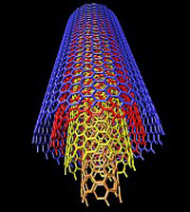
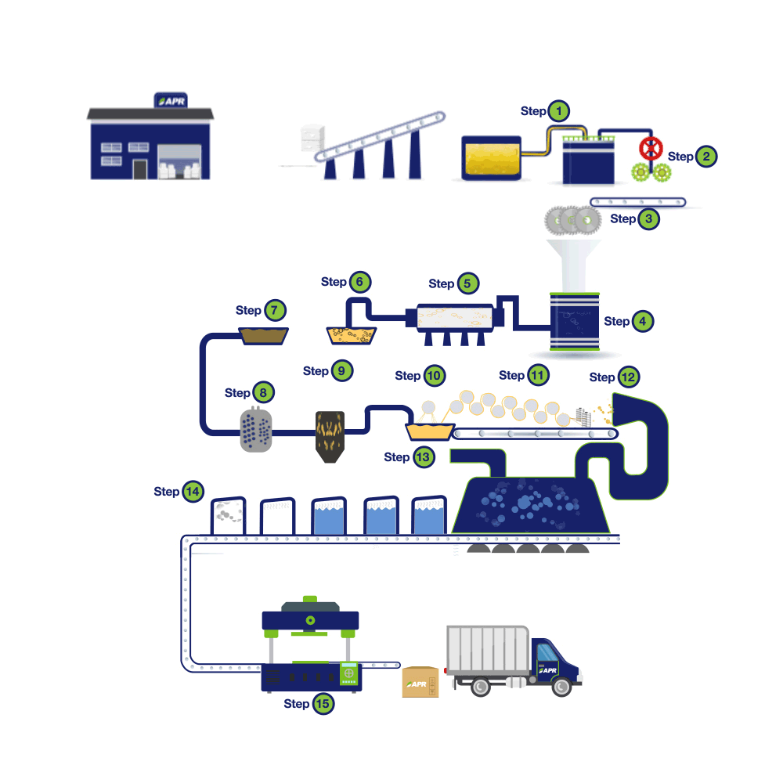
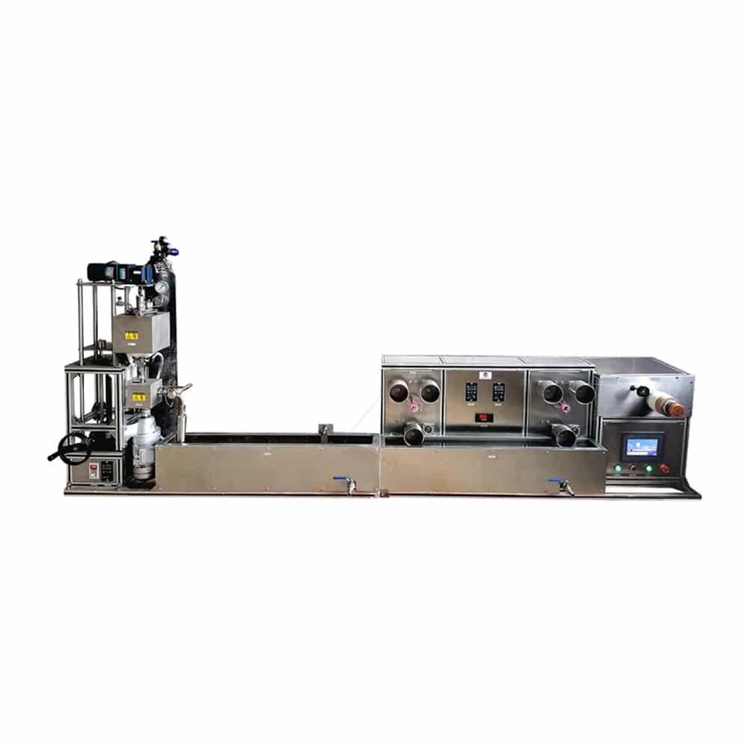
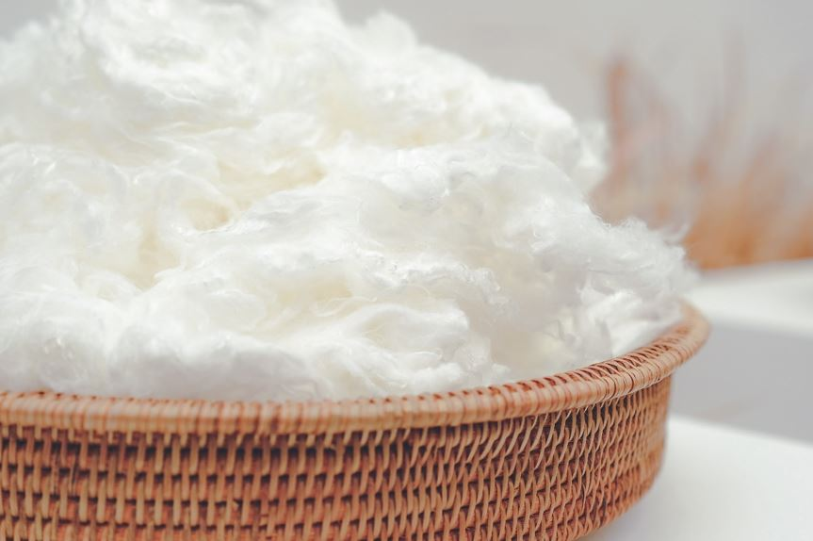





Ministry of Investment,
Industry and Trade
of the Republic of Uzbekistan
Production of synthetic fiber (nitron)
Project overview
Business model: manufacturing facility with production capacity
of 15 thsd tons of nitron fiber per year
Project scope
Production of synthetic
(nitron) fiber
Financing
55 mln USD
Production process for synthetic (acetate) fiber
Incentives
Infrastructure development at state cost*
(project cost exceeding 15 mln USD)
Across the Republic, 27 FEZs and 4 TIZs offer tax breaks on land, property, water and CIT.
(CIT - applied for investments over 3 mln USD)
Synthesis of
polyacrylonitrile
Preparation of spinning solution
Wet spinning and washing and extraction
Final processing
and quality control
Project description
Exemption from taxes
3 years if investment
is between 0,3 – 3 mln USD
5 years if investment
is between 3 – 5 mln USD
7 years if investment
is between 5 – 10 mln USD
10 years if investment
is over 10 mln
USD
4 production lines
Mainly for domestic market
Existing 5 neighbor markets
Import of raw materials:
- acrylonitrile
~250 employees
Production and trade volume of synthetic fiber (2024)
Infrastructure
Gas 12 cents/m³
Electricity 7 cents/kWh
Water 20 cents/m³
Import
Consumption
Consumption (CA)
23 thsd
tons
26 thsd
tons
130 thsd
tons

Slide 2












Ministry of Investment,
Industry and Trade
of the Republic of Uzbekistan
We invite to invest in textile production in Uzbekistan
Project overview
Trade agreements
Competition: Uzbekistan offers highly competitive structure of operating costs for manufacturing of synthetic staple fiber internationally
GSP+ agreement allows to export to EU at reduced or zero tariff for
6 200 products.
CIS Free Trade Agreement creates more integrated and open market with CIS countries.
Top-7 synthetic fiber exporters, USD bln
Synthetic fiber import to Uzbekistan, USD mln
Average wage,
USD ths per month
Average electricity cost,
US cents per kWh
China | 15 | 300 | 1,3 | 12
India | 4 | 40 | 2,0 | 12
South Korea | 3 | 50 | 0,6 | 11
Taiwan | 2,5 |  | 3,0 | 28
USA | 2 |  | 2,5 | 15
Germany | 1,8 | 30 | 4,0 | 35
Indonesia | 1,5 |  | 3,5 | 30
 | 0,003 |  | 0,4 | 7
Location
Jizzakh region
Navoi region
Size | 21 200 km²
Population | 1,4 million
Uzbekistan
Availability of labor in textile industry
Higher education institutions: 10
Faculties of higher education: 12
Number of graduates: 2 000
Local textile products manufacturers can benefit from:
  - Stable economical and political situation
  - Availability of skilled & unskilled labor
  - Building on existing infrastructure and distribution networks
  - Infrastructure development at state cost*
  - Incentives: Free economic zones offer tax breaks on land, CIT, water.

